Slide 1


Title: Recruiting and Developing a Retail Assistant Store Manager at John Lewis Partnership
Name: Camelia Alina Luchian
Student Number: 2418818
Module Code & Title: LCLM5002 Developing and Managing Individuals and Teams
Lecturer: Faizu Edu
Assignment Title: HR Presentation

Slide 2
Table of Contents
Introduction to John Lewis Partnership……………………………SLIDE 3
Job Analysis………………………………………………………......SLIDE 4
Job Description…………………………………………………….....SLIDE 5
Person Specification………………………………………………....SLIDE 6
Recruitment Process Steps………………………………………….SLIDE 7
Job Interview Process.……………………………………………….SLIDE 8
Identifying Learning/Training and Development Needs……… ….SLIDE 9
Analysis Using Behaviourist Theory…………………….……….…SLIDE 10
Analysis Using Cognitivist Theory………………………………..…SLIDE 11
Humanist/Experiential Learning Theory…………………………....SLIDE 12
Benefits of Effective Learning & Development…………………….SLIDE 13
Conclusion…………………………………………………….……….SLIDE 14
References……………………………………………………………..SLIDE 15

Slide 3
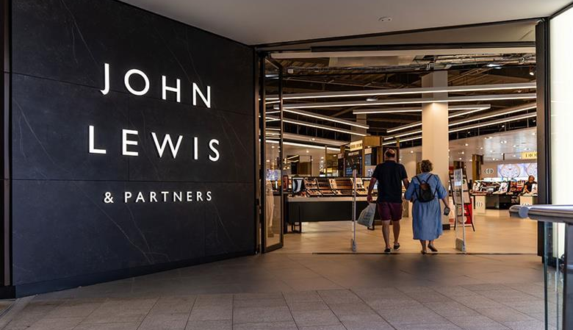

Introduction to John Lewis Partnership
Founded 1929 by John Spedan Lewis – UK’s largest employee-owned business
Operates John Lewis department stores + Waitrose supermarkets
Core values: Partnership (all colleagues = Partners), exceptional customer service, ethical sourcing, sustainability
~80,000 Partners; strong emphasis on colleague voice, profit-sharing bonuses, and long-term career development
Unique model fosters high engagement, loyalty, and performance in competitive retail sector.
Relevance to Role: Seeks team members who align with collaborative, customer-centric culture for smooth operations.
John Lewis is a iconic UK retailer emphasizing employee ownership and sustainability. This foundation ensures recruited team members contribute to organizational growth through diverse perspectives and efficiency (Branine, 2008).

Slide 4
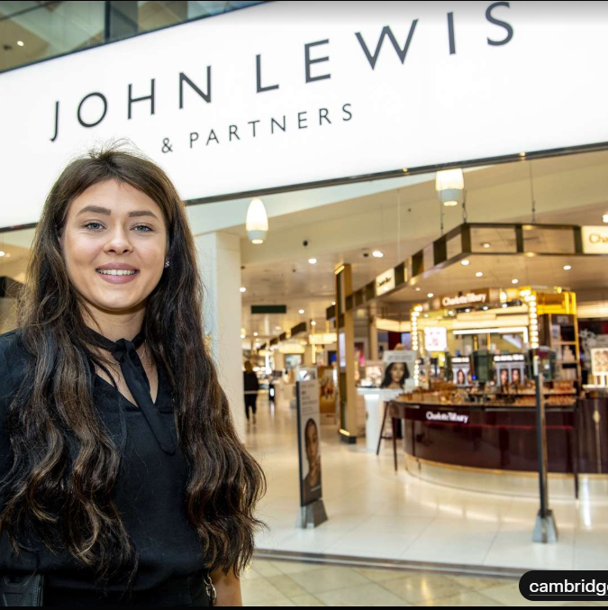
Job Analysis for Retail Assistant Store Manager
Systematic process to identify duties, responsibilities, skills, and working conditions for Retail Assistant Store Manager
Methods: Observation, interviews with current managers, questionnaires, and review of store performance data (Armstrong, 2022)
Key Duties: Oversee daily operations, manage inventory, lead team shifts, ensure compliance with health/safety standards.
Environment: Fast-paced urban retail setting with high customer footfall; requires adaptability to seasonal demands.
Challenges: High turnover in UK retail (up to 60.5%); analysis identifies need for leadership to reduce this (Engageli, 2026).
Outcome: Informs JD and PS to attract candidates who enhance efficiency and accountability.
Job analysis is crucial for identifying what the role entails at John Lewis. It reveals gaps like leadership in high-turnover environments, ensuring we recruit for focused efficiency (Backman et al., 2025).

Slide 5
Job Description
Position: Retail Assistant Store Manager
Key Responsibilities: Supervise team, manage sales floor, handle customer issues, monitor inventory, support sales targets, ensure policy compliance
Working Hours: Full-time, including weekends/shifts (Indeed, 2026)
Reporting: To Store Manager; collaborate with departments like HR and merchandising.
Hours/Salary: Full-time (37.5 hours/week, flexible shifts); competitive salary £28,000-£35,000 + benefits (e.g., partner discount).
Qualifications: Retail experience preferred; supports organizational growth through team problem-solving.
The JD outlines core duties to attract suitable candidates. At John Lewis, this role promotes accountability and recognition, aligning with the company's people-first values (Keeling et al., 2013).

Slide 6
Person Specification
Essential Skills: Leadership, communication, customer service, time management; 2+ years retail experience (Disprz, 2026).
Desirable: Knowledge of retail tech (e.g., POS systems), conflict resolution; degree in business/retail management.
Personal Attributes: Team player, adaptable, ethical (aligns with John Lewis values); ability to foster diverse perspectives.
Soft Skills: Aesthetic labor (e.g., presentation) and employability traits for UK retail (Nickson et al., 2012).
Equal Opportunities: John Lewis promotes diversity; no discrimination based on age, gender, etc.
The PS ensures we select candidates with the right fit. In UK retail, soft skills like communication reduce mismatches and support growth (Huddleston & Hirst, 2004).

Slide 7
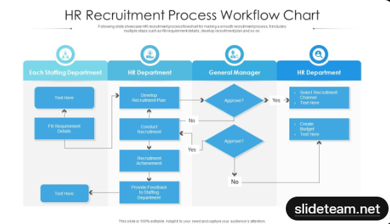
Recruitment Process Steps
Step 1: Job Posting on JLPJobs.com and platforms like Indeed; attract diverse applicants (Graduates First, 2026).
Step 2: Application Screening: CV review for skills match.
Step 3: Online Assessments: Situational judgment, numerical/verbal tests.
Step 4: Interviews & Group Exercises: Assess fit (detailed in next slide).
Step 5: Offer & Pre-Employment Checks: Background, right to work.
Goal: Ensure smooth running by selecting accountable, skilled members (Branine, 2008).
John Lewis follows a structured, multi-stage process that is simple, fair, and transparent. This ensures we select the right team member who will thrive in our employee-owned culture and contribute to organisational smoothness from day one.

Slide 8

Job Interview Process
Format: Video/phone initial, then in-person/group at assessment center.
Questions: Competency-based (e.g., "Tell me about leading a team?") and behavioral (e.g., "How do you handle conflict?") (BBC, 2024).
Preparation: John Lewis publishes sample questions online for fairness (e.g., innovative ideas).
Follow-Ups: Detailed probes on responses; assess cultural fit.
Interviews focus on real-world fit. Publishing questions aids neurodiverse candidates, promoting inclusivity in UK retail (Markel, 2024).

Slide 9

Identifying Learning/Training and Development Needs
Needs for Role: Leadership, team development, customer service, time management; address high turnover (60.5% in retail) (Indeed, 2025).
Individual Focus: For new Assistant Manager, gaps in digital skills or conflict resolution via performance reviews.
Methods: Skills audits, feedback surveys; align with John Lewis training programs (e.g., on-the-job coaching).
Impact: Fosters problem-solving and efficiency for organizational growth (360Learning, 2026).
Identifying needs early ensures the recruited member develops quickly. In retail, this boosts retention and performance (Xenia, 2026).

Slide 10
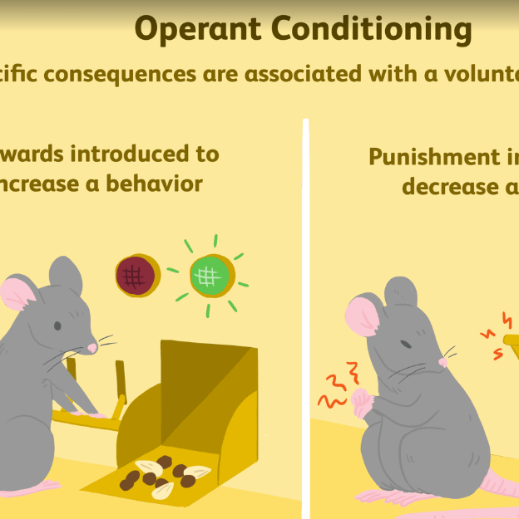
Analysis Using Behaviourist Theory
Theory Overview: Learning through rewards/consequences; shapes behavior via reinforcement (Symonds Research, 2025).
Application: For Assistant Manager, use bonuses for sales targets or feedback for improved service.
Analysis: Addresses needs like motivation; reduces turnover by reinforcing positive actions in high-stress retail.
Support: Operant conditioning in training programs enhances performance (360Learning, 2026).
Example: John Lewis recognition schemes to build accountability.
Behaviourist theory is practical for retail L&D. It uses external motivators to meet development needs, ensuring efficient operations (Phoenix, 2024).

Slide 11

Analysis Using Cognitivist Theory
Theory Overview: Focuses on internal processes like problem-solving and knowledge building (Educational Technology, 2023).
Application: Training via workshops linking new skills to existing knowledge (e.g., budgeting to analysis).
Analysis: Meets needs like decision-making; encourages reflection for manager growth in dynamic retail.
Support: Active engagement improves retention over rote learning (BizLibrary, 2024).
Example: John Lewis scenario-based simulations for cognitive development.
Cognitivism promotes deep understanding. For our role, it analyzes needs through mental frameworks, fostering innovation (Docebo, 2026).

Slide 12
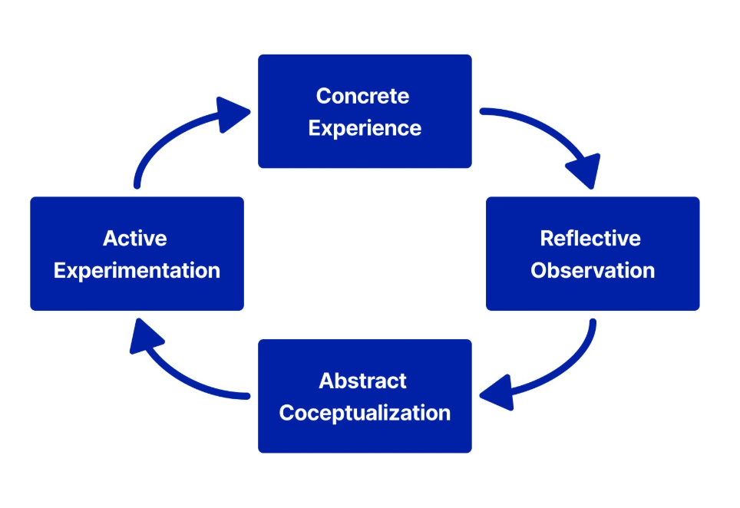
Humanist/Experiential Learning Theories
Theory Overview: Learning by doing, reflection, and personal growth (Kolb's cycle: act, reflect, conceptualize, apply) (Harvard Business Publishing, 2021).
Application: On-the-job rotations or mentoring for Assistant Manager.
Analysis: Addresses holistic needs like self-actualization; combats retail stress via meaningful experiences.
Support: Boosts engagement and skills in workplace (EfFront, 2023).
Example: John Lewis hands-on training for real-world application.
Humanist/experiential theory emphasizes growth. It analyzes L&D needs through reflection, balancing individual and team benefits (WGU, 2020).

Slide 13
Benefits of Effective Learning & Development
Retail Outcomes: Improved customer service/experience; higher engagement/retention; increased sales/profits (e.g., structured programs yield tangible gains)
Increased Retention: Reduces 60.5% turnover; boosts loyalty
Enhanced Performance: Improves sales (20% per employee) and productivity (Disprz, 2026).
Better Customer Service: Leads to 30% higher retention via skilled staff
Organizational Growth: Fosters innovation, morale, and revenue
Cost Savings: Lowers recruitment costs; ROI 200-400% in 3 years.
Effective L&D transforms recruits into assets. In retail like John Lewis, it ensures smooth running and growth (Axonify, 2024).

Slide 14
Conclusion
Structured recruitment and theory-based L&D ensures the right hire and ongoing development for Retail Assistant Store Manager
Summary: Effective recruitment (analysis, JD, PS, process) and L&D (needs analysis via theories) ensure right team members.
Recommendation: Implement at John Lewis for sustained growth and reduced turnover.
Final Thought: "A balanced approach to HR drives organizational success" (Bryson, 2025).
In conclusion, effective recruitment and development build high-performing teams aligned with our Partnership ethos.

Slide 15
References
Armstrong, M. & Taylor, S. (2020) Armstrong’s Handbook of Human Resource Management Practice. 15th edn. London: Kogan Page.
John Lewis Partnership (2026) Team Manager Job Advertisements (various locations). Available at: https://www.jlpjobs.com/ (Accessed: March 2026).
Backman, M. et al. (2025). Career trajectories in retail and wholesale. The International Review of Retail, Distribution and Consumer Research.
BBC. (2024). John Lewis job applicants get questions beforehand.
Branine, M. (2008). Graduate recruitment and selection in the UK. Career Development International.
Bryson, J.R. (2025). Human Resource Management and Retail Employment. University of Birmingham Research.
Disprz. (2026). Top 8 Retail Management Skills for 2026.
Educational Technology. (2023). Cognitivism Learning Theory.
Engageli. (2026). Benefits of Learning and Development for Retail Workers.
Graduates First. (2026). JOHN LEWIS Application Process.
Harvard Business Publishing. (2021). Experiential Learning in the Workplace.
Huddleston, P. & Hirst, C. (2004). Skills Gaps and Training Needs in Retail. SKOPE Research Paper.
JLPJobs. (2026). How to Apply | Recruitment Process.
Keeling, K.A. et al. (2013). Staff Word-of-Mouth and Retail Employee Recruitment. Journal of Retailing.
Nickson, D. et al. (2012). Soft Skills and Employability: Evidence from UK Retail. Economic and Industrial Democracy.
Indeed (2026) Assistant Store Manager Job Description. Available at :https://www.indeed.com/hire/job-description/assistant-store-manager (Accessed: March 2026).

Slide 16


