Slide 1
Student Name: Neculai Stoenica
Student ID: 2525222
Lecturer’s Name: Annamarie Dufficy
Module Code: LCLM 4004
Module Name: Problem Solving and Decision-Making
Component 1: Basil’s Bakery

Slide 2
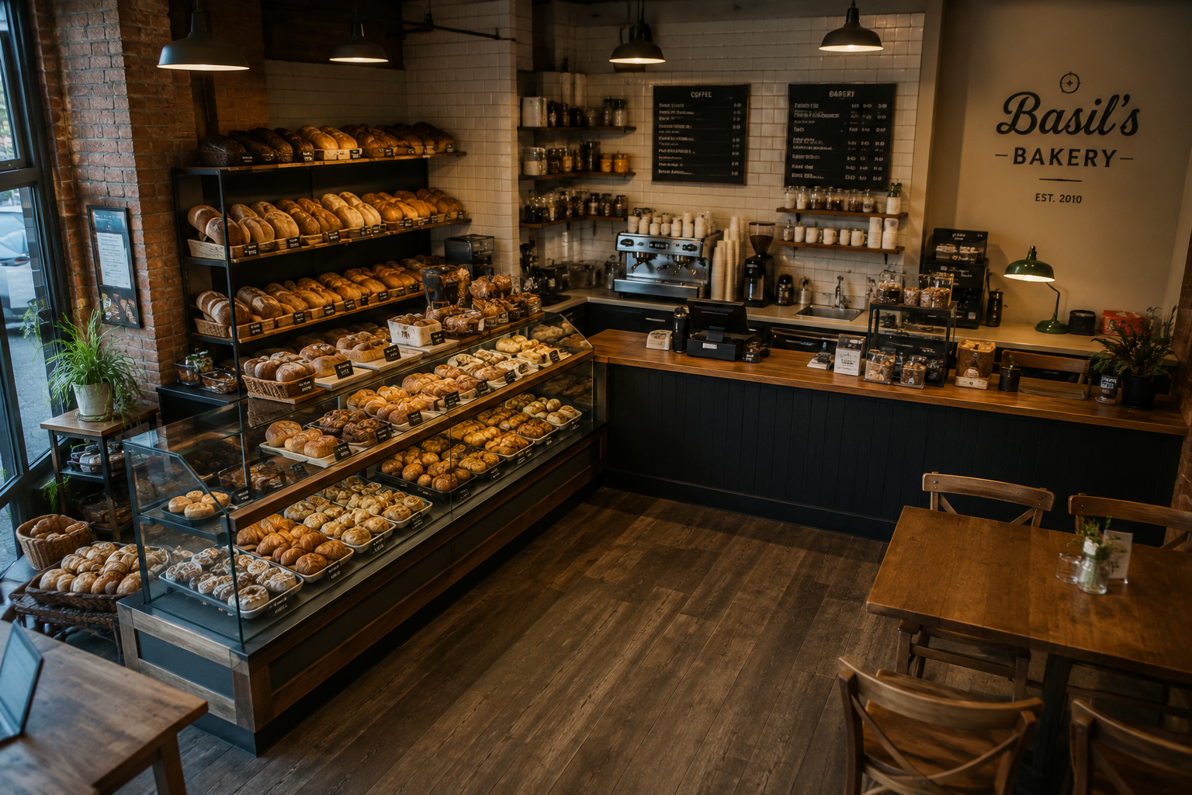
Introduction & Presentation Structure
Basil's Bakery is an independent artisan bakery located in a retail park in Birmingham. The business experienced strong growth before COVID-19 but has faced several challenges affecting its sales performance since the pandemic.for the business.
  Context
Artisan bakery business.
Organic products.
Loyal customer base.
Located in a retail park.
Facing sales challenges.
This presentation will:
Examine factors affecting sales.
Apply PESTEL analysis.
Apply Fishbone analysis.
Present key findings.

Slide 3
Issues Affecting Sales
Nature and Scope of the Problem
External issues
COVID-19 pandemic and lockdown restrictions.
Higher insurance costs.
Remote working.
Lower demand from office workers.
Internal issues
No delivery service.
Lack of capacity to offer additional customer services.
Rising operating costs.
No online ordering system.
Source: Author's illustration based on the Basil's Bakery case study.

Slide 4
Controllable and Uncontrollable Factors
The issues affecting Basil's Bakery can be categorised into factors that are within the business's control and factors that are outside its control.
Controllable Factors
No online ordering system
No delivery service
Long customer waiting times
Inability to answer phone orders during busy periods
Uncontrollable Factors
Remote work
Reduced retail park
Supply shortages of organic ingredients
Rising utility prices

Slide 5
PESTEL Analysis
PESTEL Analysis is a framework used to assess the external factors that influence an organisation. It helps businesses understand opportunities, challenges and changes within their operating environment.
Why is it used?
Helps businesses understand the external environment.
Supports strategic decision-making.
Benefits
Identifies external influences.
Helps recognise opportunities and threats.
Supports business planning.
Limitations
Does not prioritise factors by importance.
External factors can change quickly.
Results may be subjective.
(CIPD, 2024)

Slide 6
PESTEL Analysis
This PESTEL analysis has been applied to Basil's Bakery to identify the external factors.
Political Factors | Economic Factors | Social Factors | Technological Factors | Environmental Factors | Legal Factors​
• Business rates and taxation •Government responses to COVID-19 restrictions | • Rising rent and utility bills • Inflation increases ingredient prices | • Customers want delivery services • Fewer shoppers visit the retail park. | • No delivery service. • Limited phone ordering | •Weather conditions affect food production. • Supply shortages increase costs. | • Regulations affecting small businesses​

Slide 7
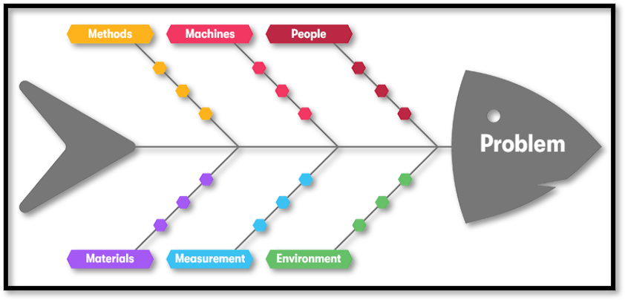
Cause-and-Effect diagram
A Fishbone Diagram is a tool used to identify and organise the possible causes of a specific problem. It helps to analyse the relationship between a problem and its contributing factors.
(Sproull, 2018).
Why do we use a Fishbone Diagram?
Provides a clear visual representation
Encourages brainstorming and teamwork
Organises causes into categories
Identifies causes of problems
How is a Fishbone Diagram constructed?
Add possible causes under each category
Identify the problem or effect
Create the main cause categories
Analyse the relationship between causes and the problem
(Sproull, 2018, page 22 - 25)
It is also known as a Fishbone diagram.

Slide 8
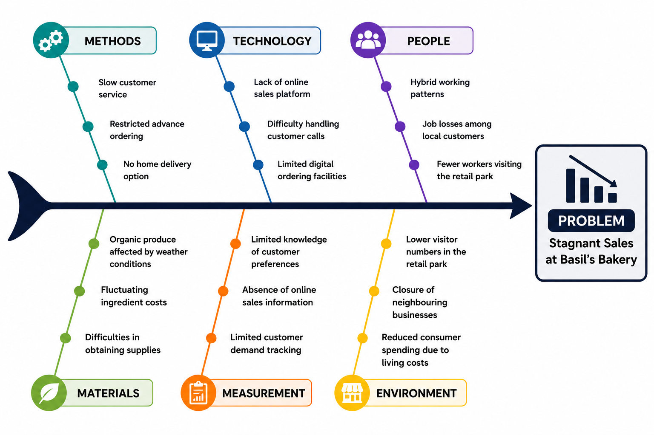
The Fishbone Diagram has been applied to Basil's Bakery to identify and analyse the causes of sales performance.
Super series Solving Problems and Making Decisions (2013, page 31)

Slide 9
Five major factors were identified as the main causes of Basil's Bakery's stagnant sales.
Reduced Customer traffic
More people working from home
No online ordering system.
No delivery service.
Higher running costs

Slide 10
Reference List:
Sproull, N.L. (2018)Handbook of Research Methods: A Guide for Practitioners and Students in the Social Sciences. 2nd edn. Lanham: Scarecrow Press.
CIPD(2024)PESTLE analysis. Available at:
https://www.cipd.org/uk/knowledge/factsheets/pestle-analysis-factsheet/ (Accessed: 14 June 2026)
Basil's Bakery Case Study (2026). Assessment case study provided as part of the module materials.
Kotler, P. and Keller, K. (2016) Marketing Management. 15th edn. Harlow: Pearson.

Slide 11


