Slide 1
Ethical Dilemma
Peer Seminar Presentation
By Katie-Ann Lillicrap

Slide 2

(Women’s aid, 2020)
Ethical Dilemma:
Cherry is attending her 2nd session for counselling, Cherry has been having telephone sessions due to the pandemic currently happening as face to face counselling is currently on hold. During her second session she discloses that she is experiencing abuse from her partner at home, Cherry explains how she doesn’t have much privacy in her home when her partner is there and the only time she does is when her partner goes out, is working from home or out shopping, the client asks yourself if she would be able to arrange the sessions when it is a safe time for her to talk so she can have a space which is private and confidential. It is addressed with Cherry to have some things put in place and in the contract to keep her and the counsellor safe such as having a safe word to use if her abuser was to enter on the her during a session and for yourself as the counsellor to know why if the client was to quickly hang up, who would the client want the counsellor to say they are or to know what to say if the abuser was to ring the counsellor back. During the forth session Cherry’s abuser comes in early from shopping, leading him to catch her on the phone, the abuser was not happy, you can hear shouting and screaming which then leads to the phone being cut off.

Slide 3
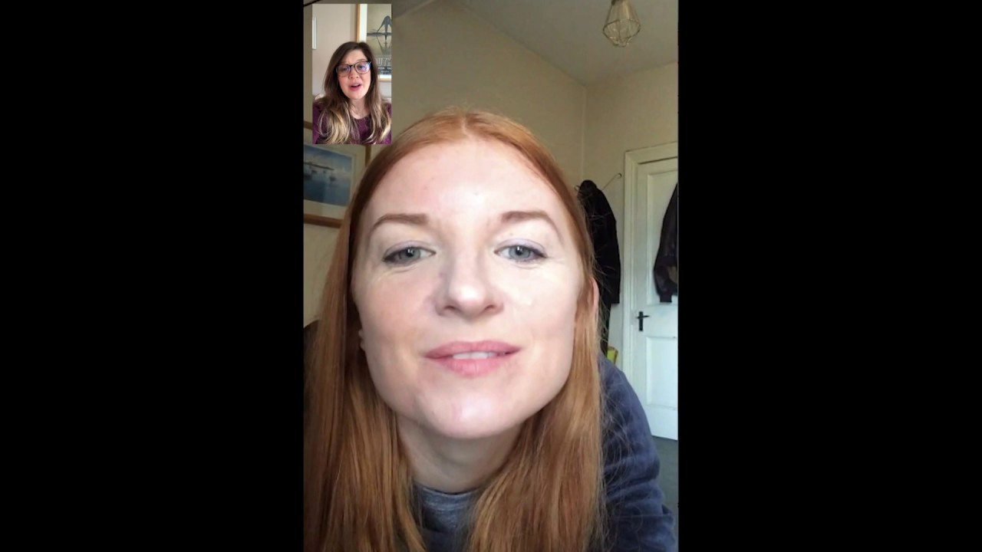
Example of the ethical Dilemma

Slide 4

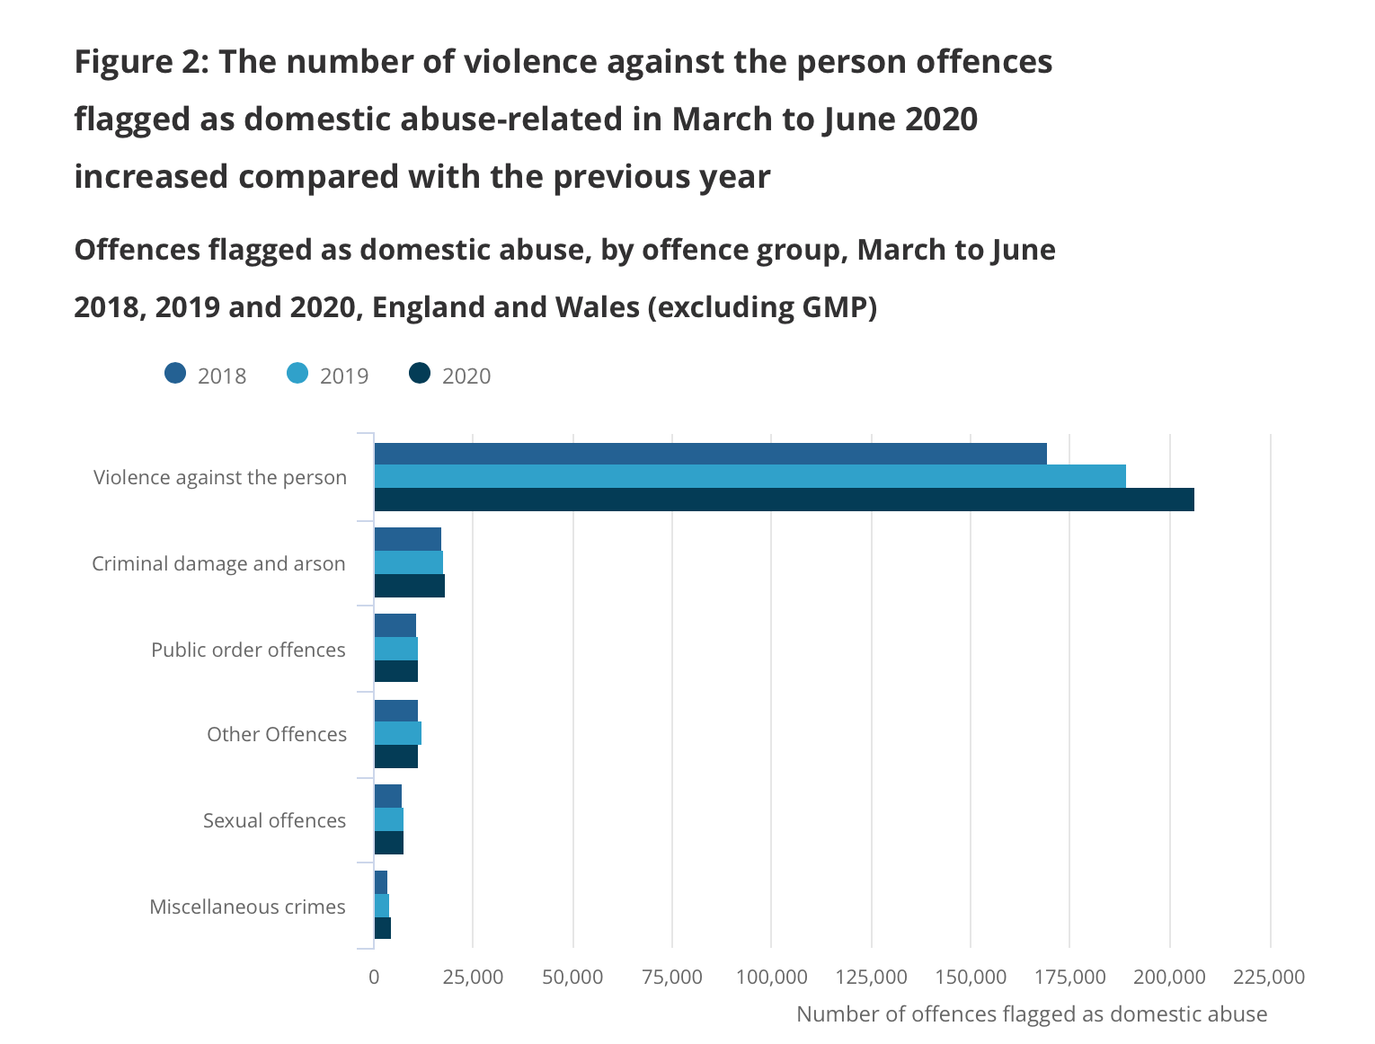
Statistic’s of abuse during lockdown
During and after the first lockdown in April, May and June, roughly one-fifth of offences involved domestic abuse.
259,324 domestic abuse offences between March and June - 7% up on the same period in 2019
More than 40,000 calls and contacts were made to the National Domestic Abuse Helpline during the first three months of lockdown, most by women seeking help
The number of deaths had trebled compared to 2019 figures - the highest in at least 11 years.

Slide 5
Questions to discuss
How would you feel as the counsellor if the client was to hang up on you?
How would it feel to work with this type of client over the phone during the pandemic and respecting the contract even if it might not sit well with your own values and beliefs?
With there being no safe space for privacy or confidentially for the client and disruptions during the sessions, would it be best for the sessions to be put on hold till face to face can return?
Who’s Ethical Dilemma is this?

Slide 6
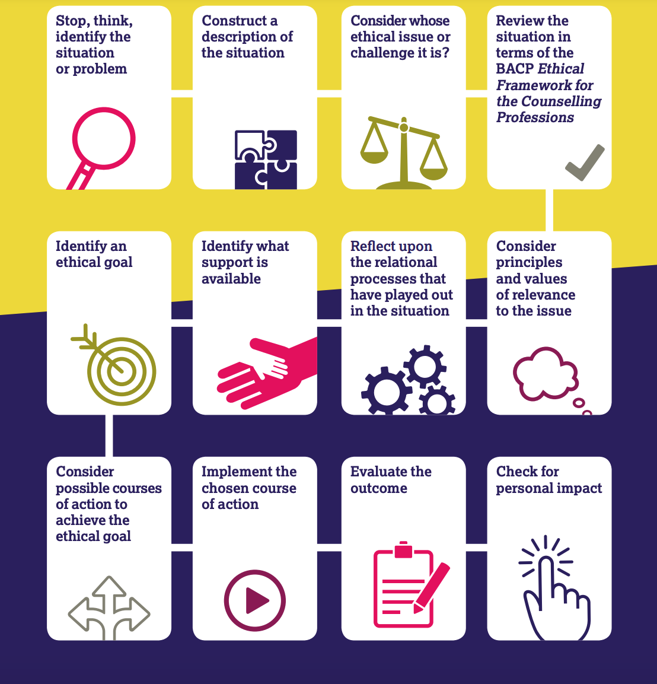
Ethical Framework
12 steps of decision making
As a counsellor aligned with the BACP, following these few points of the ethical framework (2018) can be quite challenging with this type of client.
Confidently
Personal Values & beliefs
Principles :
  Trustworthy
  Autonomy
  Beneficence
  Non-maleficence
  Justice
  Self respect
(BACP, 2018)

Slide 7
Personal Bias
For me this would be quite difficult, if there was a time where the client was to hang up during the session as the abuser came in, I would be quite concerned for this client not knowing what was happening to them after they hung up the phone, did the abuser believe the client, was the abuser to ring back the number, would the abuser believe me with the story that myself and the client came up with to tell them. If I don’t hear back from the client are they okay? have they been hurt badly? All these questions would be flying through my head and I would find it quite difficult to accept. Even though myself and the client would discuss how they could let me know they are okay further in the day, it would be a worry being left hanging like that when they abruptly hang up even though I know it is for the safety of the client but this would be hard to accept.

Slide 8
Thank you for listening

Slide 9
References:
BACP (2018) Ethical framework for the counselling professions. Available at: https://www.bacp.co.uk/events-and-resources/ethics-and-standards/ethical-framework-for-the-counselling-professions/ (Accessed: 23rd February 2021)
Department of Justice Ireland (2020) StillHere Domestic Abuse Awareness Campaign TV Advert [video]. Available at: https://www.youtube.com/watch?v=VTcVbHpCTVQ&feature=emb_title (Accessed: 23rd February 2021)
BACP (2018) Ethical decision making in the context of the counselling professions. Available at: https://moodle.uwtsd.ac.uk/pluginfile.php/467261/mod_resource/content/0/bacp-ethical-decision-making-in-context-counselling-professions-fact-sheet-gpia044.pdf (Accessed: 23rd February 2021).
Women’s aid (2020) Survivors says domestic abuse is escalating under lockdown. Available at: https://www.womensaid.org.uk/survivors-say-domestic-abuse-is-escalating-under-lockdown/ (Accessed:23rd February 2021)
BBC (2020) ‘Coronavirus: Domestic abuse offences increased during pandemic’ BBC News, 25th November. Available at: https://www.bbc.co.uk/news/uk-55073229 (Accessed: 23rd February 2021)
Kelly, J. and Graham, S. (2020) ‘Coronavirus: Domestic abuse helpline sees lockdown surge’ BBC News, 23rd July. Available at: https://www.bbc.co.uk/news/uk-53498675 (Accessed: 24th February 2021).
Centre for Women’s Justice (2020) Covid-19 and The Surge In Domestic Abuse In The UK. Available at: https://www.centreforwomensjustice.org.uk/new-blog-1/2020/11/10/covid-19-and-surge-in-domestic-abuse-in-uk (Accessed: 24th February 2021)
Stripe, N (2020) ‘Domestic abuse during the coronavirus (COVID-19) pandemic, England and Wales: November 2020’ Office for National Statistics, pp. 1-27. Available at: https://www.ons.gov.uk/peoplepopulationandcommunity/crimeandjustice/articles/domesticabuseduringthecoronaviruscovid19pandemicenglandandwales/november2020 (Accessed: 24th February 2021)

