Slide 1

LAWS RELATING TO HIGHWAYS
WEEK 5 - TORT LAW

Slide 2

CONTENT
- Aims and Learning objectives.
- Legislation.
- Rights of the public.
- Activities.
- Summary.
- Thank you, any questions.

Slide 3

AIMS AND LEARNING OBJECTIVES
- The aim of today's session is to discuss the highway laws and how they apply in tort law.
- By the end of today's session students should be able to demonstrate that they understand tort law and highway laws.

Slide 4

INTRODUCTION
The common law of negligence covers the duty of care road users owe to each other, what if an accident is caused by the condition of the highway itself as opposed to an individual? Who is responsible?
Complex area of tort law containing both statutory and common law principles involving multiple areas.
In negligence claims, the question of who to sue is prominent in the minds of claimants as it can be difficult to establish who owns the land, who is responsible for its maintenance and what evidence is required to show a breach of duty and resulting damage.
Look at the nature and extent of the statutory duty to maintain public roads and the situations when a claim in negligence may or may not be successful.
We will look at public rights of way and the process of adoption of new roads by the local authority.
Notes:
Week 5 - We will consider application of the law of negligence in relation to the statutory duties of the highway authority to maintain public roads and highways.

Slide 5
LEGISLATION
- Who is responsible to ensure that the roads are safe?
- Highways Act 1980.
- S.238.
- Defines highways.
- Research what it says.
- Defined in case law ; ''Willis J in Ex parte Lews (1888)''
Notes:
There was no civil liability at common law for a failure by the highway authority to discharge its duty to keep the highway in repair: the only “remedy” was criminal proceedings on indictment, with limited exceptions. This was heavily criticised and the immunity to civil claims was abolished by the Highways (Miscellaneous Provisions) Act 1961.
The law in this area is now found in the Highways Act 1980, which consolidated the different pieces of legislation between 1959 and 1971 into a single enactment. It is a large piece of legislation and has been amended significantly, most notably by the Infrastructure Act 2015 and Railways and Transport Safety Act 2003.
Students to research – what is a highway and feedback to the group.

Slide 6
WHAT IS A HIGHWAY?
S328 attempts to define the meaning of highway.
For the purposes of the Act, highway means the whole or a part of a highway other than a ferry or waterway and includes bridges and tunnels which the highway passes over or through.
We are not really given a definition of a highway, therefore, it has been left to common law to apply the legislative provisions through case law.
The meaning of highway given at common law was by Willis J in Ex Parte Lews (1888)
“a highway is a way over which there exists a public right of passage, that is to say a right for all Her Majesty’s subjects at all seasons of the year freely and at their will to pass and repass without let or hindrance”.

Slide 7
ACTIVITY
At common law, there are three kinds of highway according to the degree of restriction of the public rights of passage over them.
Take 5 minutes to research what these are and feedback to the group.

Slide 8
THREE KINDS OF HIGHWAY
1 - A “cartway” or “carriageway” is a highway over which the public has a right of way (a) on foot; (b) riding on or accompanied by a beast of burden; or (c) with vehicles and livestock.
2 - A “bridleway” is a highway over which the rights of passage are cut down by the exclusion of the right of passage with vehicles and sometimes, although not invariably, the exclusion of the right of driftway, that is, driving cattle.
3 - A “footpath” is a highway over which there is a public right of passage on foot.
It should be noted that s329 of the 1980 Act gives similar definitions of these main types of highway

Slide 9

MAINTENANCE
- Public pay.
- S.41.
- Highway Maintenace is responsible.
- S.36.
- Public roads for example.
- listed under S.36(6).
- '' Must repair and Maintain it''.
Notes:
S41 of the 1980 Act provides that the highway authority is under a duty to maintain any highway which is maintainable at public expense.
Further guidance as to what this means is set out in s36 of the 1980 Act, but it is not straightforward. Generally, the following highways are maintainable at public expense:
highways which were maintainable at public expense before the commencement of the Act
highways constructed by the highway authority;
highways constructed by a council within their own area;
certain footpaths and bridleways.
It includes most roads which would generally be understood to be public roads. Fortunately, to assist in determining whether a road is maintainable at the public expense, the highway authority is required to publish a list of all highways for which it is responsible under s36(6).

Slide 10
CONTINUED
- Cannot be delegated.
- ''Burnside and Emerson'' [ 1986] - define the duty.
- Duty can arise in three areas.
Notes:
Common law and non-delegable statutory duty meaning that the highway authority cannot pass responsibility to another party. The duty is to put and keep the highway in such good repair as renders it reasonably passable for the ordinary traffic of the neighbourhood at all seasons of the year without danger caused by its physical condition” (Diplock J in Burnside v Emerson [1986]).
The duty to maintain covers repair and maintenance, but not making improvements or giving warnings about normal road conditions. You should have come across a few cases in your pre-reading.

Slide 11

ACTIVITY
Consider the facts of the following cases which are contained in your pre-reading. What can you tell us about these cases and how they relate to the topic?
Gorringe v Calderdale Metropolitan Borough Council [2004]
Dabinett v Somerset County Council [2006]
Valentine v Transport for London [2010].
Haydon v Kent CC [1978] and Lord Hoffman in Goodes v East Sussex CC [2000].
Rollinson v Dudley Metropolitan Borough Council [2015]
Wentworth v Wilts CC [1993]).

Slide 12

TEMPORARY HAZARD
- S.329(1) 1980.
- ''Haydon v Kent County Council [1978]''
- Has the duty to put gravel down etc.
- As soon as ice appears they are liable.
Notes:
Under s329(1) of the 1980 Act, “maintenance” is defined in terms that it “includes repair” so that it is plain that the fabric of the highway itself has to be kept in repair, as we have seen above. What was less clear over the years was whether the word “maintain” included anything else and particularly whether it included an obligation to clear transient dangers brought on by foul weather.
Traditionally, the common law was hostile to claimants seeking redress for harm caused on the highway due to bad weather conditions i.e. snow and ice (Reference Burnside v Emerson 1968) but this was changed in the Haydon v Kent County Council 1978 case which concluded that the duty to maintain meant more than simply keeping in repair the surface of the highway and extended to removing snow and ice or taking protective measures to render the highway safe in bad weather conditions. Lord Goff stated:
“In my judgment, the [claimant] must prove…either…that the highway authority is at fault apart from merely failing to take steps to deal with the ice, or, …that, having regard to the nature and importance of the way, sufficient time had elapsed to make it prima facie unreasonable for the authority to have failed to take remedial measures. Then the authority is liable unless it is able to make out the statutory defence.”
The duty is an absolute duty in the sense that the highway authority would technically be in immediate breach as soon as any part of the highway became covered in ice, which is why Lord Goff above referred to a “sufficient time ha[s] elapsed”.

Slide 13
ACTIVITY
Why do you think the common law takes a strict approach to transient hazards on the highway?
Should local authorities be responsible for removing surface-lying material which creates a danger to the public?

Slide 14
ANY AVAILABLE DEFENCES
- Did the individuals take '' Reasonable care''.
- S.58(1).
- ''Can use the Mills case to decide reasonable foreseeability''.
Notes:
Final relevant component of the 1980 Act, the statutory defence of reasonable care.
The highway authority may claim in defence that they have taken all reasonable steps in exercising their duty to maintain. This is contained in s58(1) Highways Act 1980 which states:
In an action against a highway authority in respect of damage resulting from their failure to maintain a highway maintainable at the public expense it is a defence…to prove that the authority had taken such care as in all the circumstances was reasonably required to secure that the part of the highway to which the action relates was not dangerous for traffic.
The Act also gives a list of statutory factors the court shall consider when assessing the applicability of the defence. These are contained in s58(2):
the character of the highway, and the traffic which was reasonably to be expected to use it;
the standard of maintenance appropriate for a highway of that character and used by such traffic;
the state of repair in which a reasonable person would have expected to find the highway;
whether the highway authority knew, or could reasonably have been expected to know, that the condition of the part of the highway to which the action relates was likely to cause danger to users of the highway; and
where the highway authority could not reasonably have been expected to repair that part of the highway before the cause of action arose, what warning notices of its condition had been displayed.
A long list of factors the court has to regard when assessing whether the actions taken by the relevant authority are reasonable or not.
A lot of litigation with claimants seeking compensation for accidents due to potholes and other defects in the road. S58 offers a statutory defence for highway authorities if they can show that they had taken reasonable measures to ensure that problems such as potholes are found and dealt with swiftly. This has led to increased scrutiny on local authority systems and procedures for dealing with highway repairs.

Slide 15
ACTIVITY
Research the case of Mills v Barnsley MBC [1992] and any other relevant case law you may find relating to ’reasonable foreseeability’
What are the facts of the cases?
Feedback to the group.
Notes:
The case law has shown a real gulf between the statutory legal duties highway authorities are placed under and their allocated resources and budgets. We have seen that the common law has shown some understanding of the limited nature of local finances when assessing the extent of the duty owed, though it is clear that resource constraints alone will not be sufficient to establish the reasonableness defence.

Slide 16
S41statutory duty to maintain
S58 STATUTORY DEFENCE OF REASONABLE CARE
Highway authority is under a non-delegable duty to maintain any highway which is maintainable at public expense.
Duty to maintain extends to repair and maintenance of the fabric of the highway but not improvements.
Duty includes transient hazards as snow and ice, unlikely to include other types such as surface-lying material.
Defence is to show authority took all reasonable steps to fulfil duty to maintain in the particular circumstances.
Mandatory statutory factors are what the court will consider in assessing reasonableness.
Nature and location of the highway may be relevant as well as whether the authority knew or should have known the highway is dangerous.
Test appears to be reasonable foreseeability.
Lack of resources is no basis for claiming the defence.

Slide 17
THE RIGHTS OF THE PUBLIC
- Ability to use private land.
- Can claim for in a number of areas.
- Three types;
1. Footpaths.
2. Bridleways.
3. Roads.
S.36(b) of the Highway Act 1980.
Notes:
Where members of the public have the right to cross private land, a public right of way exists. Rights of way must be distinguished from easements and licences, by which an individual acquires personal rights for himself over another’s land by process of law, which are outside the scope of this coursebook.
In respect of liability in Tort, this can arise in several ways. An example being, in the tort of trespass, if we stray from a public right of way onto private land.
In terms of liability in tort, this may arise in several ways, for example in the tort of trespass (later in the module) if we stray from a public right of way onto private land. Of course, the existence of a highway gives rise to statutory obligations under the 1980 Act, as we have seen, so there may be liability in negligence if an accident occurs on a public right of way maintainable at public expense due to its poor repair. Not all public rights of way are maintained, however, by the highway authority, and so a private landowner may be liable for injuries and other accidents occurring on that particular highway. There can be an overlap with the statutory duties under the occupiers’ liability legislation for defective premises owed by a private landowner, even towards trespassers.

Slide 18
PUBLIC RIGHTS OF WAY
Public rights of way are all highways in law, but not all highways are public rights of way.
Public rights of way are divided into three kinds.
ACTIVITY
What are the three kinds of public rights of way? How would you define them?
Did you find any case law in relation to S.36(b) of the Highways Act 1980 in your reading?

Slide 19

CONTINUED
- When is something a public walkway.
- S.118 of the Highways Act 1980.
- Duty to repair.
- Countryside and Rights of Way Act 2000.
- No liability to repair private land with a public walkway.
- Changes if this relates to occupiers' liability.
Notes:
In theory most paths (or other type of highway) become rights of way because the owner dedicates them to public use. In fact, very few paths have been formally dedicated, but the common law assumes that if the public uses a path without interference for some period of time – set by statute at 20 years – then the owner had intended to dedicate it as a right of way.
The highway authority can order a diversion (ss118–121, Highways Act 1980) where it is satisfied that, in the interests of an owner or occupier whose land is crossed by a right of way, it is expedient that the line be diverted. Under s118 it can also extinguish a right of way completely on the grounds that the right of way is now not needed for public use. The only factor is whether the path is likely to be used by the public.
Duty to repair - There is a case McGeown v Northen Ireland Housing Executive 1994 in your story board relating to the interplay between public rights of way, negligence and occupiers liability, to the extent to which a private landowner is liable in negligence towards users of a public right of way for failure to maintain/repair. Please read this case.
The harshness of the common law position in relation to public rights of way not maintainable at public expense, as shown in McGeown above, was somewhat mitigated by the passing of the Countryside and Rights of Way Act 2000. The Act improves the rights of way legislation by encouraging the creation of new routes and clarifying uncertainties about what rights already exist.
In terms of liability of a landowner in tort, it is clear from s12(1) that the general right in s2(1) “does not increase the liability…of a person interested in the access land or any adjoining land in respect of the state of the land or of things done or omitted to be done on the land”. It is clear therefore that it is simply a right of access for open-air recreation and does not impose any statutory duties on land owners over and above those already existing in law. Further, CRoW 2000 makes it clear that a person exercising the right of way over access land is not to be regarded as a “visitor” for the purposes of the Occupiers’ Liability Act 1957, as provided by s13(1).
A landowner may also exclude the public who would otherwise have a right of way for up to 28 days a year under s22(1) CRoW 2000.

Slide 20

ACTIVITY
In groups, please have a discussion as to whether you think there should be a universal “right to roam”?
Please consider to what extent do you think the Countryside and Rights of Way Act 2000 strikes the right balance between this concept and the private rights of landowners over their land?

Slide 21

OTHERS
- Adopt a highway.
- LA take responsibility for it.
- Highways Act 1980 S.38(1)- Private adoption.
Notes:
We will consider LA adopted highways. The process of adoption means that the relevant highway authority agrees to take on the maintenance of a road or highway at public expense. As a result, giving rise to statutory obligations and protections.
This is of importance to new housing developments where land is in private ownership. For example, a developer seeking to have the newly built access roads maintainable at public expense. A buyer of such newbuilt property will want to ensure that the common public paths and roads on the estate will be adopted by the local authority as a condition of proceeding. This is relevant in determining who is responsible for the repair.
The key provision for adoption of a private road is s38(1) Highways Act 1980 which states:
where an agreement is made under this subsection the highway to which the agreement relates shall, on such date as may be specified in the agreement, become for the purposes of this Act a highway maintainable at the public expense and the liability of that person to maintain the highway shall be extinguished.
Adoption will normally take place at a pre-agreed period of time after completion of the highway works (typically 12 months). Until that final adoption takes place, the developer remains responsible for their maintenance: both for rectification of defects in the works and for ongoing routine maintenance. After the agreed maintenance period, the local authority takes on responsibility for maintenance.
Since most local authority adopted roads become highways maintainable at public expense, the law relating to the statutory duty to maintain will govern any liability in negligence.

Slide 22

ACTIVITY
- Create a mind map concerning the law relating to highways.
- In groups prepare to present this to the rest of the class.

Slide 23

QUIZ
Notes:
This quiz does not count towards your final grade, it is a knowledge check.

Slide 24


Slide 25

RECAP
Who can recall what we have learnt today?

Slide 26
SUMMARY
The law in this area is now found in the Highways Act 1980, which consolidated the different pieces of legislation between 1959 and 1971 into a single enactment.
S41 of the 1980 Act provides that the highway authority is under a duty to maintain any highway which is maintainable at public expense
In determining whether a road is maintainable at public expense, the highway authority is required to publish a list of all highways for which it is responsible under s36(6).
This is both a common law duty and a non-delegable statutory duty, which means that the highway authority cannot pass responsibility to another party.

Slide 27
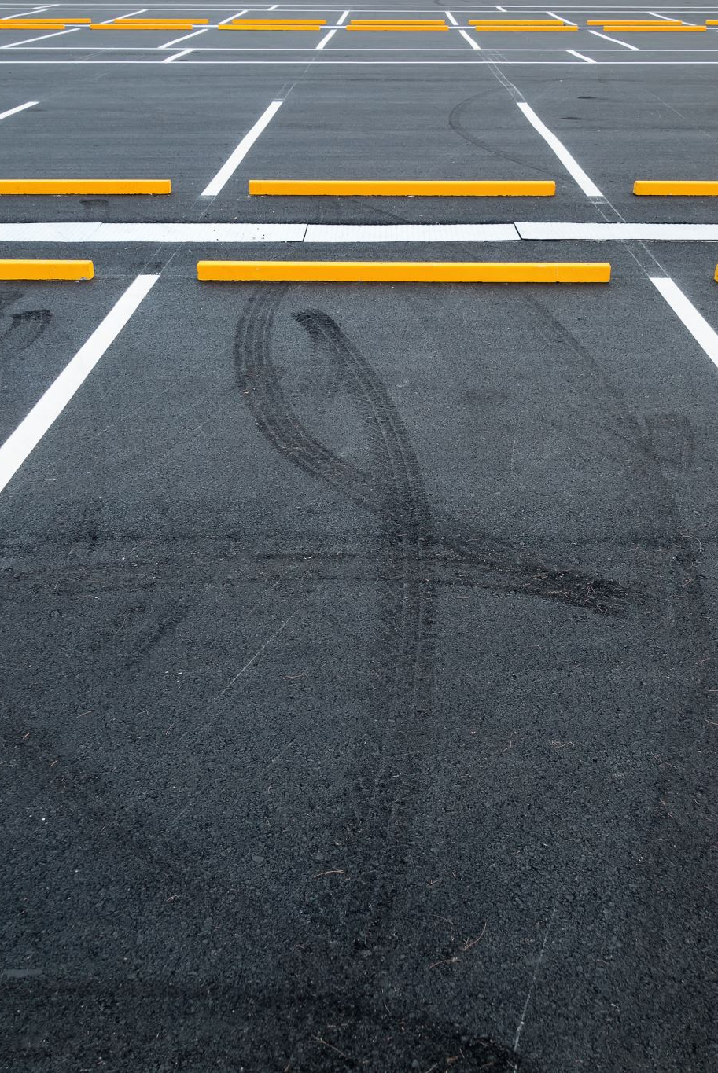
SUMMARY
The duty to maintain covers repair and maintenance but not making improvements or giving warnings about normal road conditions. “Repair” means making good defects in the surface of the highway itself. This would include where the surface is inadequate in some way, or the surface is defective or disturbed. Examples include: a hole or bump; a slope; a dip; or a raised edge
The highway authority duty to maintain includes transient hazards, though only in relation to snow and ice. Transient hazards caused by other reasons will be subject to the common law
The highway authority may claim in defence that they have taken all reasonable steps in exercising their duty to maintain under s58 of the Act

Slide 28
SUMMARY
The Act gives a list of statutory factors the court shall consider when assessing the applicability of the defence. These are contained in s58(2):
(a) the character of the highway, and the traffic which was reasonably to be expected to use it;
(b) the standard of maintenance appropriate for a highway of that character and used by such traffic;
(c) the state of repair in which a reasonable person would have expected to find the highway;
(d) whether the highway authority knew, or could reasonably have been expected to know, that the condition of the part of the highway to which the action relates was likely to cause danger to users of the highway; and
(e) where the highway authority could not reasonably have been expected to repair that part of the highway before the cause of action arose, what warning notices of its condition had been displayed.

Slide 29
SUMMARY
The test appears to be whether there is a “reasonable foreseeability of danger” in order for a claim under s41 to be made out, and lack of resources is not a sufficient basis for the statutory defence to operate
Where members of the public have the right to cross private land, a public right of way exists. Rights of way must be distinguished from easements and licences, by which an individual acquires personal rights for himself over another’s land by process of law. There are several ways in which tort liability may arise when accessing a public right of way, particularly in relation to nuisance and trespass.
The Countryside and Rights of Way Act 2000 significantly expanded the public’s rights of way over open and access land
New roads and developments will only be maintainable at public expense if the local authority has entered into an adoption agreement under s38 Highways Act 1980.

Slide 30
NEXT WEEK – TRESPASS TO LAND AND NUISANCE

Slide 31
THANK YOU!

