Slide 1
Logistics and Transport-
Strategic Contexts

Slide 2
Globalisation
Definition
“The process through which an increasingly free flow of ideas, people, goods, services and capital leads to the integration of economies and societies”

Slide 3
Globalisation Issues to consider
Multilateral trade liberalisation
Successful economic reforms

Slide 4
Drivers of Globalisation
Include: -
Market drivers
Cost drivers
Government drivers
Competitive drivers
Other drivers

Slide 5
Market Drivers
Converging lifestyles and tastes in global markets
Organisations beginning to behave like global customers
Growth of global and regional distribution channels
Global marketing and advertising resulting in global brands

Slide 6
Cost Drivers
Increasing economies of scale from international mergers and acquisition
Accelerating technological innovation allowing outsourcing of functions
Advances in transport systems
Emergence of newly industrialised countries with a productive capability and low cost base
Increasing cost of product development with shorter product life cycles

Slide 7
Government Drivers
Reduction of tariff and non-tariff barriers
Increasing membership of trading blocs
Relative decline in governments as producers and consumers
Privatisation and deregulation of industries
Shift to market-based economies especially in Eastern Europe
Increasing participation in world markets of China, India and other emerging economies

Slide 8
Competitive Drivers
Continuous increase in international trade
Increasing ownership of businesses by foreign multinationals
Growth of global networks meaning countries are more interdependent in certain industries
Companies becoming more international than national centred
Increasing formation of global strategic alliances
Increasing number of companies with a mission to become global players

Slide 9
Other Drivers
A revolution in information and communication technologies e.g. Internet
Globalisation of financial markets
Improvements in business travel and falling transport costs

Slide 10
Impact of Globalisation
Increased competition
Greater awareness
Economies of scale
Location flexibility
Increased mergers and joint ventures

Slide 11
Impact of Globalisation
Increased competition: - caused by more foreign investment flowing to countries, de-regulation which allows businesses to enter markets from which they were once precluded
Greater awareness: - and reactions to customer needs- the consumer is how very selective on such essentials as quality, service and price

Slide 12
Impact of Globalisation
Economies of scale: - by selling across many continents business can acquire economies of large-scale production. This makes them very competitive
Location flexibility: - many modern production techniques and service provisions can be allocated almost anywhere. This allows them to gain the advantages of low cost labour and resources
Increased mergers and joint ventures: - allowing access to bigger markets and associated cost advantages

Slide 13
Globalisation Example
In 1974 IKEA had only 10 stores outside of Scandinavia and company revenue was around £180 million. In 2006 there were 237 stores in 34 countries and their sales revenue was close to 17.3 billion euros

Slide 14
Multinationals
Are businesses with a headquarters in one country, but with business operations in a number of other countries
The sheer size of many multinationals means they often have considerable power and influence, especially when they locate in less developed countries
Sports goods manufacturers Nike and Puma have been criticised over poor working conditions and exploitation of cheap overseas labour employed in free trade zones where their goods are typically manufactured

Slide 15
Why the drive to become multinational
Reduced transport and distribution costs
Avoidance of trade and non-tariff barriers
Access to raw materials
Cost advantages
Increased sales turnover
Economies of scale
First mover advantage
Other marketing advantages

Slide 16
Why the drive to become multinational
Reduced transport and distribution costs: - by producing goods and services locally or regionally, firms can save considerable transport costs
Avoidance of trade and non-tariff barriers: -by locating in overseas markets, firms may avoid tariffs, quotas and other forms of protectionism. For instance, Asian firms invested in large numbers in the UK in the 1990s to allow them to export to the European Union and to compete with European suppliers without a cost disadvantage

Slide 17
Why the drive to become multinational
Access to raw materials: - by locating overseas, firms can ensure access to raw materials at reduced prices
Cost advantages: - for example, lower labour rates, energy and property costs
Increased sales turnover: - expanding overseas can provide access to large markets, including those of the developing world such as china and India

Slide 18
Why the drive to become multinational
Economies of scale: - increasing scale of operations can lead to both internal and external economics of scale and spreading of risk. However, multinationals have other markets to compensate, if one market is suffering decline or subject to political instability or natural disasters

Slide 19
Why the drive to become multinational
First mover advantage: - getting into markets first provide marketing and distribution advantages, e.g. Tesco choose to expand their retail business into Eastern Europe allowing them to gain market share and customer loyalty before other competitors appear
Other marketing advantages: - overseas brands may have an exclusive desirability allowing premium prices to be charged

Slide 20
Problems of Expansion into International Markets
Cultural differences
Lack of experience
Language difficulties
Little brand awareness
Currency fluctuations and instability
Political instability
Local opposition
Possible legal restrictions on access
Limited control over supply
Greater set-up costs

Slide 21
Multinationals from Emerging Nations
There has been more to globalisation than just a rise in world trade
There has been a significant increase in foreign direct investment (FDI) by companies over the last 15 years, particularly those from emerging nations
The easing of trade barriers and tariffs and ICT revolution has underpinned globalisation

Slide 22
Multinationals from Emerging Nations
The Fortune Global 500 companies based in Brazil, Russia, India or China (BRIC) has more than doubled from 27 to 58 in the last five years
This offers considerable opportunity for local companies that provide business-to-business services, such as communications and IT

Slide 23
Impact of Multinational Companies on the host Country
Multinational corporations can provide developing countries with critical financial infrastructure for economic and social development
However, these companies may also bring with them relaxed codes of ethical conduct that serve to exploit the developing nations, rather than provide the critical support necessary for economic and social development

Slide 24
Impact of Multinational Companies on the host Country
When a multinational invests in a host country the scale of the investment is likely to be significant
Indeed, governments will often offer incentives to firms in the form of grants, subsidies and tax breaks to attract investment into their countries.
This foreign direct investment will have advantages and disadvantages for the host country

Slide 25
Advantages of Foreign Investment
Improving the balance of payments
Providing employment
Source of tax revenue
Technology transfer
Increasing choice

Slide 26
Advantages of Foreign Investment
Improving the balance of payments: - inward investment will usually help a country’s balance of payments situation. The investment itself will be a direct flow of capital into the country and the investment is also likely to result in import substitution and export promotion
Export promotion comes due to the multinational using their production facility as a basis for exporting, while import substitution means that products previously imported may now be bought domestically.

Slide 27
Advantages of Foreign Investment
Providing employment: - FDI will usually result in employment benefits for the host country as most employees will be locally recruited
These benefits may be relatively greater given that governments will usually try to attract firms to areas where there is relatively high unemployment or a good labour supply
Source of tax revenue: - profits of multinationals will be subject to local taxes in most cases, which will provide a valuable Source of revenue for the domestic government

Slide 28
Advantages of Foreign Investment
Technology transfer: - multinationals will bring with them technology and production methods that are probably new to the host country and a lot can therefore be learnt from these techniques
Workers will be trained to use the technology and production techniques and domestic firms will see the benefits of the new technology

Slide 29
Advantages of Foreign Investment
Increasing choice: - if the multinational manufactures for domestic markets as well as for export, then the local population will gain from a wider choice of goods and services and at a price possibly lower than imported substitutes

Slide 30
Disadvantages of Foreign Investment
Environmental impact
Access to natural resources
Uncertainty
Increased competition
Crowding out
Influence and political pressure
Transfer pricing
Export of profits

Slide 31
Disadvantages of Foreign Investment
Environmental impact: - multinationals will want to produce in ways that are as efficient and as cheap as possible and this may not always be the best environmental practice
They will often lobby governments hard to try to ensure that they can benefit from regulations being as lax as possible and given their economic importance to the host country this lobbying will often be quite effective

Slide 32
Disadvantages of Foreign Investment
Access to natural resources: - multinationals will sometimes invest in countries just to get access to a plentiful supply of raw materials and host nations are often more concerned about the short-term economic benefits than the long-term costs to their country in terms of the depletion of natural resources
Uncertainty: - multinational firms are increasingly ‘footloose’. This means that they can move and change at very short notice and often will. This creates uncertainty for the host country

Slide 33
Disadvantages of Foreign Investment
Increased competition: - the impact on the local industries can be severe, because the presence of newly arrived multinationals increases the competition in the economy and because multinationals should be able to produce at a lower cost
Crowding out: - if overseas firms borrow in the domestic economy this may reduce access to funds and increase rates

Slide 34
Disadvantages of Foreign Investment
Influence and political pressure: - multinational investment can be very important to a country and this will often give them a disproportionate influence over government and other organisations in the host country.
Health and safety: - multinationals have been accused of cutting corners on helath and safety in countries where regulation and laws are not as rigorous

Slide 35
Disadvantages of Foreign Investment
Transfer pricing: - multinationals will always aim to reduce their tax liability to a minimum. One way of doing this is through transfer pricing. The aim of this is to reduce their tax liability in countries with high tax rates and increase them in the countries with low tax rates. They can do this by transferring components and part-finished goods between their operations in different countries at differing prices

Slide 36
Disadvantages of Foreign Investment
Low-skilled employment: - the jobs created in the local environment may be low-skilled with the multinational employing expatriate workers for the more senior and skilled roles
Export of profits: - large multinationals are likely to repatriate profits back to their ‘home country’, leaving little financial benefits for the host country

Slide 37
Trading Blocs
The purpose of creating trading blocs is to reduce or eliminate unnecessary trade barriers between member states, and to allow free movement of goods, services, labour and capital
However, non-members of trading blocs are faced with financial and non-financial restrictions on their exports to these blocs, such as tariffs, quotas and even embargoes

Slide 38
Trading Blocs
As a result it is difficult for any country to survive outside one of these blocs and the world is splitting into groups of trading nations promoting free trade between themselves, at the same time as they are restricting it to those countries outside of their blocs

Slide 39
Advantages of Trading Blocs
Less chance of conflict and war
Larger markets and customer base
Freedom of movement of goods and people
Increased global significance
Improving environmental and social conditions
Elimination of protectionism

Slide 40
Disadvantages of Trading Blocs
Loss of sovereignty, independence and national identity
Increased competition leading to job losses in some domestic industries
Loss of border control and the increased risk of smuggled goods and people
Loss of border control and the increased risk of smuggled goods and people

Slide 41
Protectionism
Arises because countries may not always feel that they benefit from completely free trade
They may be suffering some of the costs associated with trade and feel that they want to restrict aspects of trading activity
These restrictions are known protectionism

Slide 42
Examples of Protectionism
Tariffs
Quotas
Export Subsidies
Embargoes
Administrative barriers

Slide 43
Protectionist Policies
Tariffs: - is a tax on imports. Tariffs reduce supply and raise the price of imports. This gives domestic equivalents a competitive advantage. The EU charges a common external tariff (CET)
Quotas: - have the effect of restricting the maximum amount of imports allowed into a economy. Once again they reduce the amount of imports entering an economy and increase the equilibrium price within the market

Slide 44
Protectionist Policies
Export Subsidies: - export subsidies allow exporters to supply the market with more product than the natural market equilibrium would have allowed
Domestic employees might benefit from better wages and job security, but domestic tax payers are footing the bill for this

Slide 45
Protectionist Policies
Embargoes: - prohibits imports from certain countries completely
Administrative barriers: - aim to slow down imports and add costs. They can include requiring importing firms to obtain permits and various licences

Slide 46
Benefits of Environmental Analysis
Organisations may become more aware of emerging trends and opportunities in international markets that it may be appropriate to pursue
It enables organisations both to for see and consider the implications of environmental regulatory and political change and to manage the implementation of such changes successfully

Slide 47
Environmental Analysis
The most common one undertaken is PESTLE analysis
Political
Economic
Social
Technological
Legal
Environmental

Slide 48
Political Issues
Increases in taxation, reducing disposable income
Environmental protection
Employment law
Health and safety
Foreign trade agreements
Political stability

Slide 49
Economic Issues
Inflation rates
Interest rates
Income levels
Resources
Gross national product
Gross domestic product
Employment levels
Exchange rates

Slide 50
Social Issues
Demographics
Values and attitudes
Healthcare
Education
Social organisation

Slide 51
Technological Issues
Wireless technology
Rate of change
Internet
Innovation

Slide 52
Environmental Issues
Effects of weather
Global warming
Air pollution
Transportation
Waste management
Carbon trading

Slide 53
Legal issues
Monopolies and mergers
Competitive activities
Unfair trading
Consumer legislation
Trade descriptions
Professional codes of conduct

Slide 54
Competitive Rivalry
Key factors
Stage of product life cycle of competing products
Use of specialised production techniques
Liquidity of competitor
Ability to achieve differentiation and brad loyalty
Competitor intentions
The relative size of the competitor
Barrier of exit from the industry

Slide 55
Bargaining power of supplies
The strength of the supplier brand
The source of supply spans only a small number of suppliers
Switching supplier
Substitute products of suppliers
Forward integration

Slide 56
Bargaining power of buyers
Where few buyers control a large volume of the market
Cost of switching supplier is low
Strong customer power
Where there are a large number of smaller suppliers fighting for a share of the market

Slide 57
Threat for potential entrants
Economies of scale
Access to new distribution channels
Brand loyalty
Capital investment
Competitor retaliation
Regulatory influence

Slide 58
Threat of substitutes
A new product or service equivalent
A new product replacing an existing product
Consumer substitution

Slide 59
SWOT Analysis
SWOT stands for
Strengths, Weaknesses, Opportunities and Threats
The SWOT analysis contains an explanation of the key factors affecting an organisation at a certain period in time

Slide 61
SWOT Analysis
Key questions to ask are:
How can we exploit this strength?
How can we eliminate this weaknesses?
How can we exploit this opportunity
How can we minimise or avoid the effects of this threat

Slide 62
SWOT Analysis
The aim of SWOT analysis is to convert weaknesses into strengths and threats into opportunities
When performing a SWOT analysis organisations should be aware of the differences between controllable and uncontrollable factors

Slide 63
SWOT Analysis
Controllable factors: - are those factors relating to technology skills, resources and investment
Uncontrollable factors: - are competitor activity, interest rates, legislation and global markets

Slide 64
SWOT Analysis
The key point with SWOT analysis is to realise that an organisation cannot aim to address all of the issues raised within the SWOT analysis
Instead it must prioritise its actions appropriately

Slide 65
Ansoff Matrix
Present New
New Product
Market Market Diversification
Development
Present Market Product
Penetration Development

Slide 66
Ansoff Matrix
The matrix essentially shows the risk that a particular strategy will expose you to, the idea being that each time you move into a new quadrant (horizontally or vertically) you increase risk
The low risk option is to stay with your existing product in your existing market

Slide 67
Ansoff Matrix
However, you expose yourself to a whole new level of risk by either moving into a new market with an existing product or developing a new product for an existing market
The new market may turn out to have radically different needs and dynamics than you thought, and the new product may just not be commercially successful

Slide 68
How to use the Matrix
Market Penetration
With this approach you are trying to sell more of the same products to the same markets. You might consider: -
Introducing a loyal scheme
Increase your marketing activities
Buy a competitor company
Advertise, to encourage more people within your existing market to choose your product or use more of it

Slide 69
How to use the Matrix
Market Development
You are trying to sell more of the same products to different customers. You might consider: -
Target different groups of people/customers
Target different geographical markets at home or abroad
Use different sales methods

Slide 70
How to use the Matrix
Product Development
You are trying to sell new products to the same customers. You might consider: -
Extending your product range
Develop related products or services
Improving customer service

Slide 71
How to use the Matrix
Diversification
Is a risky strategy because you are trying to sell completely different products or services to different customers.

Slide 72
Stages of Economic Integration
These are: -
Preferential trading area
Free trade area
Customs union
Common market
Economic and monetary union
Political union

Slide 73
Preferential trading area
Is a trading bloc which gives preferential access to certain products from the participating countries. This is done by reducing tariffs, but not by abolishing them completely

Slide 74
Free Trade Area
Sovereign countries belonging to free trade areas trade freely with each other, but have individual trade barriers with countries outside the free trade area
Examples of Free Trade Areas include North America Free Trade Area (NAFTA) between USA, Canada and Mexico; Asia Pacific Economic Cooperation (APEC)

Slide 75
Free Trade Area
Free Trade embargo
TRADE
10% Tariff
A
B
C
D

Slide 76
Customs Union
In a customs union, member countries are no longer fully sovereign over trade policy. There will be some degree of standardisation of trade policies
They will have a common external tariff (CET), which is applied to all countries outside the customs union. The countries will be represented at trade negotiations with organisations such as the World trade Organisation by EU representatives

Slide 77
Common Market
This trading bloc is a customs union, which has in addition to economic integration the free movement of factors of production such as labour and capital between the member countries without restriction
Mercosur is an example of a common market comprising of South American nations and the European Union

Slide 78
Economic and Monetary
Is a common market where the level of integration is more developed. The member states may adopt common economic policies, such as monetary policy

Slide 79
International Agreements
Examples of types of International agreements and conventions include: -
WTO (World Trade Organistion)
GATT (General Agreement on Tariffs and Trade)
Free Trade Areas

Slide 80
World Trade Organisation
Is a forum for governments to settle trade disputes, negotiate trade agreements based on a set of rules

Slide 81
Deming (1)
Defines quality in terms of:
Quality of design
Quality of conformance
Quality of sales and service

Slide 82
Deming (2)
Argues that:
A reduction in statistical variation improves production and market performance. This results in improved quality, better job security and the long-term security of the business as well as an increase in market share

Slide 83
Deming (3)
Quality costs should not be reduced
No way to calculate the cost of delivering defective products to customers, which he believes is the major quality cost
Quality measured by direct statistical measures of production performance against specification and that management should concentrate and learn to understand the differences between special causes and common causes

Slide 84
Deming (4)
Special causes of variation influence some or all the measurements in different ways
Change in raw material or a machine setting being changed
Common causes of variation influence all measurements in the same way and they are often difficult to identify. Examples of common causes are; badly maintained machines, poor supervision and instructions

Slide 85
Deming (5)
Believes the goal of quality improvement is to reduce variation. His methods are very much statistical and all employees should be trained to use statistical process control techniques

Slide 86
Deming (6)
Deming’s Fourteen Points
Create a constancy of purpose
Adopt new philosophy
Cease dependence on mass inspection
Don’t award business on price
Find problems
Training
Supervision
Drive out fear
Break down barrier
Eliminate numerical goals
Eliminate numerical work standards
Pride of workmanship
Education and retraining
Senior management commitment

Slide 87
Deming (7)
Seven Deadly diseases (some specific to US) those that are not include: -
Lack of consistency of purpose
Emphasis on short-term profits
Evaluation of performance, merit rating or annual review
Mobility of management
Running a company on visible figures alone

Slide 88
Deming (8)
PDCA cycle of continuous improvement
Plan
Act
Do
Check

Slide 89
Deming (9)
Believes:
Quality management and improvement is the responsibility of all employees in a company
Top management must adopt the ‘new religion’ of quality and lead the improvement process at every stage
Shop floor workers should be trained and encouraged to prevent defects, improve quality and rewarded

Slide 90
Deming (10)
Believes:
Quality professionals should educate other managers in the use of statistical techniques

Slide 91
Deming (11)
New Climate consists of three elements
Joy in work
Innovation
Co-operation
Referred to as ‘win-win’

Slide 92
Deming (12)
System of Profound Knowledge
Consists of four inter related parts
Appreciation for a system
Knowledge of statistical techniques
Theory of knowledge
Knowledge of psychology

Slide 93
Deming’s 14 points
Create constancy of purpose
Adopt new philosophy
Cease dependence on mass inspection
Don’t award business on price
Find problems
Training
Supervision
Drive out fear
Break down barrier
Eliminate numerical goals
Eliminate numerical work standards
Pride of workmanship
Education and retraining
Senior management commitment

Slide 94
Cost benefit analysis
Cost benefit analysis (CBA) is a powerful, widely used and relatively easy tool in its simplest form for deciding whether to make change
When deciding to implement a collaboration strategy or policy, it is a good idea to use a cost benefit-analysis to justify the change

Slide 95
Cost benefit analysis
Is carried out using only financial costs and financial benefits
For example, a simple cost-benefit analysis of a road scheme would measure the cost of building the road, and subtract this from the economic benefit of improving transport links
It would not measure either the cost of environmental damage or the benefit of quicker and easier travel to work

Slide 96
Cost benefit analysis
To use cost benefit analysis, firstly work out how much the change will cost to make
Then attempt to calculate the benefit you will gain from implementing the change
Work out the time it will take for the benefits to repay the costs

Slide 97
Cost benefit analysis
The problem of intangible benefits is solved by a simple technique known as shadow pricing to place a value on such items
This places a value on an outcome other than market price
Reasonable and realistic application of shadow pricing is necessary in order to avoid overly optimistic or highly inflated estimates of benefits

Slide 98
Benchmarking
Definition
‘Process of identifying ‘best practice in relation to both products (including) and the processes by which those products are created and delivered

Slide 99
Benefits of Benchmarking
Allowing best practice from any industry to be incorporated in the company’s processes
Can encourage managers to be more creative when they observe other businesses trying new ideas and processes
Can break down barriers to change and managers are more receptive to ideas from outside sources

Slide 100
Benefits of benchmarking
Recognises that a technology used successfully in another industry could be adapted and applied elsewhere

Slide 101
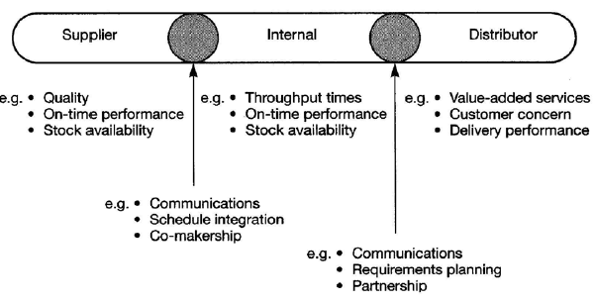
Benchmarking measures

Slide 102
Strategic Benchmarking
Where businesses need to improve overall performance by examining the long-term strategies and general approaches that have enabled high-performers to succeed
It involves considering high level aspects such as core competencies, developing new products and services and improving capabilities for dealing with changes in the external environment

Slide 103
Strategic benchmarking
Changes resulting from this type of benchmarking may be difficult to implement and take along time to materialise

Slide 104
Competitive Benchmarking
Business consider their position in relation to performance characteristics of key products and services
Benchmarking partners are drawn from the same sector
Assessing relative level of performance in key areas of activities in comparison with others in the same sector and finding ways of closing gaps in performance

Slide 105
Process Benchmarking
Focuses on improving specific critical processes and operations
Benchmarking partners are sought from best practice organisations that perform similar work or deliver similar services
Process benchmarking invariably involves producing process maps to facilitate comparison and analysis

Slide 106
Functional benchmarking
Businesses look to benchmark with partners drawn from different business sectors or areas of activity to find ways of improving similar functions or work processes
This sort of benchmarking can lead to innovation and dramatic improvements

Slide 107
Internal Benchmarking
Involves benchmarking businesses or operations from within the same organisation
The main advantages of internal benchmarking are that access to sensitive data and information is easier
Standardised data is often readily available; and usually less time and resources are needed

Slide 108
Internal Benchmarking
There may be fewer barriers to implementation as practices may be relatively easy to transfer across the same organisation
However, real innovation may be lacking and best in class performance is more likely to be found through external benchmarking

Slide 109
External Benchmarking
Involves analysing outside organisations that are known to best in class
External benchmarking provides opportunities of learning from those who are at the “leading edge”

Slide 110
External Benchmarking
This type of benchmarking can take up significant time and resource to ensure the comparability of data and information, the credibility of the findings and the development of sound recommendations

Slide 111
International Benchmarking
Best practitioners are identified and analysed elsewhere in the world, perhaps because there are too few benchmarking partners within the same country to produce valid results
Globalisation and advances in information technology are increasing opportunities for international projects

Slide 112
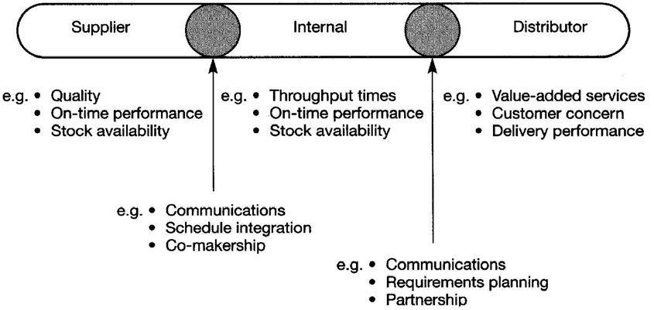
Benchmarking Measures

Slide 113
Benchmarking Priorities
Walleck (1991) suggests that benchmarking should focus on:
Processes, which are strategically important
Processes which have a direct impact on the business
Situations where there is an eagerness to change
Situations where a make or buy choice can be made

Slide 114
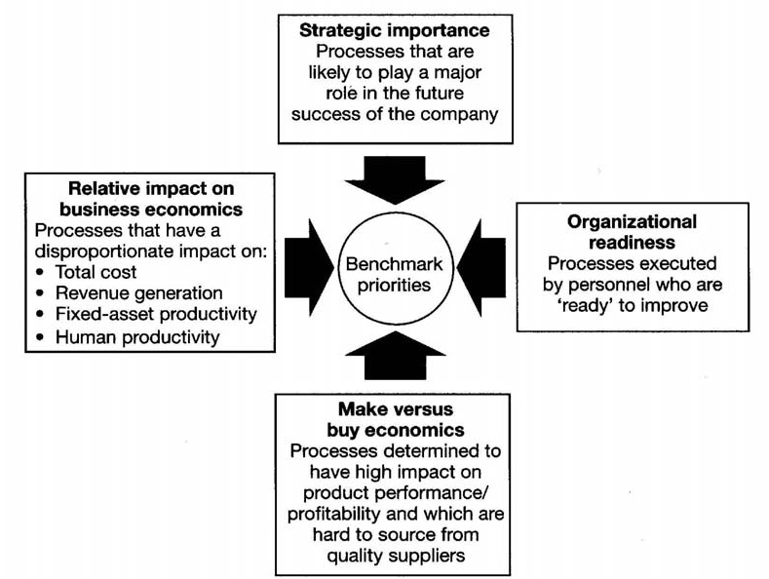

Slide 115
Benchmarking Process
Identify what is the subject to be benchmarked, select a team, roles and responsibilities, benchmark measures to be used
The process chosen for benchmarking should have a significant impact on customer satisfaction and/or internal efficiency and management must be committed to improving the process

Slide 116
Benchmarking Process
2. Identify which companies will be benchmarked from a set of selection criteria defined from the critical success factors of the project
Research potential partners

Slide 117
Benchmarking Process
Develop a data-collection plan
Agree the most appropriate means of collecting the data, the type of data to be collected, who will be involved and plan of action to obtain the data
Tabulate and analyse the data
Determine the reasons for the current gap in performance between the company and best amongst the companies involved

Slide 118
Benchmarking Process
5. Define and establish the goals to close or increase the gap in performance
This step requires effective communication of the benchmarking

Slide 119
Benchmarking Process
Develop action plans to achieve the goals
This step involves gaining acceptance of the plans by all employees likely by the changes
7. Implement the actions, plans and strategies. This involves project planning and management

Slide 120
Benchmarking Process
8. Assess and report the results of the action plans
Monitor the benchmark to see if the improvement is sustained

