Slide 1



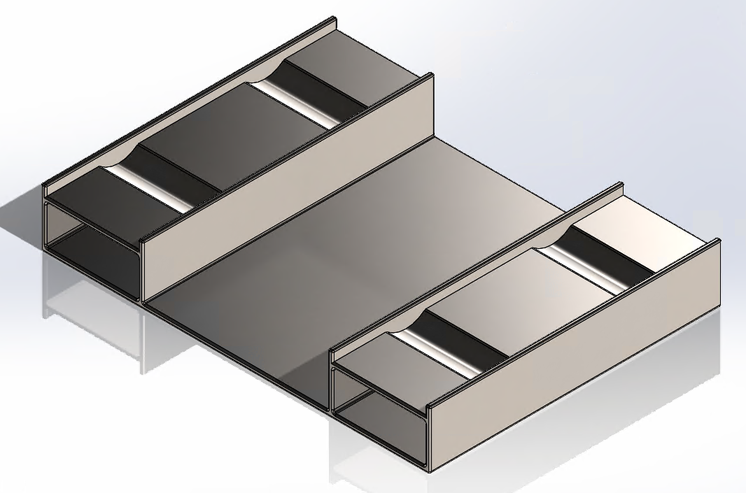
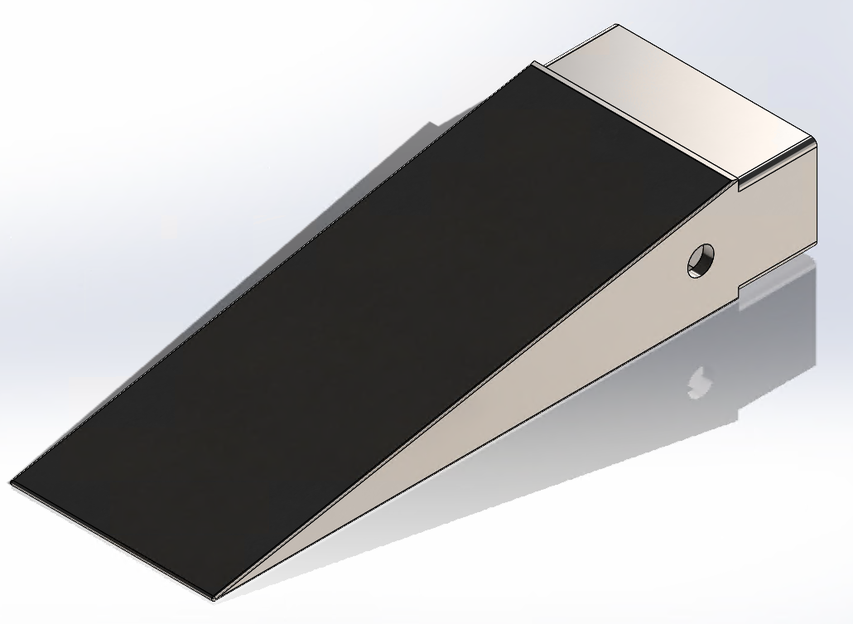
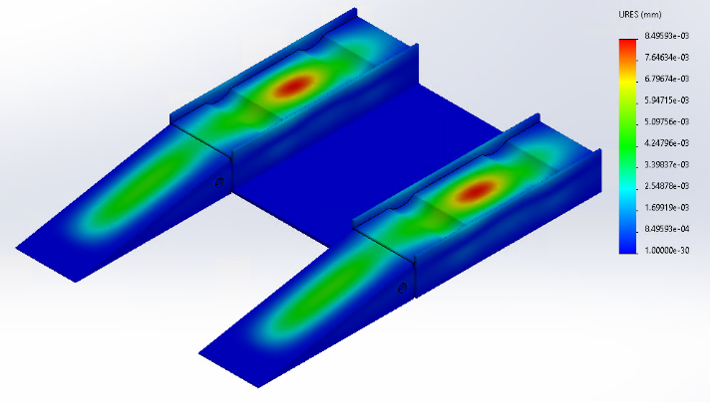
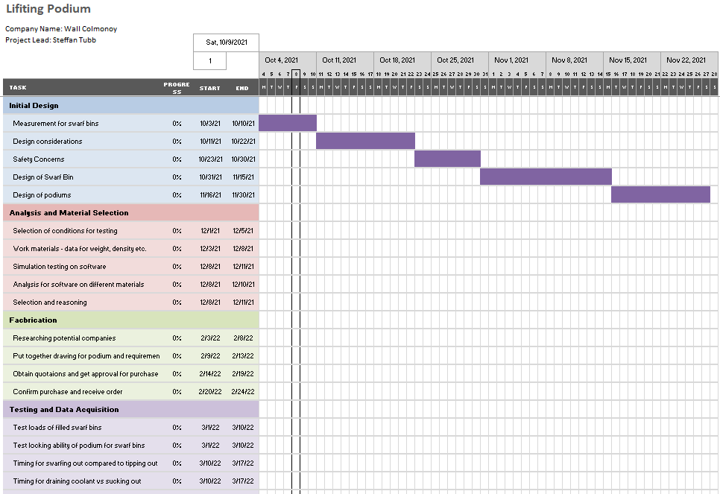


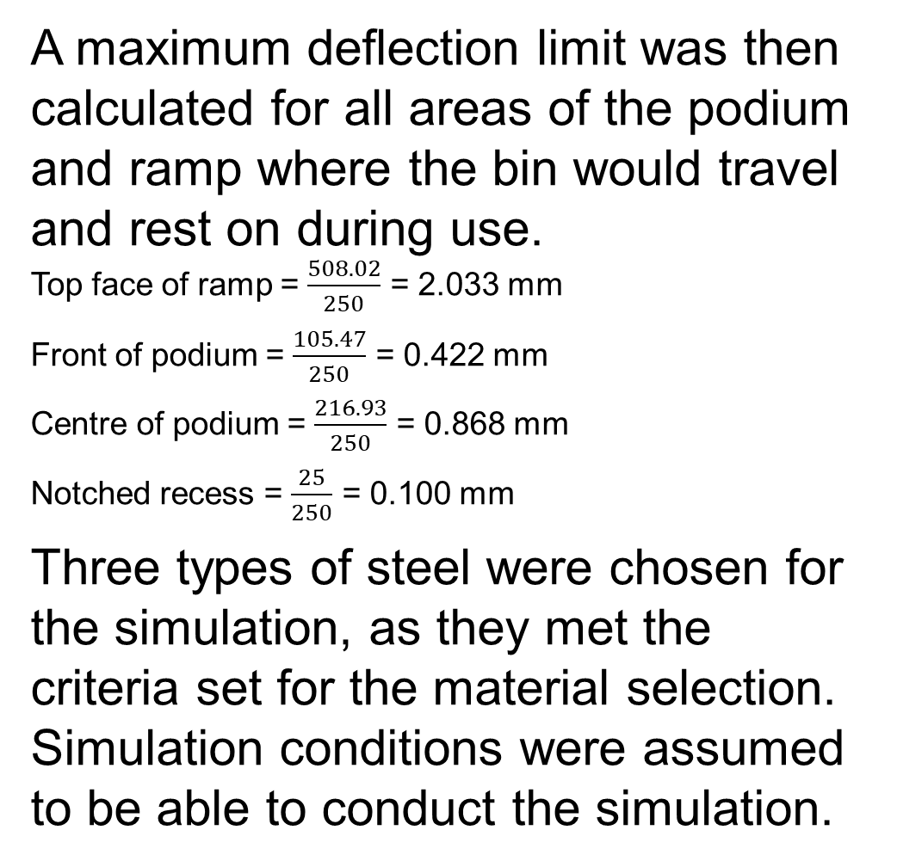
Design and Simulation Testing of a Lifting Podium and Ramp
Steffan Tubb
Kelvin Lake
School of Engineering
BEng (Hons) Mechanical & Manufacturing Engineering
Introduction
In the Wall Colmonoy machine shop, swarf is currently shovelled into ton sandbags for it to be weighed and drained of excess coolant. The sandbags are propped up on a podium to allow the coolant to drain out of them and into a tray.
The current method uses a lot of man hours and energy, with operators shovelling by hand and a wet vacuum used to suck the excess coolant out of bins and trays.
The process could be improved if the bins could be lifted. The contents of the bins could then be tipped into the bags. This would save the operators swarfing out by hand and the coolant could be drained out while the bins were suspended in the air.
Research study
A research study was conducted to ensure the project was viable and to ensure all health and safety protocol would be met. The study covered key areas such as Technical, operational, economic and health and safety factors.
The technical study compared different modelling software and which would be the best choice for the project, with Solidworks chosen.
To cover the health and safety aspect of the project, LOLER and PUWER regulations were studied from the government website [2] to ensure compliance was met throughout.
Finally, to get a baseline performance for the current method operators were asked to swarf out full bins to get an average time taken to complete. The results of the task showed that the times for the current method could be easily improved.
A maximum deflection limit was then calculated for all areas of the podium and ramp where the bin would travel and rest on during use.
Top face of ramp = $\frac{508.02}{250}$ = 2.033 mm
Front of podium = $\frac{105.47}{250}$ = 0.422 mm
Centre of podium = $\frac{216.93}{250}$ = 0.868 mm
Notched recess = $\frac{25}{250}$ = 0.100 mm
Three types of steel were chosen for the simulation, as they met the criteria set for the material selection. Simulation conditions were assumed to be able to conduct the simulation.
Project Aims
The main aim of the project was to come up with a cost effective solution that improved the current process.
Another important aim for the project was to ensure all health and safety requirements would be met.
With saved time and energy, manpower and financial savings could be diverted back to areas deemed fit by the business.
 | Operator 1 | Operator 2 | Operator 3 | Operator 4 | Operator 5
Time 1 (Mins) | 8.42 | 9.12 | 7.4 | 8.26 | 9.38
Time 2 (Mins) | 8.28 | 8.56 | 7.51 | 8.11 | 9.13
Time 3 (Mins) | 8.33 | 8.59 | 7.38 | 8.47 | 9.08
Total (Mins) | 25.03 | 26.27 | 22.29 | 24.84 | 27.59
Average (Mins) | 8.3433333 | 8.7566667 | 7.43 | 8.28 | 9.196666667
Average of group (Mins) | 8.4013333
Conclusions/Further work
All three simulation were comfortably within the deflection limits calculated.
Carbon steel was the material selected for fabrication as it was the cheapest of the three and this was key to getting the project approved.
The project was halted due to projects being stopped due to company budgetary constraints.
Further work for the project include optimizing the design further and looking at different materials within an appropriate budget.
With future fabrication of the podium and ramp complete, real-life testing could then be completed to prove an increase in efficiency and time and cost saving calculated.
Work Undertaken
Out of all the ideas considered a lifting podium and ramp was selected as the choice for the project. It had to be designed from scratch as the pallet stacker on the shop floor didn’t fit the lifting slots on the swarf bins.
The pallet stacker would lift the podium up once the bin had been pushed onto it using the ramp.
The swarf bins were accurately drawn up so that they could be used to ensure the dimensions of the podium were correct.
Design and safety considerations were set to ensure that the designs met the aims of the project.
Timing plan
A Gantt chart was produced to ensure that project tasks stayed on track and to give a visual aid for the progress of the project [1] . The project was divided into four separate phases, each with their own tasks to complete before moving on to the next phase. The initial plan can be seen below.
References
[1] Maylor, H., 2001. Beyond the Gantt chart:. European Management Journal, 19(1), pp.92-100.
[2] Hse.gov.uk. 2022. Lifting equipment at work. [online] Available at: <https://www.hse.gov.uk/pubns/indg290.pdf>
School of Engineering

