Slide 1

Conference Presentation-The deepening mental health crisis in the hospitality industry
Module: Contemporary Themes in the Hotel and Hospitality Sector
Module code: BMIH6001
Lecturer: Dr Ernest Balutie Wavei
Author: Marinela Covasneanu
Student number: 1920078

Slide 2




INTRODUCTION
Epicenter of deepening mental health crisis
Threat to organisational sustainability, service quality and workforce stability
High emotional labour demand
Chronic understaffing
Ground for burnout, anxiety and psychological strain
Emerging from not only a human concern to a strategic imperative for organisations
Mental health directly influences productivity, turnover intentions, service performance, and the overall guest experience

Slide 3
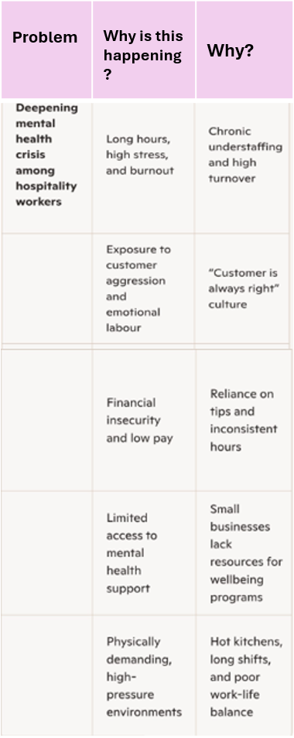
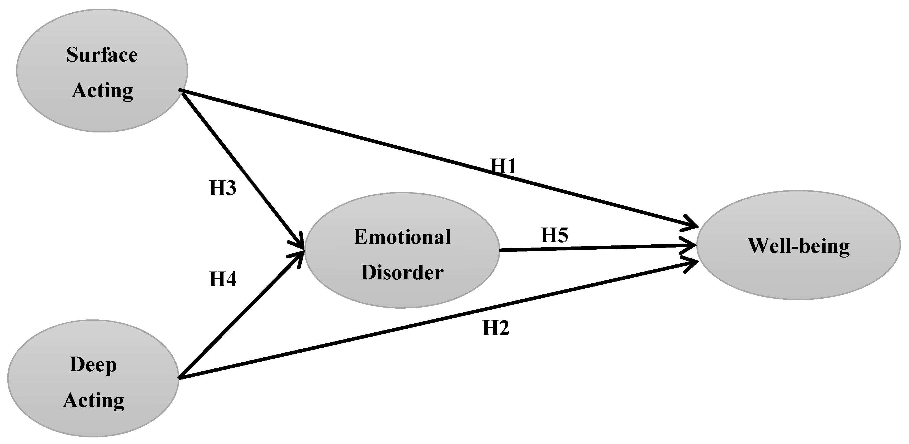
LITERATURE REWIEW
5 Why’s theory (Laasch, 2024)
Emotional labour theory and psychological strain (Hochschild,1993)
-Surface acting vs deep acting (Tang & Gu, 2024)
-Display rules and authenticity conflict
-Customer incivility and abuse (Shin et al, 2021)

Slide 4
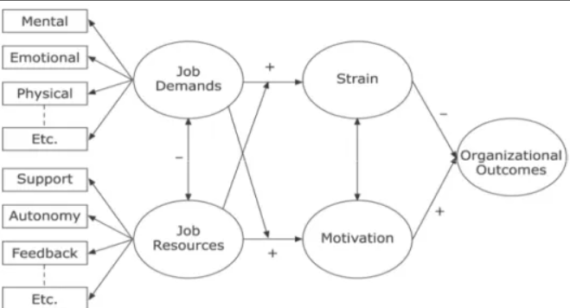

LITERATURE REVIEW
Conservation of Resources Theory (Abdou et al, 2025)
Resource loss and chronic job demands. (Bakker et al, 2023)
burnout. (Cheng et al, 2023)
Limited resource gain opportunities.
Organizational implications. (Rees & French, 2023)

Slide 5

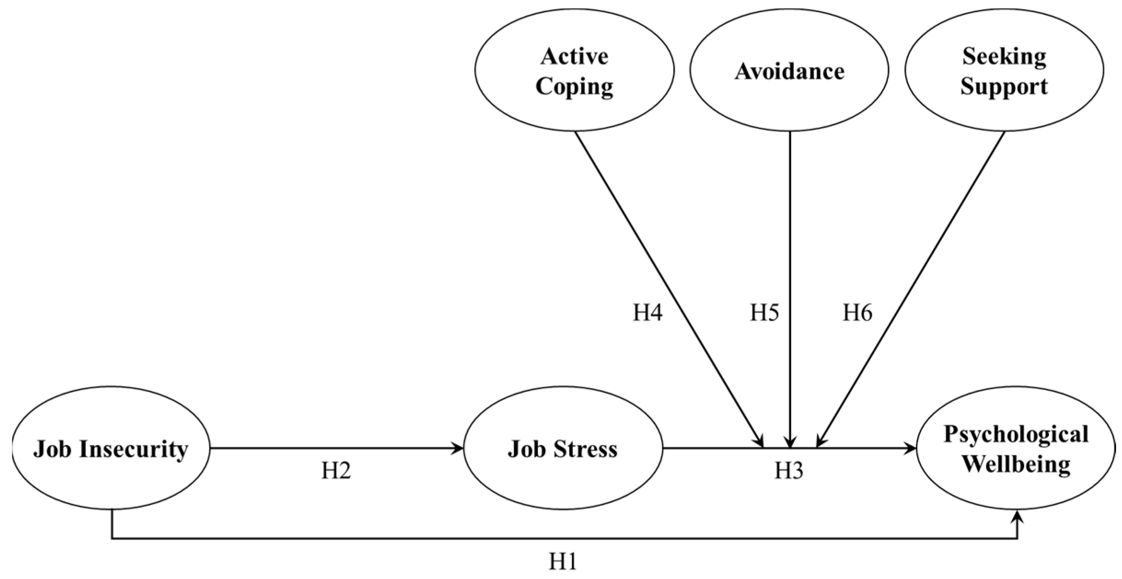
LITERATURE REVIEW
Hospitality Stress Matrix (Dong, 2023)
Organisational and structural (Choirisa, 2025)
Operational stressors (Xie et al, 2023)
Interpersonal stressors (Marília Durão et al, 2024)
Personal characteristics and surrounding conditions (Chou, 2014)
(Yoo, 2023)

Slide 6
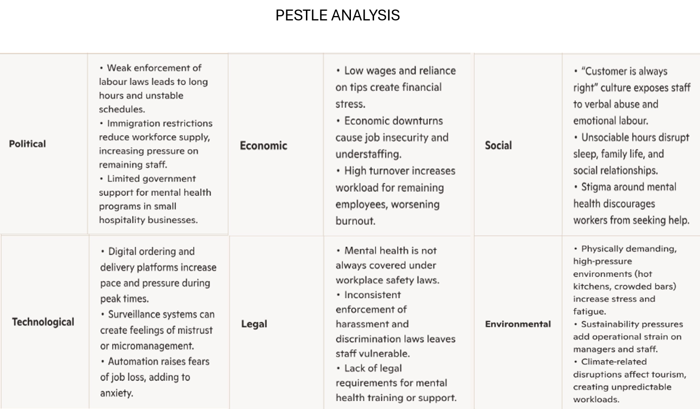
METHOD

Slide 7
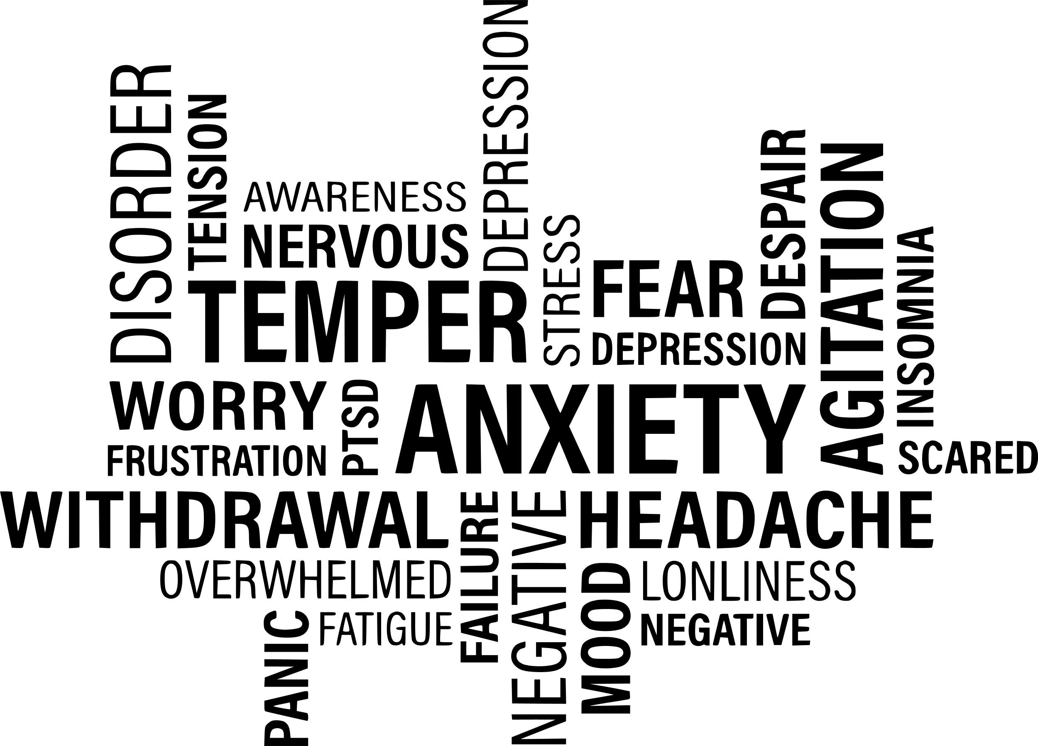

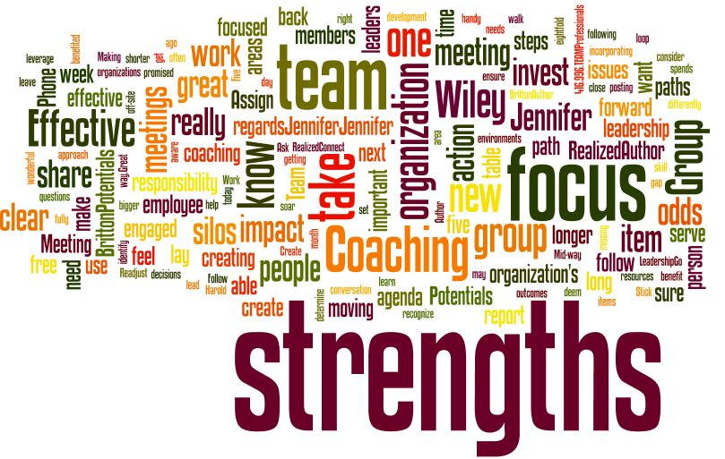
Strengths:
• Growing recognition of mental health as a strategic priority.
• Increased training, policy development, and wellbeing initiatives.
• Technological tools offering new ways to monitor and support staff.
• Sustainability initiatives can improve organisational culture and employee pride.
Limitations:
• Cost‑cutting often targets labour, worsening stress and emotional exhaustion.
• Most responses remain reactive, not preventative.
• Structural drivers—understaffing, emotional labour, workload intensity—remain largely unchanged.
• Economic pressures and labour shortages limit the feasibility of deep organisational reform.
• Many interventions focus on individual resilience rather than systemic redesign.

Slide 8

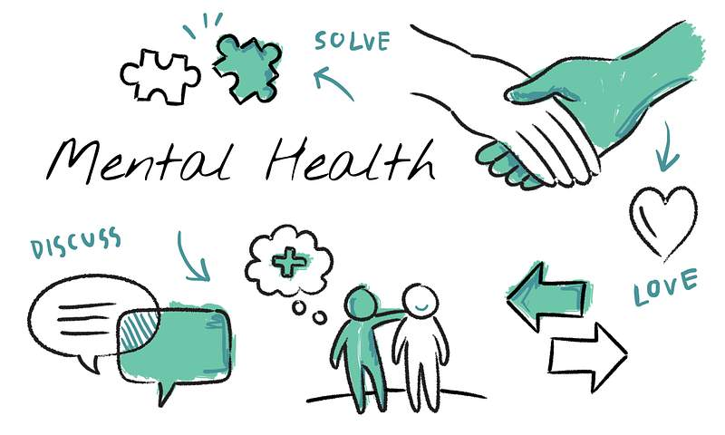

CONCLUSION
By looking at the mental‑health crisis in hotels through these three ideas—how people lose and gain personal resources (COR theory), how staff must manage their emotions at work (emotional labour theory), and the specific pressures of hospitality jobs (the hospitality stress matrix)—you can show that poor mental health is not just the employee’s mental health fault. It is also a natural result of how the industry is organised and run. This approach also helps you explain why real change needs to happen at an organisational level, not just an individual one.
To deal with this crisis properly, we need to understand the unique pressures hospitality workers face and design solutions that genuinely support their wellbeing while also helping hotels operate more effectively.

Slide 9

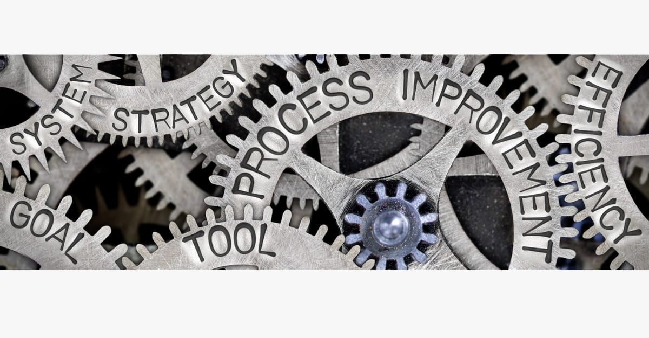
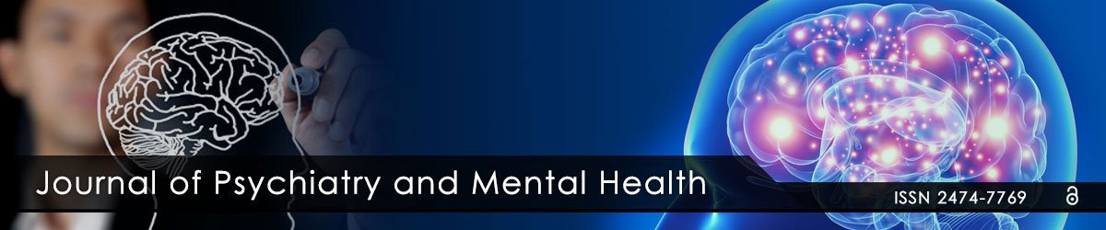
RECOMMENDATIONS
1.Redesign Workloads and Staffing Models to Reduce Chronic Resource Depletion
2. Embed Emotional Labour Support into Training, Leadership, and Service Standards
3. Strengthen Organisational Culture Through Supportive Leadership and Psychological Safety
4. Implement Evidence Based Wellbeing Strategies That Address Both Prevention and Recovery

Slide 10
REFERENCES
ABDOU, A.H. et al. (2025) “THE SYNERGY OF PSYCHOLOGICAL CAPITAL AND JOB EMBEDDEDNESS: EXTENDING THE CONSERVATION OF RESOURCES THEORY IN HOSPITALITY EMPLOYEE RETENTION,” Geo Journal of tourism and geo sites, 58(2), pp. 344–353. Available at: https://doi.org/10.30892/gtg.58131-1416. [Accessed 04 February 2026].
Bakker, A.B., Xanthopoulou, D. and Demerouti, E. (2023) “How does chronic burnout affect dealing with weekly job demands? A test of central propositions in JD‐R and COR‐theories,” Applied psychology, 72(1), pp. 389–410. Available at: https://doi.org/10.1111/apps.12382. [Accessed 04 February 2026].
Cheng, X.-M., Lyu, Y. and Ye, Y. (2023) “Linking organizational exploitation to extra-role behaviours: a conservation of resources perspective,” International journal of contemporary hospitality management, 35(3), pp. 1109–1124. Available at: https://doi.org/10.1108/IJCHM-11-2021-1373. [Accessed 04 February 2026].
Choirisa, S.F. (2025) “Examining Organizational Commitment Between Multidimensional Work Stressors and Employees Behaviour in Indonesia Through the Conservation of Resources Theory,” Journal of quality assurance in hospitality & tourism, 26(6), pp. 1319–1345. Available at: https://doi.org/10.1080/1528008X.2023.2293140. [Accessed 05 February 2026]
Chou, C.-J. (2014) “Hotels’ environmental policies and employee personal environmental beliefs: Interactions and outcomes,” Tourism management (1982), 40, pp. 436–446. Available at: https://doi.org/10.1016/j.tourman.2013.08.001. [Accessed 05 February 2026].
DONG, Y.Y., 2023. The Hospitality Stress Matrix: Exploring Job Stressors and Their Effects on Psychological Well-Being. Sustainability, 15(17), pp. 13116. ProQuest. Available at: https://www.proquest.com/docview/2862719691?accountid=130472&parentSessionId, [Accessed 05 February 2026].
Hochschild, A.R. (1993) The managed heart: The commercialization of human feeling
Laasch, O. (2024) Principles of business & management : practicing ethics, responsibility, sustainability. 3rd edition. London, England: SAGE
Marília Durão et al. (2024) “Perceptions of Quality of Work Life in Hospitality Jobs: The Role of Interpersonal and Supportive Relations at Work,” Journal of Tourism, Sustainability and Well-being, 12(2), pp. 146–166. Available at: https://doi.org/10.34623/pt6j-td67. [Accessed 05 February 2026].

Slide 11
Pillai, S.G. et al. (2021) “COVID-19 and hospitality 5.0: Redefining hospitality operations,” International journal of hospitality management, 94. Available at: https://doi.org/10.1016/j.ijhm.2021.102869. [Accessed 04 February 2026].
Rees, G. and French, R. (eds.) (2023) Strategic people management and development: theory and practice. Sixth edition. London: Kogan Page.
Shin, Y., Hur, W.-M. and Kang, S. (2021) “Mistreatment from Multiple Sources: Interaction Effects of Abusive Supervision, Coworker Incivility, and Customer Incivility on Work Outcomes,” International journal of environmental research and public health, 18(10), p. 5377. Available at: https://doi.org/10.3390/ijerph18105377. [Accessed 04 February 2026].
Tang, X. and Gu, Y. (2024) “Influence of Leaders’ Emotional Labor and Its Perceived Appropriateness on Employees’ Emotional Labor,” Behavioural sciences, 14(5), p. 413. Available at: https://doi.org/10.3390/bs14050413. [Accessed 04 February 2026].
Xie, C. et al. (2023) “The effect of hotel employee resilience during COVID-19: The moderation role of perceived risk and challenge stressors,” Tourism management perspectives, 46. Available at: https://doi.org/10.1016/j.tmp.2023.101087. [Accessed 05 February 2026].
Yoo, D. Y. (2023). The Hospitality Stress Matrix: Exploring Job Stressors and Their Effects on Psychological Well-Being. Sustainability, 15(17), 13116. Available at: https://doi.org/10.3390/su151713116, [Accessed 05 February 2026].

Slide 12



