Slide 1
LCBB6003
Leadership and management, theory and practice
WEEK 6
Session 1:
Management Theories

Slide 2
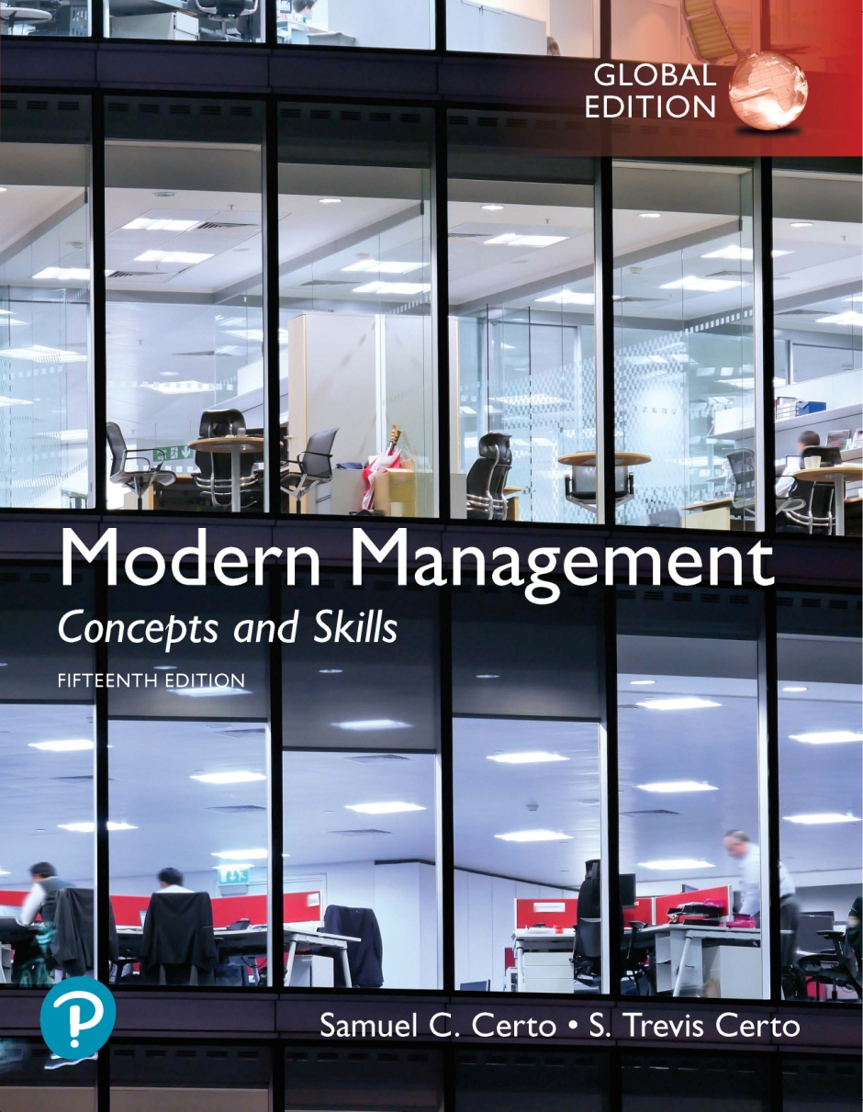
Management Theories

Slide 3
Learning Objectives (1 of 2)
An understanding of the 14 principles of management
An understanding of the behavioral approach to management
An understanding of the Hawthorne studies
An understanding of the human relations movement
An understanding of the contingency approach

Slide 4
Henry Fayol (1 of 9)
Henry Fayol, a French mining engineer and management theorist, proposed 14 principles of management in his book "General and Industrial Management" published in 1916. These principles serve as a framework for managing organizations effectively.
Principles of management are universal. Here are Fayol's 14 principles of management:

Slide 5
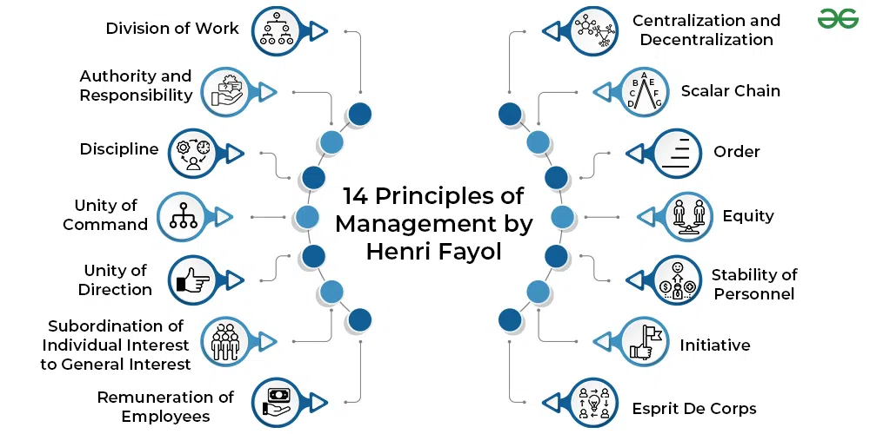
14 Principles of Management (2 of 9)

Slide 6
14 Principles of Management (3 of 9)
Division of work: Specialization and division of labour increase efficiency by allowing individuals to focus on specific tasks, leading to expertise and productivity gains.
Authority and responsibility: Managers must have the authority to give orders, and with that authority comes the responsibility for ensuring that tasks are carried out effectively.

Slide 7
14 Principles of Management (4 of 9)
Discipline: Employees must obey and respect the rules and agreements established by the organization. Discipline ensures consistency and order within the organization.
Unity of command: Each employee should receive orders from only one superior to avoid confusion and conflicting instructions, thus maintaining clarity and direction in the chain of command.

Slide 8
14 Principles of Management (5 of 9)
Unity of direction: All activities within the organization should be directed towards a common goal or purpose to ensure alignment and coherence in the pursuit of organizational objectives.
Subordination of individual interests to the general interest: The interests of the organization as a whole take precedence over the interests of any individual or group within the organization.

Slide 9
14 Principles of Management (6 of 9)
Remuneration: Employees should be fairly compensated for their work, considering factors such as effort, skill, responsibility, and market conditions, to motivate and retain talent.
Centralization: The degree to which decision-making authority is concentrated at the top of the organization affects efficiency and control. Fayol suggested finding the right balance between centralization and decentralization based on the organization's needs.

Slide 10
14 Principles of Management (7 of 9)
Scalar chain: The hierarchical structure of authority within the organization should be clearly defined, with a formal chain of command from the highest to the lowest levels of the organization.
Order: Organizational resources and activities should be arranged in the most efficient manner to promote productivity and minimize waste.

Slide 11
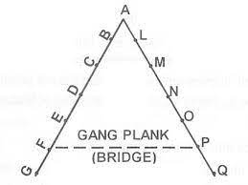
14 Principles of Management (8 of 9)
Equity: Fairness and justice in dealing with employees should be maintained to build trust, morale, and commitment within the organization.
Stability of tenure of personnel: Employee turnover disrupts productivity and morale. Therefore, efforts should be made to provide stability and continuity in employment whenever possible.

Slide 12
14 Principles of Management (9 of 9)
Initiative: Encouraging employees to take initiative and be creative fosters innovation and improves organizational performance.
Esprit de corps: Promoting a sense of unity, camaraderie, and teamwork among employees enhances morale, collaboration, and organizational cohesion.

Slide 13

The Behavioral Approach
The Behavioural Approach in management, also known as the Human Relations Approach, emerged in the mid-20th century as a reaction to the classical management theories that focused primarily on tasks, structures, and processes.
Emphasises managers can increase organizational production through understanding employees.
When managers understand employees and organizations adapt to those people, success follows.

Slide 14
The Hawthorne Studies (1 of 3)
The Hawthorne Studies refer to a series of experiments conducted at the Hawthorne Works, a Western Electric factory in Chicago, Illinois, between 1924 and 1932.
These studies were initiated to investigate the effects of various factors, such as lighting, working conditions, and employee incentives, on worker productivity and morale.
However, the studies ended up uncovering unexpected findings about the influence of social and psychological factors on productivity.

Slide 15
The Hawthorne Studies (2 of 3)
Results were surprising
  No matter what conditions employees were exposed to, their production increased
  The study emphasized the importance of employee involvement, communication, and interpersonal relationships in enhancing productivity and job satisfaction.

Slide 16
The Hawthorne Studies (3 of 3)
Research Conclusions—“The Hawthorne Effect”
  Employees enjoyed working in the test room
  Supervisory relationship in test room allowed employees to work freely, without fear
  Employees realized they were taking part in an important and interesting study
  Employees seemed to become friendly as a group
  Human Factors Within An Organization Can Significantly Influence Production

Slide 17
The Human Relations Movement
The Human Relations Movement emerged as a response to the mechanistic and rigid approaches of classical management theories, particularly during the early 20th century.
It gained prominence in the 1930s and 1940s, building upon the findings of the Hawthorne Studies and other research in psychology and sociology.

Slide 18
The Human Relations Movement
The movement emphasised the importance of understanding and addressing the social and psychological needs of employees within organisations, viewing them as complex individuals rather than mere production units.
  Focus on Human Needs and Motivation
  Importance of Informal Groups and Relationships
  Leadership and Management Style
  Employee Participation and Involvement
  Communication and Feedback
  Organizational Culture and Climate
  Job Design and Enrichment

Slide 19

The Human Relations Movement
People-oriented approach to management
Ultimate objective is to enhance organizational success by encouraging appropriate relationships among people
Managers need to understand the human component in organizations and how to appropriately channel it to enhance organizational success

Slide 20

The Contingency Approach
What managers do is contingent upon a given set of situational circumstances
Although there is no one best way to solve a management problem in all organisations, there probably is one best way to solve any given management problem in any one organization

Slide 21
The Contingency Approach
The Contingency Approach to management is based on the idea that there is no one-size-fits-all solution to management problems.
It states that the most effective management style, organizational structure, and decision-making processes depend on the specific circumstances or contingencies faced by an organization.
The Contingency Approach suggests that managers should adapt their strategies and practices to fit the unique needs and challenges of their situation.

Slide 22
Activity
Understanding Management in Turbulent Environments:
In groups of 4-5, briefly introduce the concept of management in turbulent environments.
Explain what constitutes a turbulent environment (e.g., economic downturns, technological disruptions, political instability), and how should managers adapt.
Provide examples from real life organisations or from your own experience.

