Slide 1
Chapter 10
Marketing Decisions

Slide 2
Overview
The marketing function and accounting
Cost behaviour: fixed and variable costs
Cost-volume-profit analysis
Alternative approaches to pricing
Segmental and customer profitability analysis

Slide 3
Competition & marketing strategy
Competitive forces & industry profitability
  Customers
  Suppliers
  Competitors
  New entrants
  Substitutes
    Porter’s ‘Five Forces’ model
Three generic competitive strategies
  Low-cost producer
  Higher cost producer that can differentiate its products/ services
  Focus on a niche market
    Porter

Slide 4
The Marketing function
Marketing is the business activity that aims to understand customer needs and satisfy those needs more effectively than competitors
Price is based on the ‘factors which drive up the utility of an offer’
  Doyle
Product sales mix
Market segments
Pricing strategies
  Skimming or penetration
Product drivers: performance, features, reliability, operating costs, serviceability
Service drivers: credit availability, ordering, delivery, after-sales service
Personnel drivers: professionalism & courtesy
Image drivers: customer confidence in company or brand
Each of these value drivers have cost drivers
  Doyle

Slide 5
Marketing & accounting
Marketing strategy for a business will encompass decisions about
  product/service mix,
  customer mix,
  market segmentation,
  value and cost drivers,
  pricing, and
  distribution channel
What is the volume of product/services we need to sell to maintain profitability?
What alternative approaches to pricing can we adopt?
What is our customer, product/service and distribution channel profitability in each of our market segments?

Slide 6
Cost behaviour
Fixed costs
Variable costs
Semi-fixed costs
Semi-variable costs
Marginal costs
Average costs

Slide 7
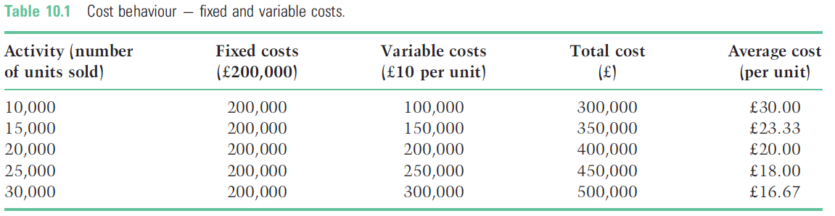
Cost behaviour

Slide 8
Cost-volume-profit (CVP) analysis
The relationship between changes in the number of units sold, selling prices and fixed and variable costs
  Relevant range
  Sensitivity analysis

Slide 9
Profit formulae
Net profit = revenue – (fixed costs + variable costs)
Net profit = (units sold x selling price) – [fixed costs + (units sold x unit variable cost)]
  In mathematical terms:
  N = Pu – (F + Bu)

Slide 10
Breakeven
The point at which total costs equal total revenue – there is neither a profit or loss
  Breakeven sales (in units) =
  Fixed costs
  Unit contribution
Unit contribution = selling price per unit – variable cost per unit
  Breakeven sales (in £s)
  Fixed costs
  Unit contribution as a % of sales

Slide 11
CVP analysis
Fixed costs £200,000
Variable costs £10 per unit
Selling price £25
20,000 units
N = Pu – (F + Bu)
N = (£25 x 20,000) – [200,000 + (£10 x 20,000)]
N = 500,000 – 400,000
N = £100,000

Slide 12
Breakeven
Breakeven (in units):
Fixed costs
Selling price p.u. – variable costs p.u.
200,000
20 – 10
= 20,000 units
Breakeven (in £sales):
Fixed costs
Unit contribution as % of sales
200,000
0.5*
= £400,000
Or 20,000 units @ £20
*Unit contribution is 20 – 10 = 10
As a % of sales 10/20 = 50% or 0.5

Slide 13
Target profit (variation on breakeven)
Units to sell:
Fixed costs + Profit
Selling price p.u. – variable costs p.u.
200,000 + 150,000
20 – 10
= 35,000 units
Sales value:
Fixed costs + Profit
Unit contribution as % of sales
200,000 + 150,000
0.5*
= £700,000
Or 35,000 units @ £20
*Unit contribution is 20 – 10 = 10
As a % of sales 10/20 = 50% or 0.5

Slide 14
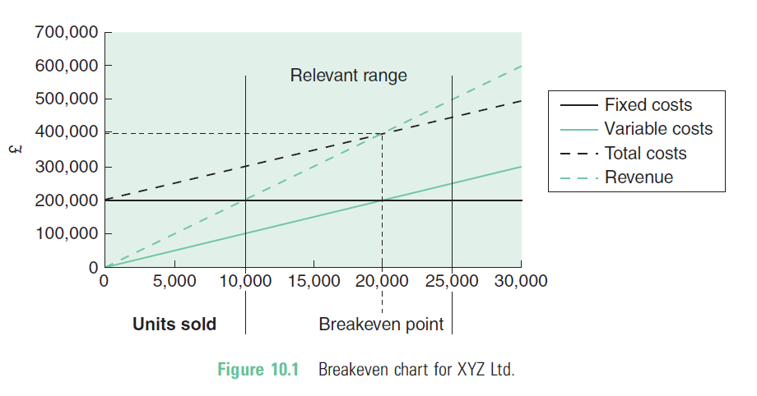
Breakeven chart

Slide 15
Margin of safety
A measure of the difference between the anticipated and breakeven levels of activity
  Margin of safety (%)
  = Expected sales – Breakeven sales x 100
        Expected sales

Slide 16
Margin of safety illustration
  Expected sales – Breakeven sales x 100
        Expected sales
Breakeven sales 20,000 units
Anticipated sales 25,000 units
Margin of safety = 25,000 – 20,000 x 100
20,000
= 20%

Slide 17
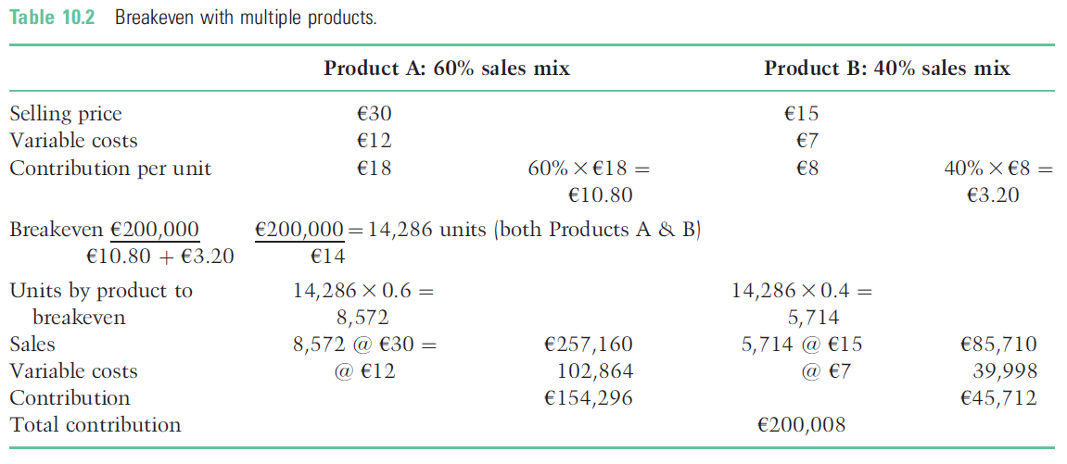
Breakeven with multiple products Fixed costs €200,000

Slide 18
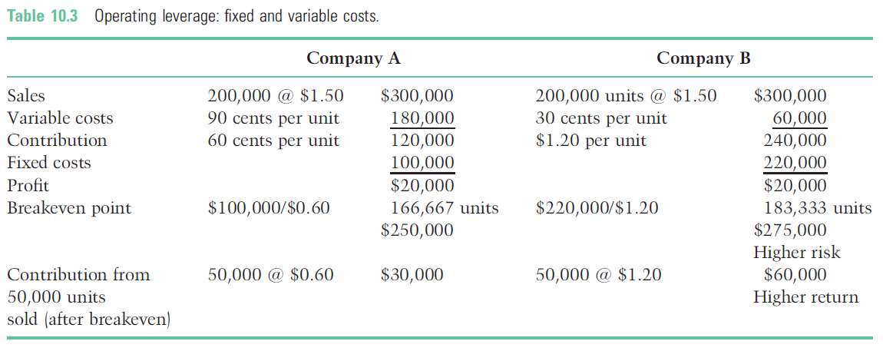
Operating leverage
Two company’s sell the same product at same price with same profits.
Only the mix of variable and fixed costs is different

Slide 19
Limitations of CVP Analysis
Volume is the only factor that causes prices and variable costs to alter
Single product/service or a product/service mix that remains constant
Costs can be accurately divided into fixed and variable elements
Fixed costs do not change
Total costs and revenues are linear
Applies only to the relevant range
Applies only to the short term, and cannot reliably be used in the longer term

Slide 20
Alternative approaches to pricing
Cost-plus pricing
Target rate of return pricing
Optimum selling price
Special pricing decisions
Transfer pricing.

Slide 21
Cost plus pricing
Full cost + mark-up on cost = Selling price
  £20 + (25% of £20) = £25
  Margin of 20% (£5/£25)

Slide 22
Target rate of return pricing
Investment €1 million
Desired profit 12%
  €120,000/20,000 units = €6 profit per unit
  Cost €20 + Profit €6 = Price €26

Slide 23
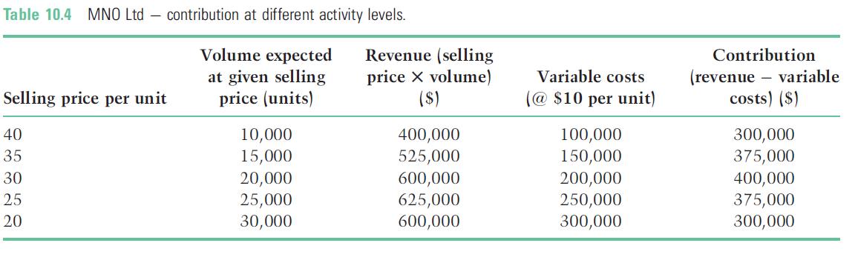
Optimum selling price
Maximise profits where contribution to fixed costs and profits is highest

Slide 24
Special pricing decisions
One-off pricing (tactical decisions)
  Maximise profit by recovering the variable costs and some of the fixed costs
    Fixed costs do not change, irrespective of volume
  Effect on competition, future selling price, and use of capacity

Slide 25
Special pricing decisions
£’000
Revenue
17,000 @ £30 510
Variable costs
17,000 @ £10 170
Contribution 340
Fixed costs 200
Net profit 140
Accepting an order of 3,000 units @ £12 will increase profits by
3,000 x (12 – 10) = £6,000
Short-term v. long-term

Slide 26
Segmental profitability & contribution
Pricing in different market segments
  A minimum short term price taking into account only marginal, i.e. usually variable costs;
  A minimum long term price that covers the full product/service cost;
  A target long term price that takes into account the return on investment necessary to increase shareholder value

Slide 27
Separating fixed costs
Fixed costs may be either:
  Unavoidable and allocated to market segments or business units
    Typically head office (corporate) costs
  Avoidable and will no longer be incurred where a market segment or business unit closes
    Specific to each business segment

Slide 28
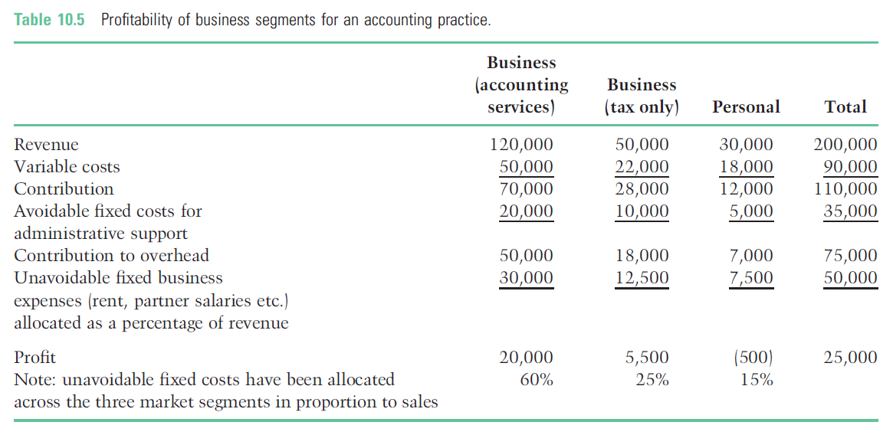
Segmental profitability

Slide 29
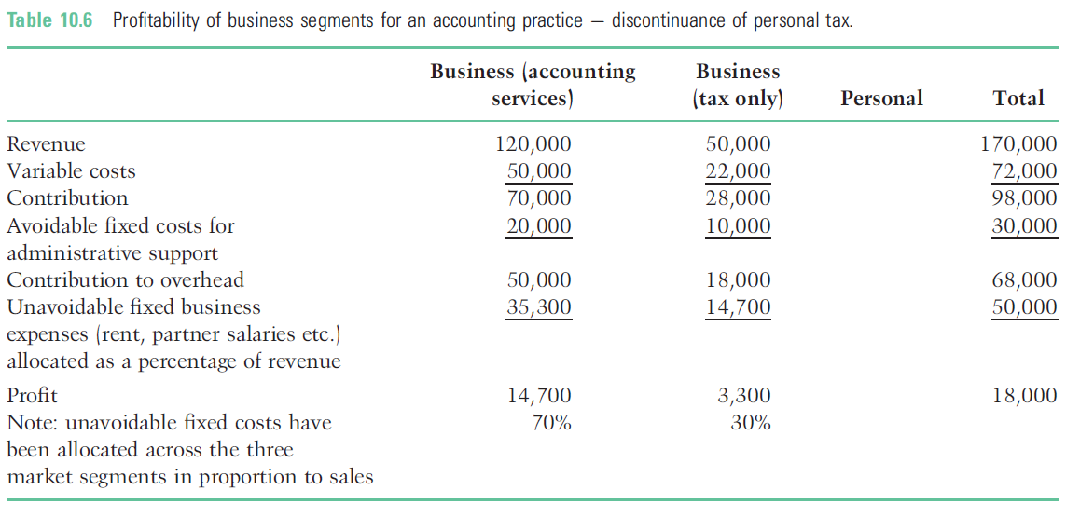
Segmental profitability

Slide 30
Customer profitability analysis
Understanding which customers are profitable and which are not
Reducing the costs of servicing unprofitable customers;
Increasing prices to unprofitable customers to cover those costs;
No longer doing business with unprofitable customers.

Slide 31
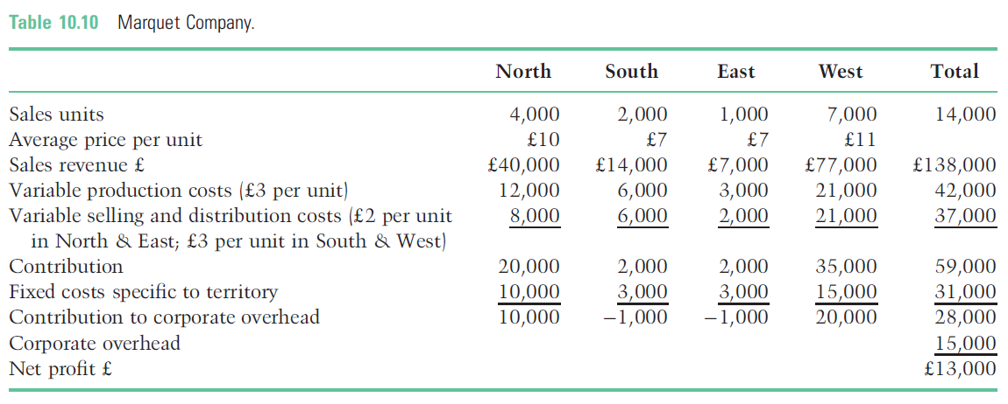
Customer profitability analysis - Illustration

Slide 32
Key points
Using accounting to help make marketing decisions
  Cost behaviour and CVP analysis
    Contribution, breakeven & margin of safety calculations, operating leverage
  Alternative approaches to pricing
    Cost-plus, target rate of return, optimum selling price, special pricing decisions
  Segmental and customer profitability
    Costs may be fixed but are they avoidable or unavoidable costs?

