Slide 1
SJEQ7003
Power and Social (Re)production of Inequality
Anna Murphy 1303267 7th April 2018

Slide 2
Question Title
Critically reflect in depth upon what constitutes power and control in society; focus on one area of power and control and refer to legislation, policy and theory in your answer.

Slide 3
Disability
‘The disabled and the mentally ill are two of the most powerless groups in society’ (Best, 2005).
Estimated 11.6 Million Disabled People in the UK. (Dept. for Works and Pensions, 2012).

Slide 4
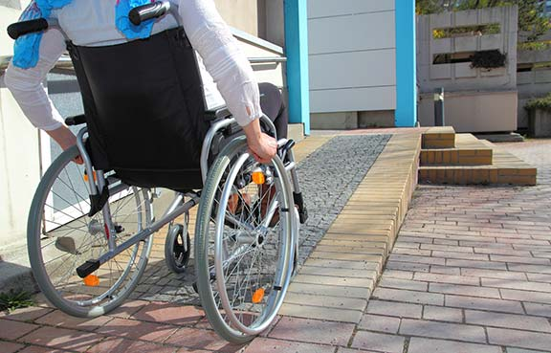

Exclusion
Lack of physical access
Difficulty in communicating or interacting
Go Access, 2014
Shutterstock, 2018

Slide 5

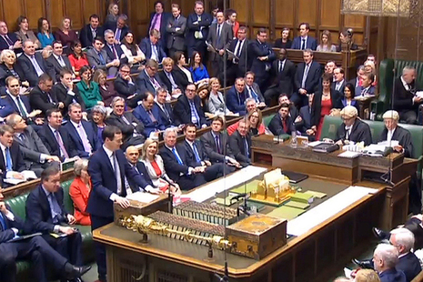
Power and Control in Society
Teacher has power over children
Government has power to make laws
Expert Beacon, 2017
Gov.uk, 2016

Slide 6
Social Control
Informal – Familiar setting such as family, school, community group
Medical – Medical profession use their power to make sense of anyone who does not conform to society
Legal – Government create laws, policies, standards of behaviour

Slide 7
Disability Laws in the UK
Special Educational Needs and Disability Act 2001:
Allows parents to choose school setting for their child.
Disability Discrimination Act 2005:
Illegal to discriminate against disabled persons.
Equalities Act 2010:
Legally protects from being discriminated against both in the workplace and in society.

Slide 8
Models of Disability
Medical Model of Disability
‘Health is defined as a ‘normal’ and stable state that underpins optimum role capacity, whereas illness is disruptive insofar as it makes a person unproductive and dependent’. (Parsons, 1950)
Social Model of Disability
Advocated removal of barriers
Promotes action research
Findings be used to enhance lives

Slide 9
Conclusion
UK Government recognises issues of discrimination and inequality
19% of disabled people experienced discrimination at work (Dept. for Works and Pensions, 2014)
Attitudes need to change to become more inclusive
Community needs to help remove barriers
End negative attitudes towards disabled

Slide 10
Reference List
Barnes, C & Mercer, G (2010) Exploring Disability. Polity Press.
Best, S (2005) Understanding Social Divisions. SAGE Publications Ltd: London
Department for Works and Pensions (2014) Disability Facts and Figures https://www.gov.uk/government/publications/disability-facts-and-figures/disability-facts-and-figures [Accessed: 26th March 2018].
Expert Beacon (2018) What to do when you or your child do not get along with the teacher https://expertbeacon.com/what-do-when-you-or-your-child-do-not-get-along-teacher/#.Wrq0HojwbIU [Accessed: 27th March 2018].
Go Access (2014) Questions and Answers to Consider When Choosing a Disabled Access Ramp http://www.goaccess.co.uk/questions-answers-consider-choosing-disabled-access-ramp/ [Accessed: 27th March 2018].
Shutterstock (2018) Rehab group sitting in a circle with one man excluded at group therapy session https://www.shutterstock.com/video/clip-5898194-stock-footage-rehab-group-sitting-in-a-circle-with-one-man-excluded-at-group-therapy-session.html [Accessed: 27th March 2018].
UK Government (2012) Disability Prevalence Estimates 2011/12 https://www.gov.uk/government/uploads/system/uploads/attachment_data/file/321594/disability-prevalence.pdf [Accessed: 27th March 2018].
UK Government (2015) Equality Act 2010: guidance. https://www.gov.uk/guidance/equality-act-2010-guidance [Accessed: 25th March 2018].
UK Government (2016) Budget 2016 https://www.gov.uk/government/topical-events/budget-2016 [Accessed: 26th March 2018].

