Slide 1
EFFECTIVE TEAM WORKING AND COMMUNICATION
Name: margarita chaparova
Student ID: 2123016
Module code: bmsw4002
Lecturer’s name: dr Obinna Nkwocha

Slide 2
Contents
Introduction………………………………………………………………………………3
Overview of organization………………………………………………………………...4
Benefits of effective communication on business………………………………………5
Use of theories related to models of communication……………………………………6
Potential barriers that can prevent effective communication between organization and external stakeholders…………………………………………………………………………….....7
Communication Channels………………………………………………………………...8-9
Conclusion…………………………………………………………………………….......10
References………………………………………………………………………...............11-12

Slide 3
Introduction
The aim of this presentation is to provide an understanding about the importance of good communication in an organization and the barriers that come in making communication effective. It will also provide an overview of channels of communication used in an organization and how they can be improved. The health foundation is a well known charity organization based at UK that is working towards better healthcare sector in the country. It is committed towards welfare of society by contributing for a sound healthcare system (The Health Foundation, 2022).

Slide 4
Overview of Organization
The health foundation is a well known charity organization founded in 1983 and is based at London, UK that is working towards better healthcare sector in the country. The organization aims for a healthy population which is supported by better quality healthcare system and having equal access to it. It conducts a lot of research in this field so that better healthcare can be achieved. It is committed towards welfare of society by contributing for a sound healthcare system (The Health Foundation, 2022).

Slide 5
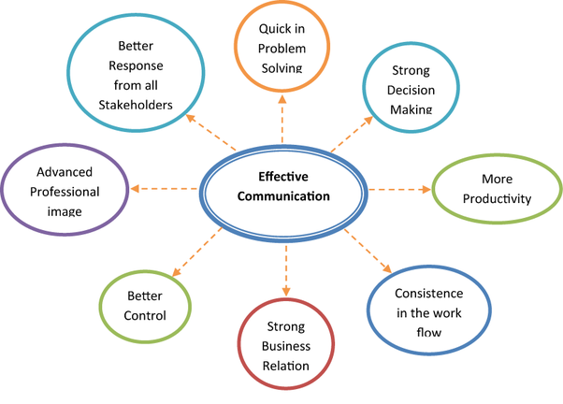
Benefits of effective communication on business
Lesser conflicts
Enhanced efficiency and productivity
Better employee engagement at workplace
Better sharing of ideas and increased innovations
Improved customer relations
Healthy organizational culture
Job satisfaction (Radovic Markovic and Salamzadeh, 2018)
Source: Communication skill at workplace, 2022
Notes:
Effective communication is essential for an organization in multiple aspects. Its help in enhancing efficiency and productivity of the organization. Being a social service organization, the health foundation has to approach various type of people sometimes those in distress, therefore, a good communication style not only helps the people working in the firm but also help those seeking help form the organization. Apart from this, it helps in creating good work culture and a platform for better sharing of ideas which also leads to job satisfaction among the employees.

Slide 6

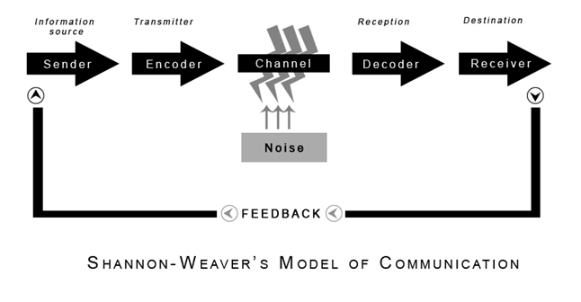
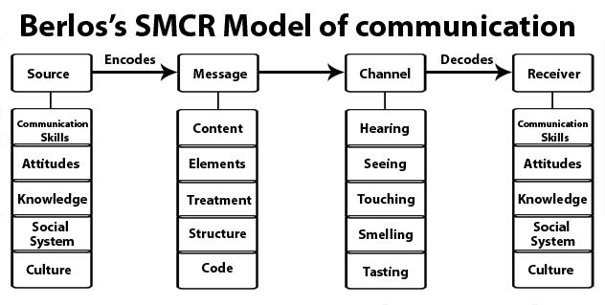
models of communication
Shannon-Weaver's Model
Schramm's Model of Communication
Berlo’s SMCR model of communication (Managementstudyguide. 2022)
Notes:
Berlo’s model: This theory uses emotional aspect of the message conveyed by the speaker. For better transfer of iddeas, better communication skills, attitude, knowledge and culture is essential.

Slide 7
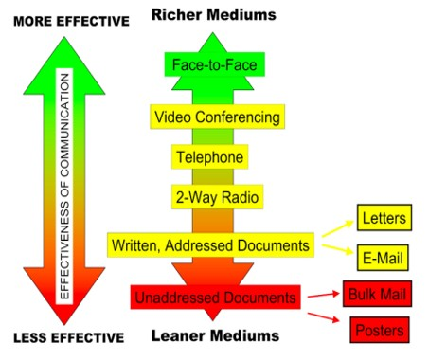
Use of theories related to models of communication
The Lendle-Daft model Channel Richness Hierarchy

Slide 8

Potential barriers that can prevent effective communication between organization and external stakeholders
Psychological barriers
Organizational structure related barriers
Cultural hindrances
Physiological barriers
Language barriers (Kapur, 2018)
Notes:
There can be psychological barriers like apprehensions in talking to co-workers or there can be structural barriers such as a complex structure can lead to mismanagement and miscommunication problems. Others are the language and cultural barriers where people hesitate to approach each other due to different language and cultures.

Slide 9

Communication Channels
Channels of communication used by the organization
Employee newsletters
Documents
Meetings and reviews
Video conferencing
Social media (Mohd Hanafiah, et. al., 2021)
(Source: Communication channel types, 2022)
Notes:
Various communication channels that are employed in the organization are e-mails which is widely used,circulation of information documents, newsletters
Conducting timely meetings to get a know-how of what is status of organization’s activities.
The other modes can be use of social media or texting platforms and video conferencing.

Slide 10

Channels that can be used to improve communication
More in-person communication
Live chats
Proper grievance redress mechanism
Use of communication softwares (Oltarzhevskyi, 2019)
Effective communication channels are required to prevent any crises in the organization. Lack of communication can lead to misunderstandings and miscommunications that can prove disastrous for the smooth running of the buisness (Sano and Sano, 2019).

Slide 11
Conclusion
The presentation was aimed at providing an insights into role of effective communication in the organization. The Health Foundation uses a number of communication channels at its place so as to get a hindrance free communication between its employees. A better communication is essential for proper working and growth of an organization. The presentation also provided the types of communication channels used by the organization and what other means it can use for improvement.

Slide 12
References
Kapur, R., 2018. Barriers to effective communication. Delhi University.
Mohd Hanafiah, K., Ng, C. and Wan, A.M., 2021. Effective communication at different phases of COVID-19 prevention: roles, enablers and barriers. Viruses, 13(6), p.1058.
Managementstudyguide.com. 2022. Popular Theories of Organizational Communication. [online] Available at: <https://www.managementstudyguide.com/theories-of-organizational-communication.htm> [Accessed 23 June 2022].
Oltarzhevskyi, D.O., 2019. Typology of contemporary corporate communication channels. Corporate Communications: An International Journal.

Slide 13
Radovic Markovic, M. and Salamzadeh, A., 2018. The importance of communication in business management. In Radovic Markovic, M., & Salamzadeh, A.(2018). The Importance of Communication in Business Management, The 7th International Scientific Conference on Employment, Education and Entrepreneurship, Belgrade, Serbia.
Sano, K. and Sano, H., 2019. The effect of different crisis communication channels. Annals of Tourism Research, 79, p.102804.
The Health Foundation. 2022. Home | The Health Foundation. [online] Available at: <https://health.org.uk/> [Accessed 23 June 2022].

Slide 14
THANK YOU..

Slide 15
Teamwork Evaluation | Team responses.
Who was in your team? | SOPHIE nyari 2122779 – wael Hussein 2123543
What were the key strengths of your team? | Just one of them was very responsible and reliable as a team worker.
What were the challenges that you overcame as a team? | Not responsible effectively
What would you do differently if you worked as a team again? | Probably I will change into a different team which I hope is going to be more responsible.
How would you rate your team working? Out of 10? | 5 out of 10

