Slide 1
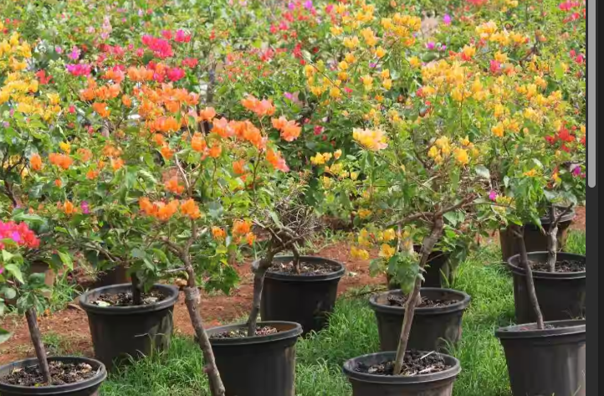
Green Haven Florists: Problem Solving and Decision Making
Student name: Maria Bianca Manafu
Student ID: 2439136
Module code: LCLM4004
Module name: Problem Solving and Decision Making

Slide 2

Introduction
About Green Haven Florists
  Est. 2016, Norwich
  Eco-friendly, bespoke designs
  Strong local reputation
Aim
  Identify key problems
  Analyse internal & external factors
  Suggest solutions
Structure: Problem → PESTEL → Cause & Effect → Conclusion
Notes:
Green Haven Florist is a small local company that was started in 2016 in Norwich. Creative and customised floral designs and eco-friendly wrapping made the shop famous and contributed to the positive reputation in the community. The recent performance has begun to decrease as the flower market has become more digital and competitive. This presentation aims to find the primary issues that are impacting the shop, examine internal flaws, and external market forces and hence provide viable solutions to assist in recovery. The discussion has a simple format, and the first part outlines the problem, then it looks at the external factors using PESTEL, the root causes of the problem and finally draws explicit conclusions and recommendations.

Slide 3
Nature & Scope of Problem (5W2H)
5W2H | Key Points
What | 30% sales drop
Why | Rising costs, low footfall, online rivals
Where | Norwich High Street
When | Last 12 months
Who | Liam & Priya Patel
How | Weak digital marketing
How Much | Profit ↓, traffic ↓
Notes:
The case of Green Haven Florists indicates that the sales of the company have dropped by 30 percent in the last year. The key problems include the increasing operating cost, decreased customer visits, and stiff competition with online flower sellers. The location of the business is Norwich High Street which has recorded decreased footfall. Liam and Priya Patel, the founders of the company, are struggling to adapt to the changes in the digital world. The primary reason is poor digital marketing and the old-fashioned site that restricts the development of the internet. These issues have decreased profitability and total traffic. The 5W2H technique assists in systematising this information, as it shows what the issue is, why it occurred, and the extent to which it affects the performance of the business at the moment.

Slide 4
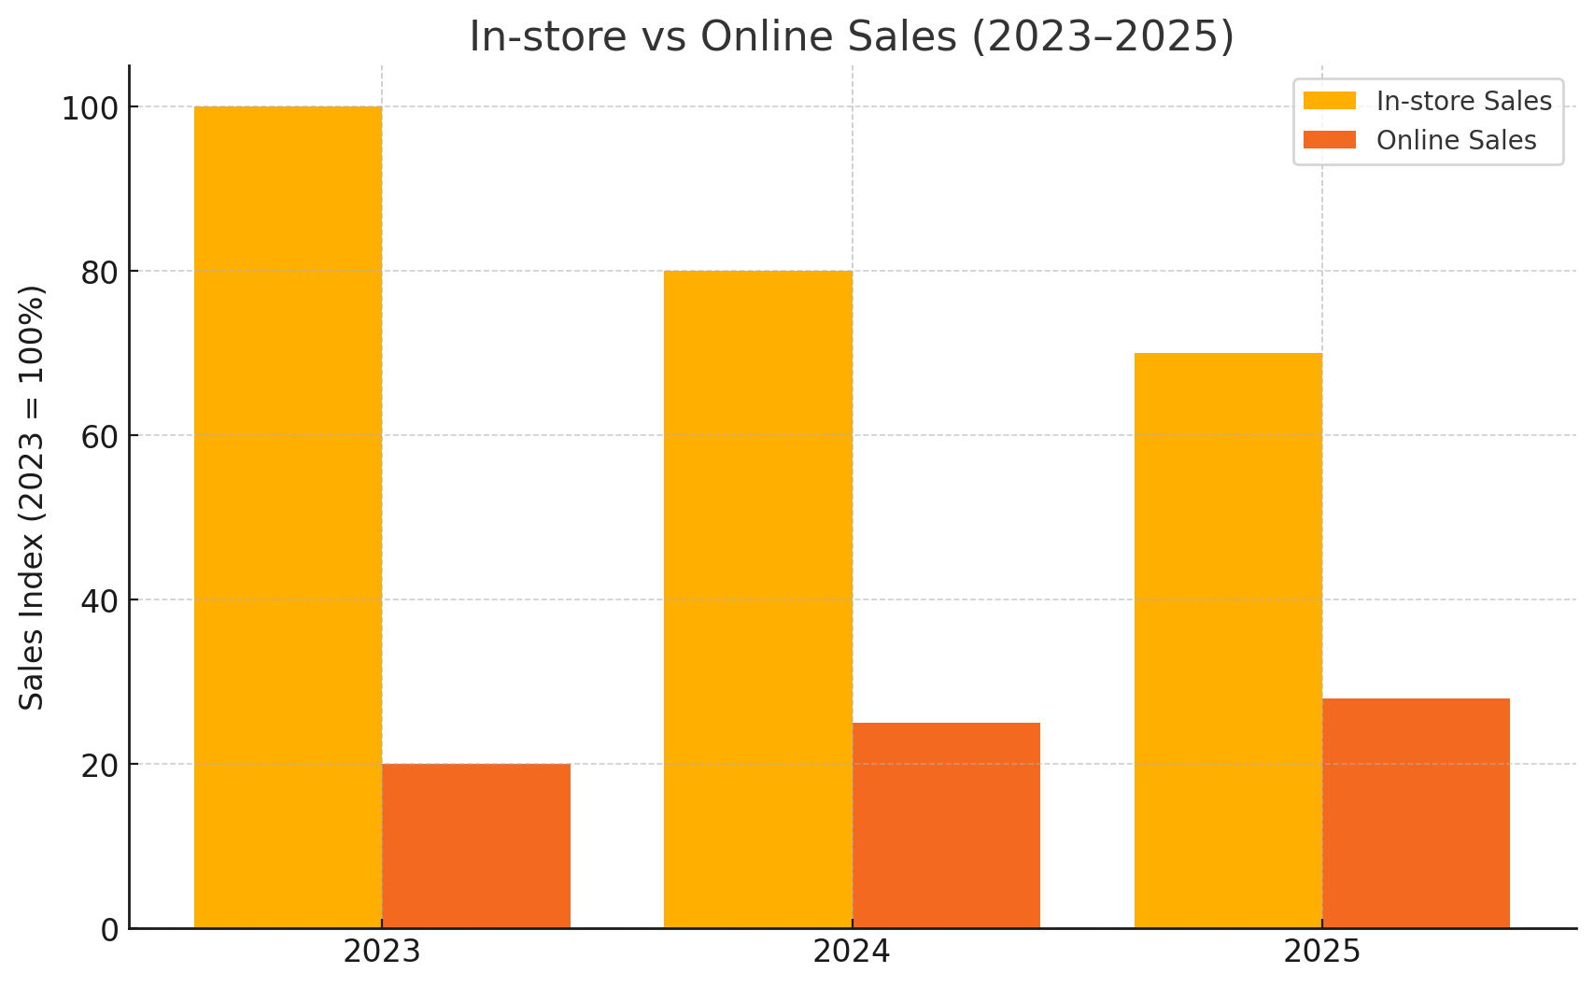
Supporting Data & Trends
Performance:
  Sales ↓ 30%
  Online ↑ 8% (not enough)
Market Shift:
  Growth of e-commerce florists
  Price-based competition
Customer Feedback:
  Quality & creativity
  Outdated website, limited delivery
Notes:
The sales numbers show that physical store sales dropped by 30 percent and online sales only increased by approximately 8 percent that is not enough to offset the total losses. The flower market has taken a new direction into e-commerce where most customers prefer online florists that are cheaper and quicker in delivery. According to consumer reviews, quality and creativity of the products of Green Haven is still high, however, the design of the site and the lack of delivery options do not encourage their repeat-buys. Convenience and online presence are proven to be the drivers of purchase behaviour in the industry data. These results show that there is a decisive necessity to improve the digital and adjust the pricing strategy to the level of consumer expectations and compete with the national and online brands.

Slide 5
External Factors (PESTEL Analysis)
Factor | Key Insight
Political | UK import tariffs on cut flowers range 8.5–12%, increasing supply costs (AHDB, 2025).
Economic | Inflation rose to 3.5% (Apr 2025) and CPIH 4.1% (Jun 2025) (ONS, 2025); UK cut-flower imports £635 m (2024) (OEC, 2022).
Social | Shift toward online convenience and same-day delivery expectations (Xi et al., 2020).
Technological | Outdated website and weak digital marketing reduce visibility.
Environmental | Focus on eco-friendly sourcing and biodegradable packaging (Ankita and Khanna, 2024).
Legal | Tightened plastic-waste regulations raise compliance costs (Tumu et al., 2023).
Notes:
The PESTEL analysis determines some external pressures. The UK importation tariffs on cut flowers vary between 8.5 to 12 percent which increases the total supply cost (AHDB, 2025). Inflation had been at 3.5 percent in April 2025 and CPIH 4.1 percent in June 2025 (ONS, 2025), and flower imports were worth about £635 million (OEC, 2024). On the social side, consumers would favor online order and delivery on the same day (Xi et al., 2020). Limitations that are technological like having an old site decrease market visibility. The firm is environmentally sustainable in sourcing and biodegradable packaging (Ankita and Khanna, 2024). Stricter rules on plastic-waste have increased the cost of compliance with packaging, legally (Tumu et al., 2023). All these combine to explain why the national and global conditions have a direct effect on the prices of the shop, demand and competitiveness.

Slide 6
Discussion of PESTEL Impacts
💷 Economic: Inflation raises costs → lower profit.
💻 Technological: Poor online presence → lost customers.
🌱 Environmental: Green focus = higher costs but branding edge.
Opportunity: Go digital & promote sustainability (Rosário and Dias, 2023).
Notes:
Three primary external pressures are found in the economic, technological and environmental areas. Flower and packaging have become more expensive due to inflation, and profit margins are decreasing (ONS, 2025). The technological flaws like weak online presence restrict access to customers and create difficulties in competing with digital first florists. The green orientation adds costs but also generates a competitive brand image since most consumers favor green businesses (Rosario and Dias, 2023). All these pressures indicate that to survive, one has to embrace change. To generate more customers and gain more grounds in the market, creating better online marketing and emphasizing on sustainability in branding might be the solution to securing a more robust market standing upon the sustainability that made Green Haven Florists unique in Norwich in the first place.

Slide 7
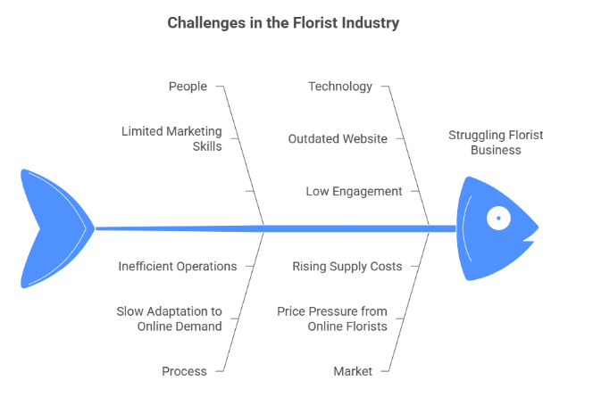
Cause and Effect
Notes:
The Fishbone diagram points out the underlying causes of the performance deterioration at Green Haven. In the category of People, there are negative marketing skills and digital training that influence the promotion. In Process, the pace of adaptation to online shopping trends is slow and retards progress. Under Technology, the old-fashioned site and poor interaction minimizes visibility. In Environment, sustainable yet expensive materials are used which adds on costs. Market category demonstrates the increasing competition and aggressive prices of online florists, whereas Finance reflects the increasing cost of imports and declining profit margins. These six categories are interrelated in order to demonstrate that the problem is not upheld by a single factor but a number of interrelated weaknesses within and outside the business environment.

Slide 8

Key Findings
Decline caused by both internal inefficiencies & external pressures.
Digital transformation critical for growth.
Sustainability = core strength & marketing advantage.
Notes:
The report demonstrates that Green Haven Florists is experiencing internal inefficiencies, as well as external pressures. On the inside, ineffective digital marketing and inadequate technology adjustment have restricted competitiveness of the company. Outwardly, the total revenues have been lowered by inflation, high costs of supply and online competition. The greatest lesson is that digital transformation is not an option anymore, it is essential to survive and develop in the long run. The sustainability focus has already given the business a significant competitive edge since it is in line with the interests of environmentally sensitive customers. Technology in conjunction with this environmentally friendly image could assist in restoring customer trust and also attract new clients as well as support the overall integrity of the brand within the Norwich flower market.

Slide 9
Recommendations
Action | Expected Benefit
Redesign website & add subscriptions (Khalil, 2022) | Boost online orders
Strengthen social media & SEO | Attract younger audience
Expand eco-product line (Türkeș, 2024) | Differentiate brand
Partner with locals / loyalty plan (Hammond, 2025) | Build community trust
Notes:
Business performance can be enhanced by a number of measures. First, the online orders can be simplified by redesigning the website and introducing subscription options that will lead to recurring sales (Khalil, 2022). The presence on social media and search engine optimisation will be strengthened and this will boost visibility and get the younger and tech savvy customers. The extension of the eco-product range will support the green brand image and make the shop stand out against competitors who focus on prices (Türkeesh, 2024). Lastly, building relations with local farmers and launching loyalty programs may enhance ties with the community and retention (Hammond, 2025). The combination of these steps will provide both short-term customer growth and competitive advantage in the long-term as Green Haven Florists can operate in a shifting retail environment with digital improvement, sustainability, and local involvement.

Slide 10
Conclusion
Green Haven’s fall: mix of digital gap & rising costs.
Decision tools (5W2H, PESTEL, Fishbone) clarified root issues.
Future focus: Adapt, digitalise, and promote sustainability.
Notes:
The conclusion of the analysis is that Green Haven Florists problems are caused by a combination of digital gaps, an increase in the cost of operations, and more powerful online competitors. The 5W2H, PESTEL, and the Fishbone diagram tools were useful in determining the principal causes and their interrelations. The facts demonstrate that recovery is critical to digitalisation and innovation. The positive aspects of the business can modernise the business without compromising its ethical values by enhancing the site, marketing strategy, and the environmentally-friendly activities. The point is that it is survival of the most adaptable, i.e. when starting to adapt to the new technologies, market demands, and tendencies towards sustainability, Green Haven Florists will be able to restore its image, recover the market share, and become stable in the competitive environment.

Slide 11
References
AHDB. (2025). EU and UK import tariff rates for selected horticultural products | AHDB. [online] Available at: https://archive.ahdb.org.uk/eu-and-uk-import-tariff-rates-for-selected-horticultural-products [Accessed 1 November 2025].
Ankita, A., and Khanna, A. (2024). Integrating environmental impact and digital marketing strategies for deteriorating items with preservation technology investment. Process Integration and Optimization for Sustainability, 8(4), 1131-1148.‌
Hammond, P. K. A. (2025). Community Engagement: How Authentic Community Engagement Builds Brand Trust, Loyalty, and Sustainable Growth. Loyalty, and Sustainable Growth (May 03, 2025).
Khalil, I. (2022). Website redesign: The role of the user experience design process in the improvement of local e-commerce website design (Doctoral dissertation, Doctoral dissertation, Rhine-Waal University of Applied Sciences).
OEC. (2022). Cut Flowers in United Kingdom | The Observatory of Economic Complexity. [online] Available at: https://oec.world/en/profile/bilateral-product/cut-flowers/reporter/gbr [Accessed 1 November 2025].
ONS. (2025). Consumer price inflation, UK. [online] Ons.gov.uk. Available at: https://www.ons.gov.uk/economy/inflationandpriceindices/bulletins/consumerpriceinflation/june2025 [Accessed 1 November 2025].
Rosário, A. T., and Dias, J. C. (2023). The new digital economy and sustainability: challenges and opportunities. Sustainability, 15(14), 10902.
Tumu, K., Vorst, K., and Curtzwiler, G. (2023). Global plastic waste recycling and extended producer responsibility laws. Journal of Environmental Management, 348, 119242.
Türkeș, M. C. (2024). Driving success: Unveiling the synergy of e-marketing, sustainability, and technology orientation in online SME. Journal of Theoretical and Applied Electronic Commerce Research, 19(2), 1411-1441.
Xi, G., Cao, X., and Zhen, F. (2020). The impacts of same day delivery online shopping on local store shopping in Nanjing, China. Transportation Research Part A: Policy and Practice, 136, 35-47.‌

