Slide 1

Psychology in Health and Social Care
(LCHS4010)
Assessment 1: Individual presentation
Programme : Certificate of Higher Education in H & C
Muhammad Zubair Hamayo : 2514993
Lecturer name: Dr. Shepherd Ziko Date: 09/07/2026

Slide 2

Introduction
Isaac is four years old and attends a Children's Centre in London.
Lives with his mother, who suffers from postnatal depression and has limited social support.
The family just relocated, resulting in disturbed childcare
Arrangements.
Observed Concerns
Quiet behaviour.
Separation distress.
Language delay
Difficulty to join group activities.
Sleep difficulties
Purpose
To analyse Isaac’s development by using Vygotsky’s Sociocultural Theory and discuss support plan

Slide 3

Lev Vygotsky ( 1896-1934 )
Born in 1896 in Russian
Studied in Law,Literature and psychology at Moscow state university
Worked as teacher and psychologist
Introduced the cognitive development theory known as Sociocultural Theory of Cognitive Development (1926)
He died from TB in 1934 at age 37 in Moscow

Slide 4
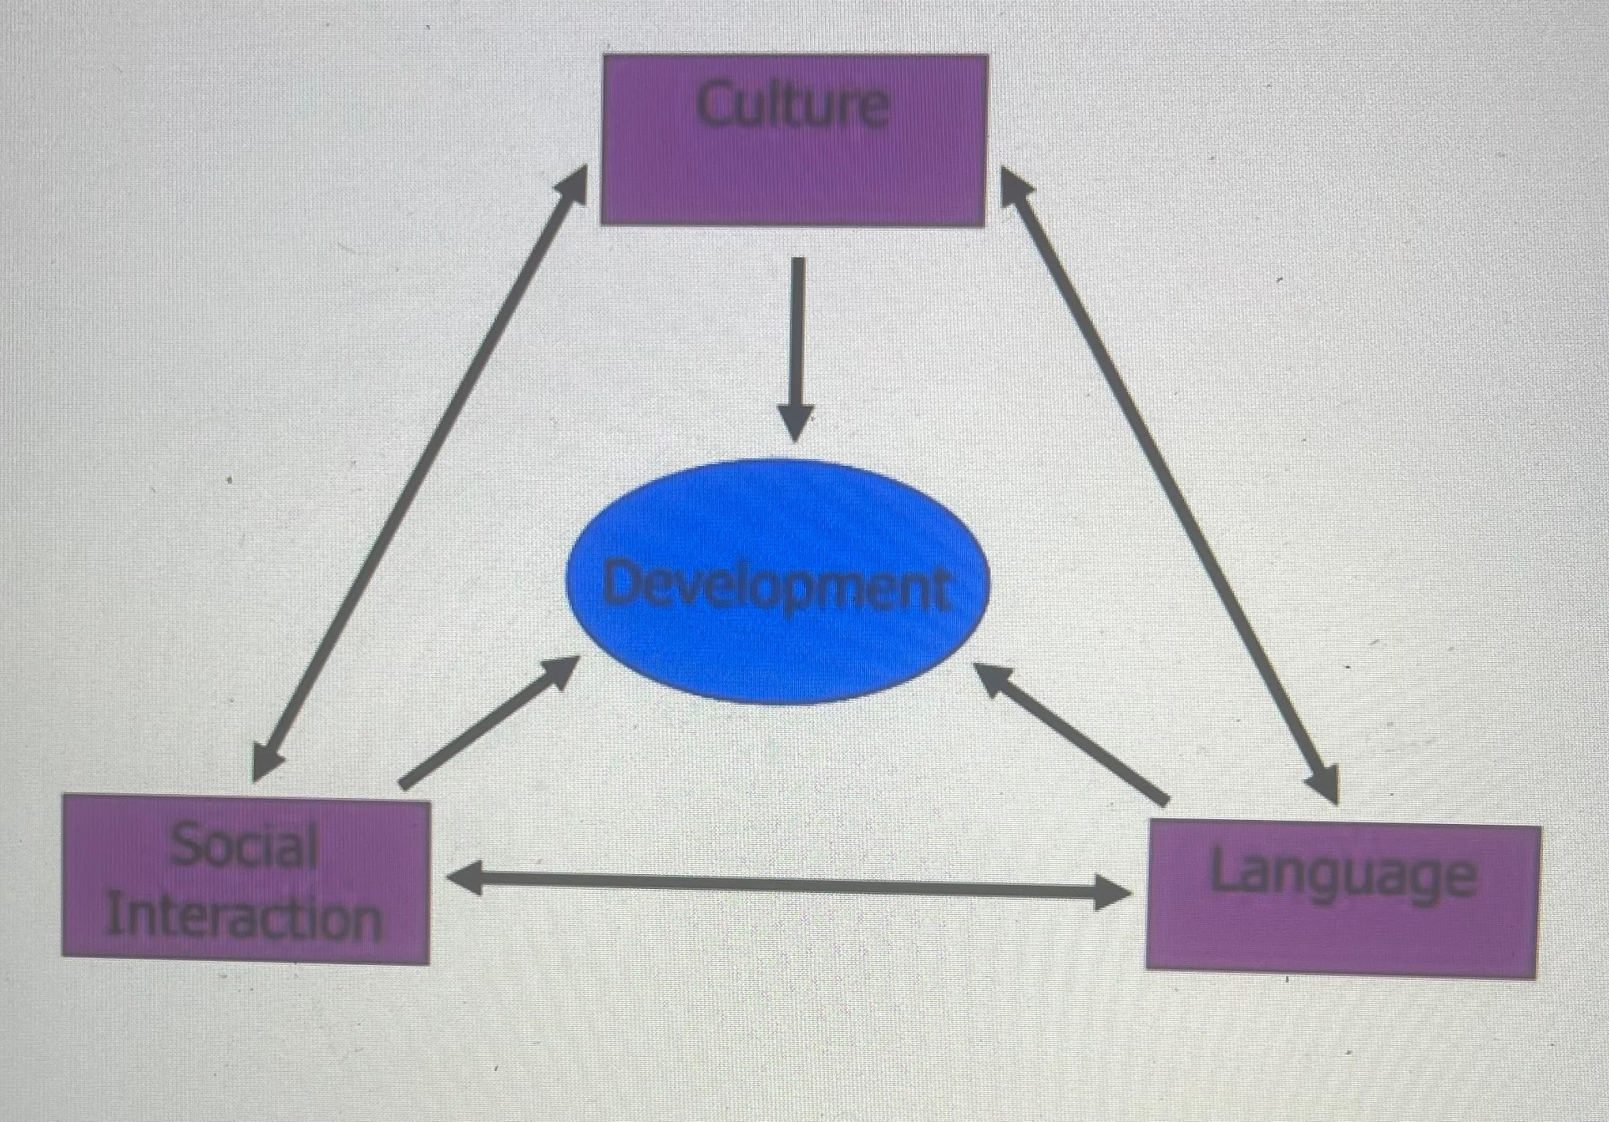
Vygotsky’s Sociocultural Theory
According to Vygotsky, social interaction,and cultural experiences are the greatest ways for children learning
Languages and other’s supports are essential for children cognitive development

Slide 5
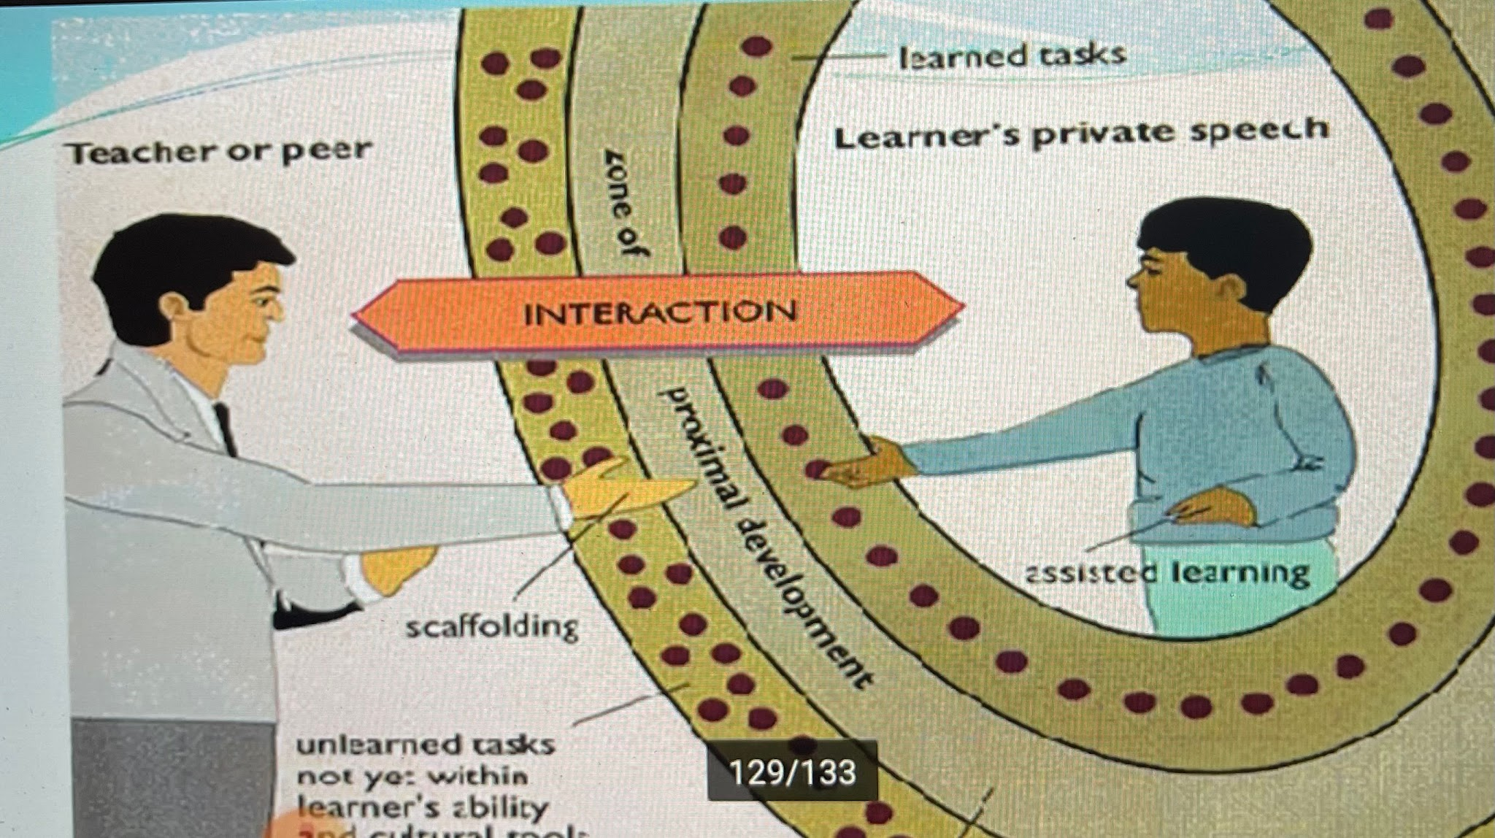
Key points of Vygotsky’s Sociocultural Theory
Learning through social interaction – Children learn knowledge through social contact.
More Knowledgeable Other (MKO) – Learning is supported by someone else who have more knowledge or experience (e.g., teacher, parent, or peer).
Zone of Proximal Development (ZPD) – The gap between what children can do alone and what they can do with help.
Scaffolding –Vygotsky defined scaffolding instruction as a teacher's and others' involvement important in promoting a child's learning and growth.
Language is important – Speaking and communication help children think, solve problems, and learn.
Culture influences learning – A child's cognitive development is influenced by their surroundings and culture.
Scaffolding allows children to develop beyond their current skills through directed engagement (Wood et al., 1976)

Slide 6
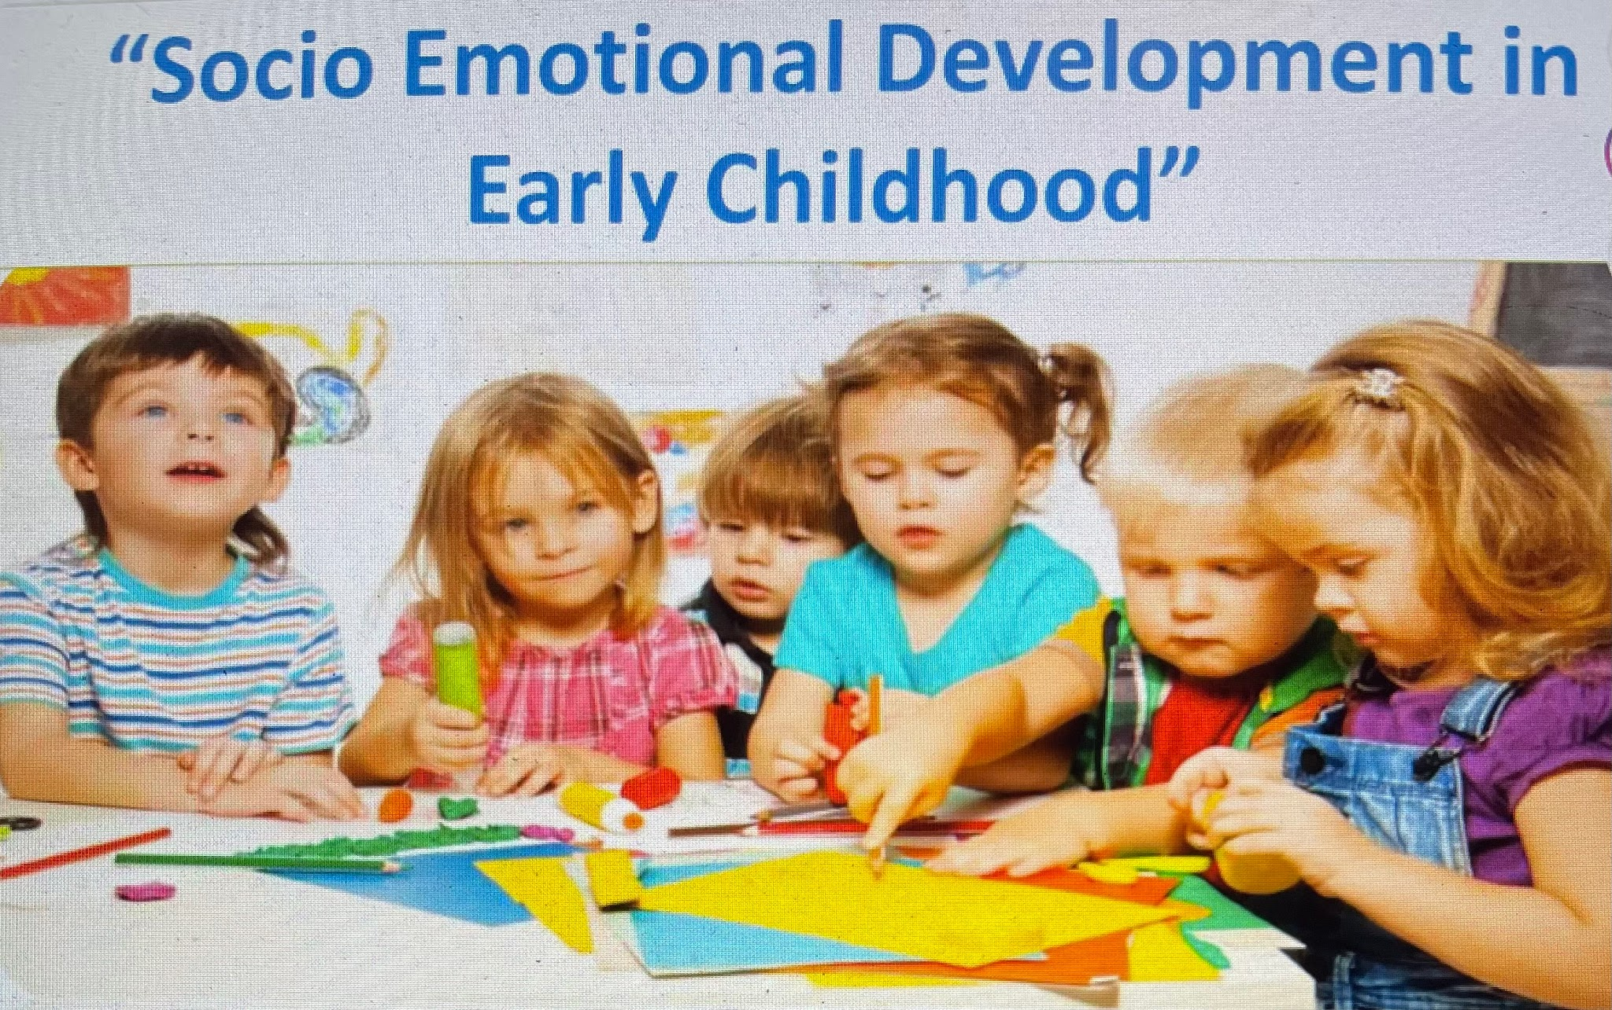
Developmental Assumptions
The ideas about how kids learn, grow, and change over time.
Key Assumptions
Kids grow at different rates
physical, cognitive, language, social, and emotional development
is comprehensive.
Development is influenced by both genetics and environment.
Positive relationships support healthy development.
Play is essential for learning.
Future development is shaped by early experiences.
Isaac's mother's postnatal depression, limited social support and moving home may have affected his emotional, language, and social development,the theory emphasising the importance of stable connections and focused early intervention.

Slide 7

Applying the Theory to Isaac’s Experiences
Isaac situation
Quite behaviour →
Language delay →
Separation distress→
Applied theory
By using Vygotsky's theory of social learning Isaac should be gradually encouraged and improve social skill to participate in group interactions like play activities
Vygotsky believed language develops through interaction with others like encouraging to speech that helps Isaac to develop thinking skills and will able to communicate independently.
Vygotsky believed strong focus on learning through supported independence that help Isaac to create safe connections and Isaac can build confidence

Slide 8

Isaac situation
4. Limited social support →
5. Disrupted childcare →
Applying the Theory to Isaac’s Experiences
Applied Theory
Vygotsky mentioned importance of a More Knowledgeable Other (MKO), if assign key worker for Isaac and increase parents involvement session will improve his learning opportunities
Vygotsky believed that learning depends on consistent guidance,effective scaffolding is made possible by consistency, allowing Isaac to gradually progress through his ZPD.

Slide 9
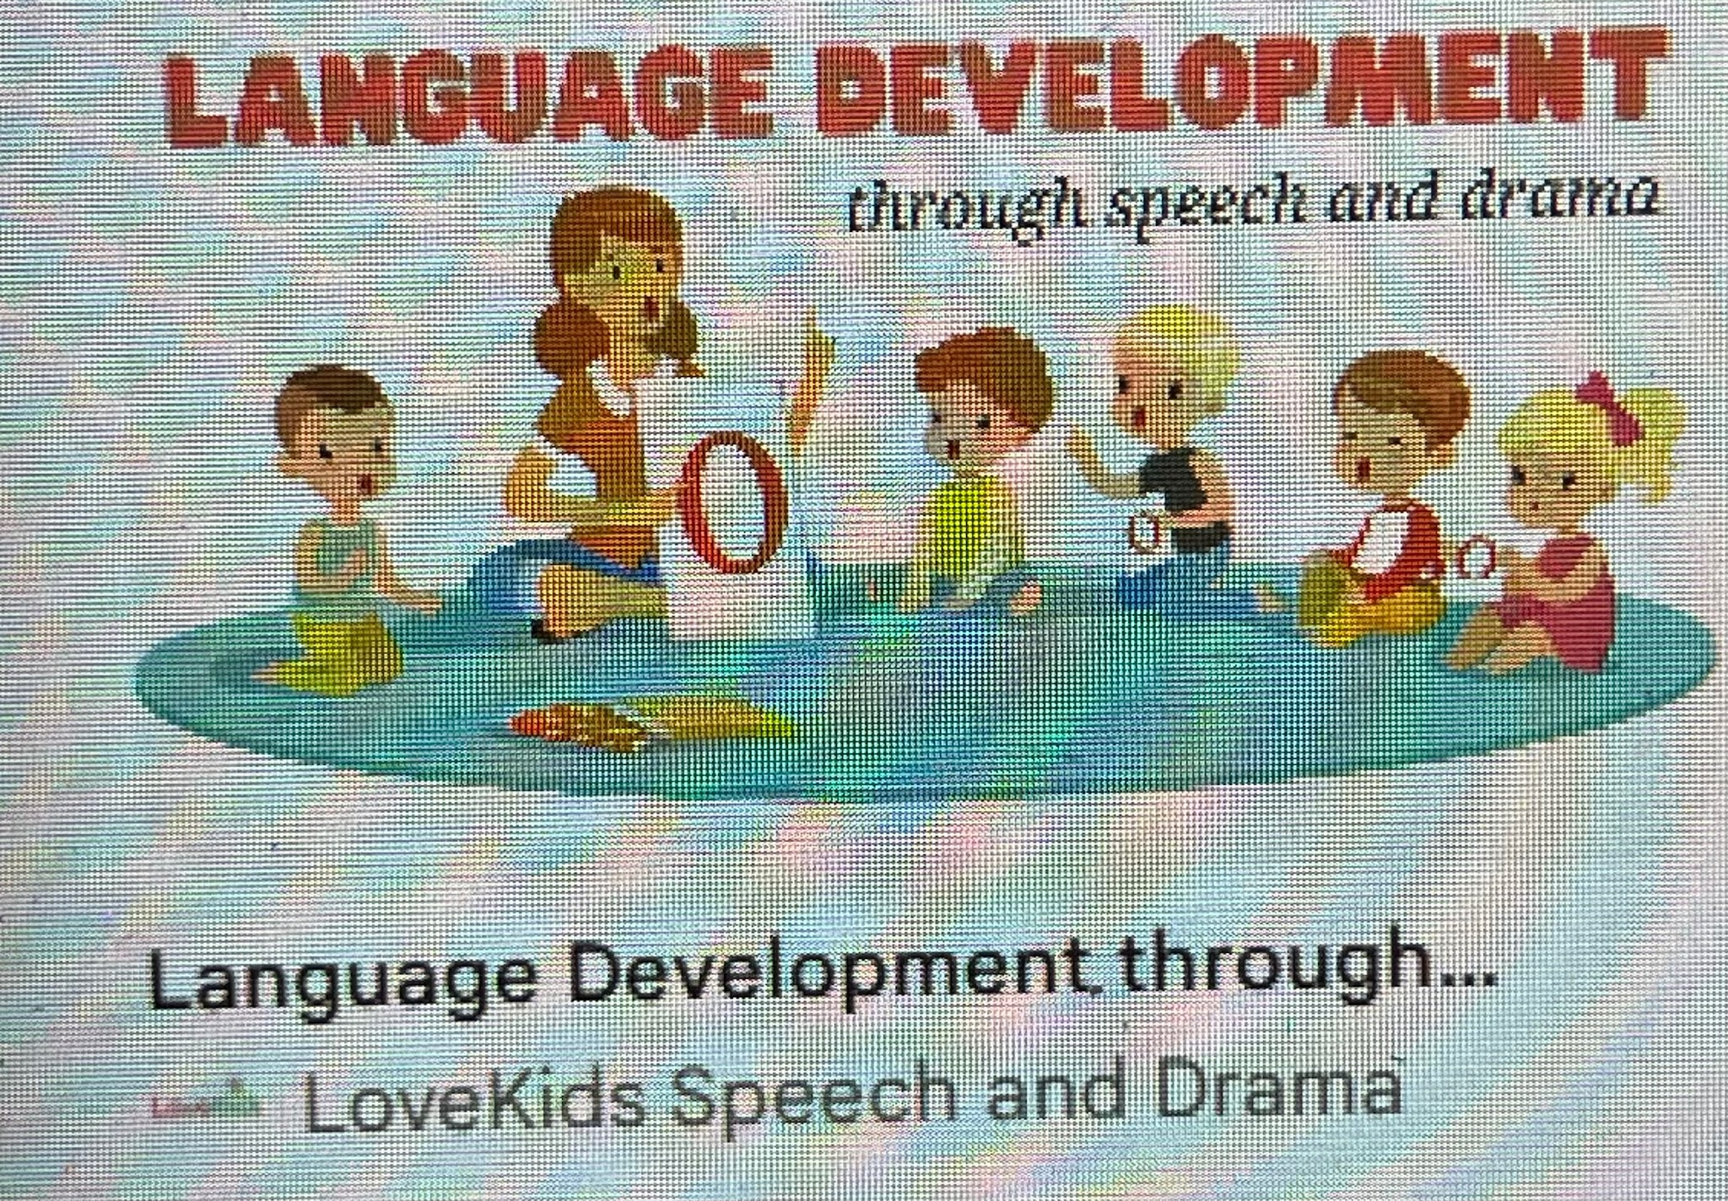
Language Development and communication
Vygotsky’s View of Language
Language is developed through interaction with others.
Isaac’s Language \Delay
Possible contributing factors:
Reduced opportunities for communication.
Social withdrawal.
Instability and frequent shifts of key worker
Language Impact on Development
connections with others.
Emotional expression.
Participation in learning activities.
Early Years Implications
Language-rich environments are important for supporting progress.
Children's thinking and learning are shaped by language, that acts as a cultural tool.(Vygotsky, 1978).

Slide 10

Nature and Nature Considerations
Biological Factors
Possible individual temperament.
Early brain development.
Genetic influences on emotional regulation.
Environmental Factors
Maternal mental health.
Quality of caregiving.
Social experiences.
Childcare disruptions.
Recent relocation and transitions.
According to recent study, both biological and environmental factors influence development(Shonkoff & Phillips, 2000).

Slide 11
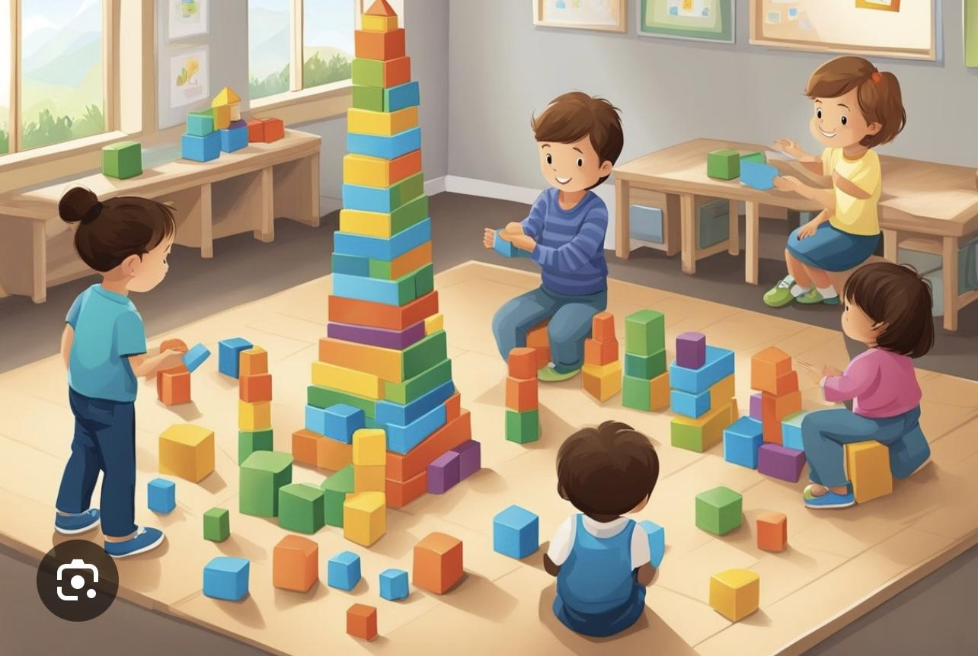
Vygotsky’s Theory Support Plan strategies
Attachment-Based Approaches
Allocate a key person.
Consistent daily routines.
Gradual separation strategies.
Play-Based Learning
Small-group play sessions.
Adult-supported role play.
Peer buddy systems.
Language-Rich Environment
Shared reading.
Storytelling activities.
Modelling and extending language.
Emotional Regulation Support
Emotion coaching.
Visual timetables.
Feelings cards and social stories.
These strategies provide scaffolding within Isaac’s Zone of Proximal Development.

Slide 12

Multi-Agency and Parental Support
Working with Parents
Parenting support programmes.
Modelling communication techniques.
Encouraging play at home.
Encourage to speech
Multi-Agency Collaboration
Health Visitor.
Speech and Language Therapist.
Family Support Worker.
Early Years practitioners.
GP and mental health services.
Expected Outcomes
Improved language skills.
Increased confidence.
Better emotional regulation.
Stronger social relationships.
Collaborative support improves outcomes for vulnerable children and families (Department for Education, 2024).

Slide 13

Critical Evaluation of Vygotsky’s Theory
Strengths
Emphasises importance of social interaction.
Focus on early years practice.
Supports inclusive and collaborative interventions.
Importance of scaffolding ,Mko,ZPD
Limitations
May underestimate biological influences.
Limited explanation of attachment and emotional development.
Difficult to measure concepts such as ZPD precisely.
Minimised role of genetics
Limited focus to individual differences
.
Cultural Considerations
Values cultural diversity.
Relevant to London’s multicultural communities.
Encourages practitioners to recognise different family practices and experiences.

Slide 14

Conclusion
Isaac’s development has been influenced by social and environmental experiences.
Vygotsky’s Sociocultural Theory highlights the importance of relationships, language and social interaction.
Practical interventions should focus on scaffolding, communication and supportive relationships.
Multi-agency working can help improve outcomes for Isaac and his family.

Slide 15
References
Daniels, H. (2016) Vygotsky and Pedagogy. 2nd edn. London: Routledge.
Department for Education (2024) Working Together to Safeguard Children. London: HMSO.
Pound, L. (2019) How Children Learn. 3rd edn. London: Practical Pre-School Books.
Shonkoff, J.P. and Phillips, D.A. (2000) From Neurons to Neighborhoods: The Science of Early Childhood Development. Washington DC: National Academy Press.
Vygotsky, L.S. (1978) Mind in Society: The Development of Higher Psychological Processes. Cambridge, MA: Harvard University Press.
Wood, D., Bruner, J.S. and Ross, G. (1976) ‘The role of tutoring in problem solving’, Journal of Child Psychology and Psychiatry, 17(2), pp. 89–100.
Bruce, T. (2021) Early Childhood Education. 6th edn. London: Hodder Education.

