Slide 1

SFR CUTS
Lecturer : Ejike Udeogu
Student & Number : Gavrila-Mihail Calin
2420083

Slide 2
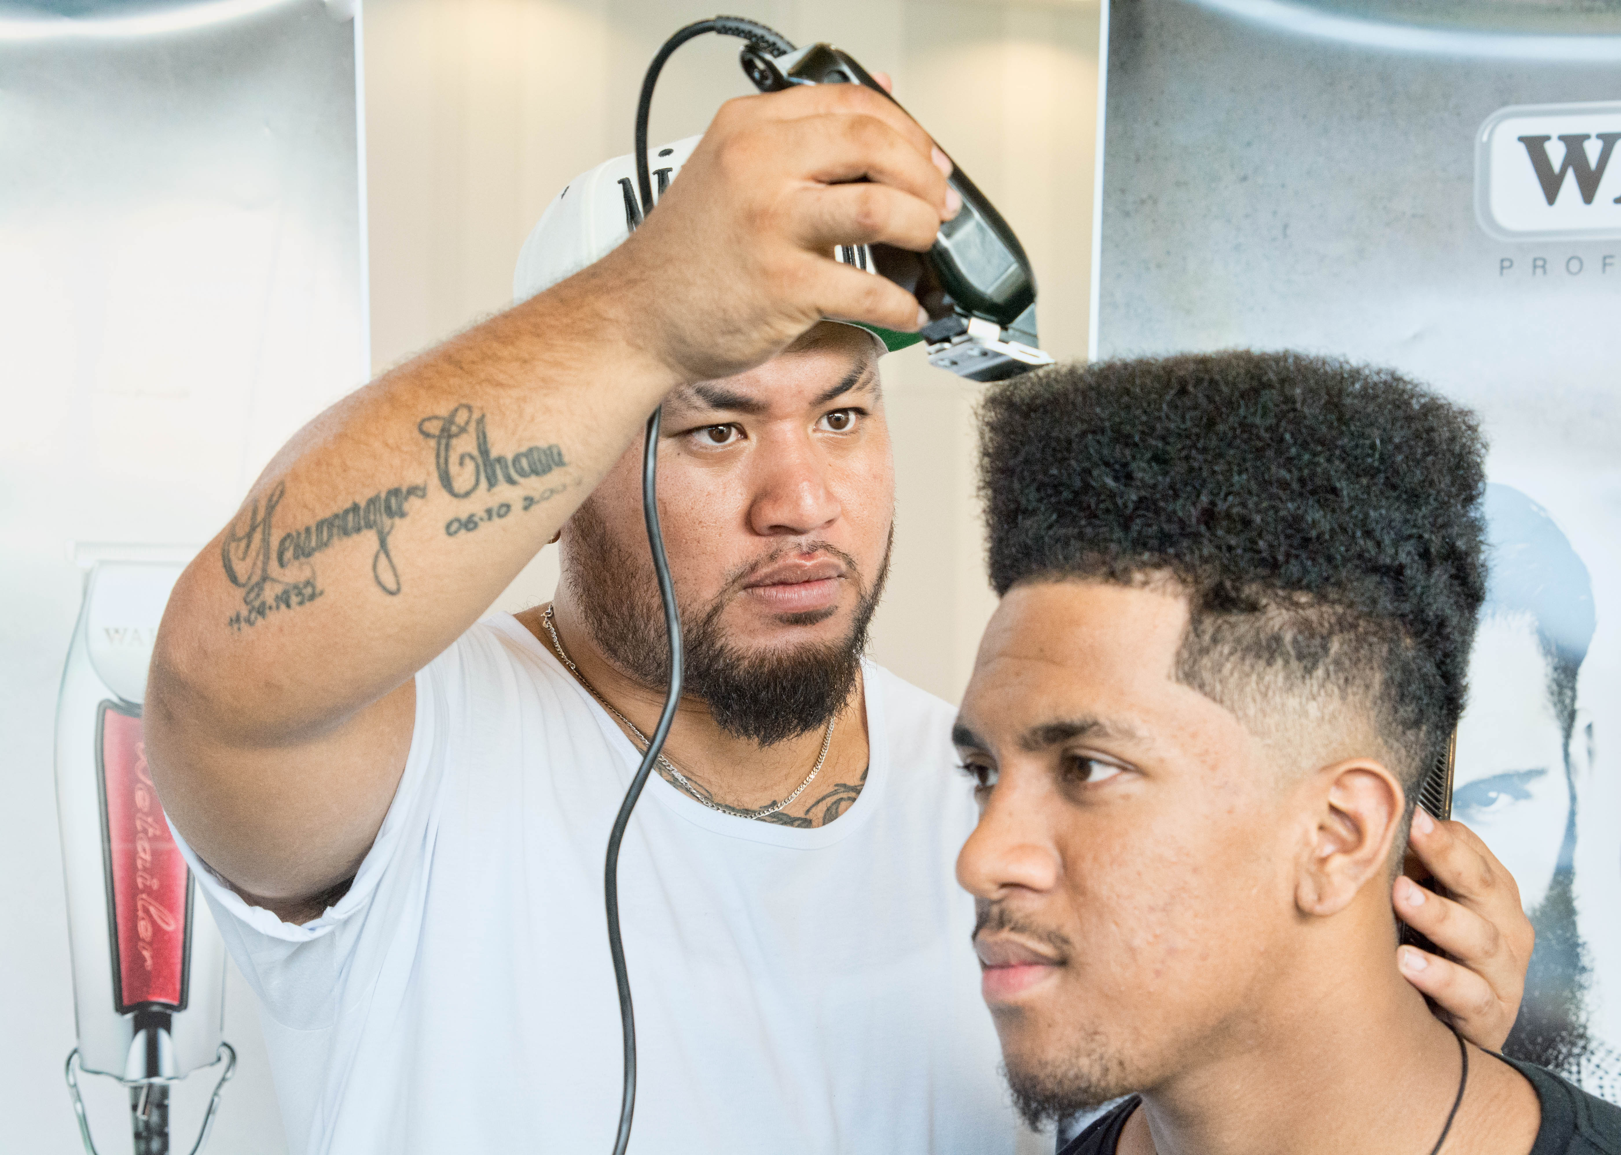
Business Idea
• Business Name: SFR Cuts
Location: Birmingham City Centre
Type: Service-based (Barber Shop)
Legal Structure: Private Limited Company (Ltd)
SFR Cuts will offer premium grooming and barbering services, focusing on style, inclusivity, and customer experience

Slide 3


Management Structure
Management: Managed by the founder (Owner-Manager) with a small flat structure:
2 Full-time Barbers
1 Part-time Receptionist
1 Apprentice Barber

Slide 4

PESTEL
Political: Government grants and support for small businesses.
Economic: High city footfall, but inflation may affect spending.
Social: Growing interest in men’s grooming and self-care.
Technological: Use of online booking, contactless payments, social media.
Environmental: Eco-friendly products and reduced plastic use.
ThePhoto by PhotoAuthor is licensed under CCYYSA.
ThePhoto by PhotoAuthor is licensed under CCYYSA.
ThePhoto by PhotoAuthor is licensed under CCYYSA.

Slide 5




Marketing Strategies
Branding: Luxurious and modern – Tagline: 'Cut Above the Rest'.
Online Presence: Website, social media (Instagram, TikTok, Facebook).
Promotions: Launch offers, loyalty cards, student/NHS discounts.
Community: Sponsor local events and grooming days for the homeless.
ThePhoto by PhotoAuthor is licensed under CCYYSA.
ThePhoto by PhotoAuthor is licensed under CCYYSA.
ThePhoto by PhotoAuthor is licensed under CCYYSA.
ThePhoto by PhotoAuthor is licensed under CCYYSA.

Slide 6

Funding
Sources:
Personal savings: £10,000
Start-up loan: £15,000
Angel investor/local grant: £10,000
Purpose:
To cover lease, renovation, staff, marketing, and equipment.

Slide 7

Costs Breakdown
Shop lease & deposit – £10,000
Renovation & interior – £7,000
Barber chairs & equipment – £6,000
Initial stock – £2,000
Licensing & insurance – £1,000
Marketing & launch promo – £2,000
Website & booking system – £1,000
Staff salaries (first month) – £4,000
Contingency fund – £2,000
Total - £ 35,000

Slide 8
Key Factors Summary
SFR Cuts aims to redefine men's grooming in Birmingham by blending style, Service, and Inclusivity
With a strong business plan, targeted marketing, and clear financial structure, SFR Cuts is positioned for long-term success and brand loyalty.
Prime location in Birmingham City Centre
Inclusive and premium customer experience
Affordable luxury with modern appeal
Strong marketing and community engagement
Skilled staff and efficient management
Sustainable and tech-enabled operations

Slide 9

References
British Business Bank (2023). Start Up Loans.
Statista (2024). UK Male Grooming Market.
Kotler & Armstrong (2021). Principles of Marketing.
Porter (2008). The Five Competitive Forces.
The Times (2023). Why Men’s Grooming is Booming.
Mintel (2024). Men’s Grooming Habits – UK

