Slide 1

OPTIMIZING SECURITY POSTURE IN AN ENTERPRISE NETWORK: ROLE OF BALANCING COMPONENTS IN CHECKPOINT ARCHITECTURE

Slide 2
CONTENT PAGE
Introduction
Chapter 1: Importance of security requirements in an enterprise network
  Risk assessment
  Security compliance and standards
Chapter 2: Checkpoint’s architecture’s role in optimizing security posture in an enterprise network
  The main components of checkpoint architecture- security gateway, management server, and smart console
  How Stateful Inspection Technology will significantly support in the context of modern cybersecurity and how it differs from traditional packet filtering and its role in enhancing security.
Chapter 3:
  real-world examples/ case studies on the principles of Checkpoint Architecture, Stateful Inspection, and the Security Gateway
  The success and challenges of this study
  Personal reflections

Slide 3
Introduction
Cyber threats have long been a problem for enterprise networks, as companies build up a business and continue upping their earnings, they inevitably become targets for these attacks. For them to be able to survive this, a security plan is needed which needs to be designed, implemented, and continuously maintained within their network infrastructure to be able to keep up with the ever-rising sophistication of the techniques used.The fact that cyber attacks are on the rise has been continuously brought up in academic papers, one stated that specific threats which listed “ as Shell Shock, Ghost RATs, Zero-Day, Stuxnet, Advanced Persistent Threats, and Ransomware” were causing distress to big businesses.[1] One answer to this problem was the implementation of a three-tier checkpoint network, this would include three main components, a smart console, a security management server, and a security gateway.
To help improve our knowledge of the importance of enterprise network security, a study has been conducted on two of the different categories of the subject. In Chapter One there was a focus on Risk assessments and security compliance and standards.
Chapter 2 will be centred around the subject of checkpoint architecture and how its role plays in the security of a enterprise network. It will go into depth of the different components and how it plays as a whole to improve the security of the network.
Chapter 3 will concentrate on the practical aspect of the work where we will be looking at real-world examples and case studies.

Slide 4

Chapter 1
Importance of security requirements in an enterprise network

Slide 5
Risk assessment
In terms of cybersecurity, one of the most important parts of it is the risk assessment.
The risk assessment is the very beginning of all the work in cybersecurity, and a continuous task in order to always be ready in case of problems. During the risk assessment, different members of a company will work together on every level, to find what risk may happen in the company, which will lead to a way to take care of the risk, and to the building of its policies.

Slide 6
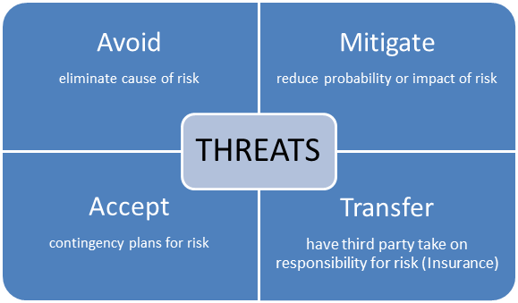
How to take care of the risk

Slide 7
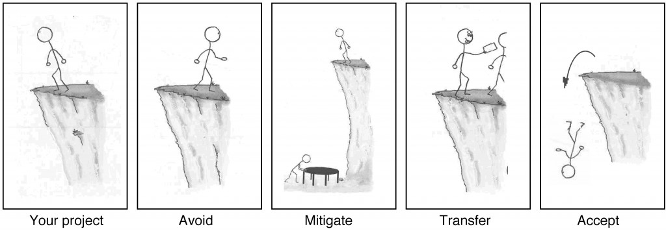

Slide 8
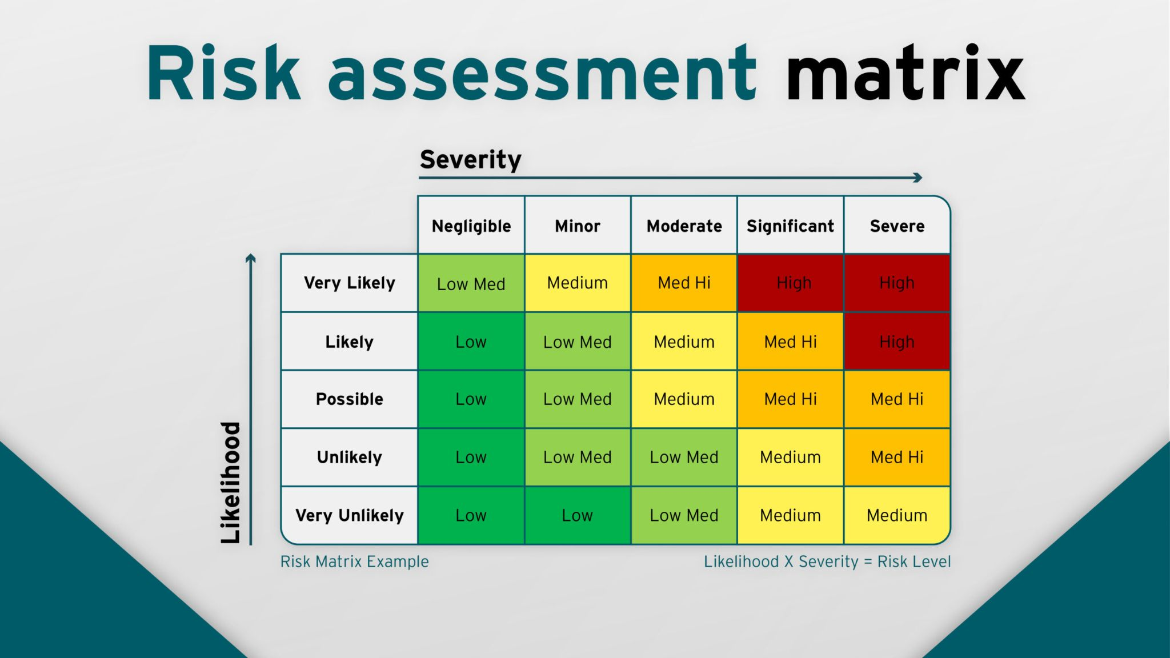
Risk assessment
In terms of cybersecurity, one of the most important parts of it is the risk assessment.
The risk assessment is the very beginning of all the work in cybersecurity, and a continuous task in order to always be ready in case of problems. During the risk assessment, different members of a company will work together on every level, to find what risk may happened in the company, which will lead to a way to take care of the risk.
The choices are the followings:
Mitigate the risk:
Accept the risk:
Avoid the risk:
Transfer the risk:

Slide 9
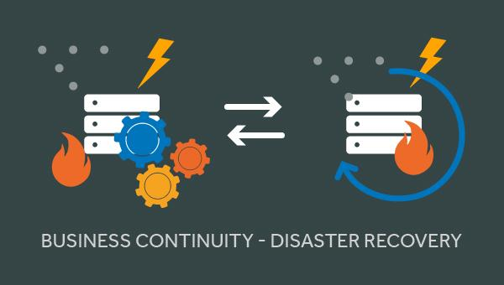
Next steps

Slide 10
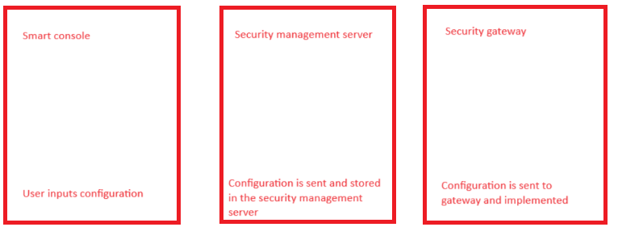
Security policies and standards
Why security policies and standards are important requirements within a checkpoint based enterprise network?
For any network, it is important to have security policies and standards set in place to maintain a safe working environment. This is also the case for enterprise networks, especially ones that incorporate checkpoint services within their infrastructure. Upon researching, there was a paper that highlighted the need for configuring devices following the standard of policies that are set out, this helps to avoid attacks such as “DoS, DDoS, aurora, malware attacks”[2], and many more.

Slide 11

Security policies and standards- Consistency
Since checkpoint centred networks require configurations at a very complex level and makes use of numerous devices, it is a good idea for policies and standards to be stated so proper planning, implementation, and maintenance is done within the company’s best interest. By following the stated policies, the configurations will hopefully be able to remain consistent throughout the network since a framework will already be provided within the policies.

Slide 12
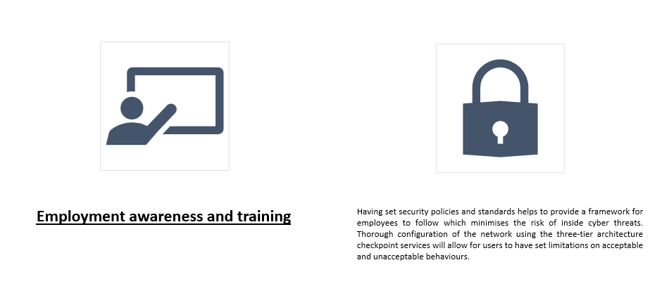
Security policies and standards

Slide 13

Security policies and standards

Slide 14
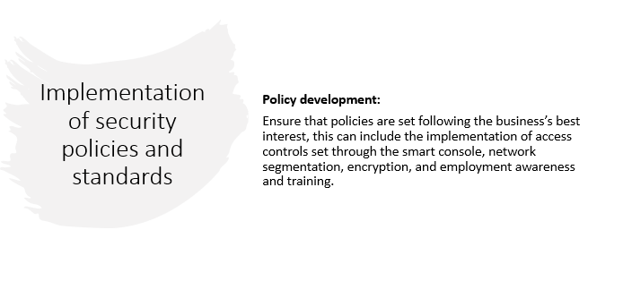

Slide 15

Security and policies
When handling a checkpoint network it is vital to ensure that configurations done on any devices follow the company’s security policies and standards. This usually includes the implementation of access-control rules, NAT settings, VPN configurations, and so on. In a checkpoint environment this can all be centrally managed by the management console.

Slide 16
Chapter 2

Slide 17
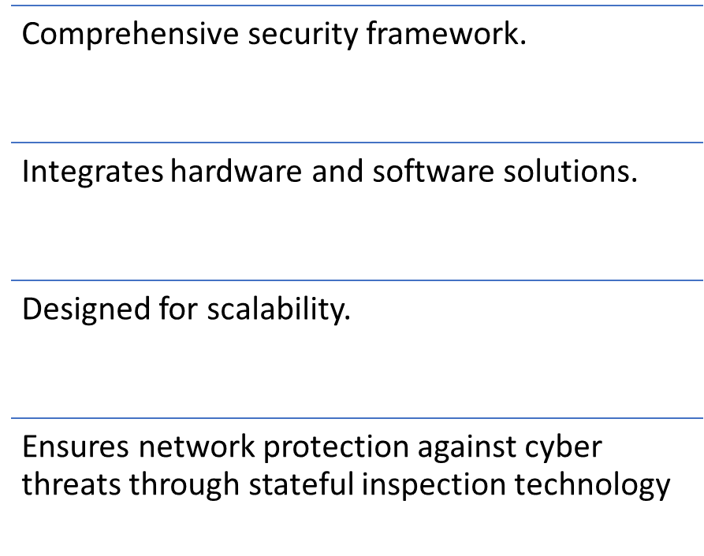
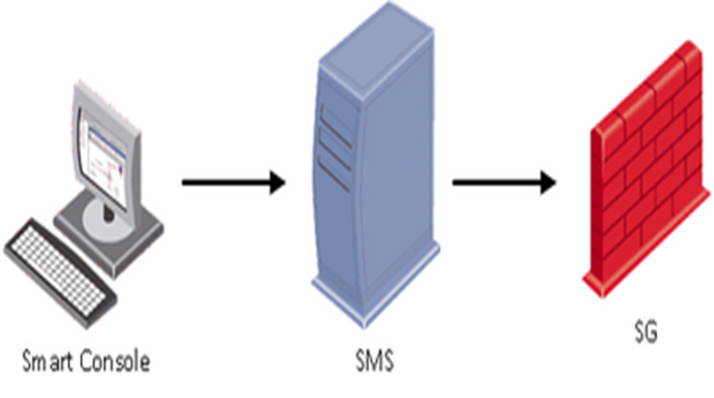
Introduction to checkpoint architecture

Slide 18
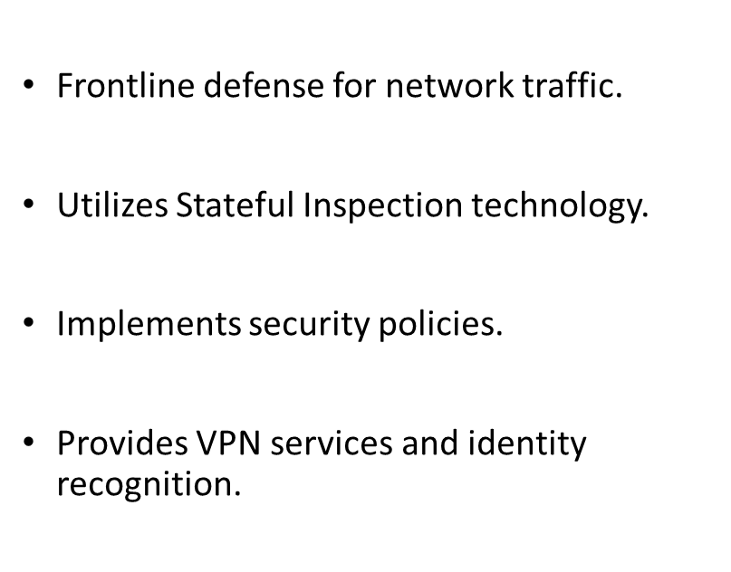
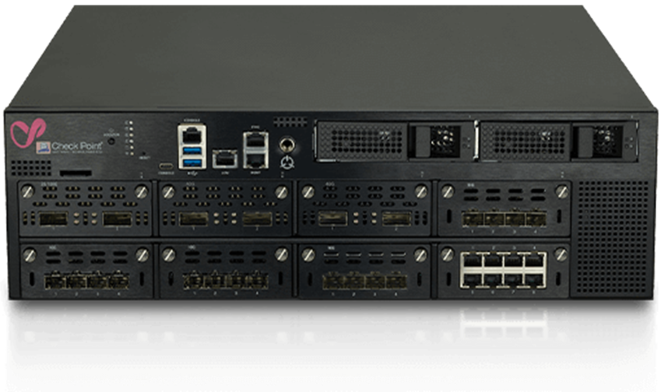
Security gateway

Slide 19
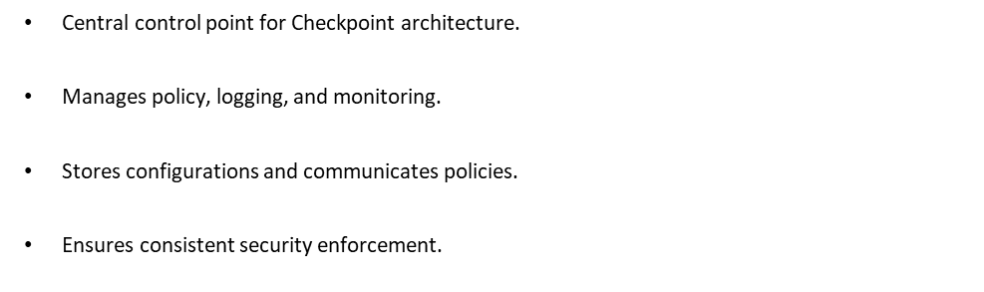
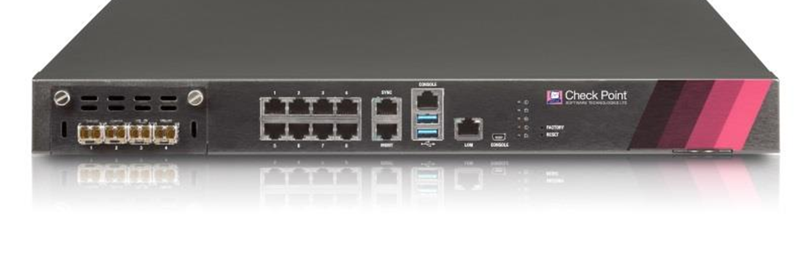
Management server

Slide 20
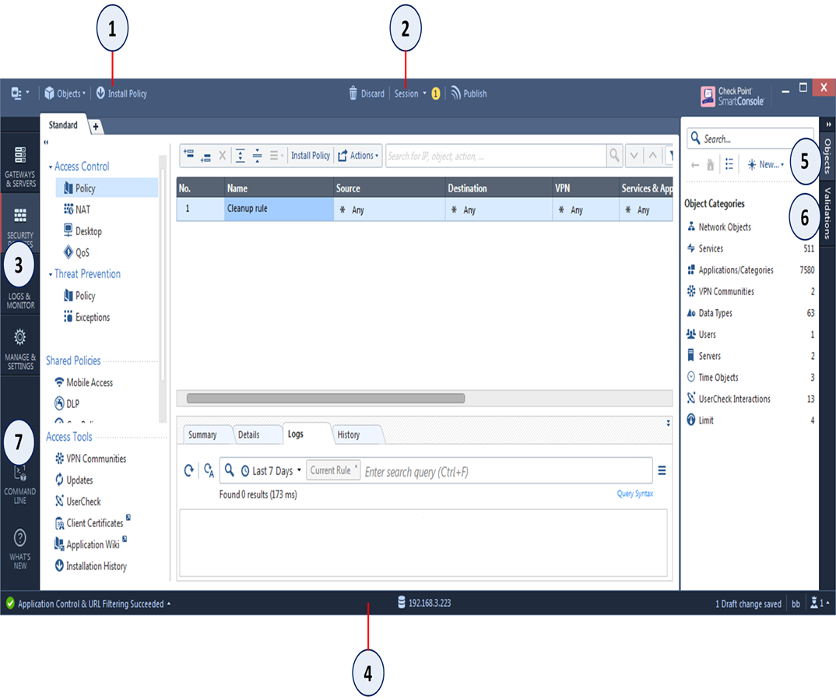
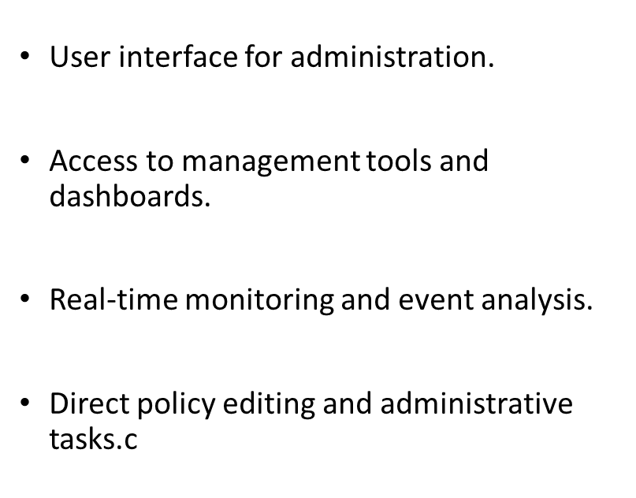
Smart Console

Slide 21
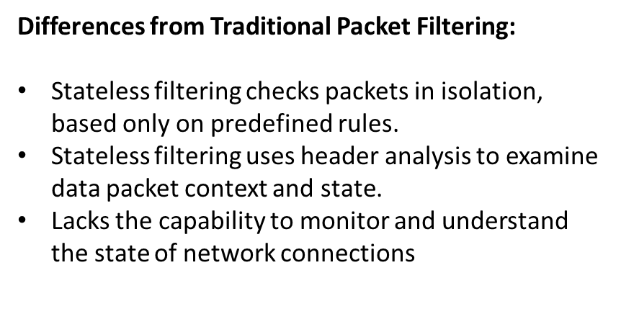
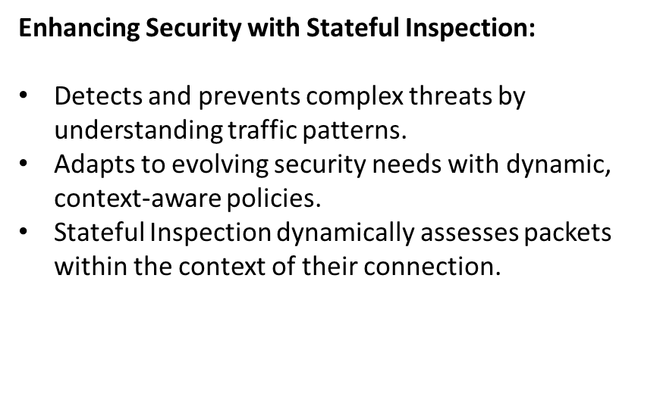

The role of stateful inspection in modern cybersecurity

Slide 22

Chapter 3

Slide 23
Enhancing NHS Mobile Security
A Case Study on Check Point's Agile Solution

Slide 24
Introduction to the Solution
•In 2017, Checkpoint equipped 7000 agile workers within the NHS with secured mobile devices, leveraging a solution that ensured secure collaboration. This initiative was driven by the necessity for protected mobility and stringent data security protocols, emphasizing IT security advocacy in the workplace.

Slide 25
Benefits of the Solution
•Check Point SandBlast Mobile provides comprehensive protection against a multitude of security risks such as malware, network and phishing attacks, OS exploits, and malicious apps. Furthermore, the integration with IBM Maas360 for mobile device management enhances hardware control and policy enforcement, aligning with NHS's risk assessment policies.

Slide 26
Checkpoint solution quotes
•"We have to make sure, have protected mobility and that we have our data security protocols in place. We have to be advocates of IT security in the workplace." [3]
•“Check Point SandBlast Mobile protects NHS England mobile users from malware, network and phishing attacks, OS exploits and malicious apps.” [4]

Slide 27
Security Insights from Edward Snowden
•Edward Snowden, a notable figure in cybersecurity, emphasizes the vulnerability of modern smartphones to hacking by any organization with sufficient resources. He highlights the use of IMSI catchers for metadata extraction and the difficulty in detecting whether a device has been compromised.

Slide 28
References from Snowdondocumentary.
•“People, money and time to target then any organisation can hack into a device.”. [5]
•“if your device had been hacked you would likely never know”’ [6]

Slide 29
Strategic Importance for the NHS
•For an organization like the NHS, safeguarding against both individual and sophisticated state-sponsored attacks is crucial. The adoption of Check Point's solutions offers a robust defense mechanism, especially in the context of the WannaCry attack in May 2017, highlighting the need for advanced security measures.

Slide 30
NHS Stats Quote
•around 80 out of 236 hospitals were effected around the UK [7]

Slide 31
References
1.Opara, Emmanuel U., and Onochie J. Dieli. "Enterprise cyber security challenges to medium and large firms: An analysis." International Journal of Electronics and Information Engineering 13.2 (2021): 77-85.
2.Arefin, Md Taslim, et al. "Enterprise network: Security enhancement and policy management using next-generation firewall (NGFW)." Computer Networks, Big Data and IoT: Proceedings of ICCBI 2020. Springer Singapore, 2021.
•NHS England provides 7,000 Agile Workers with Check Point Secured Mobile Devices. (n.d.). Retrieved February 26, 2024, from https://resources.checkpoint.com/case-study/nhs-england-provides-7000-agile-workers-with-check-point-secured-mobile-devices [3][4].
•“State of Surveillance” with Edward Snowden and Shane Smith (VICE on HBO: Season 4, Episode 13) - YouTube. (n.d.). Retrieved February 26, 2024, from https://www.youtube.com/watch?v=ucRWyGKBVzo [5][6]
•Lessons learned review of the WannaCry Ransomware Cyber Attack. (2018). www.nationalarchives.gov.uk/doc/open-government-licence/ [7]

