Slide 1
MODULE NAME: PSYCHOLOGY IN HEALTH AND SOCIAL CARE
STUDENT NAME:VIHONA AGNES DE OLIVEIRA
STUDENT ID:2422046
MODULE CODE:LCHS4010
LECTURER'S NAME:MUHAMMAD ALIYU

Slide 2
CONTENT OVERVIEW
CONTENTS | SLIDE NO.
INTRODUCTION | 03
WHAT IS ATTACHMENT? | 04
BOWLBY’S KEY IDEAS | 05
APPLYING THEORY TO AMIRA | 06
STRATEGIES TO SUPPORT AMIRA | 07
NATURE AND NURTURE | 08
STRENGTHS OF BOWLBY’S THEORY | 09
LIMITATIONS OF BOWLBY’S THEORY | 10
CONCLUSION | 11
REFERENCES | 12

Slide 3

UNDERSTANDING AMIRA’S DEVELOPMENT THROUGH BOWLBY’S ATTACHMENT THEORY

Slide 4

INTRODUCTION
Amira is three years old and she is new in the nursery.
When her parents leave her, she gets worried and cries.
Amira speaks very rarely and spends a lot of time alone.
The Attachment Theory of Bowlby is the approach taken in this presentation to learn her needs and assist her in development.
Notes:
Amira experiences anxiety, significant restriction of speech, and withdrawal, which indicates problems with attachment. This presentation utilises the Attachment Theory by Bowlby to discuss the elements of secure relationships that may strengthen her development and confidence in order to build a stronger emotional and social bond with others within the nursery environment.

Slide 5
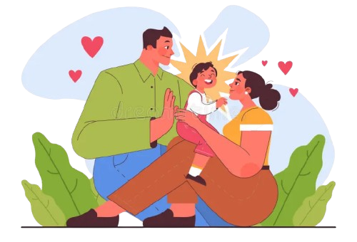
WHAT IS ATTACHMENT?
Attachment refers to a close emotional connection between a child and the primary caregiver (Balbernie 2022).
It helps children to feel secure, safe and to be open to the environment around them.
Early attachment affects future feelings, behaviour and learning capabilities.
Notes:
According to Bowlby, children are born in need of bonds and warmth with adults. A child feels secure when a care giver treats him with care and warmth. It is also evident today that the good attachments create confidence, assist in the learning process, and influence the way children will trust others at later stages of life.

Slide 6
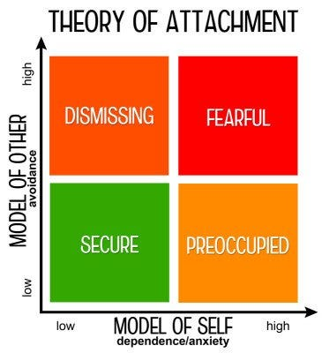
BOWLBY’S KEY IDEAS
According to Bowlby, children are initially born with a sense of the need to remain with adults that are close to them to be safe and comforted (Venezia 2023).
A carer is a kind of a safe platform where the kid would have the power to go out and reach back in order to seek help.
Strange Situation by Mary Ainsworth (1978) refined the work of Bowlby demonstrating three types of attachment: secure, insecure-avoidant and insecure-ambivalent (Madigan 2023).
Childhood attachments create internal working models, which determine how children trust and form relationships in life.
Notes:
Attachment is crucial according to Bowlby and it starts at an early age. These ideas were later on tested by Ainsworth in her Strange Situation study. She noted the responses of babies upon their mothers leaving and coming back to them. Some stayed as calm and trusting and others avoided or became upset. Her research confirmed that secure attachment provided in child development by Bowlby gave children confidence and emotional stability.

Slide 7
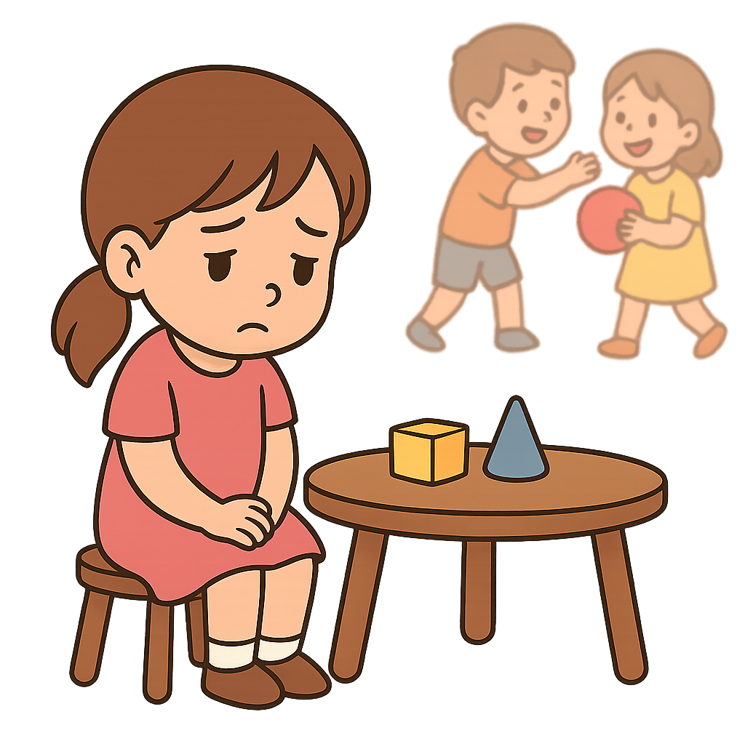
APPLYING THEORY TO AMIRA
Separation anxiety in Amira could also be a sign of early stress in adapting to new surroundings, or insecure attachment.
Her short answers and non-communication behaviour could indicate that she is yet to gain some form of confidence and requires time to develop her social abilities.
Avoiding group play can indicate that she feels better with those she has known or played with.
According to Bowlby theory, children must get regular comfortability then they can explore and interact with others without restrictions (Bergen 2022).
Sometimes even such well-attached children might also be concerned in a new location until they are confident and develop trust once more (Blake 2025).
Notes:
The behaviour of Amira demonstrates what Bowlby described about being attached and feeling secure. She appears to be confused and nervous with the departure of her caregiver and the fact that she is still trying to trust this new environment. Her speech and poor behaviour could be her process of dealing with stress. It does not always imply a negative response, many young children respond this way. Through the interventions of reassurance, regularity, and providing kind adults, she will eventually feel more secure and open to others.

Slide 8

STRATEGIES TO SUPPORT AMIRA
One parent must provide Amira with the necessary attention and support to feel safe and develop trust in a nursery environment.
By beginning with short good-byes and gradually increasing their separation, Amira will be able to feel safer and trust her caregiver will come back to her.
Maintaining daily routine as something predictable and calm allows reducing anxiety in Amira and provides her with the feeling of safety and control (Khouri 2021).
The close collaboration with parents Is a way of monitoring observations and comfort techniques is necessary to keep the consistency between home and nursery (Wilson 2024).
Notes:
Amira requires time, patience and a steady timetable to feel safe in her new environment. The presence of one trusted adult that she meets every day will assist her to build trust. Short, but sweet farewells can assist people in being less frightened and more relaxed. Once she has a normal day, she begins to feel secure and calm. Softened tones, smiles, and mini-steps during a group play assist her to build confidence. In both places she feels supported with the support of her parents and nursery.

Slide 9
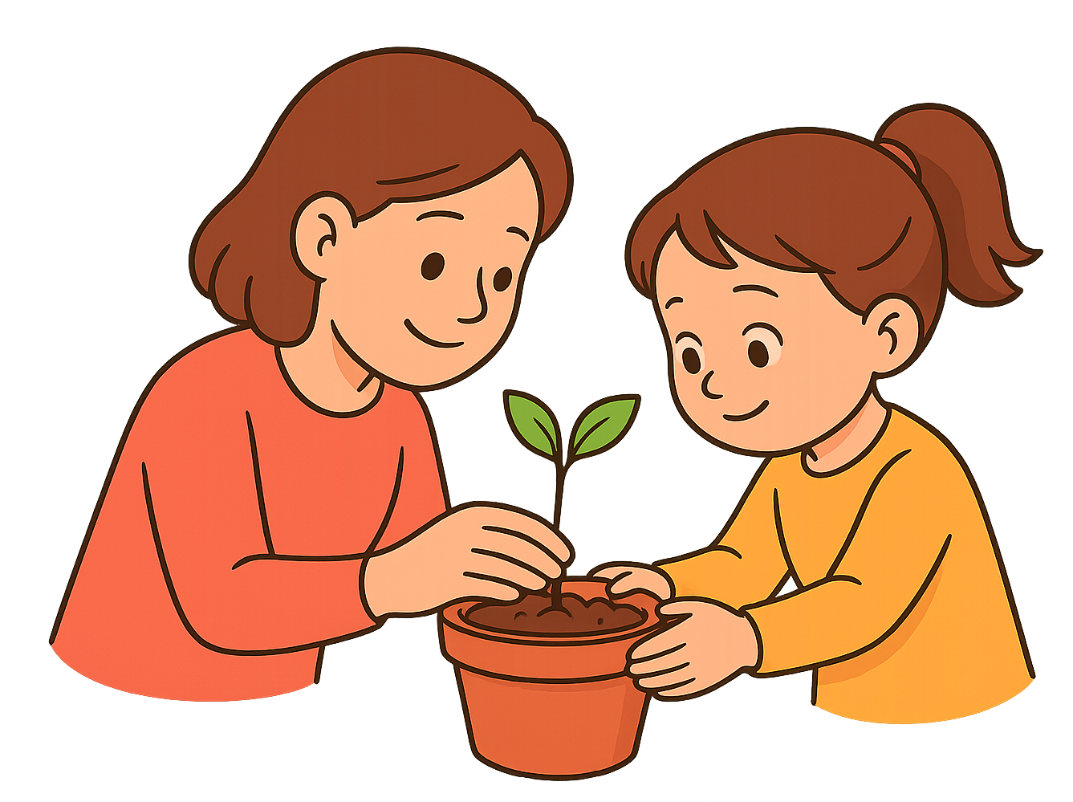
NATURE AND NURTURE
Children require close emotional attachments to the adults whose care they most need.
Separation may create stress in the body such as an increase in cortisol levels, demonstrating the impact of attachment on the physical body of children (Johnson 2025).
Emotional security and healthy development at early ages are formed by warm and consistent interactions with caregivers (Moore 2021).
Caring adults can make children recover trust and develop secure attachments once more even after disruption.
Notes:
Nature and nurture are part of the development of every child. Amira might act this way because her body will react naturally to stress when it tries to cope with the separation of her caregiver. However, the reaction of adults is also significant. When she finds comfort and kindness it will help her to relax and to trust once more. Eventually, she can be cured and made more secure by the right treatment and environment.

Slide 10

STRENGTHS OF BOWLBY’S THEORY
Describes the development of emotional and social growth by means of close bonds.
This is supported by research conducted by Ainsworth and later studies showing that there are important benefits of attachment.
Helps practitioners be aware of behaviour and emotional needs of children in care.
Points out that early attachment by caregivers plays a crucial role in emotional and mental growth.
Notes:
The theory by Bowlby provides a good idea of the importance of love and care at an early age. It assists staff to react better towards children. Studies continue to confirm that secure placements result in greater trust and improved psychological health even in adulthood.

Slide 11

LIMITATIONS OF BOWLBY’S THEORY
Gives too much attention to mothers; neglects the role of other close caregivers.
Not applicable to all cultures where children are nurtured by a large number of adults.
Several children overcome childhood loss and demonstrate excellent resilience and adaptation.
Lesser attention on thinking and language development compared with other theories.
Notes:
Although the ideas of Bowlby are useful, they do not cover everything. Children are capable of developing attachments not only with their mothers. The development is also influenced by culture and life experience. There are some children who remain healthy even when their early years were stressed or changed thus being very strong.

Slide 12

CONCLUSION
This theory of Bowlby helps us to comprehend why Amira is nervous and silent.
She can be given gentle treatment and constant encouragement to make her feel secure and learn to trust others.
Knowing the attachment, adults can care for the entire child, both emotionally, socially, and mentally.
Notes:
The storey of Amira demonstrates how healthy relationships are relevant to children. The thoughts by Bowlby make us remember that care and trust are time consuming. Through patience and gentleness, Amira will be able to feel safe, learn more, and establish positive relationships with other people.

Slide 13
REFERENCES
Bergen, D., 2022. Developing attachment: the theoretical work of John Bowlby and Mary Ainsworth. In Theories of Early Childhood Education (pp. 118-127). Routledge.
Johnson, J., 2025. HOW ATTACHMENT CONTROLS OUR STRESS LEVELS: INSIGHT INTO BRAIN RESEARCH. Образование, научни изследвания и иновации, 3(2), pp.114-118.
Moore, J., 2021. Developing secure attachment through play: Helping vulnerable children build their social and emotional wellbeing. Routledge.
Wilson, T., 2024. Working with parents, carers and families in the early years: The essential guide. Routledge.
Khouri, H., 2021. Peace from anxiety: Get grounded, build resilience, and stay connected amidst the chaos. Shambhala Publications.
Blake, J., 2025. Anxious Attachment Cure: Heal your Inner Child, Overcome Fear of Abandonment, and Build Secure, Loving Relationships. AB Publisher LLC.
Balbernie, R., 2022. Attachment: A play of closeness and distance. In Contemporary Issues in Perinatal Education (pp. 49-56). Routledge.
Venezia, V., 2023. Attachment Theory in Relationships: Useful Tools to Increase Stability and Build Happy and Lasting Bonds. A Journey from Childhood to Adulthood. Vincenzo Venezia.
Madigan, S., Fearon, R.M., van IJzendoorn, M.H., Duschinsky, R., Schuengel, C., Bakermans-Kranenburg, M.J., Ly, A., Cooke, J.E., Deneault, A.A., Oosterman, M. and Verhage, M.L., 2023. The first 20,000 strange situation procedures: A meta-analytic review. Psychological Bulletin, 149(1-2), p.99.

Slide 14
Thank You

