Slide 1
LCBB6000
Dissertation Workshop
Methodology and Methods

Slide 2
Learning Objectives
Develop a Comprehensive Understanding of Research Methodology
Master Key Terminologies in Research Methodology
Distinguish Between Methodology and Methods
Explore the Components of the Methodology Section

Slide 3
Methods and Methodology
Methodology Vs Methods
Methodology is the general approach to studying research topics or finding answers to research problems. Example: quantitative, qualitative.
Method is a specific research technique such as interview, content analysis, correlation.
While methodology examines what you are trying to find out, the methods are the means of solving the problem.
Creswell and Creswell (2018)

Slide 4
Methods and Methodology
Methodology Vs Methods
Task 1: What is the difference between research methods and research methodology?
Creswell and Creswell (2018)

Slide 5
The Research Onion
Philosophy
Approach
Design
Research Paradigm
Strategy
Time horizon
Methods
Saunders, Lewis and Thornhill (2019)

Slide 6
Research
Philosophy
Understanding Research Paradigms: Ontology
Ontology concerns what is knowable and the nature of reality in the context of research. It questions the assumptions researchers make about the world and the type of data that can be collected.
Types:
  Realism: Assumes a scientific approach to the development of knowledge. Realists accept the existence of a reality independent of human thought.
  Nominalism: Believes that realities are specific to the way in which individuals perceive them.
Saunders, Lewis and Thornhill (2019)

Slide 7
Research
Philosophy
Understanding Research Paradigms: Epistemology
Epistemology considers the acceptable knowledge in a field of study and by what criteria the researcher stands to differentiate between adequate and inadequate knowledge.
Types:
Positivism: Works with an observable social reality and that the end product of such research can be law-like generalisations similar to those produced by the natural sciences.
Interpretivism: Advocates that it is necessary for the researcher to understand differences between humans in our role as social actors
Saunders, Lewis and Thornhill (2019)

Slide 8
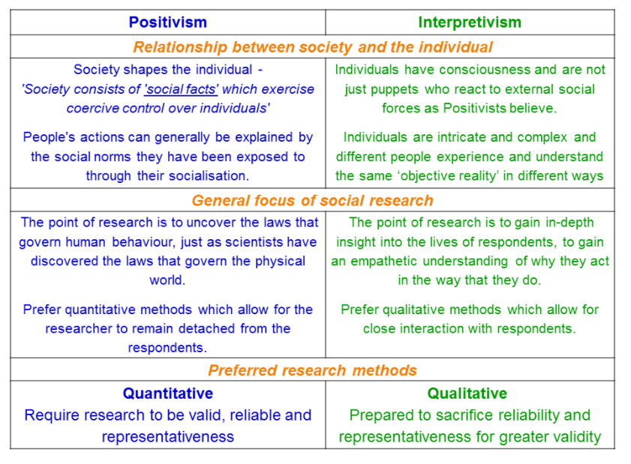
Positivism vs interpretivism

Slide 9
Research
Philosophy
Understanding Research Paradigms: Axiology
Axiology discusses the role of values in research, looking at the researcher's biases and value systems that can affect various stages of the research process.
Example: Considering how a researcher’s personal beliefs about corporate ethics might influence the choice of case studies in business research.
Saunders, Lewis and Thornhill (2019)

Slide 10
Research
Philosophy
Approaches To Research: Deductive Approach
Definition: The deductive approach starts with a hypothesis derived from theory and then designs a research strategy to test the hypothesis. It is a top-down approach where you start with a theory, develop a hypothesis, and then design experiments to collect data to confirm or refute the hypothesis.
Example: Testing the hypothesis that higher employee satisfaction improves job performance through a structured survey designed to measure satisfaction levels and performance metrics.

Slide 11
Research
Philosophy
Approaches To Research: Inductive Approach
Definition: The inductive approach collects data and develops theory as a result of the data analysis. It is a bottom-up approach where patterns observed from empirical observations are used to develop theories.
Example: Conducting interviews with consumers to understand their experiences and deriving theories about consumer behavior from these qualitative data.

Slide 12
Research
Philosophy
Approaches To Research: Abductive Reasoning
Definition: Abductive reasoning begins with an incomplete set of observations and proceeds to the likeliest possible explanation for the group. It is an approach that is used when the scenario does not fit with existing theories, thus requiring the researcher to propose new theories based on the available data.
Example: Observing unexpected consumer behaviour that does not fit existing marketing theories and proposing new theoretical frameworks that better align with the observed data.
Saunders, Lewis and Thornhill (2019)

Slide 13
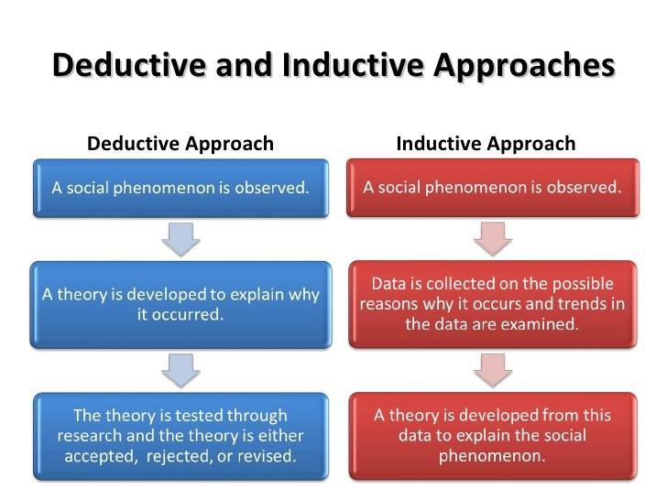
Research
Philosophy
Deductive Vs Inductive Approaches

Slide 14
Task 2: What are the key differences between qualitative, quantitative, and mixed-methods research designs?
Deductive Vs Inductive Approaches

Slide 15
Research
Philosophy
Research Design
Qualitative
Quantitative
Mixed
Concerned with understanding human behaviour from the informant's perspective
Data is analysed and reported by themes and descriptions by the informants
Interview
Focus group
Observation
Concerned with discovering facts about social phenomena
Data is collected through measurements
Data is reported and presented through numerical and statistical methods
Experiment
Survey
Program evaluation
Secondary data
Concerned with methods and evidence from qualitative and quantitative research
Saunders, Lewis and Thornhill (2019)

Slide 16
Research
Philosophy
Time horizon
Cross sectional - One short study conducted over a single period of time.
Example: Data study of stock market for April 2024.
Longitudinal - A study of information at more than one period of time.
Example: Change in the behaviour of employees before and after management change.

Slide 17
SAMPLING

Slide 18
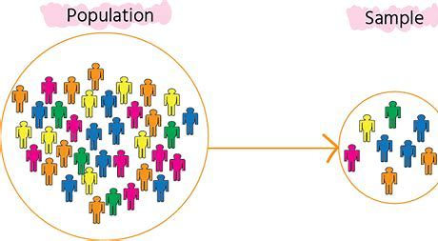
Population and Sample
Population in research refers to the entire set of individuals or elements that have common observable characteristics.
A sample is a subset of a population selected for participation in a study.
Sampling is the process of collecting a subset of data from an entire population in order to infer characteristics of the population based on the sample.
When to Sample:
When collecting all the data is impractical or too costly.
When measuring a high-volume process.
When sound conclusions can be drawn from a subset of the total available data.
Key Point:
Use samples to make inferences about a larger population.

Slide 19
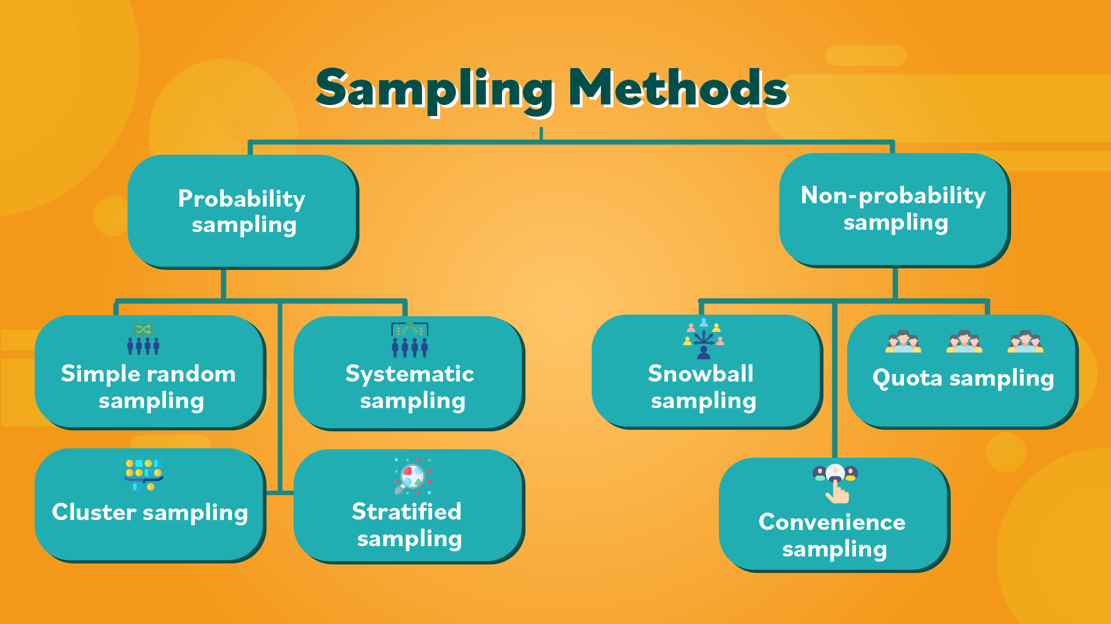
Research
Philosophy
Sampling Methods
Let’s watch a Video:
Types of Sampling Methods

Slide 20
Population and Sampling
Task 3: What are the main differences between probability and non-probability sampling methods?

Slide 21
Research
Philosophy
Selecting the Sampling Method

Slide 22
Research
Philosophy
Data collection
A systematic approach to gathering data for a particular purpose from various sources, that has been systematically observed, recorded, and organised.
The various steps or strategies for gathering and analysing data in research investigations.
Saunders, Lewis and Thornhill (2019)

Slide 23
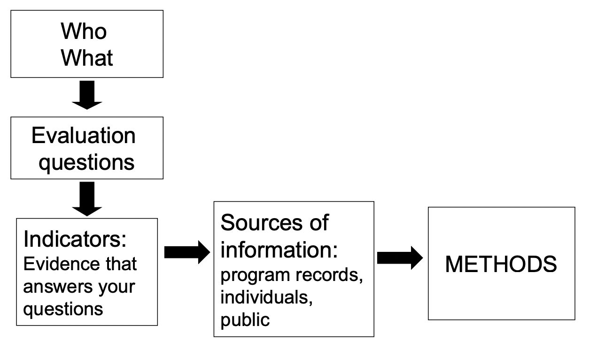
Research
Philosophy
Data collection
No one best way: decision depends on:
  What you need to know: numbers or stories
  Where the data reside: environment, files, people
  Resources and time available
  Complexity of the data to be collected
  Frequency of data collection
  Intended forms of data analysis

Slide 24
Research
Philosophy
Rules for collecting data
To use available data, the researcher:
  Should know the measures were defined
  Should know how the data were collected and cleaned
  Know the extent of missing data
  Ensure the accuracy of the data

Slide 25
Research
Philosophy
Approaches To Data Collection
There are two major approaches to gathering information about a situation, person, problem or phenomenon.
Sometimes, information required is already available and need only to be extracted
However, there are times when the information must be collected fresh from the field.
Based on the two broad approaches to information gathering, data in research can be categorised as:

Slide 26
Approaches To Data Collection Cont.
Primary data
Secondary data
Primary data refers to raw data that has been originally collected by the researcher specifically for the study at hand.
Secondary data refers to data that previously may have been collected for other purposes but can be used in the immediate study.

Slide 27
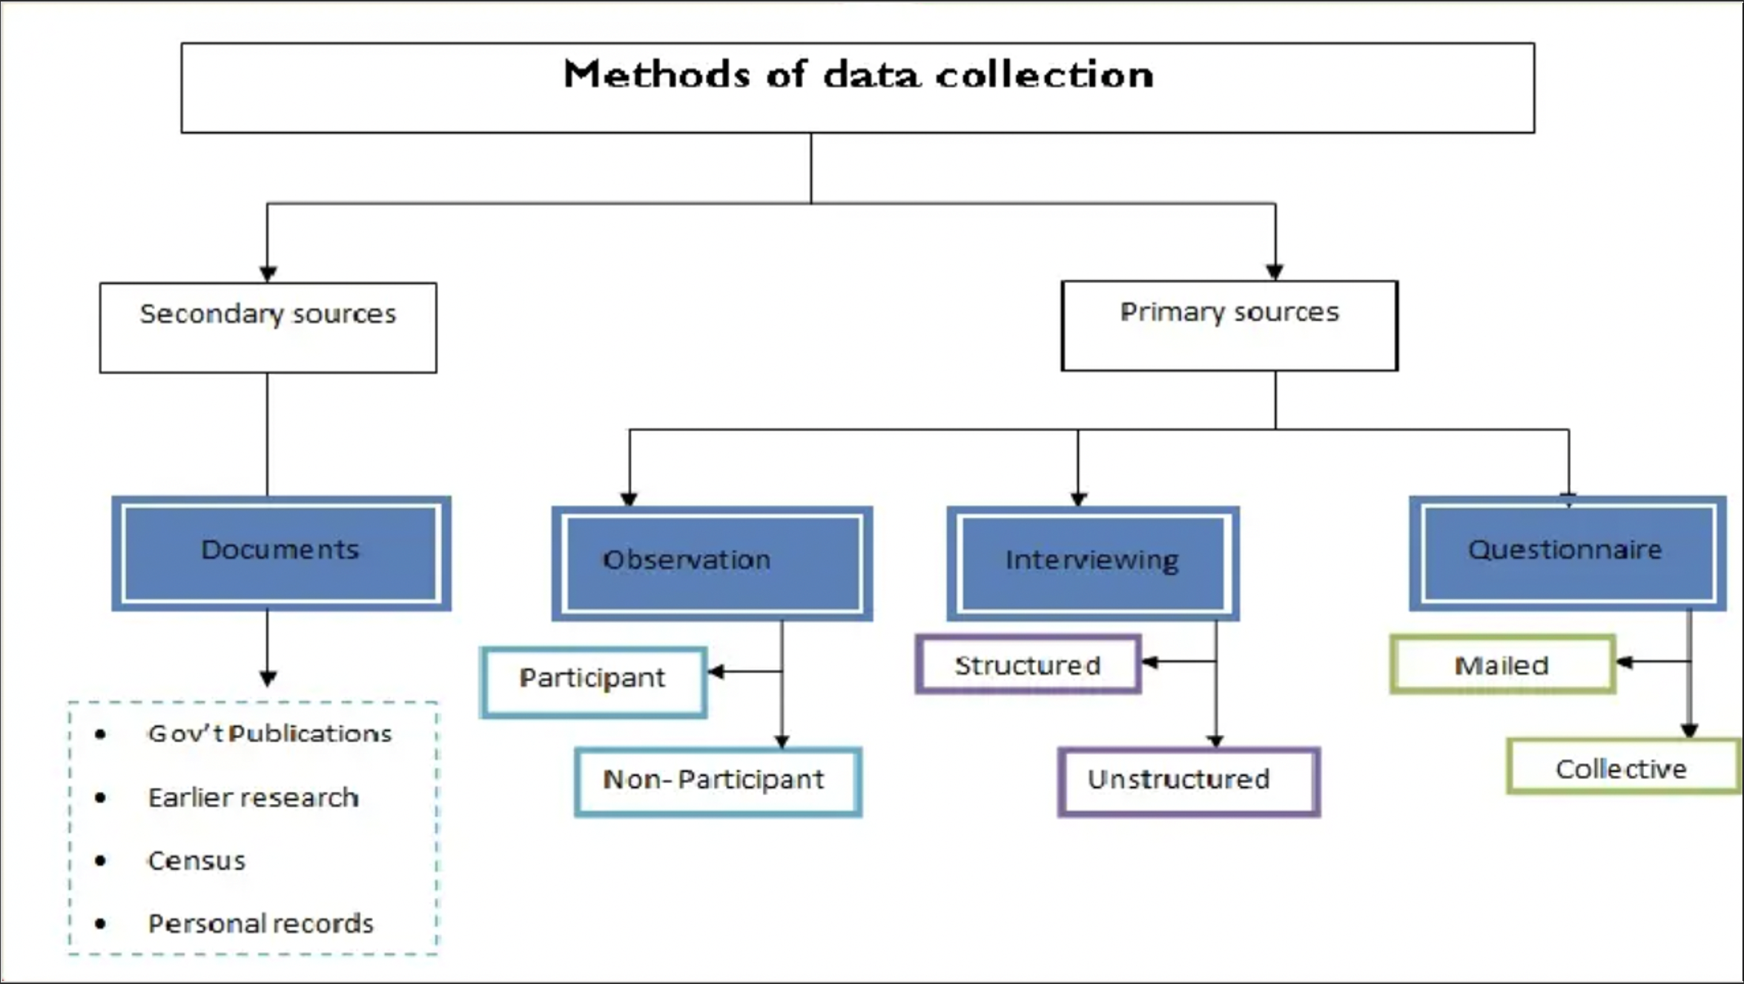

Slide 28
Research
Philosophy
Characteristics Of Good Measures
Is the measure relevant? Does it capture what matters? Does not measure what is easy as compared to what us needed.
Is the measure credible? Is the measure believable? Can it be viewed as a reasonable and appropriate way to capture the information sought?
Is the measure valid? How well does the measure capture what it is supposed to? Are waiting lists a valid measure of demand?
Is the measure reliable? The extent to which the same result would be obtained with repeated trials

Slide 29
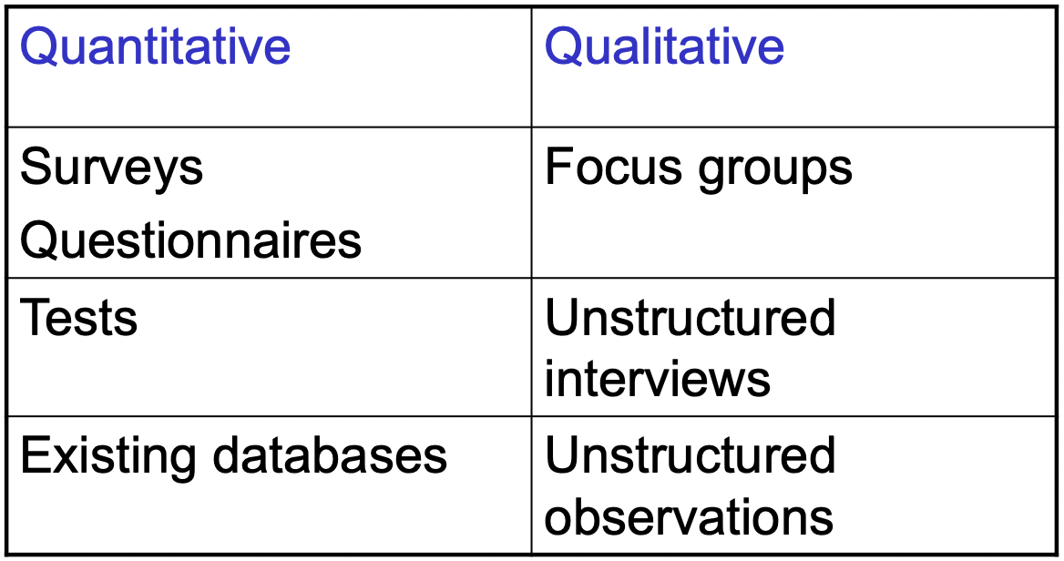
Research
Philosophy
Methods

Slide 30
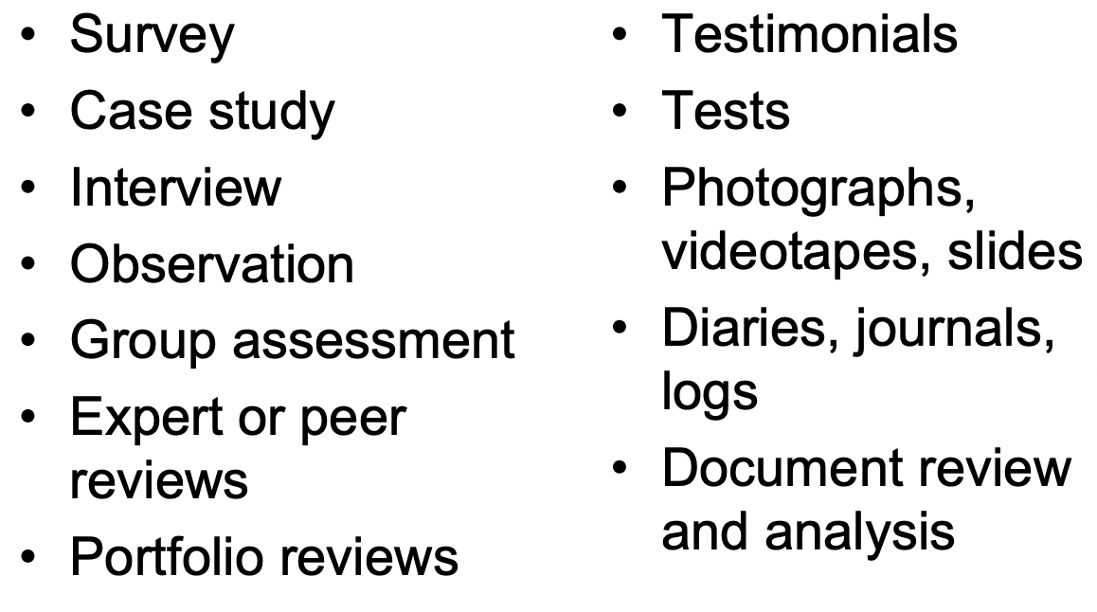
Research
Philosophy
Common data collection techniques

Slide 31
Data collection techniques
Task 4: What factors should a researcher consider when choosing a data collection method?

Slide 32

Any Questions?
Thank You ☺

Slide 33
Sources
Adams, J. (2014) Research Methods for Business and Social Science Students. New Delhi: SAGE Publications.
Clippinger, D. (2017) Business research reporting. Business Expert Press.
Creswell, J. W., & Creswell, J. D. (2018). Research Design: Qualitative, Quantitative, and Mixed Methods Approaches. 5th edition. Sage Publications.
O’Gorman, K. (2015) Research methods for business & management: a guide to writing your dissertation. 2nd ed. Oxford, England: Goodfellow Publishers Ltd.
Saunders, M., Lewis, P., & Thornhill, A. (2019) Research Methods for Business Students. 8th ed. Pearson Education Limited.
Zikmund, W. G. (2010) Business research methods. 8th ed. Mason, OH: South-Western Cengage Learning.

