Slide 1

Introduction to Code g and PACE 1984
(Jake Pooley, 2405143)

Slide 2

Introduction to Code g
Code g was designed as a practise guideline which manages focusing on legal authority of the police to detain who are participating in illegal criminal activity (Home Office, 2022).
The reasoning of the arrest must be deemed as an illegal matter as there is no tolerance of any sort of discrimination (College of Policing).
The suspect must be treated in a neutral positive manner and must follow the equality act 2010.

Slide 3

Equality act 2010
The equality act focuses on defending individuals from unlawful inequality within the police and prisoner sentencing.
It is also structured as an individual act which aids individuals to comprehend the act with more (Government equality office, 2015).

Slide 4
Objective of code G
(ACPO, 2012)
Lawful Arrest
Reasonable grounds to suspect
Match the description being via clothing or vehicle
Same described features in face
Group around a suspected area
Reasonable grounds to believe
Finding out an individual's name
Finding a individuals address
Prevent physical harm
Prevent loss of or damage to property
Investigating the offence
The objective of code G is to make sure that all arrests are made with certainty that the arrest is done in a lawful manner and with reason.

Slide 5

PACE 1984
It is seen that PACE 1984 is heavily orientated around an ideal balance with the authority of police within the free will of the community of being treated in a fair and equal manner (Home Office, 2023).
PACE is used within the overall of when police detain and inspect, apprehend, examination of a suspect and questioning and consulting prisoners or detained individuals.

Slide 6
Prisoners being treated fairly within the PACE 1984 practise
It is a vital importance that prisoners get the same treatment as others in the communities as prisoners are human to.
There are set positions that involve moving detainees being police officers or escort officers may move detains.
It is in the police officer or escort officers' duty to follow the PACE 1984 practise of receiving equal treatment (College of Policing, 2024).

Slide 7
Condition powers of arrest before code g was introduced
Prior to Code g and PACE 1984 being in place it was seen that the condition powers of arrest was deemed as police processes and reviews were not reviewed in the correct manner.
As in 1969 it was seen there was a case regarding a man by the name of David Oluwale who was found being arrest gaining bodily harm which led to the imprisonment(BBC, 2019).
Later finding out after David being released the police officers at hand of the arrest purposely wanted to make the detainees time unwelcoming and racist comments was found on the files from the police officers.
This findings came from a protest done from the community to do a inquiry which if there had been no protest this would have led to the racist comments not being found and the police officers not being arrested.

Slide 8
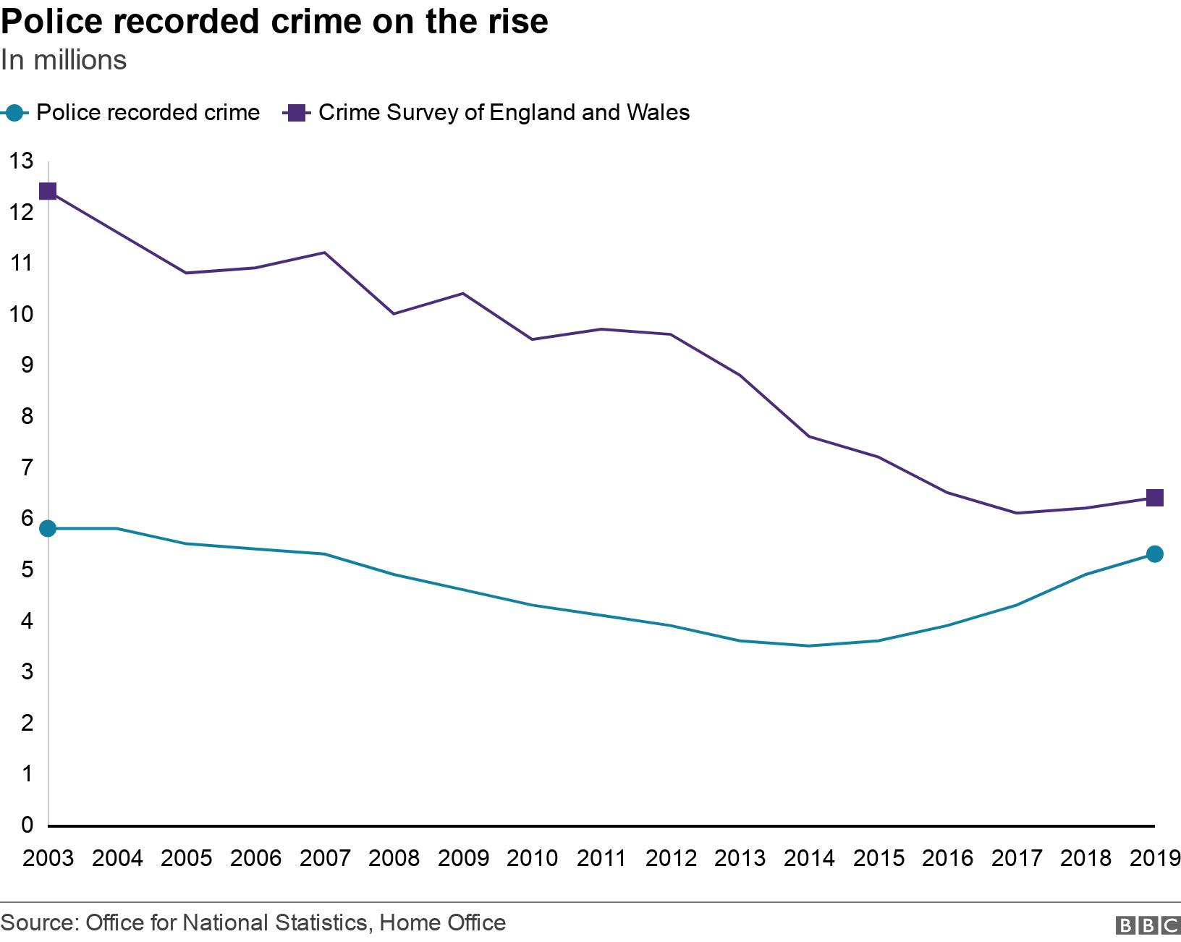
Statistics
In the graph to the right the start of Code G was originally made in 2013
As seen from the start of 2013 there is a heavy drop of recorded crimes
This can see to be possibly a result from police officers following the new legislation and policies being in place being Code G(BBC, 2019).

Slide 9
Case study
In this case study it is seen from reports of black inmates within prisoners and how they are treated.
The inmates within prisoners of an ethnic community felt as they were treated different to other ethnic communities.
These actions being treated different from the police staff and that they were not viewed as human individuals but rather viewed as groups.
These unethical actions being from prison staff showing signs of racism or racial wording.
This leads to a failure in Code G and PACE 1984 for inmates to be treated in an equal and right manner.
(HM Chief Inspector of prisoners, 2022)

Slide 10


Slide 11
Reference list
Home office (2022), PACE Code g 2022 (accessible), available at PACE Code G 2012 (accessible) - GOV.UK, (Accessed on: 5/3/2025)
Government equality office, Equality and human right commission (2015), Equality act 2010:guideline, available at Equality Act 2010: guidance - GOV.UK, (Accessed on: 5/3/2025)
College of Policing, 2024, Moving and transporting detainees, available at Moving and transporting detainees | College of Policing ,(Accessed on 5/3/2025)
Home Office, 2023, Police and Criminal Evidence act 1984 (PACE) code of practise ,available at Police and Criminal Evidence Act 1984 (PACE) codes of practice - GOV.UK, (Accessed on 5/3/2025)
Association of Chief Police Officers (2012), Necessity to arrest, available at ACPO Position Statement:, (Accessed on: 5/3/2025)
HM Chief inspector of prisoners (2022), The experience of adult black male prisoners and black prison staff, available at Thematic review: The experiences of adult black make prisoners and black prison staff, (Accessed on: 5/3/2025)
BBC, (2019), David Oluwale's death in 1969 helped 'reshape leads', available at David Oluwale's death in 1969 helped 'reshape Leeds' - BBC News, (Accessed on: 5/3/2025)
BBC (2019), Which Crimes are least likely to get solved, available at Which crimes are least likely to be solved? - BBC News, (Accessed on:
College of policing (2023), Legal Application, available at Legal application | College of Policing, (Accessed on: 5/3/2025)

