Slide 1
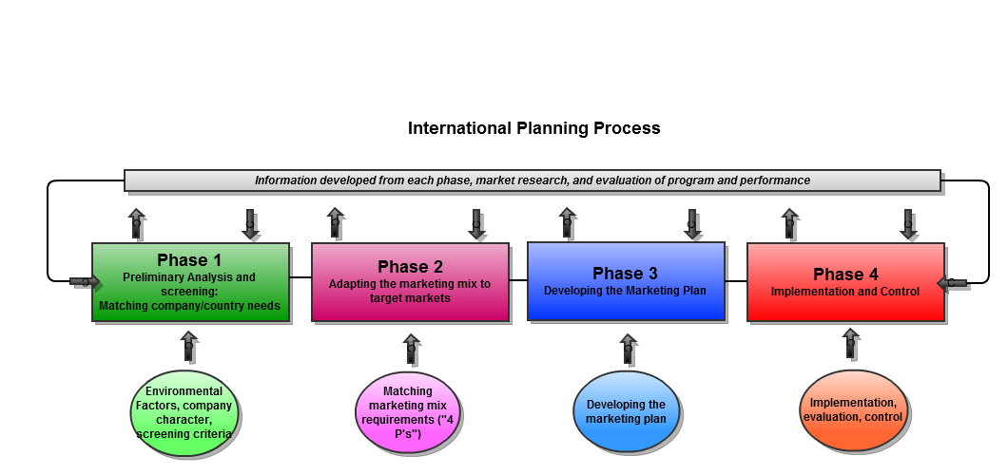
Global Marketing Strategy
Planning for International Markets

Slide 2
From the last session….
Discuss the process that Small to Medium sized Enterprise (SME) companies go through when developing their international business, (how do they relate to the theories of International trading? do you think there are other routes?
Again discuss the process that Large companies go through when developing their international business, how it relates to theory and could it be done differently?

Slide 3
Planning for International Markets
- introduction
The future is different from the past so planning is about forecasting possible and probable changes and preparing the organisation for them.
Planning for home markets is difficult, International planning is even more difficult.
Yet planning is immensely beneficial and International planning is even more beneficial
Today we are going to look at the following:
The planning process for global markets
How companies organise themselves

Slide 4
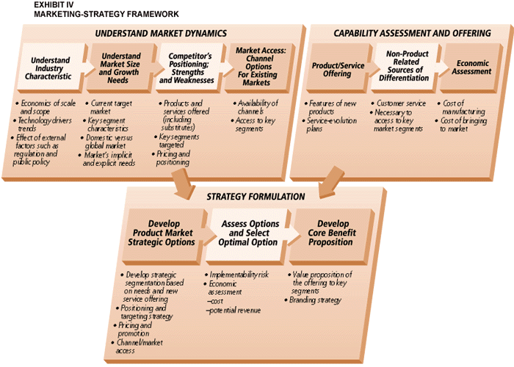
The linear planning process
- a postmodern view?

Slide 5
Planning for International Markets
- benefits of planning
Co-ordinate strategy
Proactive outlook
Systematic approach
State objectives
Clarify policies
Focuses thinking
Help react quickly
Co-ordinates decisions
Common performance standards
Common quality standards
Increase ownership of objectives
Reduces internal conflict
Standardises information systems
Integrates strategies with action programmes and control and evaluation

Slide 6
Planning for International Markets
- stages in planning for Intl markets
Remember from semester one as most companies grow into competing in International markets then they also grow into planning for International markets:
The unplanned stage (just trying to find export markets)
The budgetary stage (begin to systemise the organisations export activities)
Annual business planning (whole business begins to plan for the foreign markets)
Strategic planning stage (standardised planning process creating a working document)

Slide 7
Planning for International Markets
- levels of management
Levels of management for domestic and International markets are:
The strategic level
The management level
The operational level
The functions [HRM, production, MARKETING. etc] of the operations will each have their own plan.
The main tasks of management have been identified as analysis, planning, implementation and control.

Slide 8
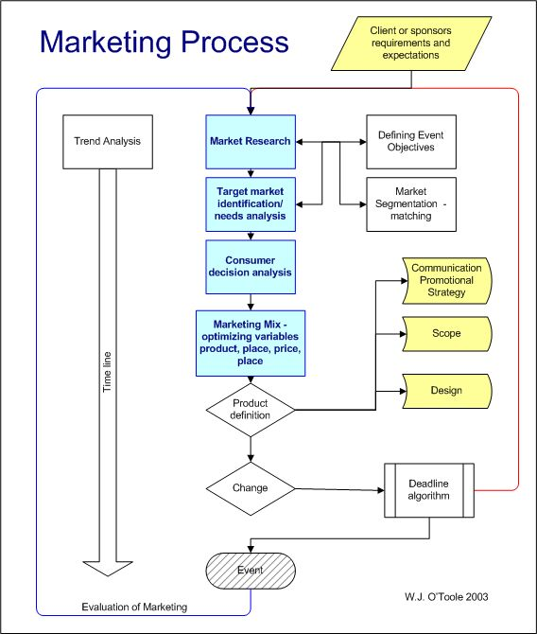
Essentials of the marketing process for planning

Slide 9
Planning for International Markets
- the planning cycle
Any organisation should be able to answer the following questions:
Where are we now? - analysis
Where do we want to be? - planning
How are we going to get there? - planning
Which way is best? - implementation
How can we ensure arrival? - control

Slide 10
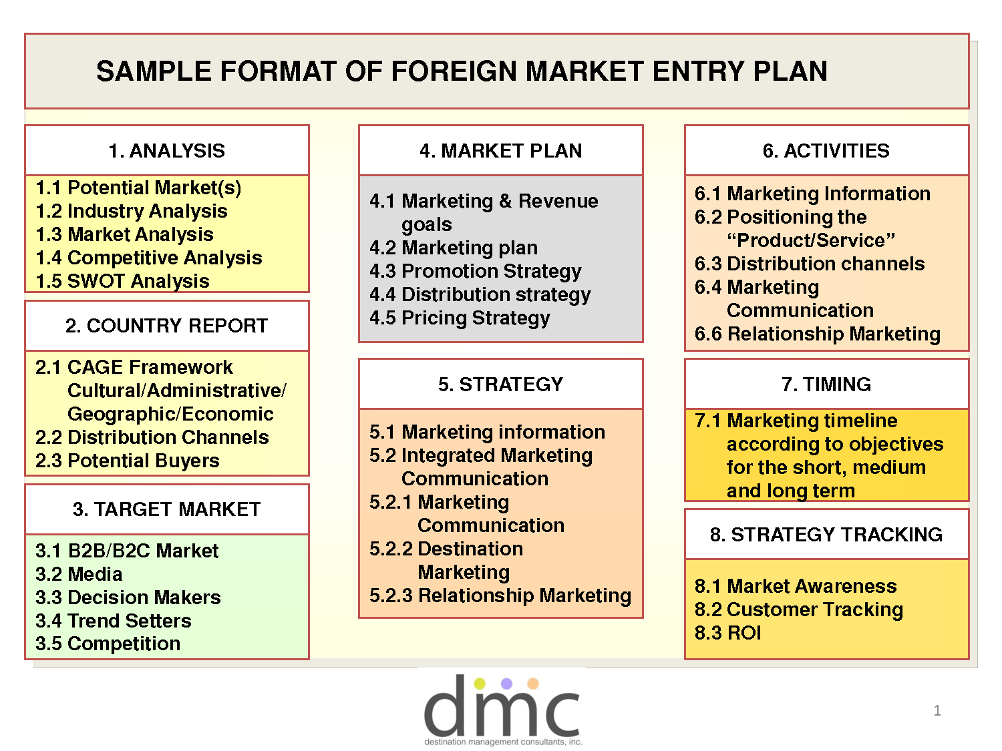
Planning for International Markets
- the sections of the plan
Situation or context analysis [macro, micro & internal] – where are we now?
Mission statement and Objectives: org. intentions – where do we want to be?
Strategy selection: method chosen to achieve objectives – how might we get there?
Tactics and Action: deployment of resources and activities to be undertaken to fit strategy – which way is best?
Control and Evaluation – how can we ensure arrival?
* Contingency plans

Slide 11
Planning for International Markets
- factors influencing orgn structure
Size of the business
No. of markets it operates in
Level & nature of involvement
Company objectives
Company international experience
Nature of the product
Nature of the marketing task
Width & diversity of product range

Slide 12
Planning for International Markets
- organisation structure options
The basic options are:
Product structured
Geographic structured
Developments have seen other options like:
Macropyramid: centrally controlled
Umbrella: decentralised control
Interconglomerate: subsidiary runs itself
Transnational: orgn driven by international mgr

Slide 13
Planning for International Markets
- student activity
Identify ten problems faced by organisations in planning for International Markets
Are there any arguments against planning and how could they be overcome?
What is the relationship between strategy and structure?
What is most important, the plan or the planning?

