Slide 1

MBA – Master of Business Administration
LCMB7024
Marketing Management
Notes:
Full-time students, a great university: No Exam / 10 modules 1 x month
Improve Your Workplace Skills Only way fail – can’t be bothered / we can’t be bothered
First module - Personal Development for Improvement: Always slides & Hand-outs

Slide 2
Week 4
Lecture 8
Creating Customer
Value, Satisfaction and Loyalty
Notes:
Full-time students, a great university: No Exam / 10 modules 1 x month
Improve Your Workplace Skills Only way fail – can’t be bothered / we can’t be bothered
First module - Personal Development for Improvement: Always slides & Hand-outs

Slide 3
Creating Customer Value, Satisfaction and Loyalty
At the end of today’s lecture, students should be able to:
What are customer value, satisfaction and loyalty, and how can companies deliver them?
What is the lifetime value of customers and how can marketers maximise it?
How can companies cultivate strong customer relationships?

Slide 4
Creating Customer Value, Satisfaction and Loyalty
At the end of today’s lecture, students should be able to:
How can companies both attract and retain customers?
What is the Experience Economy and how does it relate to customer’s perception of value?

Slide 5
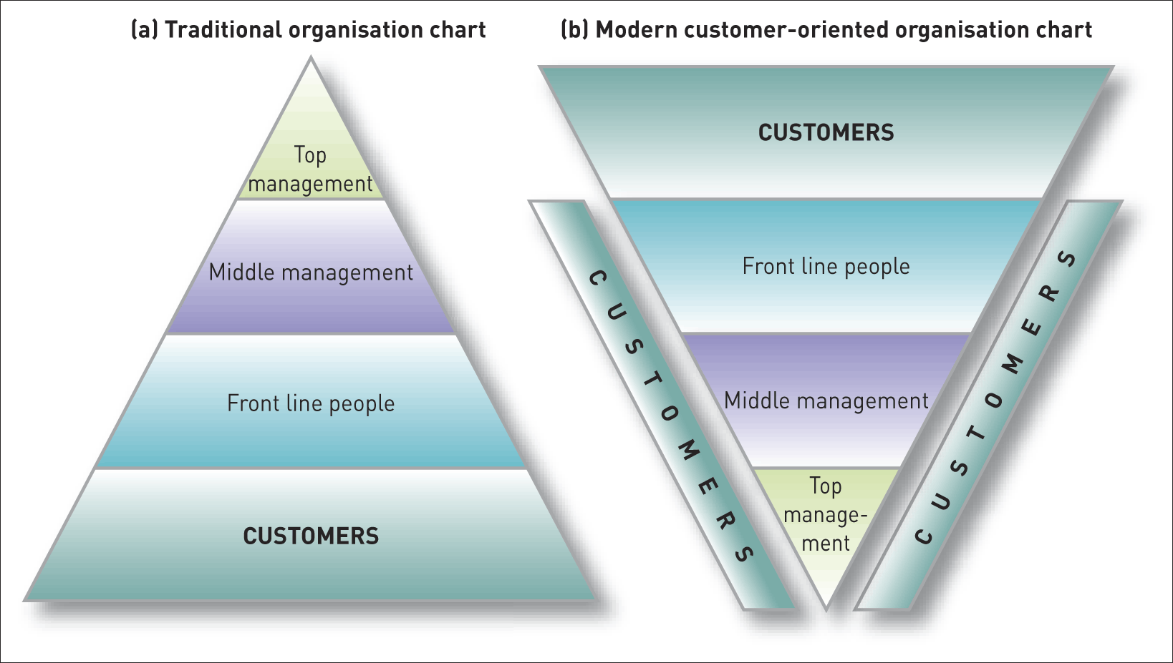
Creating Customer Value, Satisfaction and Loyalty
Traditional organisation vs. modern customer-oriented company organisation

Slide 6
Creating Customer Value, Satisfaction and Loyalty
What is Customer Perceived Value?
Customer perceived value is the difference between the prospective customer’s evaluation of all the benefits and all the costs of an offering and the perceived alternatives.

Slide 7
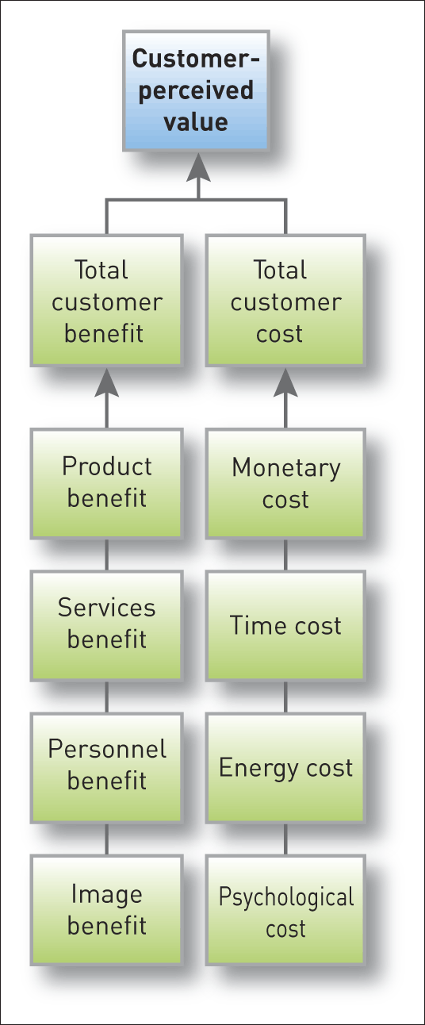
Creating Customer Value, Satisfaction and Loyalty
Determinants of Customer-Perceived Value

Slide 8
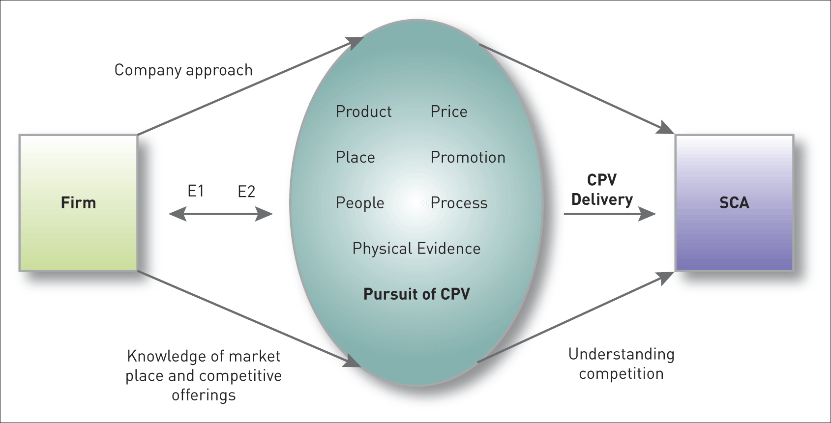
Creating Customer Value, Satisfaction and Loyalty
The Pursuit of Customer Perceived Value
The pursuit of customer-perceived value

Slide 9
Creating Customer Value, Satisfaction and Loyalty
What is loyalty?
Loyalty is a deeply held commitment to re-buy or re-patronise a preferred product or service in the future despite situational influences and marketing efforts having the potential to cause switching behaviour.
For a discussion on customer loyalty programmes go to
www.youtube.com/watch?v=HK-dDtRcO4M
and www.youtube.com/watch?v=4AfGuyxvhs0&feature=related

Slide 10
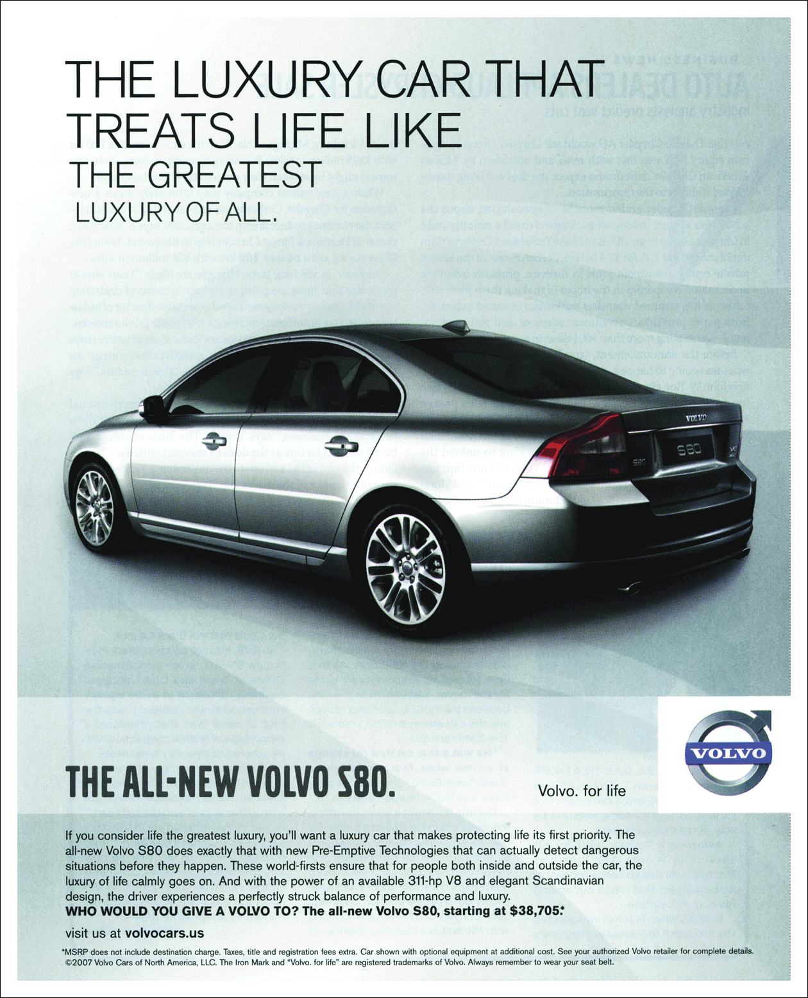
Creating Customer Value, Satisfaction and Loyalty
The Value Proposition
Safety is a leading, but not the only, benefit promised in Volvo’s value proposition
Source: Courtesy of Volvo Car Corporation / Agency: Arnold
The value proposition
consists of the
whole cluster of
benefits the
company promises
to deliver

Slide 11
Creating Customer Value, Satisfaction and Loyalty
How do buyers form their expectations?
Expectations result from past buying experience, friends’ and associates’ advice, and marketers’ and competitors’ information and promises.

Slide 12
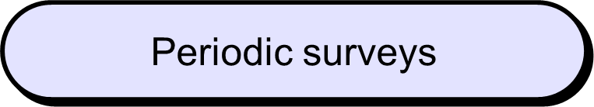
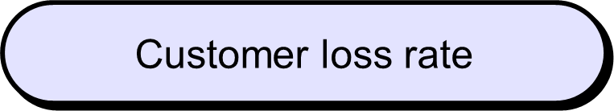
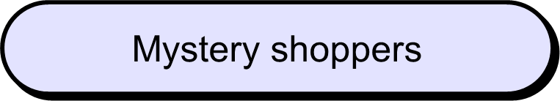
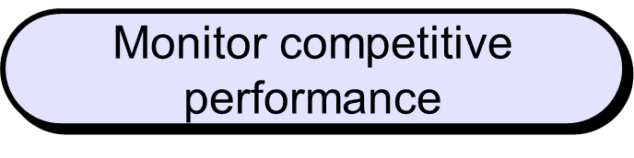
Creating Customer Value, Satisfaction and Loyalty
Measuring Satisfaction:
In this video clip, the DNA of customer experience is bookmercial that discusses emotional clusters that explain how customer experience is driven: www.youtube.com/watch?v=Y7i3IL3Q2qQ&feature=related

Slide 13
Creating Customer Value, Satisfaction and Loyalty
Recovering customer goodwill after a bad experience
Set up a hotline to receive and act on complaints
Contact the complaining customer as soon as possible
Accept responsibility for the customer’s disappointment
Use empathetic customer service people
Resolve the complaint to the customer’s satisfaction quickly

Slide 14
Creating Customer Value, Satisfaction and Loyalty
What is quality?
Quality is the totality of features and characteristics of a product or service that bear on its ability to satisfy stated or implied needs.

Slide 15
Creating Customer Value, Satisfaction and Loyalty
Maximising Customer Lifetime Value
For a brief video clip by a marketing executive of Johnson & Johnson in which he stresses the importance of customer lifetime value: www.youtube.com/watch?v=uOqGReUyaYI
Customer
profitability
Customer
equity
Lifetime
value

Slide 16
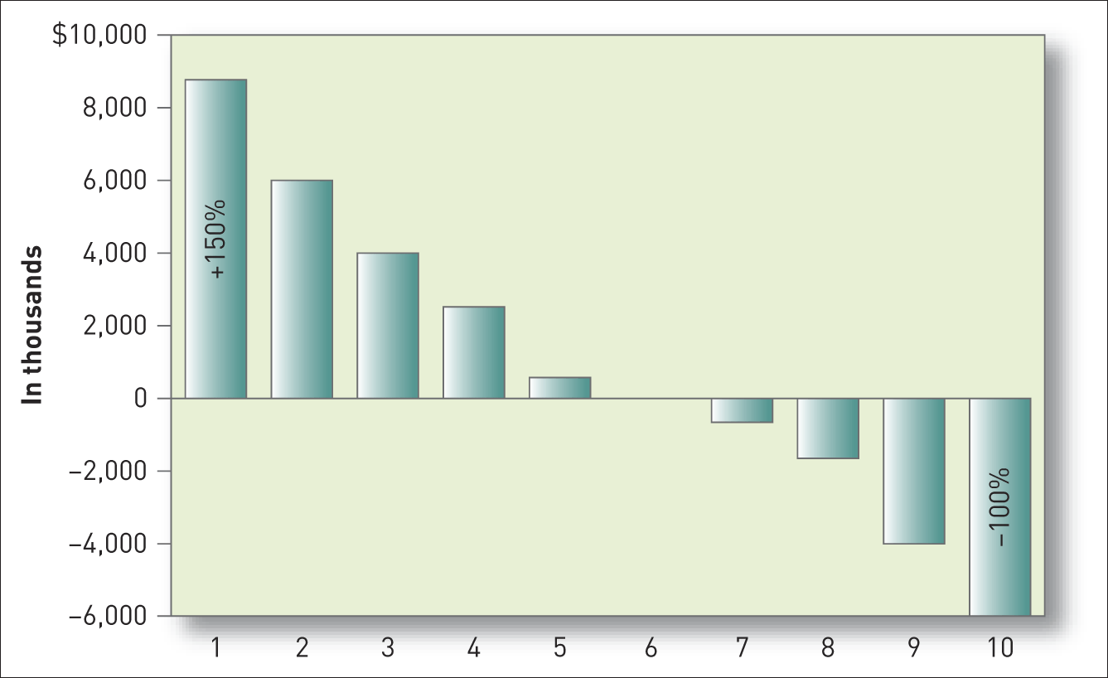
Creating Customer Value, Satisfaction and Loyalty
The 150-20 Rule
The 150-20 rule: ‘the 20 per cent most profitable customers generate as much as 150 per cent of the profits of a company; the 20 per cent least profitable lose 100 per cent of the profits’
Source: L. Selden and Y. S. Selden (2006) Profitable customer: the key to great brands, Advertising Age, 77(28), 7–9. Copyright © 2006 Crain Communications, Inc. Reproduced with permission

Slide 17
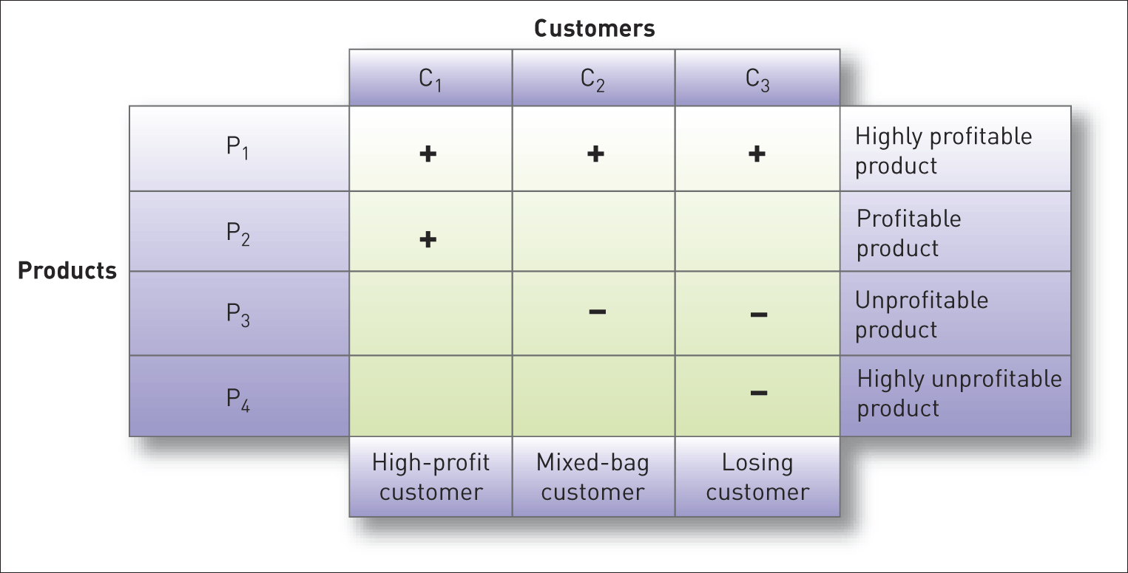
Creating Customer Value, Satisfaction and Loyalty
Customer-Product Profitability Analysis

Slide 18
Creating Customer Value, Satisfaction and Loyalty
What is the Experience Economy?
The term ‘experience economy’ was first coined in 1999 by Pine and Gilmore when they described an advanced service economy that began to market a ‘mass customisation’ of service offerings.
Using theatre as a metaphor they argued that business should function in a similar way to a theatre that develops and presents a performance which it hopes will be appreciated by its audience.

Slide 19
Creating Customer Value, Satisfaction and Loyalty
Steps in the Co-creation Process
Define clear objectives for the project.
Discover who are the right customers to involve in the process.
Work with customers to discover what they really want to include in a market offering.
Design market offerings-systems jointly to meet those customers’ needs.
Share the customer-perceived value.
Overcome internal resistance to change.

Slide 20
Creating Customer Value, Satisfaction and Loyalty
Elements in the Experience Scorecard
Personal relevance
Novelty
Surprise
Learning
Engagement

Slide 21
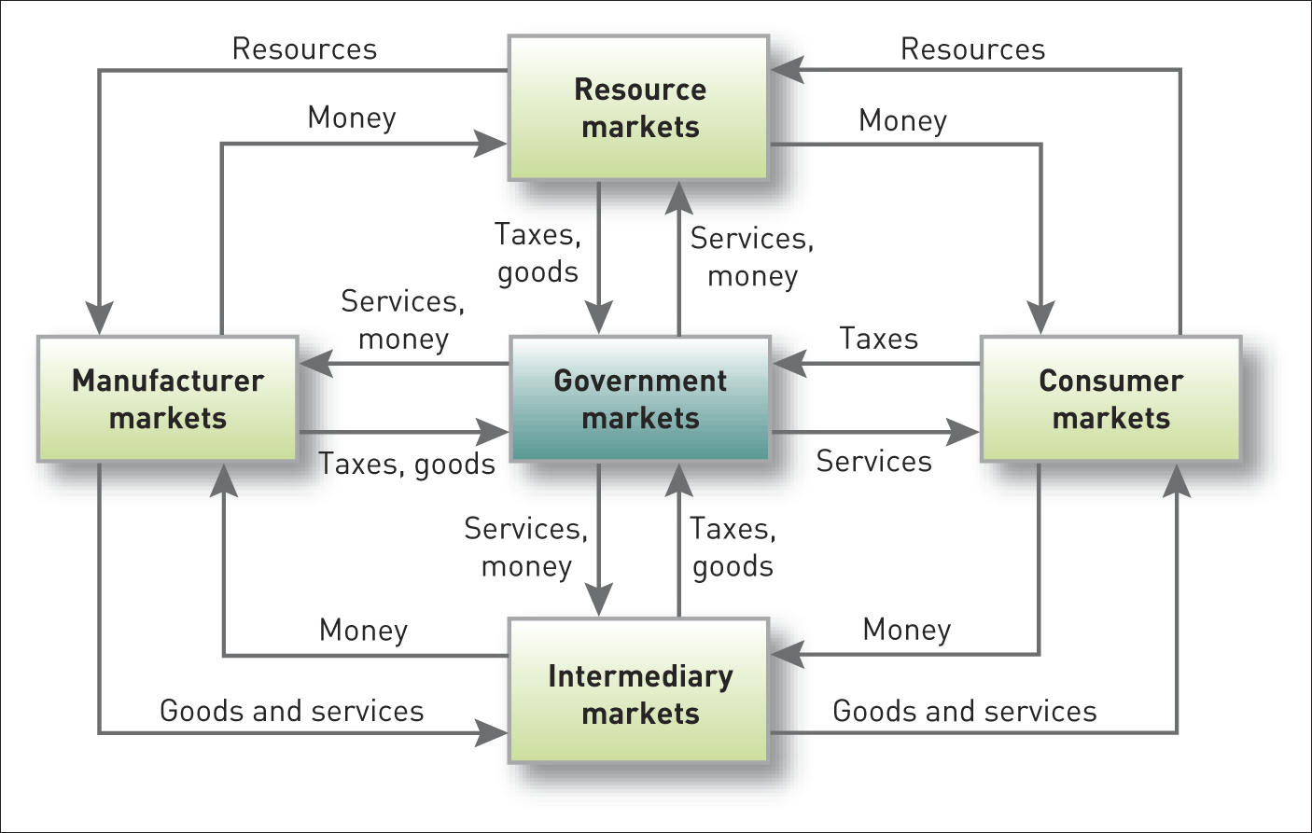
Creating Customer Value, Satisfaction and Loyalty
Structure of Flows in a Modern Exchange Economy.

Slide 22
Creating Customer Value, Satisfaction and Loyalty
Consider what is meant by customer-perceived value.
This video clip explains how companies can deliver customer value: Understanding what customers value - YouTube

Slide 23

Further Readings for Week 4.
Article:
Parasuraman, A., Valarie Zeithaml, and Leonard Berry (1985), "A Conceptual Model of Service Quality and Its Implications for Future Research," Journal of Marketing, 49 (Fall), 41-50
Prahalad, C. K. and Ramaswamy, V. (2003) The New Frontier of Experience Innovation, MIT Sloan Management Review, 44(4), 12–18.
Case Study:
Cheap but no Longer Nasty - Evolution at Ryanair

Slide 24
References.
Dawkins, P. and F. Reichheld (1990), "Customer Retention as a Competitive Weapon," Directors and Boards, 14 (Summer), 42-47
Griffin, J., (2002). Customer Loyalty: How to Earn It, How to Keep It, New and Revised Edition, Weekly publisher Gummesson, E., (2002) Total Relationship Marketing, 2nd edn, London: Elsevier
Parasuraman, A., Valarie Zeithaml, and Leonard Berry (1985), "A Conceptual Model of Service Quality and Its Implications for Future Research," Journal of Marketing, 49 (Fall), 41-50.
Raphel, M. and Raphel, N. (1995), Up the Loyalty Ladder: Turning Sometime Customers into Full-Time Advocates of Your Business, HarperBusiness, New York.

Slide 25

Marketing Management
Any Question

