Slide 1
Introduction to
Project Management

Slide 2
Introduction to Project Management
Learning Objectives
By the end of this lecture, students will be able to:
    Project Management
    Understanding Principles, Lifecycle, and Applications
Engineering Project and Management

Slide 3
Introduction to Project Management
What is Project Management?
- Organising, planning, and executing tasks to achieve specific objectives.
Example:
    Building construction projects.
    Software development processes.
    Event management like organising conferences or festivals.
Engineering Project and Management

Slide 4
Introduction to Project Management
What is Project Management?
Organising: Coordinating resources, including people, equipment, and materials, to ensure tasks are completed efficiently.
Planning: Setting clear goals, identifying resources, and creating schedules and workflows to achieve objectives.
      Executing tasks: Implementing the plan by assigning tasks, managing teams, and ensuring work aligns with project goals.
Engineering Project and Management

Slide 5
Introduction to Project Management
Importance of Project Management
Timely Achievement of Goals : Project completion within time frame.
Budget Management : Ensures cost efficiency by minimising waste and managing resources effectively.
Quality Assurance : Implements standards and checks to ensure deliverables meet expectations.
Risk Management : Identifies potential risks early and devises mitigation strategies.
Engineering Project and Management

Slide 6
Introduction to Project Management
Stages of Project Management
Specifying / Defining a project
Planning
Monitoring
Implementing
Testing & Evaluation.
Reporting
Engineering Project and Management

Slide 7
Introduction to Project Management
Stage 1: Specifying / Defining a project
Initial concepts
Setting Limits
Research
Specifications
Engineering Project and Management

Slide 8
Introduction to Project Management
Initial concepts
Reflection on the Problem:
  Free-thinking or brainstorming to arrive at a breakthrough idea.
  Designers may look for ways to surpass the competition.
  Project Team Collaboration:
    Teams work together to come up with initial concepts and ideas.
    Encourages "thinking outside the box" and open discussion of ideas.
Engineering Project and Management

Slide 9
Introduction to Project Management
Initial concepts
    Recording Ideas:
      All ideas are documented, even if they initially seem unrealistic.
    Decision-Making:
      The team evaluates recorded ideas and decides which products or initiatives to develop.
Engineering Project and Management

Slide 10
Introduction to Project Management
Setting Limits
Chance of Success: Ensure the concept or idea has a realistic chance of success before proceeding.
Resource Implications: Development requires significant investment in time and money.
Feasibility Study: Conduct a study before full-scale development to assess feasibility.
Engineering Project and Management

Slide 11
Introduction to Project Management
Setting Limits : 4 - Parameters:
    Time: Assess the timeline to achieve a viable solution, particularly for rapidly evolving technologies such as microelectronics and telecommunications.
    Cost: Evaluate the development costs involved.
    Feasibility: Determine if the concept is practical or overly ambitious.
    Need: Identify whether there is a clear market demand for the product.
Engineering Project and Management

Slide 12
Introduction to Project Management
Research
Research the chosen topic thoroughly after identifying the initial concept.
Gather sufficient information to make informed decisions for the project's specification.
Identify critical aspects such as Product size (dimensions),Materials to be used, Expertise/team/personnel required.
Plan research objectives and questions to answer before starting the research exercise.
Use brainstorming sessions to identify all relevant criteria effectively.
Engineering Project and Management

Slide 13
Introduction to Project Management
Project Specifications
Contains detailed information on requirements, legal standards, materials, and physical dimensions.
Requires consideration of technical requirements, timescale, resources, and budget.
Engineering Project and Management

Slide 14
Introduction to Project Management
Project Specifications - Template
Describe Project
  purpose, aims and deliverables.
State parameters
  timescales, budgets, scope, authority.
Engineering Project and Management

Slide 15
Introduction to Project Management
Project Specifications - Template
People involved
  States people involved and the way the team will work (frequency of meetings, decision-making process).
Establish 'break or review-points’
  to meet review and check progress, and how progress and results will be measured.
Engineering Project and Management

Slide 16
Introduction to Project Management
Stage 2 : Planning
Identify Activities: Determine the activities to be carried out in the project.
List with Timings: Organise the activities into a list with approximate timings for each.
Consider Goals and Objectives:
  Treat each activity as a goal or objective.
  Identify the resources required for each activity.
  Develop ways to monitor progress and achievement.
Engineering Project and Management

Slide 17
Introduction to Project Management
Stage 2 : Planning(conti..)
  Set Milestones:
    Establish expected outcomes at specific points in the project.
    Define milestones for these outcomes.
    Monitor Milestones:
      Decide on how and when milestones will be monitored.
      Add time markers to planning tools like Gantt charts.
Engineering Project and Management

Slide 18
Introduction to Project Management
Techniques for Effective Project Planning
Visual Techniques for Planning: Utilise various techniques to visually outline the project, showcasing the essential activities to be accomplished.
Flowcharts and Block Diagrams: A flowchart or block diagram can effectively represent the project's key stages and tasks.
Engineering Project and Management

Slide 19
Introduction to Project Management
Techniques for Effective Project Planning (conti..)
Traditional Phased Approach: This method, known as the ‘traditional phased approach’ to project management, helps structure the process.
Industry Variations: Many industries adapt these project stages to suit their needs. For instance, in software development, it is commonly referred to as the waterfall model.
Engineering Project and Management

Slide 20
Introduction to Project Management
Project chart 1: Flow-chart
The chart has no timings attached to each activity.
Ideal for showing the various stages of a project in an easy-to-see format.
Useful for presenting information about how your project is being set up.
Engineering Project and Management

Slide 21
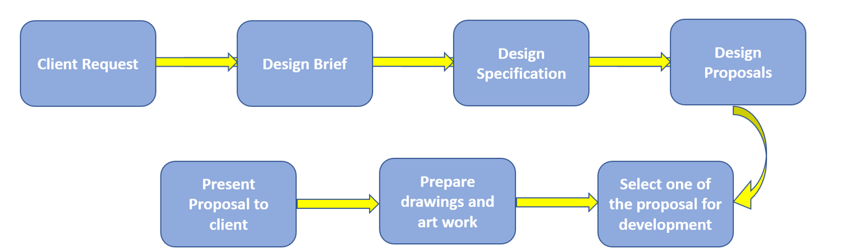
Introduction to Project Management
Project chart 1: Flow-chart
Engineering Project and Management

Slide 22
Introduction to Project Management
Project chart 2: Gantt chart
Named after US engineer and consultant Henry Gantt (1861-1919) who devised the technique in the 1910s.
Very well established method for showing the various activities which contribute to a project.
These are set out against a timeline and will have review points.
Engineering Project and Management

Slide 23
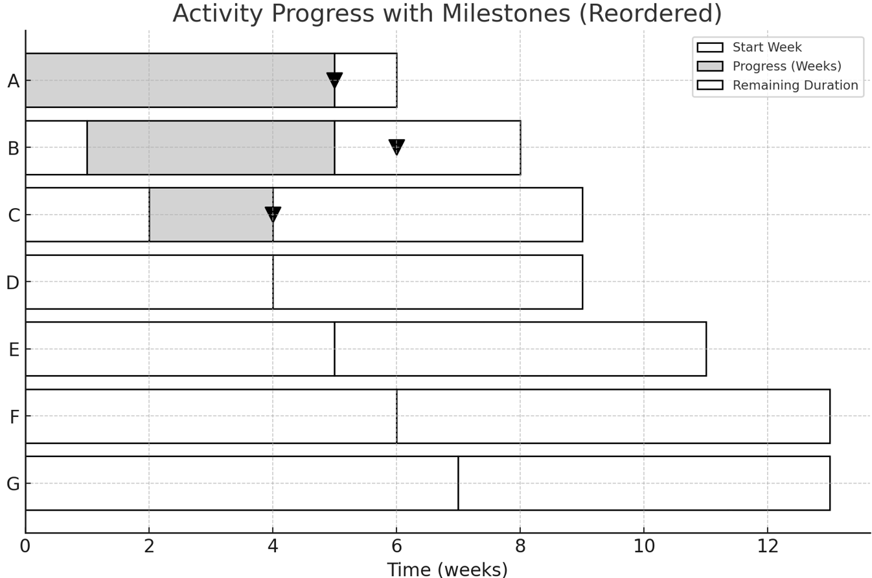
Introduction to Project Management
Project chart 2: Basic Gantt chart
Engineering Project and Management

Slide 24
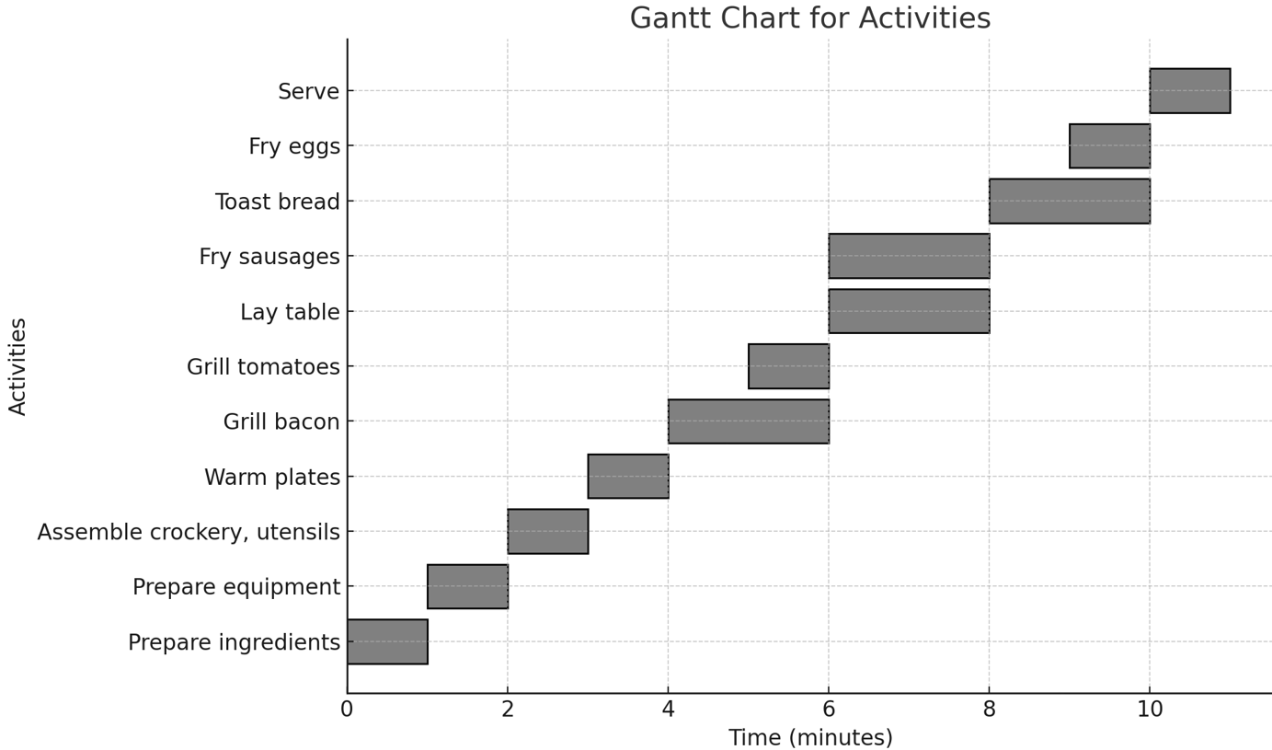
Introduction to Project Management
Project chart 2: Basic Gantt chart including Costs
A Gantt chart like this can be used to keep track of progress for each activity and how the costs are running.
The breakfast example shows the capital cost of the consumable items and a revenue cost for labour and fuel.
Engineering Project and Management

Slide 25
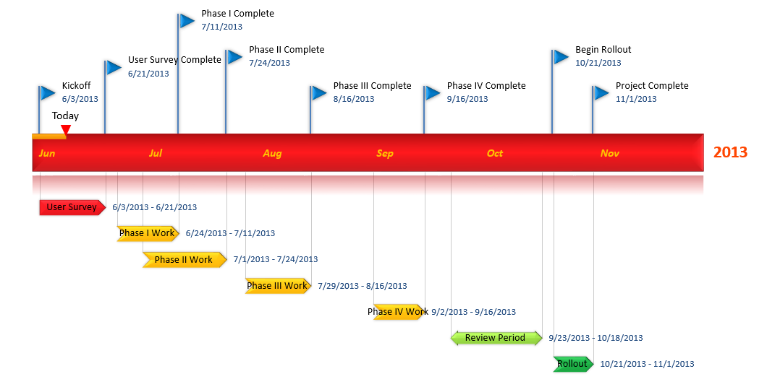
Introduction to Project Management
Flags: Key Milestones / Time-markers
Engineering Project and Management

Slide 26
Introduction to Project Management
Stage 3 : Monitoring
Monitoring and Recording Achievements:
  Managed by the Project Manager throughout the project.
  Done using tools like a logbook, journal, or diary.
  Purpose of the Logbook:
    A working document containing real-time notes and records.
    Includes notes on discussions, challenges, and decisions.
    Captures problems, revisions, and process updates.
Engineering Project and Management

Slide 27
Introduction to Project Management
Stage 3 : Monitoring (conti..)
Content of the Logbook:
  Important dates, names, addresses, and contact information.
  Goals, milestones, and critical project details.
Modern Tools for Record Keeping:
  Electronic and cloud-based applications like Google Drive, Evernote can be used.
  Offers a more streamlined and accessible approach.
Engineering Project and Management

Slide 28
Introduction to Project Management
Stage 3 : Monitoring (conti..)
Importance of Maintaining Records:
  Ensures a complete record of the project’s progress.
  Includes specifications, manufacturing data, and test results.
  Provides a full audit trail for accountability and future reference.
Engineering Project and Management

Slide 29
Introduction to Project Management
Stage 4 : Implementing
Stages of Engineering Projects:
  Specification formulation.
  Conceptual design.
  Detailed design.
  Manufacture.
  Testing.
  Evaluation against the initial specification.
Engineering Project and Management

Slide 30
Introduction to Project Management
Stage 4 : Implementing
Role of the Project Manager:
    Communicates with team members throughout the project.
    Ensures progress towards individual goals and milestones.
Teamwork Importance:
    Understanding how to work respectfully with others.
    Collaboration is key to implementing and achieving the project aim.
Engineering Project and Management

Slide 31
Introduction to Project Management
Stage 5 : Testing & Evaluation.
Final Checks: Ensure the project meets the specifications.
Functionality: Verify the product functions as planned.
Evaluation Methods: Use evaluative and analytical techniques.
Outcome Assessment: Compare the final product to original specifications through testing.
Project Success: Use Gantt charts and financial reports to evaluate progress and budget.
Engineering Project and Management

Slide 32
Introduction to Project Management
Stage 6 : Reporting
Final Stage - Reporting Back:
  Report to stakeholders, including financial backers and management.
  Dissemination to professionals, academics, and attendees of events like conferences and trade shows.
Use of Project Planning Charts:
  Tools like Gantt and CPM charts are helpful for reporting and presentations.
.
Engineering Project and Management

Slide 33
Introduction to Project Management
Stage 6 : Reporting (cont..)
Logbooks as References:
  Logbooks or diaries documenting the project are valuable reference materials.
  Useful for preparing reports and presentations.
Engineering Project and Management

Slide 34
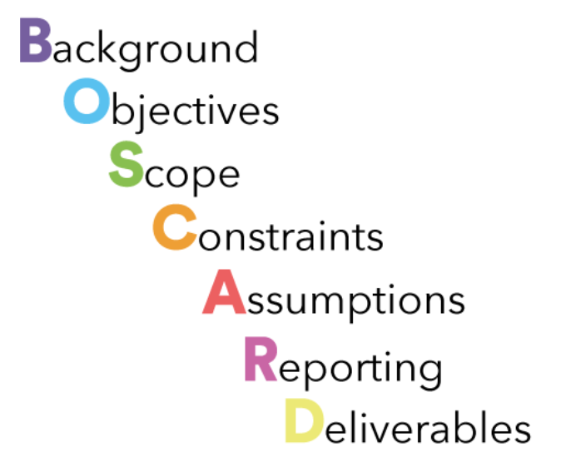
Introduction to Project Management
BOSCARD :
Originated by Cap Gemini in 1980s.
Strategic planning tool used to give the terms-of-reference for new projects. It is believed to have originated with consulting company Cap Gemini in the 1980s.
Quick way of delivering all the necessary project information to stakeholders, without having to complete a full project initiation document
Engineering Project and Management

Slide 35
Introduction to Project Management
BOSCARD :
Background : includes the reasons for creating the project and mentions the key stakeholders who will benefit from the project result.
Objectives : Describe the project goals and link each of them with related, SMART project objectives.
Scope : Provide a high-level description of the features and functions that characterise the product, service, or result the project is meant to deliver.
Engineering Project and Management

Slide 36
Introduction to Project Management
BOSCARD :
Constraints : Identify the specific constraints or restrictions that limit or place conditions on the project, especially those associated with project scope.
Assumptions : Specify all factors that are, for planning purposes considered to be true. During the planning process, these assumptions will be validated.
Engineering Project and Management

Slide 37
Introduction to Project Management
BOSCARD :
Risks : Outline the risks identified at the start of the project. Include a quick assessment of the significance of each risk and how to deal with them.
Deliverables : Define the key deliverables the project is required to produce to achieve the stated objectives.
Engineering Project and Management

Slide 38
Introduction to Project Management
Health and Safety
Legal Compliance for Products
Protecting Workers' Health and Safety
Engineering Project and Management

Slide 39
Introduction to Project Management
Health and Safety - Legal Compliance for Products
Products must meet relevant legal requirements.
  Examples:
    Motor vehicles must comply with regulations on exhaust emissions and crash protection.
    Electrical products must adhere to standards for electromagnetic compatibility (EMC).
    Manufacturers must limit electromagnetic radiation levels according to EU directives.
Engineering Project and Management

Slide 40
Introduction to Project Management
Health and Safety - Protecting Workers Health and Safety
Businesses must ensure the safety of workers during production or service delivery.
Examples:
    Use manufacturing techniques that follow workplace health and safety regulations.
    Electronics companies should use lead-free solder and minimize materials like beryllium copper, which pose health hazards.
Engineering Project and Management

Slide 41
Design Of Experiments
Reference
    [1] National Engineering, London: Edexcel, 2010. [Online]. Available: http://www.businessballs.com/project.htm. [Accessed: Jan. 26, 2025].
    [2] National Engineering, London: Edexcel, 2010. [Online]. Available: http://www.businessballs.com/project-sponsorship.htm. [Accessed: Jan. 26, 2025].
Engineering Project and Management

Slide 42
Thank You

