Slide 1
Indirect effect and state liability
By Zita Draper

Slide 2
Content
Aims and Learning Objectives
Indirect effect and state liability
Activities
Summary
Thank You

Slide 3
Aims and Learning Objectives
The aim of todays session is to recap the lecture content.
By the end of today’s session students should be able to understand indirect effect and state liability and apply what has been learnt to the activities set.

Slide 4
Indirect effect

Slide 5
Indirect effect
‘’ A principle of interpretation whereby the courts of the member states of the European Union (EU) must interpret national laws (particularly any that implement EU directives) as far as possible in a manner that is consistent with the provisions of EU law even if they do not have direct effect.’’
C-106/89 Marleasing
C-105/03 Pupino
C-334/93 Wagner Miret
If direct effect and indirect effect is not available, the final resort available is to ‘’obtain damages’’.
Notes:
Indirect effect (EU) | Practical Law (thomsonreuters.com)

Slide 6
Indirect effect
National law needs to be interpreted in light to EU law.
Notes:
Microsoft PowerPoint - Main characteristics of EU law TKR_Ankara May 2011 [Uyumluluk Modu] (ab.gov.tr)

Slide 7
Indirect effect
https://www.youtube.com/watch?v=Rusup3Pm22Y

Slide 8
Indirect effect
Directives can be influenced by general principles.
C144/04 Mangold v Helm.
Horizontal direct effect does not apply to directives.
C-212/04 Adeneler v ELOG- clarified the position held in Mangold.
Notes:
ELOG case – ‘’Means that they should not, prior to the expiry of the implementation, interpret national law in a manner that might compromise the objectives of the directive when the implementation period has then expired. . Removes the difference between directives and regulations, which is the implementation period’’.
‘’ in other words, the directive constitutes a specific , application of the general principle of equal treatment and it is the general principle that applies directly between parties, not the directive’’.

Slide 9
Remedies
‘’Provide new remedies to ensure a balance between the objective to protect the national procedural autonomy and at the same time to protect the effectiveness of EU law.’’
Article 19 (1) TEU.

Slide 10

Activity
In groups, please answer the following questions;
- What difficulties may be faced by national courts in trying to operate indirect effects? Use case law to explain your answer.

Slide 11

State liability
EU Law - State Liability - YouTube

Slide 12

State Liability
Failed to implement a directive- individual needs to rely on state liability to bring their case.
Individual
State

Slide 13
C-6 and 9/90 Francovich
‘’Member state failed to comply with the Community law obligations. ‘’
‘’Allowed action against member states to enforce EU law and overcome the difficulties generated by the lack of Horizontal direct effects of directives or where the Ven gend en loos criteria is not met’’
If breach article 4(3) TEU and 288 TFEU- remedy.
Developed by C-46 and 48/93 Brasserie du pecheur v federal republic of Germany, factortame v UK (No.3)
Developed the requirements.
Notes:
Liability without breach can happen.
Article 258 TFEU.
If the breach can be proven then – ‘’the damages arise from the date of infringement.’’
‘’Extended to determined liability between private parties’’
‘’State liability also applies to a breach of EU law rights by the judiciary’’
C-224/01 Gerhard Kobler v Republic of Austria.

Slide 14
Activity
Does everyone have access to a smart phone or tablet/laptop?
Head to Kahoot.com and sign up for an account please.
Create a Kahoot quiz regarding indirect effect and state liability at random I will choose one individual to host a Kahoot.
This is to test students knowledge of the subject area.

Slide 15
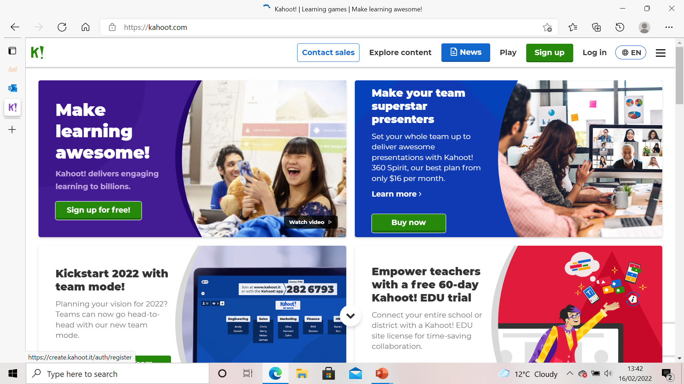
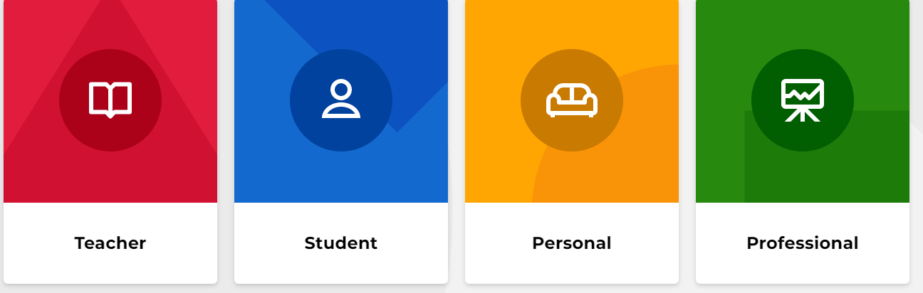
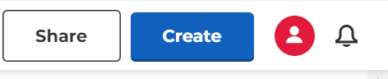

Here is how you create a Kahoot

Slide 16
Activity
In order to join another persons Kahoot.
Simply head to Kahoot.com and enter the game pin.

Slide 17
QUIZ
Please answer the questions on the paper in front of you.
20 minutes to do this.
Please feel free to work in partners or in a group.
Prepare to feedback to the class.

Slide 18

Summary
What is indirect effect?
What is the difference between direct effect and indirect effect?
What is state liability?
Why is it important?
Case law.

Slide 19
Thank You!
Any Questions?

