Slide 1
Module BMPF7061
Coaching and Mentoring
Day 2

Slide 2

Our Vision
Agenda
Coaching and mentoring skills, attributes, qualities
Values and beliefs
Emotional intelligence

Slide 3
Our Vision
Coaching and mentoring...

Slide 4

Activity
In your groups discuss, agree and record the qualities, characteristics and skills each of the following should possess:
Coach
Mentor
Facilitator

Slide 5

Activity – in groups
Notes:
Coach Menti code: 24 55 38 4
Mentor Menti code: 6448 3742
Facilitator – Menti code: 1751 5171
A facilitator has good planning and timekeeping skills; coaching skills; communication skills; active listener; good at building rapport; structuring and recording facts and feelings; higher order thinking skills; critical thinking; develop synergy amongst participants; good questioning techniques; provide psychologically safe environment; unbiased;

Slide 6
Coach
Mentor
Facilitator

Slide 7

Activity
Benefits of coaching and
mentoring to:
The coachee/mentee
The coach/mentor
The coachee’s/mentee’s organisation

Slide 8
Our Vision
Essential skills and qualities...
Demonstration of excellent interpersonal skills:
Observation skills and a genuine affinity for people
Empathy
Patience
Sensitivity
Building rapport and listening
Giving and receiving feedback
Using effective questioning techniques

Slide 9
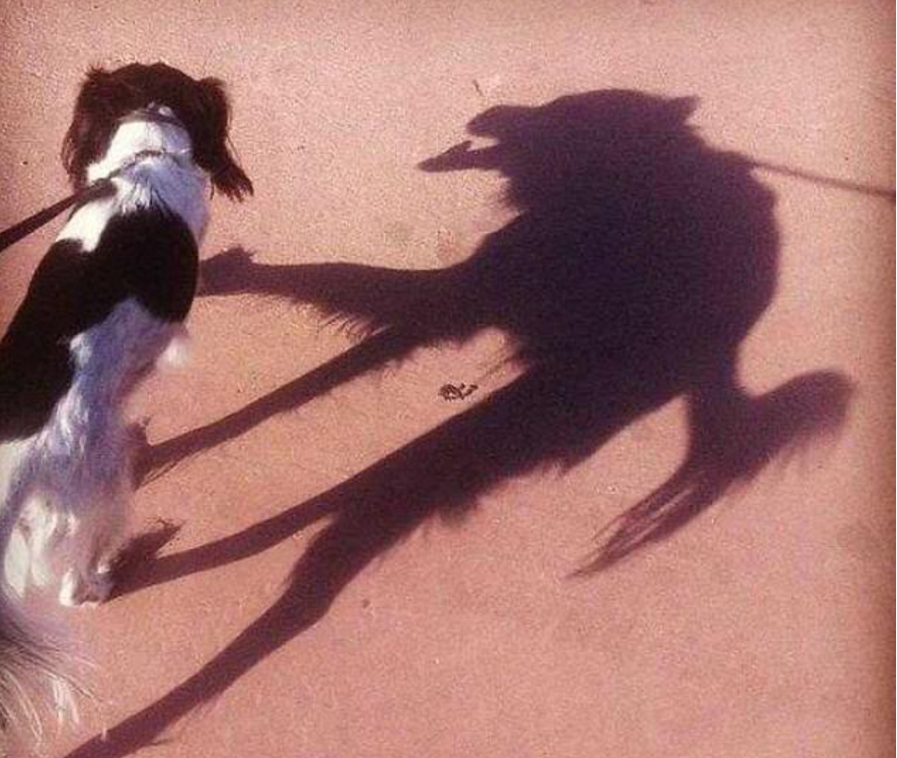
Example of tools and models that can help develop effective intrapersonal and interpersonal skills
Emotional Intelligence
Johari window
Learning Styles
VARK learning preference
NLP
Notes:
Send Johari Window questionnaire

Slide 10

Values activity

Slide 11
Our Vision
Emotional intelligence

Slide 12
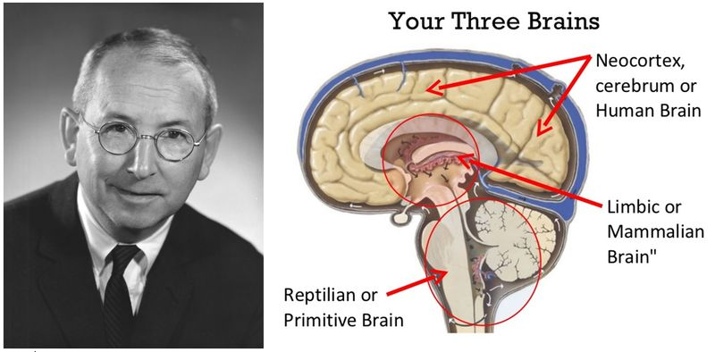
The Triune Brain Model: Balancing Instinct, Emotion and Reason - YouTube
Notes:
Listen/watch the video (10 mins) and note any pertinent aspects that resonate with you.
The Triune Brain Model: Balancing Instinct, Emotion and Reason - YouTube

Slide 13
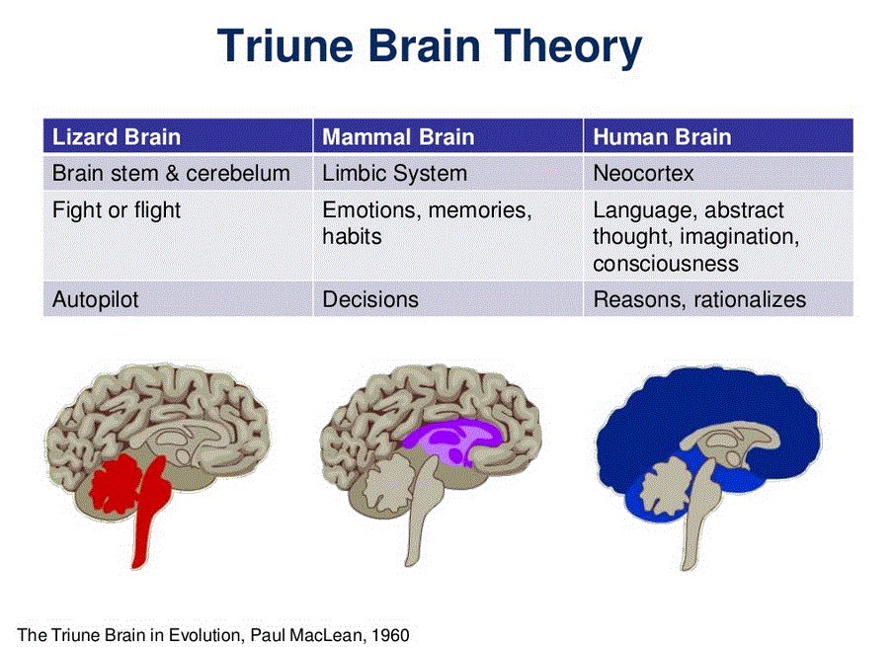
Notes:
But according to Terrence Deacon, Ph.D., an expert on the evolution of human cognition at the University of California, Berkeley, subsequent research has revealed that MacLean’s basic premise—his “‘hats on top of hats’ view” that brain systems were added by accretion over the course of evolution—was mistaken. “Adding on is almost certainly not the way the brain has evolved,” said Deacon. “Instead, the same structures have become modified in different ways in different lineages.”

Slide 14
What is Emotional Intelligence?
“A form of social intelligence that involves the ability to monitor ones own and others’ feelings and emotions, to discriminate among them, and to use this information to guide ones thinking and action.”
Peter Salovey and John Mayer (1990)
Notes:
In 1990 Peter Salovey and John Mayer first used the term emotional Intelligence and described it as a form of social intelligence that involves the ability to:
monitor one’s own and other’s feelings and emotions
discriminate among them
use this information to guide one’s own thinking and behaviour.
Daniel Goleman wrote a bestselling book in 1995 called Emotional Intelligence and this is when he developed his argument that non-cognitive skills matter as much as IQ for workplace performance. People with a high EQ handle relationships better and handle conflict better.
Daniel Goleman has conducted considerable research about the relationship between EQ and success in a job and has concluded that IQ is not a very good predictor of job performance and where very senior managers are recruited based on relevant experience and a high IQ they were likely to fail unless emotional intelligence competencies were also strong. In fact where serious weaknesses in EQ were identified then failure could be predicted with amazing accuracy.

Slide 15
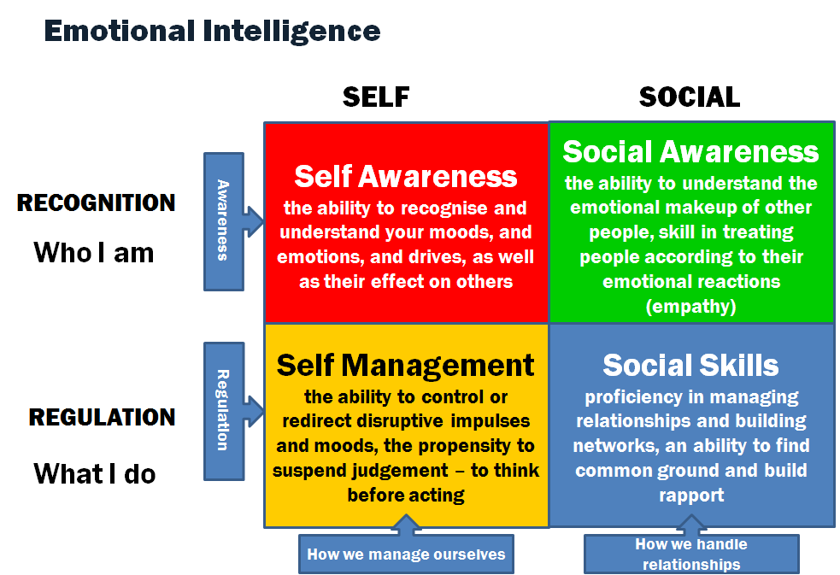
Four Domains of Emotional Intelligence
(Goleman 2009)
Notes:
The emotionally intelligent have abilities in four
main domains:
Pink boxes are domains of personal competence – these capabilities determine how we manage ourselves
Blue Boxes are domains of social competence which determine how we manage our relationships
Self-awareness – The ability to recognize your own emotions and how they affect your thoughts and behaviour, know your strengths and weaknesses, and have self-confidence. This is the ability to step outside yourself with focused observation of how you feel and react in various situations.
Self-management – The ability to control impulsive feelings and behaviours, manage your emotions in healthy ways, take initiative, follow through on commitments, and adapt to changing circumstances. Having a non-reactive analytic approach to your feelings and problem solving to increase appropriate responses.
Social awareness – The ability to observe and understand the emotions, needs, and concerns of other people, pick up on emotional cues, feel comfortable socially, and recognize the power dynamics in a group or organization. In a nutshell, this is empathy, a fundamental "people skill."
Relationship management – The ability to develop and maintain good relationships, communicate clearly, inspire and influence others, work well in a team, and manage conflict. In other words, having good social skills and being competent in relating to the emotions of others and remain connected.

Slide 16
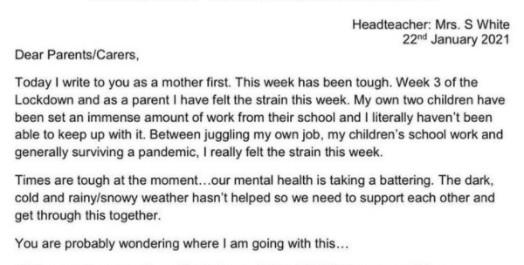
Letter to parents from Headteacher at Coates Lane Primary School

Slide 17
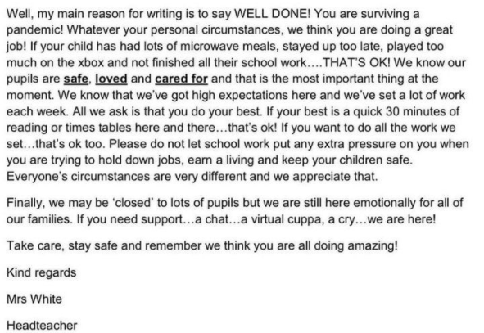

Slide 18
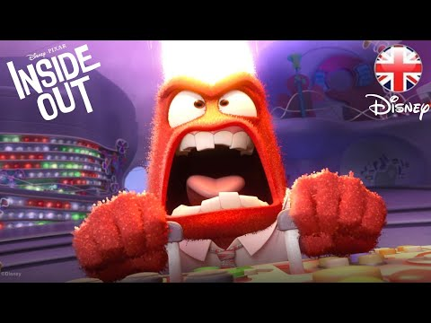

Slide 19
Developing own emotional intelligence
“First, the ineffective behavior must be brought into awareness. Next, a new or more effective behavior must be identified and finally the new behavior must be consciously rehearsed over and over until it is mastered and becomes unconscious”
Daniel Goleman, “Can emotional intelligence be learned”

Slide 20
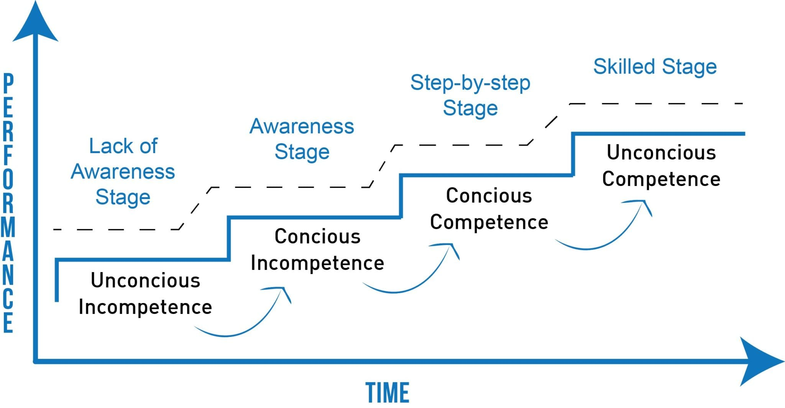
Conscious Competence model

Slide 21
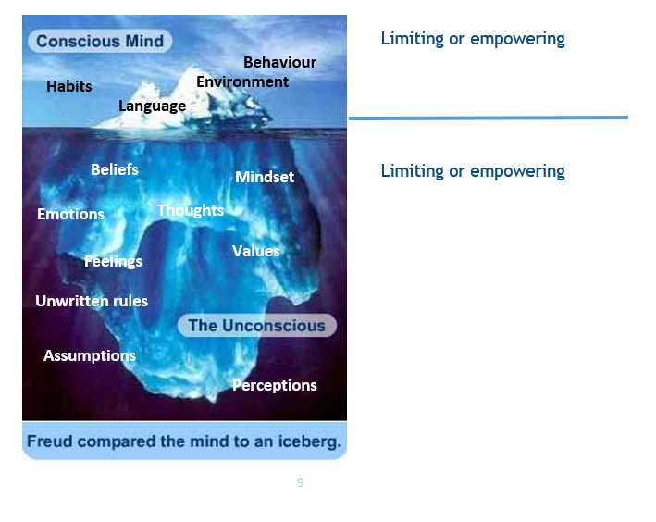

Slide 22
Our Vision
Questioning skills...and the qualities of a good listener

Slide 23
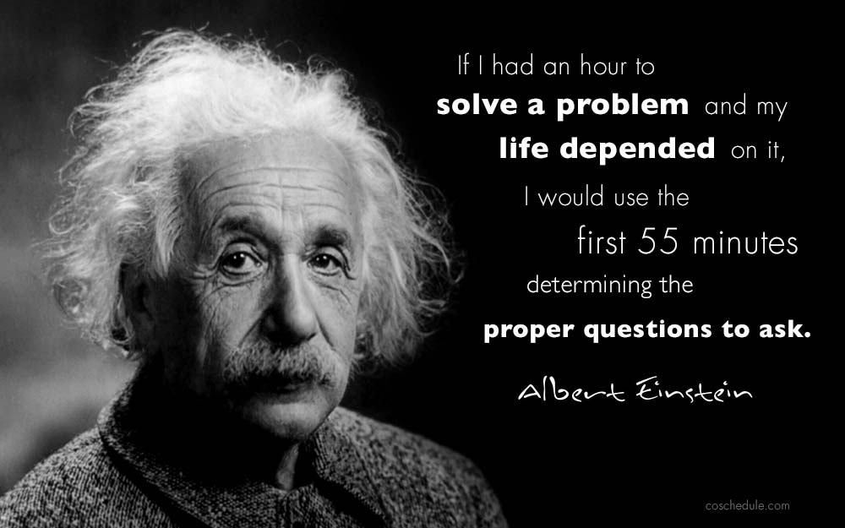
Importance of using questions

Slide 24

LISTEN

Slide 25
SILENT

Slide 26
Active listening
Being able to hear what is said as well as what is not being said
• Requires astute observation to be in touch and in tune with who is saying what, how, when and to whom
• Careful listening enables you to acquire a “helicopter-level” perspective and holistic view
• Able to focus on the problem and as well as on the development of the individual

Slide 27
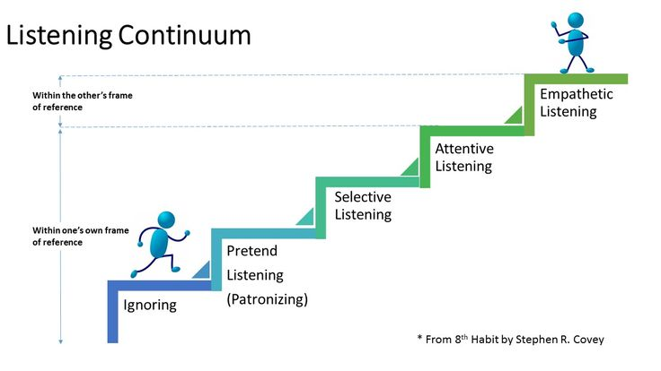

Slide 28
Our Vision
Recap
Coaching and mentoring skills, attributes, qualities
Values and beliefs
Emotional intelligence

Slide 29

Our Vision
Gwerthusiad – Plws / Delta
Evaluation – Plus / Delta

