Slide 1

INTRODUCING THE MODERN WORKPLACE
Student Name and ID:
Constantin-Alexandru Frunza- 2008383
Ioana-Theodora Popescu- 1922523
Ionela Filip-Datcu- 1922490
Oana-Florentina Bolocan- 2009953

Slide 2

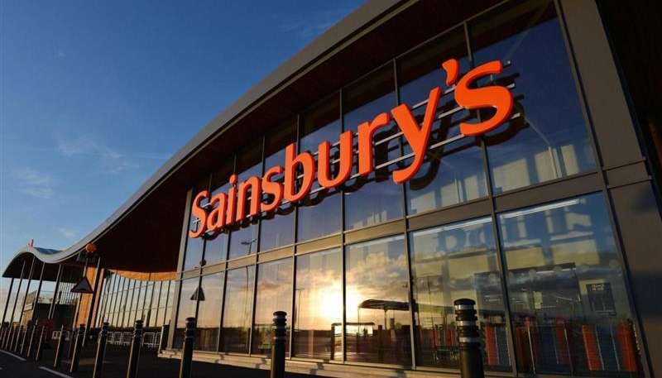
Introduction
In a workplace, the leadership is explained as the process through which an individual mainly gets manipulated as well as encouraged in order to meet all the objectives of the company (economicsdiscussion.net, 2020).
The modern workplace is very essential as it mainly demonstrates the growth of the employees as well as their prosperity (sainsburys.co.uk, 2020).

Slide 3

Background of the Organization
In 1869, John James Sainsbury and Mary Ann, his wife, opened a retail store, Sainsbury, which became popular as it was providing its customers with good quality food products at a lower rate than the outside market (sainsburys.co.uk, 2020).
In 1888, they started to sell products with their own brand name, stuck on to their motto, a pioneer company who employed first female shopkeepers
They were visionary, the first company to use computers in stores and accepted card payments.

Slide 4

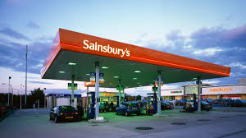
Sainsbury’s expanded their horizon by:
Expanding the area of the stores,
Grocery business,
Petrol pump, bank,
Bakeries,
Coffee shops,
Fresh fish counters,
Flower stores,
Nurseries,
Book shops,
Restaurants,
Bike shops,
Clothing brands,
Music stores,
Finance systems,
Electronic business
Electrical businesses.

Slide 5
Sainsbury expects to expand generating business margins in a complex and delivering a strong total of needs ,increase the company's program from year to year(Sarah Fatricia,2016).
The main two strategies of Sainsbury’s
Sainsbury's main mission is to deliver excellent quality services at an affordable price to a wide range of customers by working quicker and easier together, making food the first choice (Sainsbury, 2020).

Slide 6
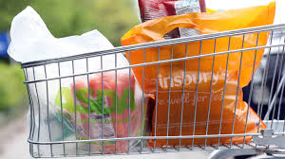
Quality for value
Expand on our solid image legacy and notoriety for quality, reach advancement and offer to clients while they shopping more advantageous.
Sainsbury's mission is to deliver quality goods and services at a reasonable price by working quicker easier, together and making it the first choice for food. By balancing revenue growth, reducing cost and rising margins, Sainsbury expects expansion to continue . (Alosani and Al-Dhaafri, 2020, p. 23).

Slide 7

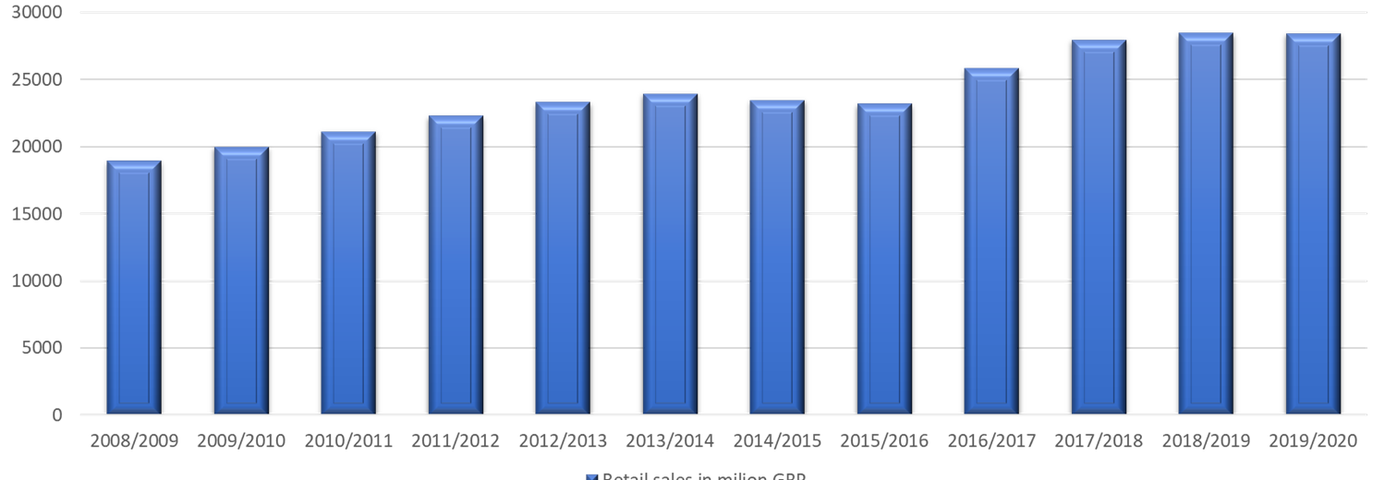
S A I N S B U R Y’ S
The company is committed to generating business margins in a complex, global marketplace and to delivering a strong total number of necessary profit growth every year of its business programmed.
Statista.com

Slide 8

To increase market share, Sainsbury's has adapted its strategy to implement the Nectar Loyalty Program. This program is a crucial part of the great Sainsbury's brand.
The biggest advantage of using Nectar Card is based on easily reaching rewards, collecting points of purchase. One year after bringing this product to market, Nectar Club has surpassed the advantage card of its rival, Tesco (Sarah Fatricia, 2016).

Slide 9
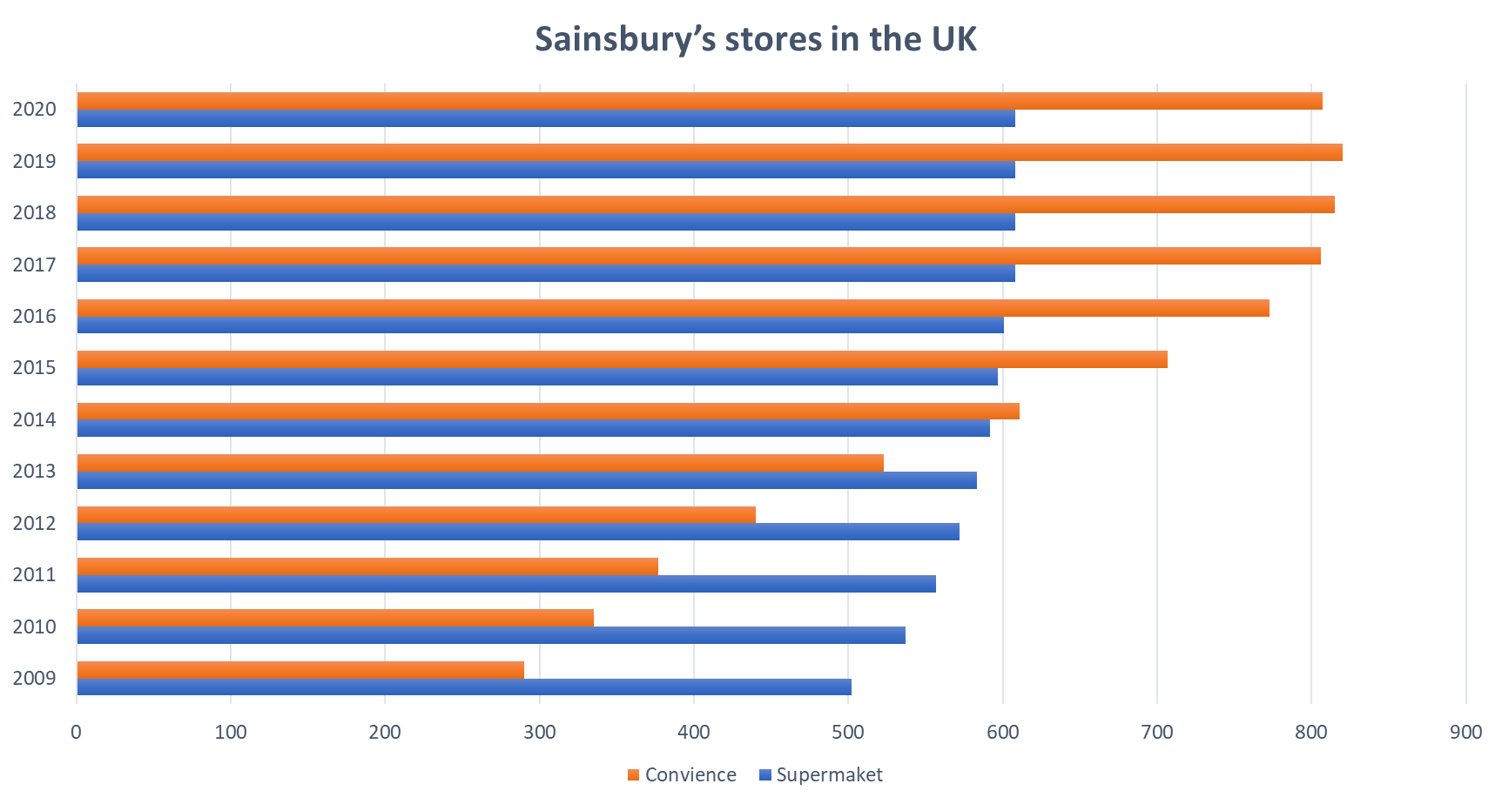
Main stores of Sainsbury’s
Organizational structure
• Regular Sainsbury’s stores
• Sainsbury’s Local
• Sainsbury’s Central
• Sainsbury’s ‘Main Plus’
• Save centre
Sainsbury’s structure
Sainsbury’s SUPERMARKETS
Sainsbury’s ONLINE
Sainsbury’s PROPERTY
Sainsbury’s BANK

Slide 10
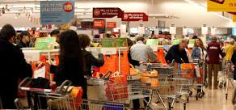

Sainsbury’s culture and structure performance
The Divisional structure
The Matrix structure
The flat organisational
Sainsbury’s has a culture of providing good products at a cheaper price, in future, they must maintain that culture in order to achieve customer’s expectation and keep them loyal (Odor, 2018, p. 15).

Slide 11
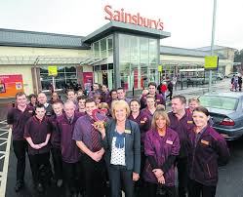
The employees are the people who will give shape to the plan and programs made by the managerial authorities.(Alosani and Al-Dhaafri, 2020, p. 23).
S A I N S B U R Y’ S
The employees are the people who make it a reality, they should be strong motivated, enthusiastic in order to increase the performance of the organization (Odor, 2018, p. 15).

Slide 12
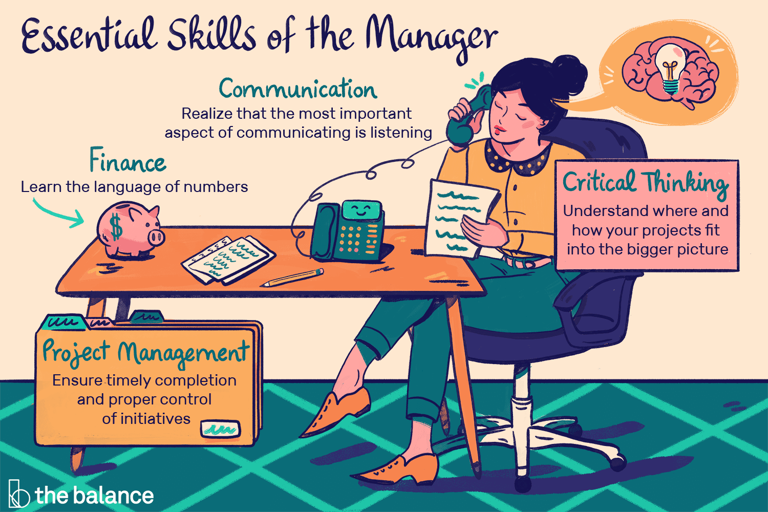
Identify the essential nature of managerial works and Communicate the role of leadership
Responsible for any type of constructive jobs in an organisation;
To look after the well beings of the employees;
To look after the financial conditions of the organisation;
Totally out the profit and loss factors of the company;
Regulate the line of action accordingly by checking the flow of money;
Gets to know about any type of politics being played on any of the employees.

Slide 13
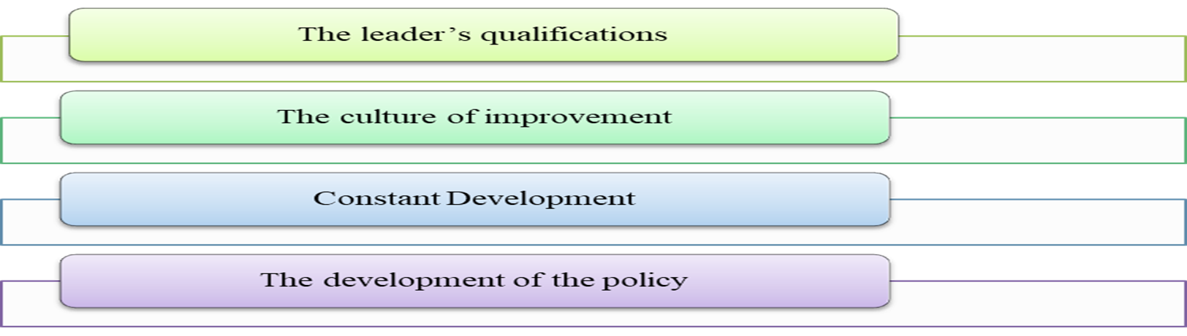
A leader is the person who, along with the employees, do the same task to help them achieve it in time. He makes the employees comfortable enough to share their thoughts, ideas, problems and solutions with him, and make an understanding of equality
Role of Leadership
(Source: Alefari et al. 2017, p. 756)

Slide 14


The leader’s qualifications: The leader should be qualified enough to tackle the job he is appointed to.
The culture of improvement: The leader should improve himself constantly in the field of the designated job or in any other field, coming from the culture of improvement, so he can adapt to any situation.
The development of the policy: A leader should be a flexible person who adapts to the changes in the business plans easily and does not stick to the backdated version of the business policies.

Slide 15

Variable that determine effective management and leadership
Sense of urgency- A leader should have the quality of managing time precisely, otherwise he will be left behind in the long run of the time.
Great quality of vision- A leader should have a great foresight, to have the capability to foresee and anticipate the consequences of a decision taken and it would allow him to take decisions that are in the favour of the company and would stop him from taking decisions that may go against the company.
(economicsdiscussion.net, 2020).

Slide 16

Keeping up to the vision- A leader has a strong vision and has enough confidence in himself, he should stick to the decision he made about the project, no matter how negative it seems looking from the other’s perspectives.
Power to remove the obstacles coming in the path of success- A leader should be powerful enough to tackle the adverse situations coming his ways and must take the responsibilities of his mistakes and should have strong proof to defend himself.
Creating short progress in the path of a long run- The leader should be a tactical worker.
Not getting satisfied by little wins- While achieving the smaller sub parts of a big project, if the leader gets over satisfied over the small achievements, he will lose the main objective of the task.
Responding to the changes of the business policy- Flexible enough in order to adapt the changes of the business policy and business system.
(Kumar et al. 2020, p. 104818).

Slide 17

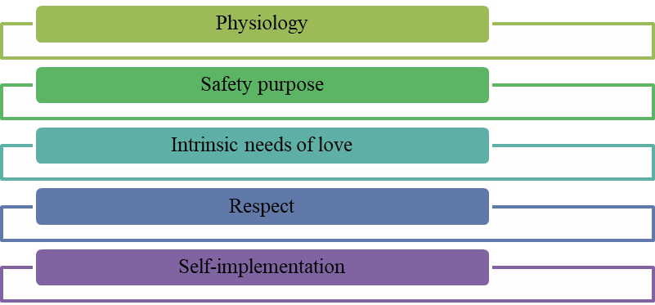
The Sainsbury organization keep hold of the workers and increase the reputation of the organization as a better workplace by encouraging their ideas making them comfortable with suitable schedules (Yu et al. 2017, p. 196).
In Sainsbury, the management of the organization believes in democratic style of leadership followed by the organization because it helps in the proper involvement of employees and due to this reason, the employees of this organization are highly motivated (Patyal and Koilakuntla, 2016, p. 319).
Figure: Five Crucial points of Maslow
(Source: Shahi et al. 2020, p. 117)

Slide 18
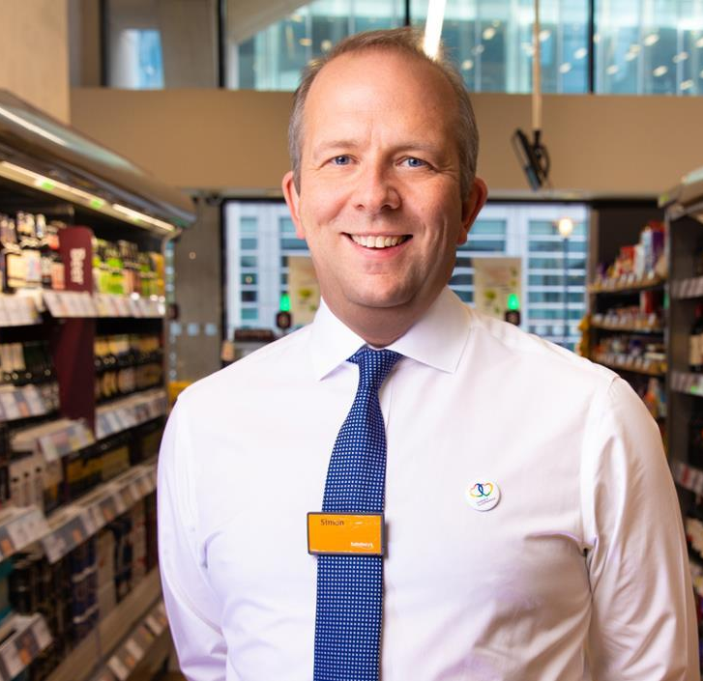
Simon Robert
CEO of Sainsbury's, allowed in 2018 the digitization and restructuring of warehousing operations in his company's industry.
The personality of Simon Roberts is unique as he helps to make a clear linkage between all the retail and the digital terms of Sainsbury in order to make the retail business much more consumer oriented (Jahshan, E., 2020).

Slide 19
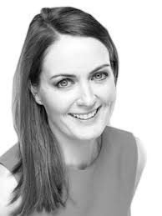
Elizabeth Newman
Self-persuaded, characteristic pioneer, equipped for working in forced conditions, very efficient, driving and moving groups to convey extended targets and complex tasks.
Her broad experience and attributes, including being solid scientifically and with amazing correspondence and introduction abilities, is borne from running the business, class, and knowledge activities for the absolute most notable media brands and UK retailers (Newman E., 2020).

Slide 20
C O N C L U S I O N S
The transition is not just of generation: most people are growing more complex and fast in a world that is more interconnected and dependent than ever before, and their hope has changed. In order to increase the modern technology, the workplace of Sainsbury's becomes more modern than the earlier workplace.
Analysing the food retailing industry and the actions of key market players, it can be expected that Sainsbury will experience rapid and continuous improvement along the route of corporate takeovers, acquisitions and therefore most current franchises.
Sainsbury will look at developing economies such as Eastern Europe, Latin America and parts of Asia. The UK market is now fragmented in such a way that perhaps the company's potential aim ought to be to retain its industry in the Uk and to acquire new overseas markets or territories.

Slide 21
R E F E R E N C E S
Alefari, M., Salonitis, K. and Xu, Y., 2017. The role of leadership in implementing lean manufacturing. Procedia CIRP, 63, pp.756-761.
Alosani, M.S. and Al-Dhaafri, H.S., 2020. An empirical examination of the relationship between benchmarking, innovation culture and organisational performance using structural equation modelling. The TQM Journal.
economicsdiscussion.net, 2020. Leadership. Available at: https://www.economicsdiscussion.net/management/leadership/what-is-leadership/32116 [Accessed on 20th October 2020]
Foster, W.M., Hassard, J.S., Morris, J. and Wolfram Cox, J., 2019. The changing nature of managerial work: The effects of corporate restructuring on management jobs and careers. Human Relations, 72(3), pp.473-504.
Jahshan, E., 2020. Sainsbury's New CEO Simon Roberts Announces 2 Key Senior Appointments. [online] Retail Gazette. Available at: <https://www.retailgazette.co.uk/blog/2020/06/sainsburys-new-ceo-simon-roberts-announces-2-key-senior-appointments/> [Accessed 23 November 2020].
Jaoua, F., 2018. Impact of strategic roles of middle managers on the relationship between successful strategy implementation and organisational performance. International Journal of Business Performance Management, 19(4), pp.476-499.
Kumar, A., Moktadir, M.A., Khan, S.A.R., Garza-Reyes, J.A., Tyagi, M. and Kazançoğlu, Y., 2020. Behavioral factors on the adoption of sustainable supply chain practices. Resources, Conservation and Recycling, 158, p.104818.

Slide 22
R E F E R E N C E S
Newman, E., 2020. Elizabeth Newman. [online] LinkedIn. Available at: <https://uk.linkedin.com/in/elizabethhnnewman> [Accessed 23 November 2020].
Odor, H.O., 2018. Organisational culture and dynamics. Global Journal of Management and Business Research.
Oyewobi, L.O., Windapo, A.O., Rotimi, J.O.B. and Jimoh, R.A., 2016. Relationship between competitive strategy and construction organization performance. Management Decision.
Patyal, V.S. and Koilakuntla, M., 2016. Relationship between organisational culture, quality practices and performance: conceptual framework. International Journal of Productivity and Quality Management, 19(3), pp.319-344. sainsburys.co.uk, 2020. About.
Available at: https://about.sainsburys.co.uk/?_ga=2.31110204.261143590.1603870269-48385226.1601292090 [Accessed on 16th October 2020]
Sharah Fatricia R. (2016). SWOT ANALYSIS OF SAINSBURY’S SUPERMARKET. Jurnal Manajemen Terapan Dan Keuangan, 5(1), 19 - 35. https://doi.org/10.22437/jmk.v5i1.3232
Sainsbury. 2020. Our Business Strategy. [online] Available at: <https://www.about.sainsburys.co.uk/about-us/our-business-strategy> [Accessed 23 November 2020].

Slide 23
R E F E R E N C E S
Sedighi, M., van Splunter, S., Zand, F. and Brazier, F., 2017. Evaluating critical success factors model of knowledge management: An analytic hierarchy process (AHP) approach. In Organizational Culture and Behavior: Concepts, Methodologies, Tools, and Applications (pp. 308-326). IGI Global.
Shahi, T., Farrokhsheresht, B. and Aghajani, H.A., 2020. Behavioral Factors Affecting Talent Management: Meta-Synthesis Technique. Iranian Journal of Management Studies, 13(1), pp.117-137.
Willmott, H., 2019. STUDYING MANAGERIAL WORK: A CRITIQUE AND APROPOSAL. Managerial Work, 24(3), p.305.
Yu, T.K., Lin, M.L. and Liao, Y.K., 2017. Understanding factors influencing information communication technology adoption behavior: The moderators of information literacy and digital skills. Computers in Human Behavior, 71, pp.196-208.
Yuliansyah, Y., Gurd, B. and Mohamed, N., 2017. The significant of business strategy in improving organizational performance. Humanomics.

Slide 24



