Slide 1

Quality Assurance in Maternity Care
The Shrewsbury & Telford Hospital NHS Trust Ockenden Report 2022
LCHS7006 – Quality Assurance and Service Improvement
Presented by: Iqdad Ali | Lecturer: Shepherd Ziko | Date: 19 November 2025
Notes:
1

Slide 2




Why Quality Assurance Matters in Maternity Care
Shrewsbury & Telford Hospital NHS Trust Ockenden Report 2022
Quality assurance in maternity services is not merely a bureaucratic requirement—it is a fundamental commitment to protecting the most vulnerable members of our society. Effective quality systems shield mothers and babies from preventable harm whilst ensuring that care consistently meets rigorous national standards set by the Care Quality Commission and NICE guidelines.(NICE,2023;CQC,2023)
Prevents Harm
Meets Standards
Protects mothers and babies through systematic safeguarding ( Ockenden, 2022)
Ensures compliance with CQC and NICE guidelines (CQC, 2023;NICE, 2023)
Measures Progress
Drives Improvement
Makes quality visible and quantifiable through metrics (NHS,2022)
Enables continuous improvement through PDSA cycles(IHI, 2020)
Through listening to women's voices and reducing unwarranted variation, quality assurance rebuilds public trust and creates equitable, compassionate care that recognises families as partners in their maternity journey. (Ockenden, 2022; NHS England, 2023)
Notes:
2

Slide 3

Case Overview: The Ockenden Maternity Review Shrewsbury & Telford Hospital NHS Trust Ockenden Report
What Went Wrong
The Trust
Mothers and babies suffered preventable injuries and deaths. Concerns raised by families were ignored. Staff escalation procedures failed. Critical staffing and skill-mix gaps undermined safe care. A weak learning culture prevented lessons from being learned.(Ockenden, 2022; CQC, 2020)
Shrewsbury & Telford Hospital NHS Trust served its community for decades, yet between 2000 and 2019, the maternity unit experienced a cascade of repeated failings that resulted in devastating harm. (Ockenden, 2022)
Impact
Maternal deaths, neonatal brain injuries, profound family trauma, and irreversible loss of public confidence in the maternity service Ockenden, 2022)
The Inquiry
The (Ockenden, 2022) Report issued Essential Actions demanding safe staffing ratios, robust escalation protocols, and genuine listening to families' concerns
Notes:
3

Slide 4
The Swiss Cheese Model: How Multiple Defences Failed
Shrewsbury & Telford Hospital NHS Trust Ockenden Report
James Reason's Swiss Cheese Model elegantly explains how system failures occur. Every system contains multiple layers of defence against error. When "holes" in these layers align, patient harm becomes inevitable. At Shrewsbury & Telford, these holes catastrophically aligned across every level.( Reason, 2000; 0ckenden, 2022)
1
Policy Layer
Weak oversight and relentless pressure to meet financial targets prioritised costs over safety(Ockenden, 2022)
Organisational Layer
2
Chronic understaffing, poor governance structures, and a safety culture that discouraged reporting( CQC,2020; Ockenden, 2022)
3
Team Layer
Conflict between midwives and doctors, breakdowns in communication, and siloed decision-making (ockendent, 2022)
4
Task Layer
Missed cardiotocograph interpretation and critically delayed escalation of fetal distress( NHS England, 2023)
Individual Layer
5
Staff fatigue, psychological fear of speaking up, and normalisation of unsafe practices( Reason, 2000; NHS England, 2023)
NHS England (2023) Patient Safety Incident Response Framework
Notes:
4

Slide 5

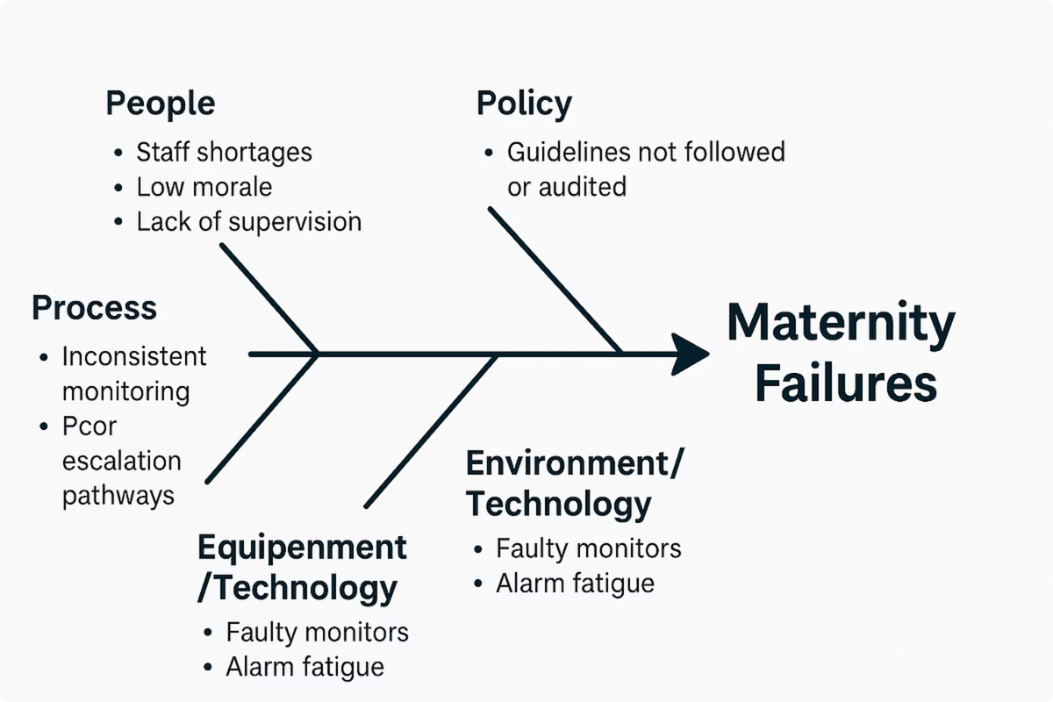

bnn
Fishbone Diagram: Root Causes of Maternity Failures
Shrewsbury & Telford Hospital NHS Trust Ockenden Report
The Fishbone (Ishikawa) Diagram provides a structured visual method for identifying root causes. At Shrewsbury & Telford, failures cascaded from six interconnected categories: People, Process, Policy, Place, and Equipment—all converging on the tragic outcome of preventable harm. (Ishikawa, 1968)
Why the Fishbone Model Matters: Originally developed by Kaoru Ishikawa in 1968, this framework remains central to NHS quality improvement in 2024. The Fishbone approach ensures that improvement efforts address systemic causes rather than isolated symptoms, enabling sustainable change across maternity services (NHS England, 2023; Ockenden, 2022)
Notes:
5

Slide 6
Root Cause Analysis: The 5 Whys Technique Shrewsbury & Telford Hospital NHS Trust Ockenden Report
The 5 Whys method, pioneered by Taiichi Toyoda as part of the Toyota Production System, helps uncover deeper systemic causes by repeatedly asking “why” until the underlying failure is revealed (Toyoda, 1982).
In maternity care, this technique is widely used by NHS organisations to understand safety incidents and prevent recurrence (NHS England, 2023).
10
02
03
Why was escalation delayed?
Why was interpretation late?
Why was staffing inadequate?
The cardiotocograph trace was interpreted late by a single midwife (Ockenden ,2022)
The maternity unit was critically understaffed with no second reader available for verificationof CTG (Ockenden, 2022)
A recruitment freeze was in place due to financial pressures (CQC,2020)
04
05
Why was the freeze implemented?
Root Cause Identified
Organisational policy emphasised cost-cutting and budget constraints (Ockenden, 2022)
Misaligned organisational priorities elevated financial targets above patient safety, creating a governance vacuum where safety risks could flourish unchecked(0ckenden , 2022; NHS England)
Notes:
6

Slide 7






The Donabedian Model: Structure, Process, Outcome
Shrewsbury & Telford Hospital NHS Trust Ockenden Report
Avedis Donabedian’s seminal framework (1966) remains the gold-standard method for assessing healthcare quality. The model evaluates three interconnected dimensions: the structural resources available, the processes through which care is delivered, and the outcomes experienced by patients and families (Donabedian, 1966).
The NHS continues to use this model within modern quality-assurance and patient-safety systems (NHS England, 2023).
Process
Communication pathways, monitoring protocols, escalation procedures, and incident reporting systems( England , 2023; Ockemdent, 2022)
Structure
Staffing levels, clinical leadership, equipment, training, and organisational infrastructure (Donoabedian,1966; CQC, 2023)
Outcome
Maternal satisfaction, survival, infant health, clinical complications, and family wellbeing Donabedian, 1966; Ockenden,2022)
Applied to Ockenden: Weak structures (understaffing and weak leadership) → unreliable processes (failed escalation, ignored concerns) → devastating negative outcomes (preventable deaths and family trauma). This framework ensures that improvement strategies simultaneously address causes at all three levels.( Ockenden, 2022;CQc 20220
Notes:
7

Slide 8








PDSA Cycle: Continuous Improvement in Practice
Shrewsbury & Telford Hospital NHS Trust Ockenden Report
The Plan–Do–Study–Act cycle, pioneered by Shewhart and later developed by W. Edwards Deming in the 1950s, embodies a philosophy of continuous learning and rapid improvement (Deming, 1950; IHI, 2020). Within the NHS, the PDSA cycle transforms insights from safety incidents into actionable enhancements that can be tested, measured, refined, and scaled across maternity teams (NHS England, 2023).
Plan
Do
Design daily safety huddles and structured CTG review protocols for all shifts (Ockenden,, 2022; NHS England 2023)
Train all maternity staff and pilot the intervention on two wards with close supervision (NHS England, 20220
Act
Study
Refine protocols based on learning and spread successful changes across all maternity units (IHI,2020; NHS England, 2023)
Measure escalation response times, staff confidence, and patient feedback from both pilot wards(IHI,2020)
Why PDSA Works: This cycle engages frontline staff as co-designers of safety, transforms accountability into shared ownership, and embeds continuous reflection into daily practice—precisely the cultural shift Ockenden demands. (0kendent , 2022; NHS England, 2023)
Notes:
8

Slide 9




Theory of Change: Mapping the Path to Safer Care
Shrewsbury & Telford Hospital NHS Trust Ockenden Report
Carol Weiss’s Theory of Change (1995) explains how inputs and activities connect through causal pathways to produce measurable outcomes. In maternity care, this framework ensures that improvement strategies remain coherent, evidence-based, and accountable for delivering safer services (Weiss, 1995; NHS England, 2024).
Inputs
Activities
New clinical leadership, comprehensive staff training programmes, policy reforms, and systematic mechanisms for families to voice concerns ( Ockenden, 2022; NHS England , 20240
Implement Birthrate Plus staffing models, establish family feedback systems, deliver team training, and create psychological safety (CQC, 2023)
Outputs
Outcomes
Enhanced multidisciplinary communication, timely clinical escalation, strengthened learning culture, and documented staff competence ( Ockenden, 2022; NHS Resolution, 2023)
Reduced preventable incidents, improved maternal and neonatal safety, restored public confidence, and families experiencing truly woman-centred care( Ockenden, 2022; CQC, 20230
Current Application: The NHS MatNeoSIP programme (2024) actively employs Theory of Change to ensure that Ockenden recommendations create measurable improvements in safety culture and clinical outcomes across England's maternity services.
Notes:
9

Slide 10
Recommendations and Quality Improvements
Shrewsbury & Telford Hospital NHS Trust Ockenden Report
The Ockenden Report's Essential Actions provide a comprehensive roadmap for transforming maternity care. These recommendations address every layer of the system—from policy and governance to team dynamics and family engagement—ensuring that lessons learned from tragedy drive sustainable improvement.( 0ckenden , 2022; NHS England, 2o230
Robust Incident Systems
1
Establish comprehensive incident reporting and structured learning systems across all maternity units, ensuring no concern is ever ignored
Strengthen Teamwork
2
Implement multidisciplinary communication training and conflict resolution to dissolve barriers between professions and build psychological safety
Safe Staffing Ratios
3
Adopt Birthrate Plus methodology to ensure adequate midwifery staffing with appropriate skill mix and no unsafe compromises
Family-Centred Policies
4
Develop policies ensuring families' voices are genuinely heard, valued, and acted upon in care decisions and service improvement
Clinical Audits and Transparency
5
Conduct regular audits of clinical practice and publish transparent outcome data to maintain accountability and build community confidence
6
Just Culture
Foster an organisational culture where staff feel psychologically safe reporting errors without fear, enabling learning instead of blame
Notes:
10

Slide 11

Leadership and Accountability — Shrewsbury & Telford Hospital NHS (2000–2019)
Strong governance and accountable leadership form the backbone of safe maternity services. At Shrewsbury & Telford (2000–2019), the Ockenden Inquiry identified persistent failings in leadership oversight, escalation pathways, and learning culture (Ockenden, 2022).
A safer model requires a clear, layered governance framework linking Trust executives, a dedicated Board Maternity Safety Committee, and frontline clinical teams (CQC, 2020; NHS England, 2023). Appointing Maternity Safety Champions at every site ensures visible responsibility and rapid escalation of concerns, while regular structured clinical supervision and reflective practice rebuild staff trust and clinical assurance (NHS England, 2023)
Quarterly independent safety reviews add external validation, ensuring that quality-improvement efforts remain honest, transparent, and continuous (NHS Resolution, 2023)..
Notes:
11

Slide 12
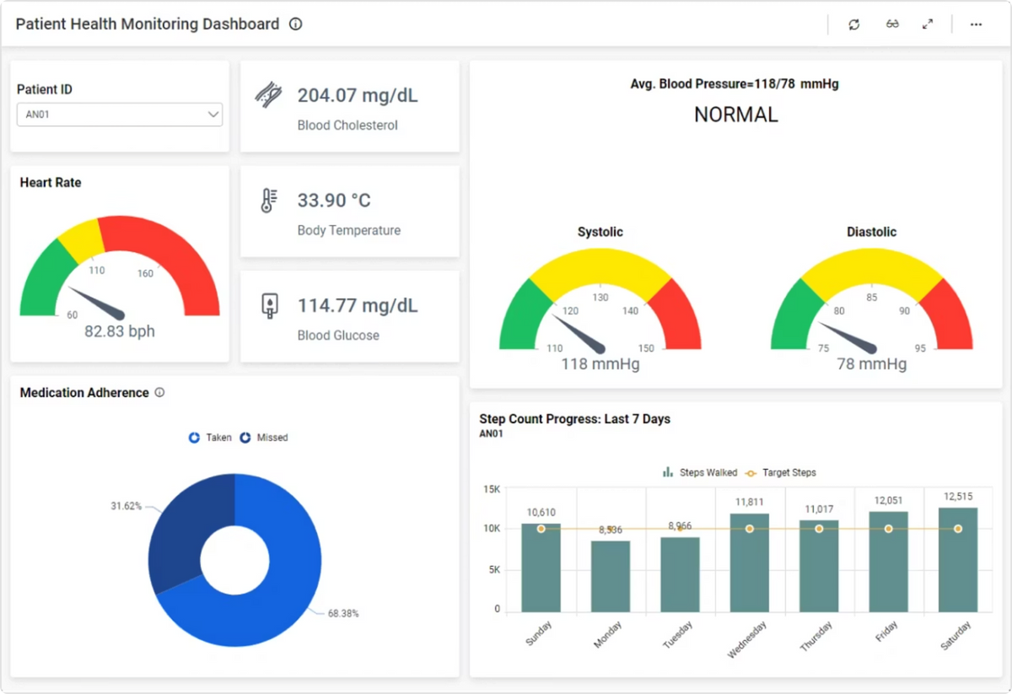

Monitoring and Evaluation — Structure, Process, Outcome
shrewsbury & Telford Hospital NHS Trust Ockenden Report.
Continuous improvement
Real-time oversight
Embed Root Cause Analysis (RCA) and PDSA cycles into every serious-incident workflow to drive continuous learning and improvement (NHS England, 2023; IHI, 2020). Incorporate routine patient feedback and staff-safety culture surveys to triangulate data and strengthen transparency (Ockenden, 2022).
Ensure external audits and CQC reviews map directly onto dashboard metrics so national maternity standards are demonstrably met and improvements tracked over time (CQC, 2023; NHS England, 2024).
Adopt Donabedian’s model—Structure, Process, Outcome—to guide monitoring and evaluation (Donabedian, 1966). Implement real-time dashboards that surface incidents, staffing levels, escalation events, and key process measures such as alcohol screening, CTG reviews, and escalation times (NHS England, 2023).
Dashboards must be accessible to clinical leads and executives with role-based filtering and automated daily safety alerts to support rapid decision-making (CQC, 2023).
Notes:
12

Slide 13




Lessons Learned from Ockenden — Listening, Safety, Culture
S hrewsbury & Telford Hospital NHS Trust Ockenden Report
Listen to families
Move from blame to learning
Families are vital safety partners. Early, compassionate engagement prevents repeat harm and restores confidence. Create family liaison roles and accessible channels for raising concerns with guaranteed timely responses.(0ckenden, 2022)
A blame culture silences staff and conceals risk. Adopt just culture principles: separate human error, at-risk behaviour and reckless acts, and focus on system fixes rather than punishment.(NHS England 2023;NHS Resolation , 2024)
Communication & escalation
Psychological safety
Clear, non-negotiable escalation pathways and standardised handovers reduce missed cues. Use checklists, mandatory escalation triggers and simulation training to embed behaviours under pressure. (Ockenden, 2022; NHS England, 2023).
Psychological safety encourages reporting and teamwork. Leaders must model openness, admit uncertainty, and act visibly on reports to close the feedback loop and rebuild trust(Ockenden, 2022; Edmondson, 2019).
.
Notes:
13

Slide 14

Conclusion — A Roadmap for Safer Maternity Care Shrewsbury & Telford Hospital NHS Trust Ockenden Report
Quality assurance is fundamental to delivering safe and effective maternity care. The Ockenden Review highlighted deep systemic failures but also provided a practical roadmap for improvement: sustained and compassionate leadership, empowered multidisciplinary teams, robust monitoring with rapid-cycle learning, and meaningful partnership with families. Achieving evidence-based, transparent and compassionate services requires long-term cultural change supported by strong governance, continuous training, and measurable quality outcomes. Immediate priorities include visible and accountable leadership, reliable escalation processes, and ongoing external assurance to maintain safety and trust (Ockenden, 2022; NHS England, 2023).
1
2
1. Leadership
2.Measurement
Board-level accountability with Maternity Safety Champions and transparent reporting.
Real-time dashboards, PDSA cycles and aligned external audits.
3
3. Families & Staff
Structured family liaison, psychological safety and learning culture.
Notes:
14

Slide 15
References
CQC (2021) Getting safer faster: Rapid improvement in maternity services. London: Care Quality Commission.
CQC (2022) Maternity services: Safety Report. London: Care Quality Commission.
DHSC (2023) Maternity Disparities Taskforce Update Report. London: Department of Health and Social Care.
Edmondson, A. (2019) The fearless organization: Creating psychological safety in the workplace for learning, innovation, and growth. Hoboken, NJ: Wiley. Health and Safety Investigation Branch (HSIB) (2020) Investigation into intrapartum stillbirths. Farnborough: HSIB.
Kings Fund (2022) Safety, culture and leadership in the NHS. London: The King’s Fund.
NHS England (2016) National Quality Board: Shared commitment to quality. London: NHS England.
NHS England (2023a) Saving Babies’ Lives Care Bundle version 3. London: NHS England.
NHS England (2023b) Three-year delivery plan for maternity and neonatal services. London: NHS England.
NHS England (2023c) Patient Safety Incident Response Framework (PSIRF). London: NHS England.
NHS Improvement (2018) SBAR communication tool: Situation, Background, Assessment, Recommendation. London: NHS Improvement.
Ockenden, D. (2022) Findings, conclusions and essential actions from the Ockenden Report – Final. London: NHS England.
Royal College of Obstetricians and Gynaecologists (RCOG) (2022) Each Baby Counts: 2022 progress report.London: RCOG. Royal College of Midwives (RCM) (2021) Evidence-based midwifery care: Improving safety and outcomes. London: RCM.
Notes:
15

