Slide 1
DIGITAL FORENSIC ANALYSIS
MSc Cyber Security & Digital Forensics
Muhammad Waleed · Student No: 2430361

Slide 2
Case Background
Quantum Tech discovered unauthorised access to their AI chip design patent (ID: QT-AI-2025)
Emma, a senior engineer with privileged database access, is the primary suspect
Emma is suspected of attempting to sell the patent to a competitor — NexGen Circuits
An intermediary named Joe facilitated the deal between Emma and the buyer
Norman Smith was identified as the buyer, coordinated by Vanessa, NexGen's R&D Director
Three devices were seized as digital evidence following proper chain-of-custody procedures

Slide 3
Aim Of the Investigation
Determine how patent QT-AI-2025 was accessed without authorization.
Investigate whether Emma shared or attempted to sell the patent to a third party
Identify who else was involved in coordinating the transfer (Joe, Norman, Vanessa)
Trace all communication channels used to arrange the deal
Establish a timeline of events linking suspects to the crime
Provide legally admissible evidence to support law enforcement action

Slide 4
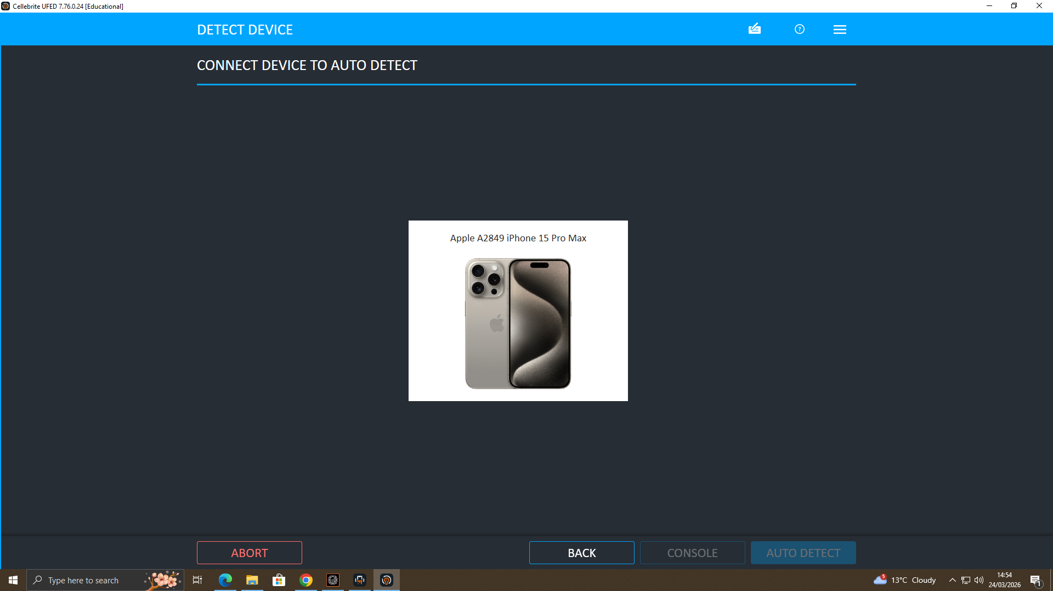
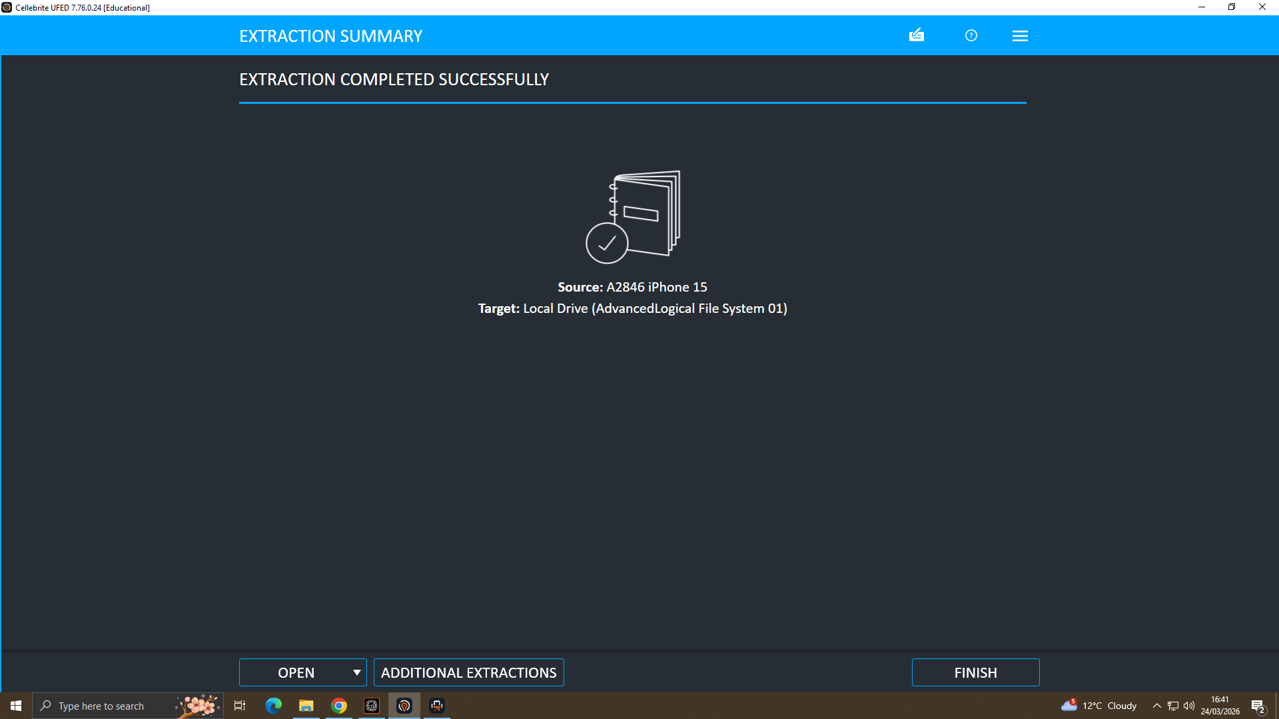
What We Did
Three devices seized under proper continuity-of-evidence protocols:
  E-001 — Emma's Huawei smartphone
  E-002 — Joe's Samsung Android
  E-003 — Norman's Nokia Android.
Forensic acquisition performed using Cellebrite UFED
SHA-1 hash verification completed on all three devices to confirm evidence integrity
Followed NIST SP 800-86 and ISO/IEC 27037:2012 standards throughout
Extraction method: Advanced Logical + File System extraction
All acquisitions are legally admissible for court proceedings

Slide 5
Consolidated Evidence Timeline
ACCA7031 | Digital Forensics
Aug 2024
CRIMINAL INTENT
Emma: 'Thinking of selling' AI info via WhatsApp (E-001)
E-001
Aug 2024
COORDINATION
Emma calls 2 numbers repeatedly — co-conspirators contacted (E-001)
E-001
Nov 2024
BUYER LOCATED
Emma applies pressure: 'May go with someone else' (E-001)
E-001
Dec 2024
PHYSICAL EVIDENCE
Joe photographed at GPS location — 2 sequential geotagged images (E-002)
E-002
Jan 2025
PATENT REQUEST
Norman: 'We need the Blueprint in chunks' — transfer negotiated (E-003)
E-003
31 Jan 2025
DEAL FINALISED
£5M offshore agreed — 'Watch ur Inbox in 48 hrs then we are ghosting' (E-003)
E-003
Mar 2026
FORENSIC ACQUISITION
All 3 devices acquired, SHA-1 hash verified — legally admissible
ALL

Slide 6
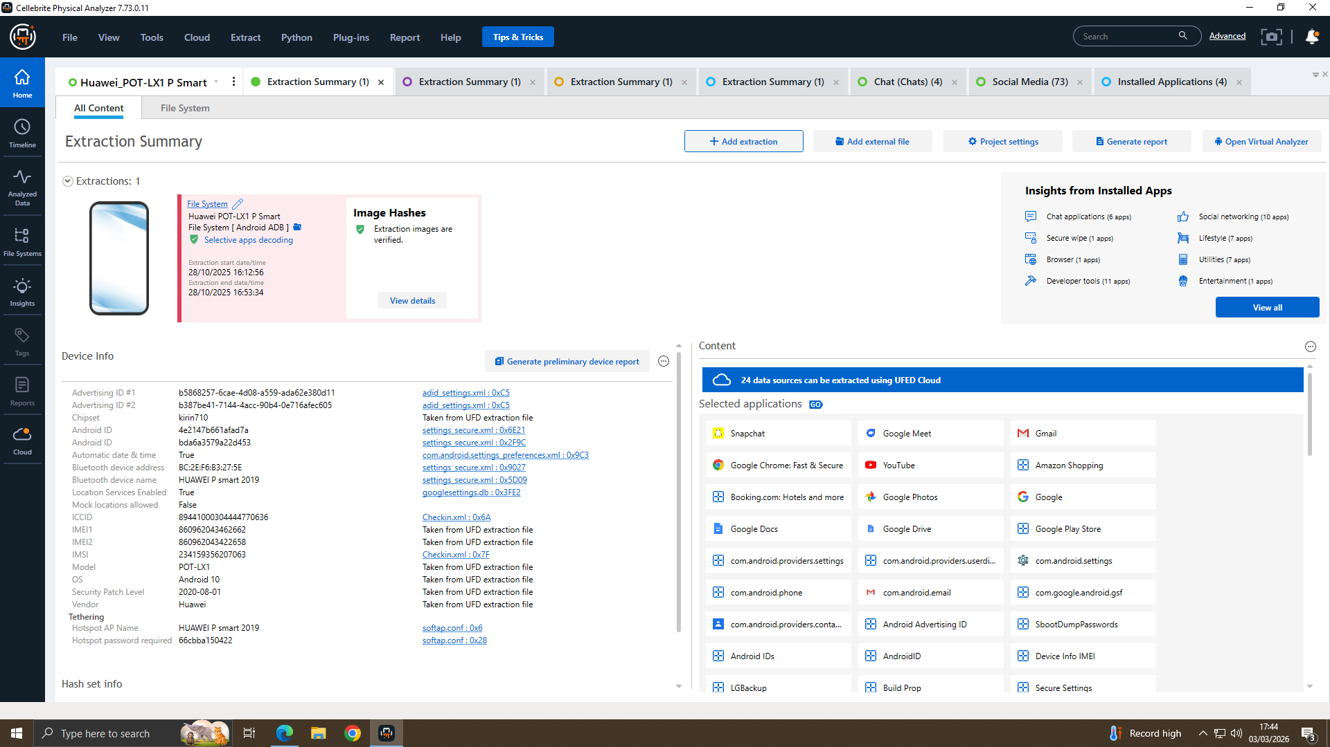
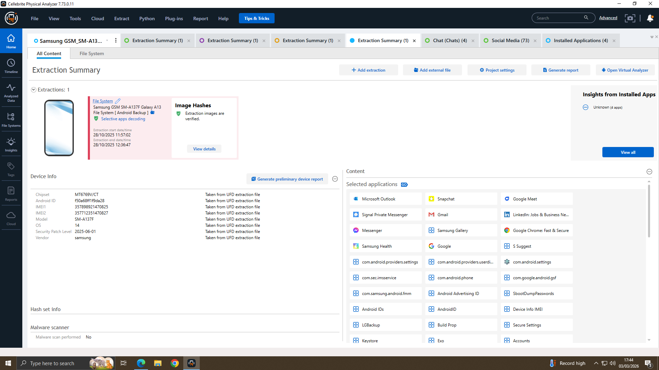
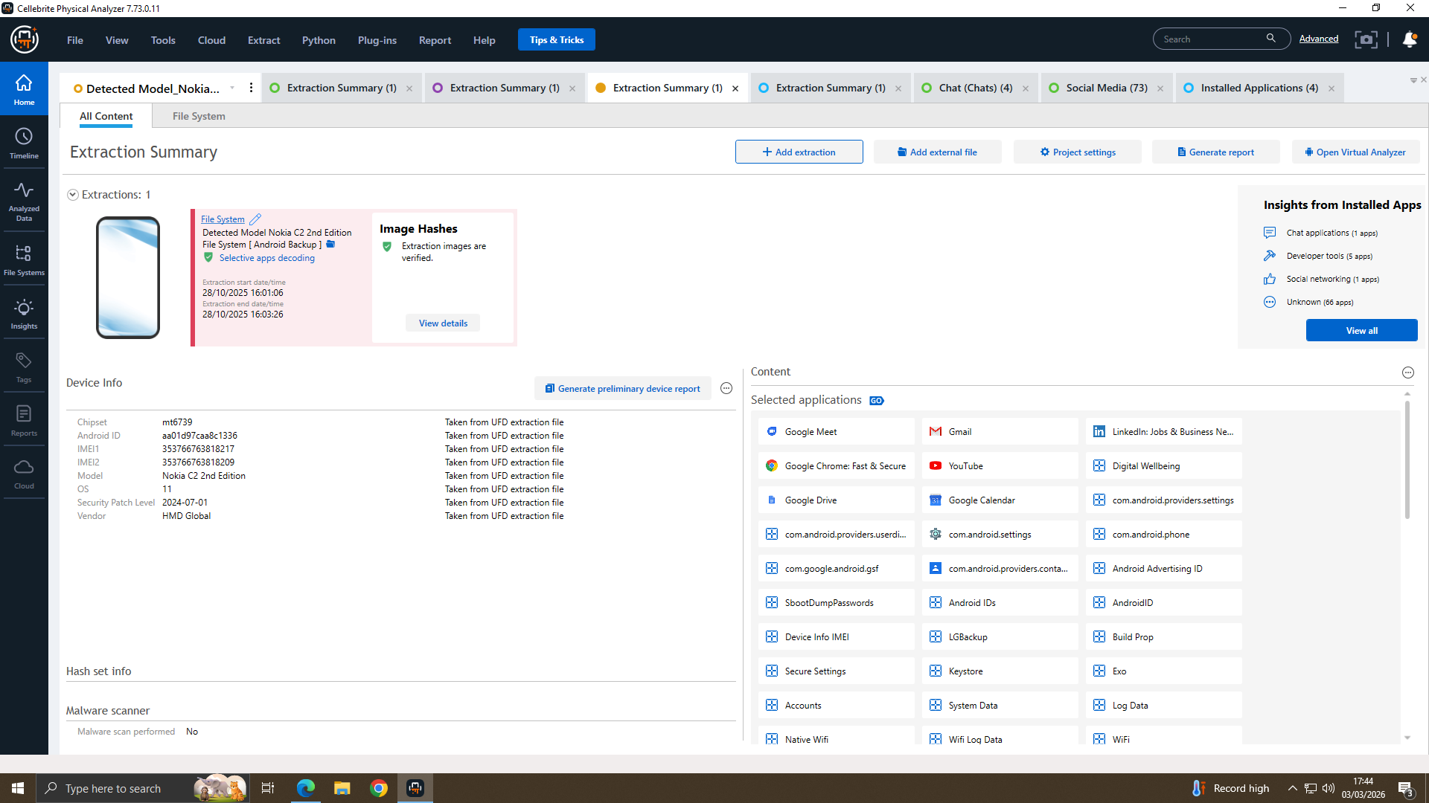
File Analysis
Emma’s Phone
.Joe’s Phone
Norman’s Phone
Analysis performed using Cellebrite Physical Analyser and FTK Imager
E-001 (Emma): 374 WhatsApp messages recovered, 5,708 media files extracted
E-002 (Joe): 15,455 images recovered including a train ticket and 2 GPS-tagged photos
GPS metadata (EXIF) from Joe's photos placed him at a specific location on 16/12/2024
E-003 (Norman): Facebook Messenger logs recovered showing direct patent requests

Slide 7
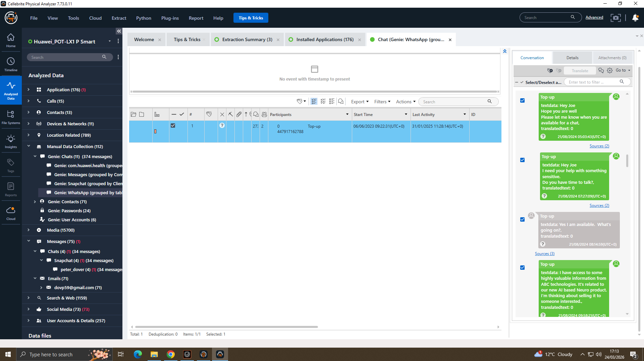
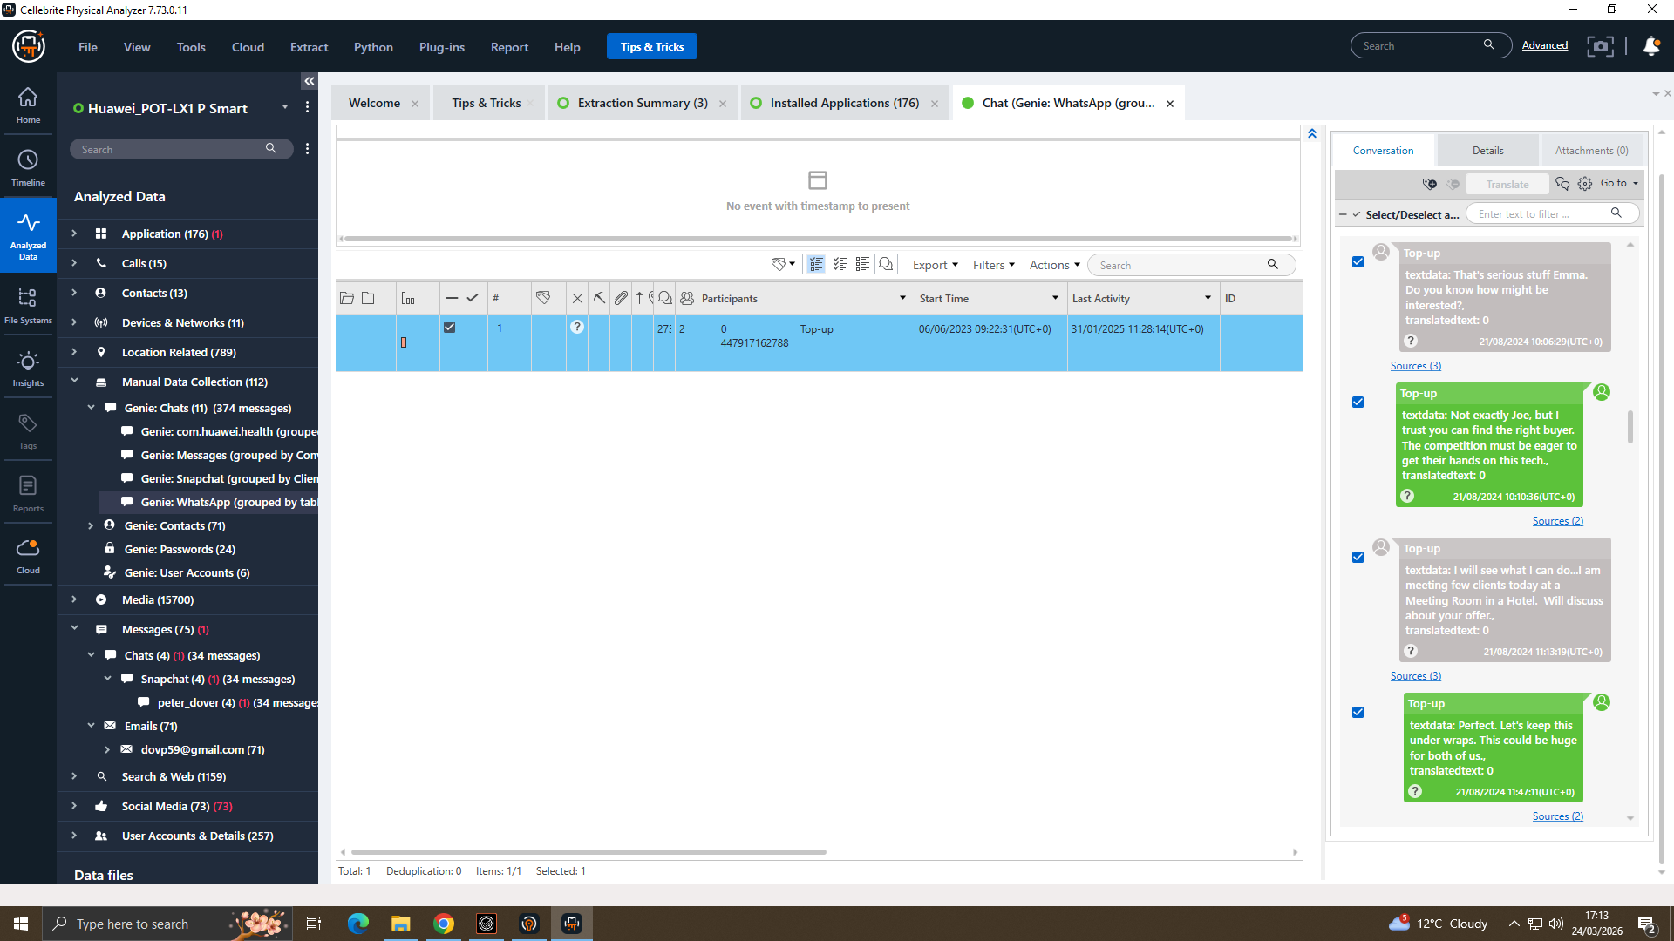
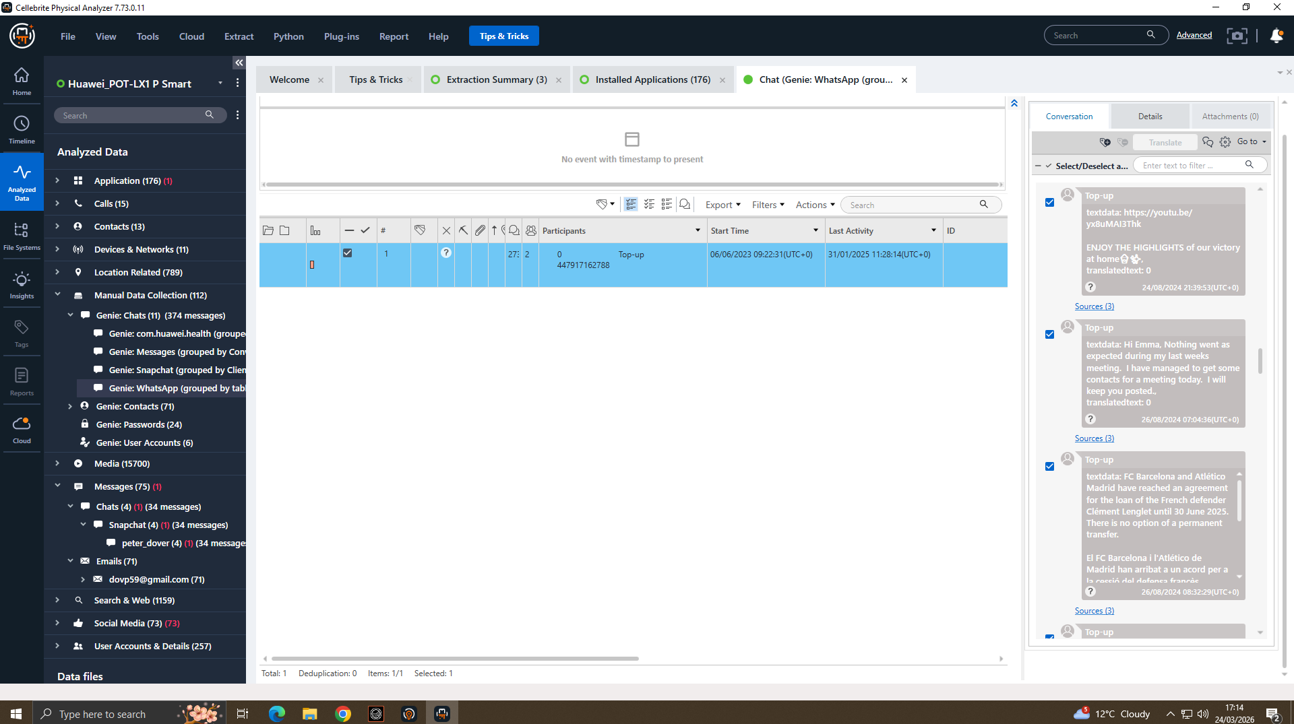
What We Found
Planing to Sell
Concealing
1st Meeting
Emma messaged: "Thinking of selling" — establishes criminal intent
Emma told Joe to "keep this under wraps" — shows Concealing
A physical meeting was arranged in Manchester — conspiracy moved offline

Slide 8
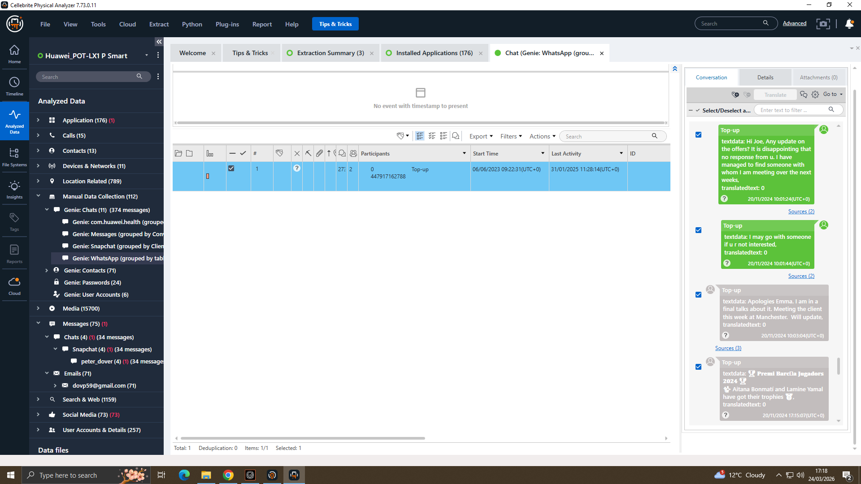
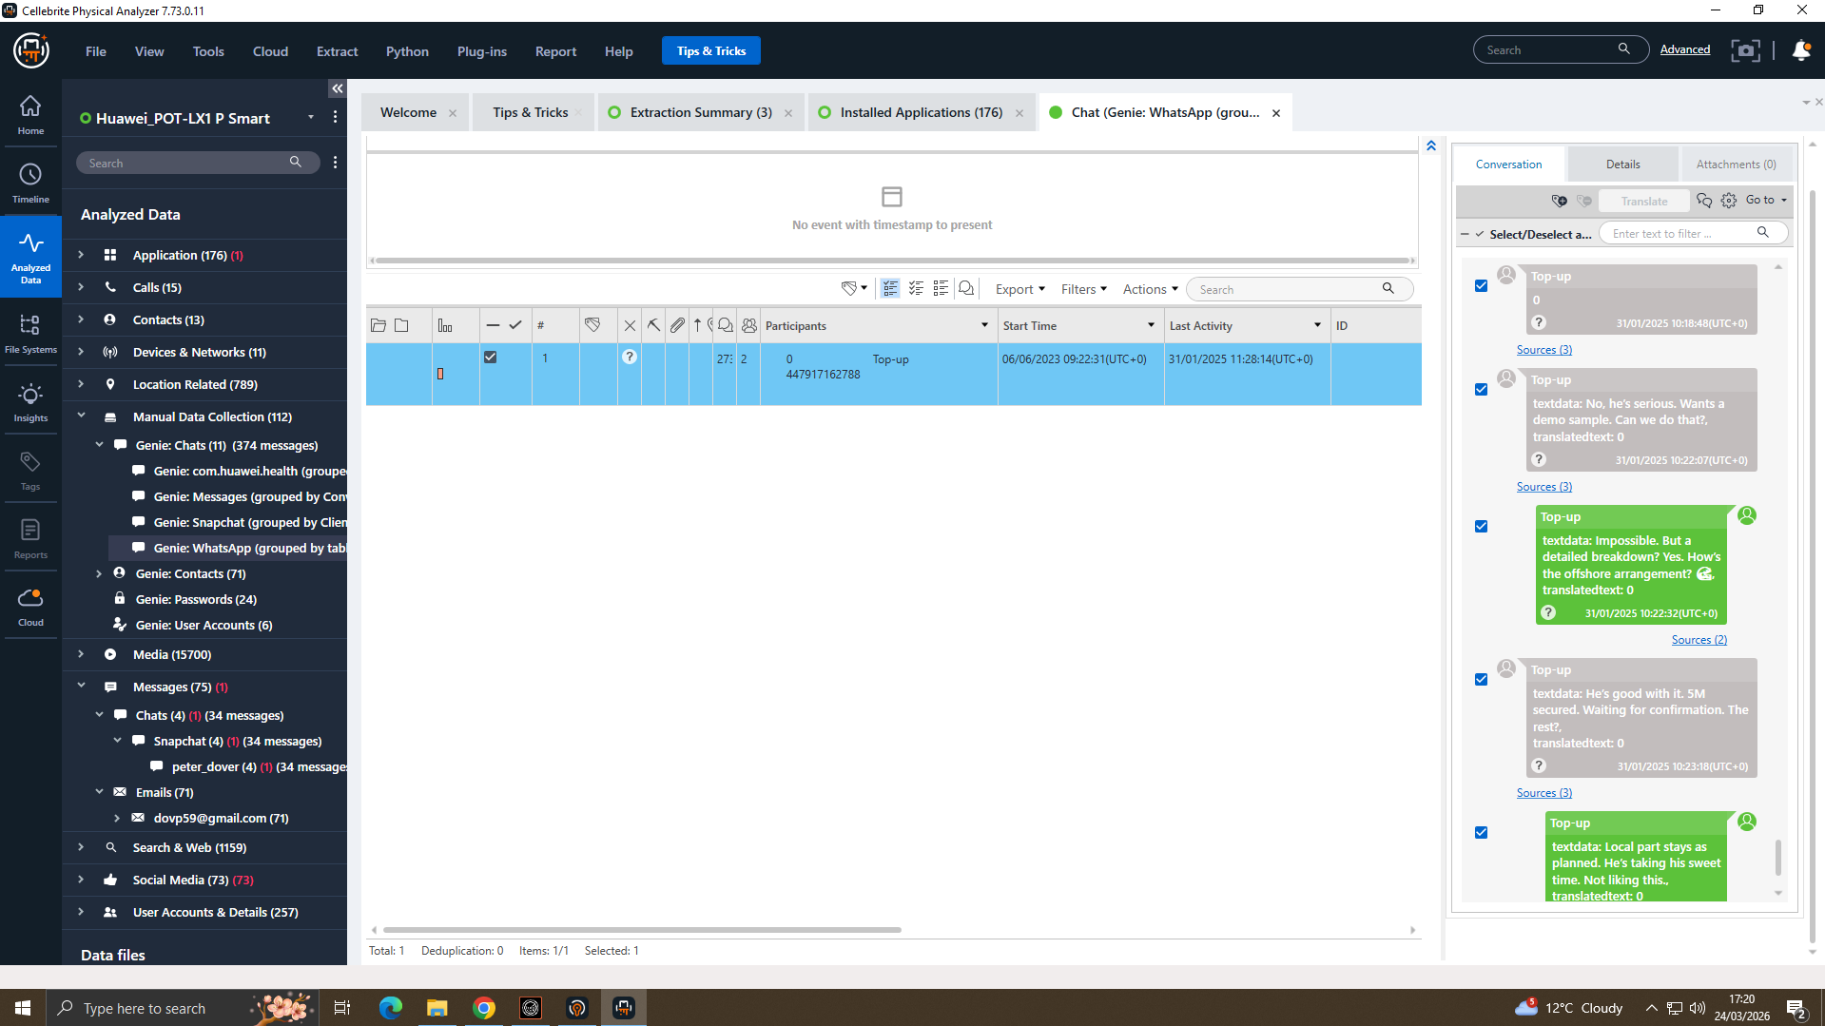
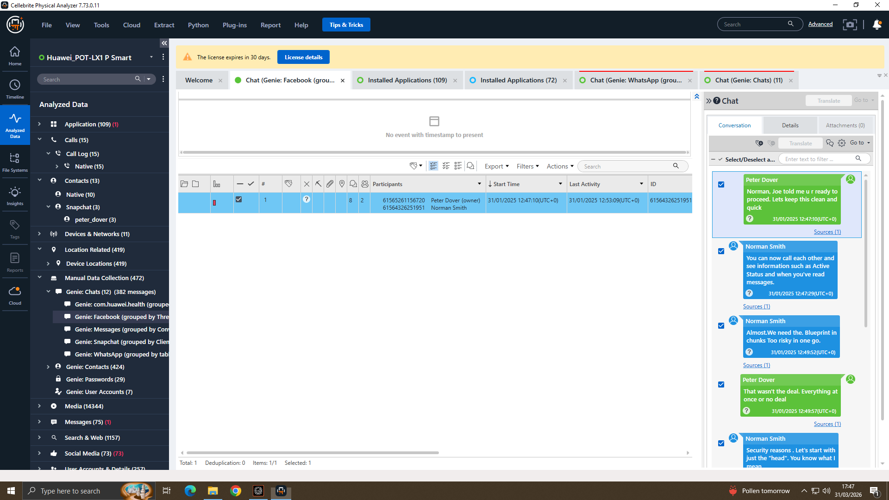
What We Found
Pressure Build up
Offshore Discussion
Blueprint Request
Emma sent: "May go with someone else" — pressure tactics to speed up the deal
Offshore payment discussed — indicates financial concealment and money laundering
Norman requested: "Blueprint in chunks" — direct request for patent QT-AI-2025

Slide 9
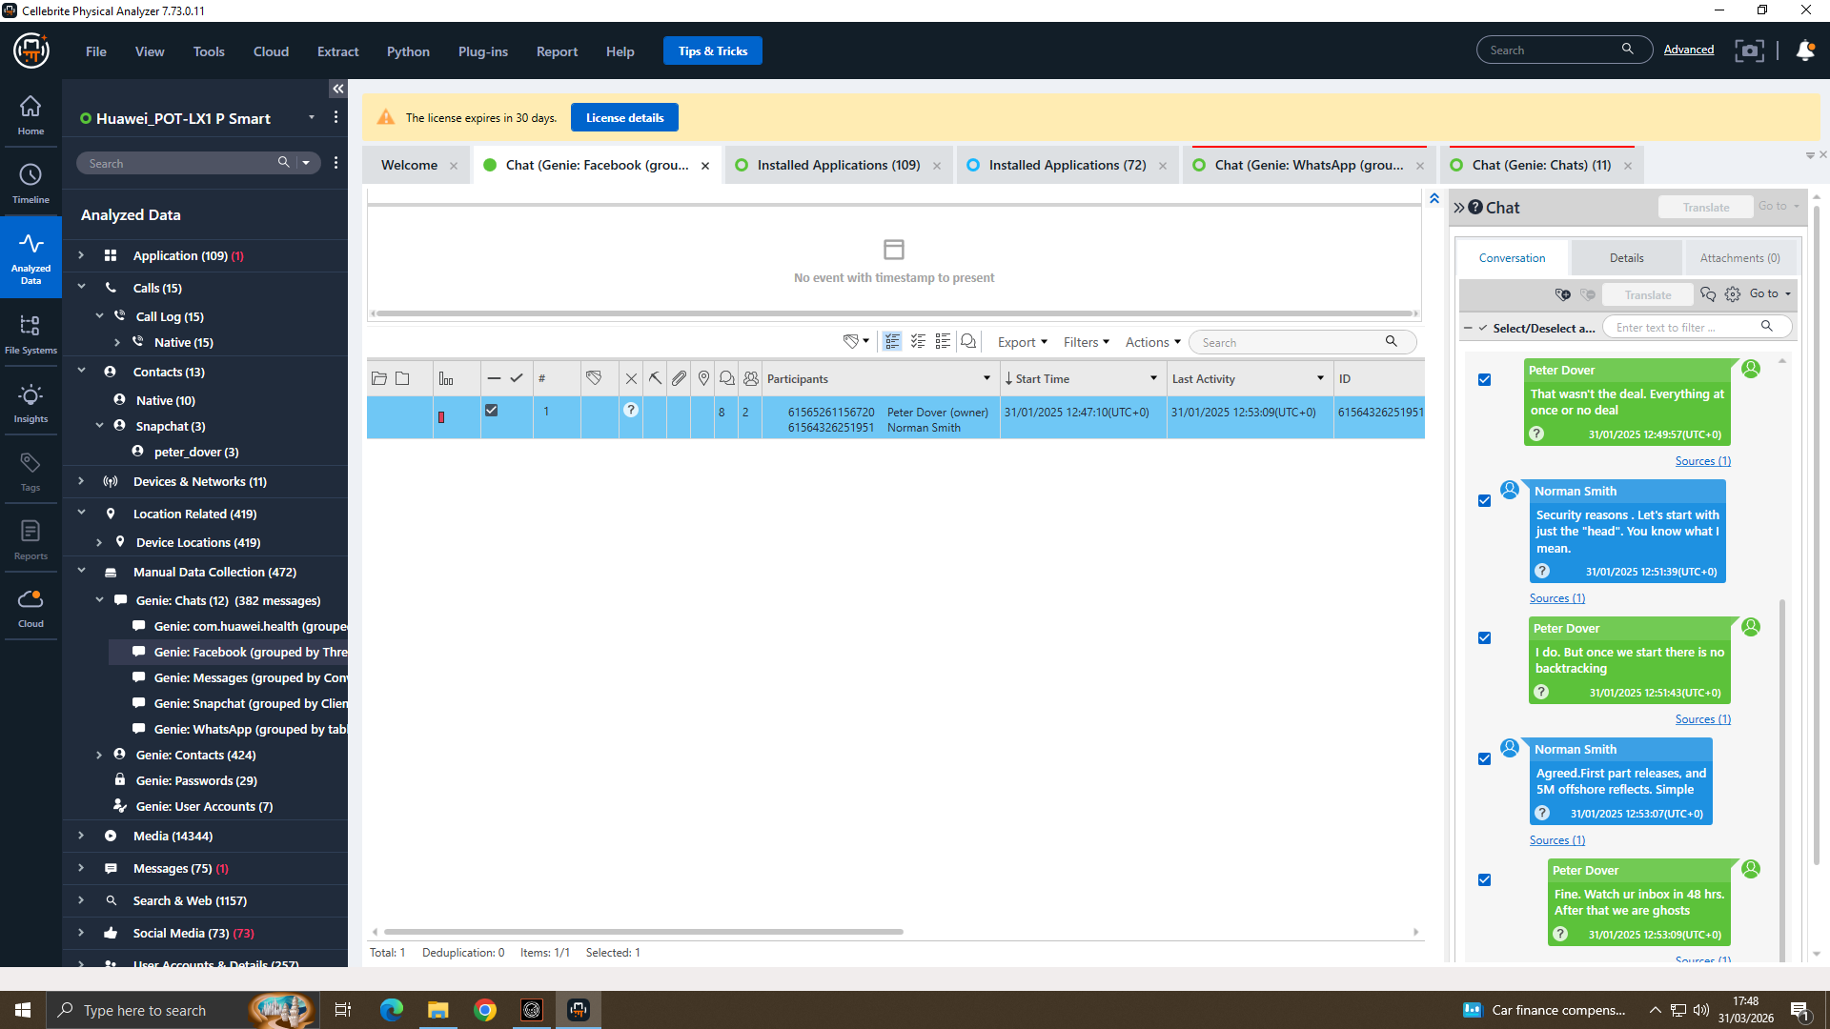
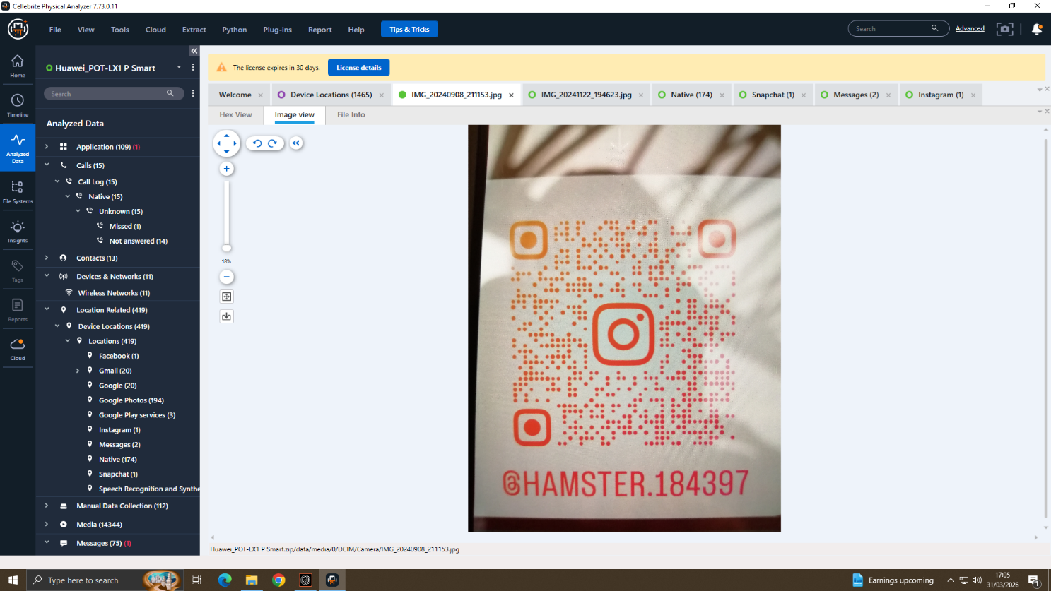
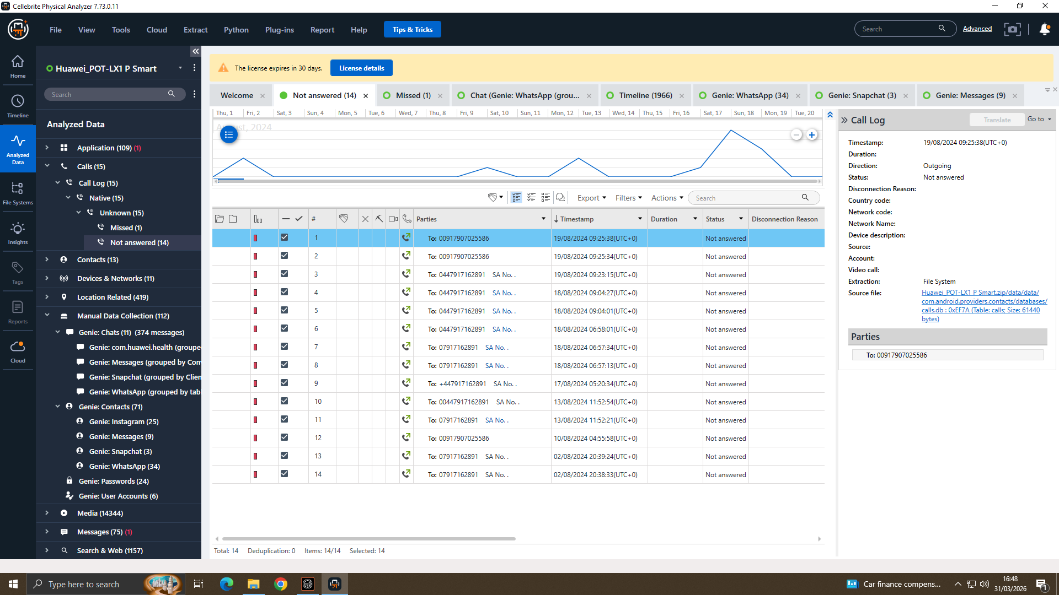
What We Found
5M Offshore Payment
Other Emma’s Account
Call Logs
£5 million offshore payment agreed — linked to Proceeds of Crime Act 2002
Emma used a secondary Instagram account (@HAMSTER.184397) as a covert channel
Call logs show 15 call records to 2 numbers, including an international number

Slide 10
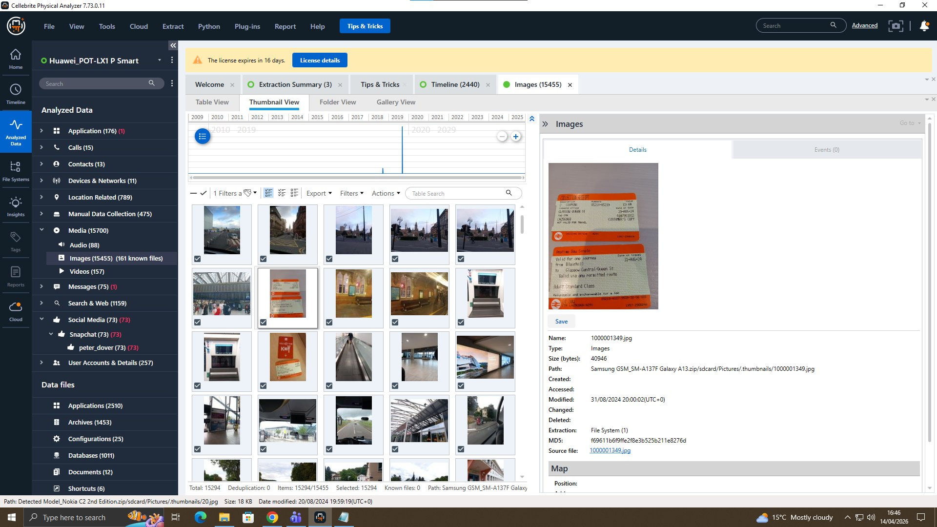
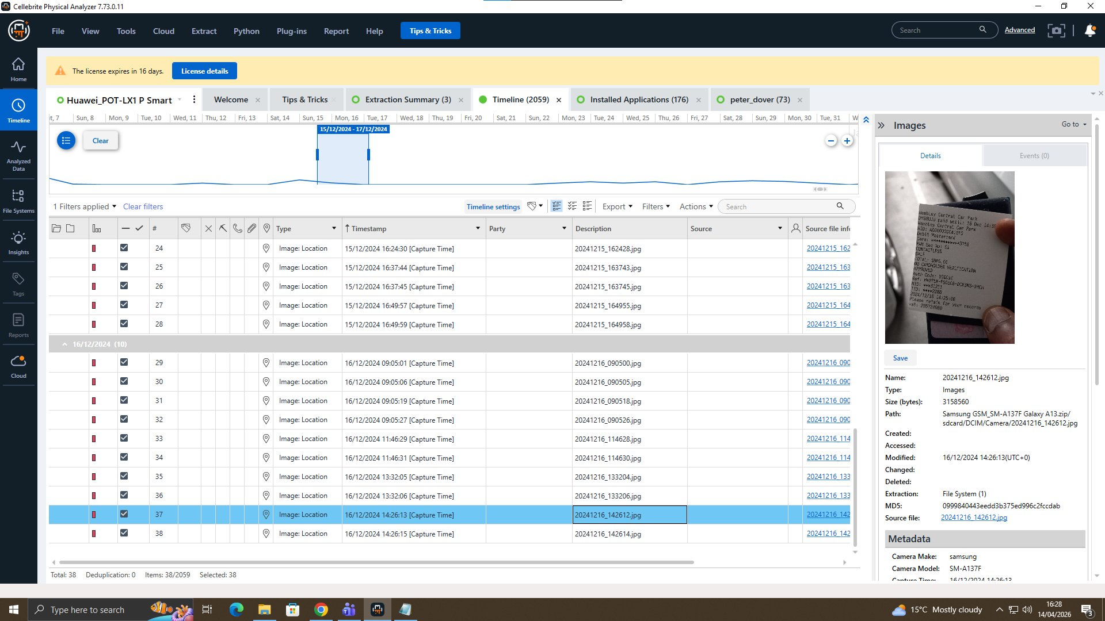
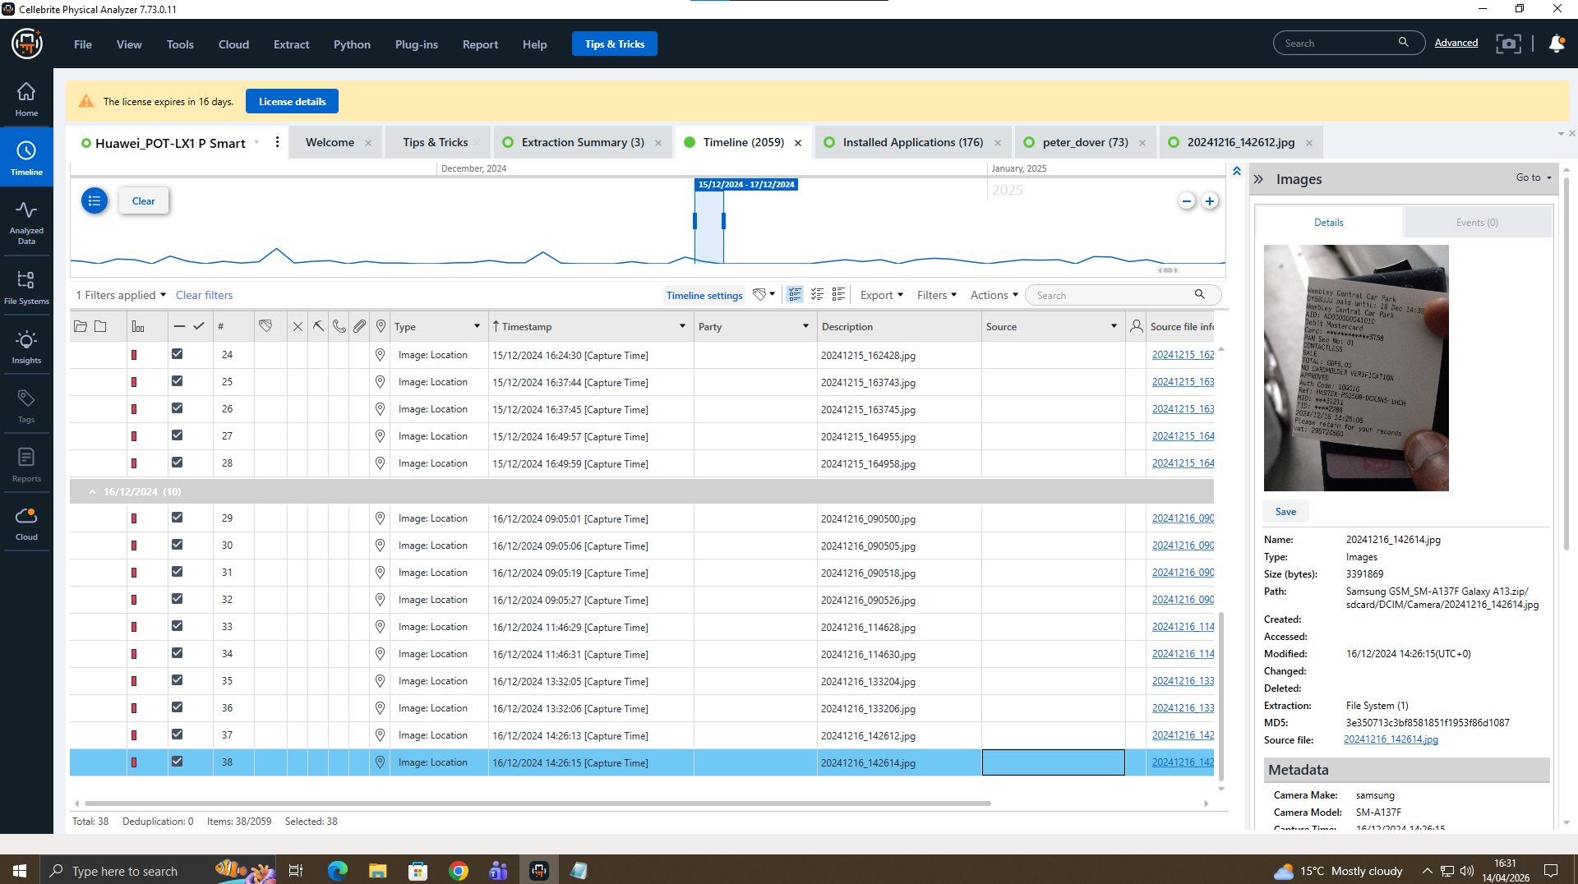
What We Found
Ticket
Location Tag
Location Tag
Recovered a train ticket and 2 GPS-tagged photos
GPS metadata (EXIF) from Joe's photos placed him at a specific location on 16/12/2024
File timestamps and metadata cross-referenced to build an accurate evidence timeline

Slide 11
Suspect Profiling
EMMA
JOE
NORMAN SMITH
Huawei POT-LX1 E-001
Samsung Android E-002
Nokia Android E-003
PRIMARY PERPETRATOR
INTERMEDIARY / BROKER
BUYER & RECEIVER
Senior engineer with privileged patent DB access
Initiated and drove the conspiracy
WhatsApp: admitted intent to sell
Used @HAMSTER.184397 as covert channel
Brokered the deal between Emma and Norman
Confirmed delivery: 'Watch ur Inbox 48 hrs'
Planned evidence wipe: 'We are ghosting'
GPS & travel evidence corroborates movement
Buyer for NexGen Circuits (via Vanessa)
Requested 'Blueprint in chunks'
Arranged £5M offshore payment
Facebook Messenger on E-003: key evidence
⚖ Computer Misuse Act 1990 | Trade Secrets Regs 2018
⚖ Computer Misuse Act 1990 | Criminal Justice Act 2003
⚖ Proceeds of Crime Act 2002 | Fraud Act 2006

Slide 12
Conclusion & Recommendations
Conclusion:
Recommendations
Three-suspect conspiracy was proven — Emma (insider), Joe (broker), Norman (buyer)
WhatsApp, Facebook Messenger, and Instagram were all used to coordinate the crime
All evidence was acquired and handled to NIST SP 800-86 and ISO/IEC 27037:2012 standards
Evidence is legally admissible and supports criminal prosecution
Charge all three suspects under Trade Secrets Regulations 2018 and Computer Misuse Act 1990
Investigate £5M offshore payment under Proceeds of Crime Act 2002
Obtain court order to preserve Instagram @HAMSTER.184397
Quantum Tech to revoke Emma's access and enforce least-privilege policies
Consider civil action against NexGen Circuits

Slide 13
Thank You
Questions Welcome
Muhammad Waleed · 2430361 · MSc Cyber Security & Digital Forensics · April 2026

