Slide 1
Finding and using the right resources

Slide 2
The NHS – types of resources
Journal Articles: British Medical Journal, Journal of Public Health
Online statistics from the NHS & Health Charities
Legal papers
Government Statistics
Newspapers
Full Fact – a fact checking website
The Library Catalogue! : http://librarycatalogue.uwtsd.ac.uk/primo_library/libweb/action/search.do?vid=44WHELF_UWTSD_VU1

Slide 3

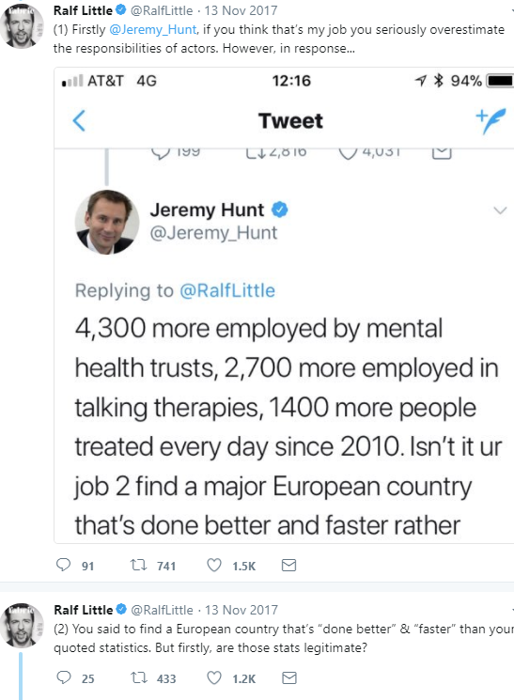
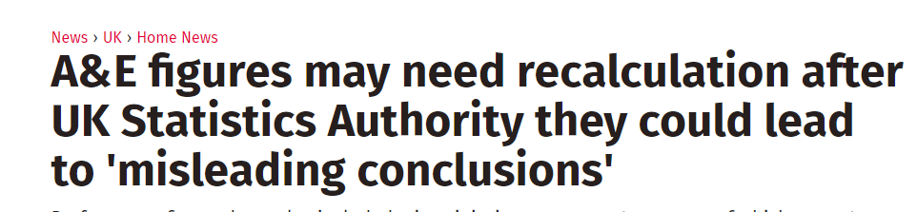
‘I can prove anything by statistics except the truth.’- George Canning
Classic examples of statistics being misused, misleading and misread include:
The infamous £350m a week
Jeremy Hunt vs Ralf Little on NHS mental health staffing
A&E figures this winter
Always read the small print
Notes:
£350m a week didn’t take into account the tax rebate we get on it (which reduces the figure by almost £100m) and ignores all EU spending on the UK
Jeremy Hunt vs Ralf Little was a twitter battle full of statistics which may be a very good idea to read, in terms of up-to-date facts and context – also very importantly ties into referencing, as long as you reference information with the correct date, then you are using correct data to the best of your knowledge, and won’t be penalized if the data changes after that date.

Slide 4



Where to find information?
The NHS is run by devolved governments, so when looking at statistics, pay attention to whether they are referring to;
- Great Britain; England Scotland and Wales
- The UK; England, Scotland, Wales and Northern Ireland
Each have separate websites which hold their statistics & publications

Slide 5
Where to find information?
Professional bodies:
British Medical Association for ‘Latest News’ https://www.bma.org.uk/
Royal College of Nursing https://www.rcn.org.uk/news-and-events/news
Government and Legal publications:
Department of Health and Social Care (Formerly Department of Health) https://www.gov.uk/government/organisations/department-of-health-and-social-care/about/statistics
Westlaw: Apply ‘Insights’ and ‘Health and social security’ http://www.uwtsd.ac.uk/library/online-library/all-resources/ (under Resources list: S-Z)

Slide 6
How to use the information
Take note of the sample size, dates and location
Compare them to similar statistics e.g. Private healthcare, countries with similar populations and development to enhance your argument
The conclusions & meaning of the statistics will not be spelled out for you, this is the part where you apply your own knowledge to create meaning

Slide 7
Frameworks: PESTEL and SWOT
PESTEL: Political, Economic, Social, Technological, Environmental, Legal,
(Sometimes written as PESTLE)
SWOT: Strengths, Weaknesses, Opportunities, Threats
Some of these areas will overlap
Notes:
There will not be a textbook called :PESTEL or SWOT, you can find examples of these frameworks on the library catalogue, they are generally used by management/ strategic planning books: Fundamentals of Strategy
PESTLE

Slide 8
Referencing
Don't Panic!

Slide 9
Referencing – why does it matter
Puts your work in academic context
Enables readers to find your sources
Prevents accidental plagiarism
Demonstrates the breadth of research you have undertaken

Slide 10

What do I need to reference
Direct quotations from a resource
Paraphrased or summarized content
If you read something but don't use it in your work, put it in the Bibliography

Slide 11
Where do I put references
Written Assignments:
In text citations are required where you have quoted or summarized sources.
A Reference List containing full details at the end
Presentations:
A slide at the end containing all references

Slide 12

Definitions
In-text Citations/ Citations - Appear in the main body of your assignment, acknowledging sources without disrupting the flow of your work
End-Text Citations/Reference List – Appears at the end of your assignment, and contains the full details of sources you have cited in your work
Bibliography – uses the same referencing style as your list, but includes background reading not cited in your work

Slide 13

Vital Information
Title
Authors/editor
Date
Publisher, and place published
Access date for online resources
Page numbers for lengthy resources
The style you are using
Notes:
This is where your e-shelf is really useful, If you've saved the resource there, then all of this information is easy for you to find immediately

Slide 14
Software
- Not 100% reliable
- Microsoft Word - you need to input the citations as you use them
- Cite this for me – limited range of resources covered
Library catalogue tool – relies on the data we're given, so formatting like capitalization is an issue
Our own guides are waiting to be approved, but I’d recommend the University of Lincoln’s referencing guide http://guides.library.lincoln.ac.uk/learn/referencing

Slide 15

Examples
Book/E-book
Chapter in an Edited Book
Article from a Journal/e-Journal
Report by the Government, or an Organisation
Websites & YouTube

Slide 16
Book/e-book
In-text: Planning your research is crucial (Smith, 2016, p.5)
Reference list/Bibliography:
Smith, E. (2016) How to improve your research project. Plymouth: Kiln Press
For E-books add Available at: Provide the link
Smith, E. (2016) How to improve your research project. Plymouth: Kiln Press. Available at: link to book (Accessed 8th February, 2018)

Slide 17
Chapter in an edited book
If you use the Whole Book, reference the same as a normal book, replacing the Author with the Editor
BUT
If you use a chapter the format is different!
Why?
Notes:
The Citation tool on the Library catalogue WILL NOT do this for you. It records the whole book and not individual chapters, so here is the format:

Slide 18
Chapter in an edited book
Whole book: Carroll, M. & Rempel, J., 2011. Living through the dead burial and commemoration in the classical world, Oxford ; Oakville, Conn.: Oxbow Books.
Chapter: Low, P. (2011). The power of the dead in classical Sparta: The case of Thermopylae. In: M. Carroll and J. Rempel, ed., Living through the dead. Oxford UK: Oxbow Books, pp.1-21.

Slide 19
Article from a journal/e-journal
Article:
Cullen, J.G., 2017. ‘Educating Business Students About Sustainability: A Bibliometric Review of Current Trends and Research Needs’. Journal of Business Ethics, 145(2), pp. 429-439.
Online Article:
Cullen, J.G., (2017). ’Educating Business Students About Sustainability: A Bibliometric Review of Current Trends and Research Needs’, Journal of Business Ethics, 145(2), pp.439-439 [online] Available at: https://search.proquest.com/docview/1945565683?accountid=130472 [Accessed 30 Nov. 2017].
Notes:
Many citation generators online, are useful for the basics, BUT some will capitalize authors or titles, and some will not add the link to the resource if it available online. SO While using them can save you time, you do need to go through them and check. If you aren’t sure of anything, give me an email or ask your tutor

Slide 20
Government & Organisation Reports
Government:
Department of Health (1991), Report on Health and Social Subjects: Dietary Reference Values for Food Energy and Nutrients for the United Kingdom, United Kingdom: The Stationary Office
Organisation:
Organisation for Research into Primary Education (2017), Learning Today. Stirling: McPhee and Jones
Notes:
Again, if these reports are hosted online then add Available at: and provide the link

Slide 21
Websites
Organisations:
National Health Service (2018), Back Pain. Available at: https://www.nhs.uk/Conditions/Back-pain/ (Accessed: 7th February, 2018).
Personal Websites:
Rowling, J.K. (2018), Writing. Available at: https://www.jkrowling.com/writing/ (Accessed: 7th February, 2018).
Youtube:
Channel 4 News (2018) Iran: Why are people protesting [video]. Available at: https://www.youtube.com/watch?v=K4WZ_PloiV0 (Accessed 8th February, 2018)

Slide 22
Citing in text examples
Planning your research is crucial (Smith, 2016, p. 5).
Planning your research is crucial (Smith, 2016, p. 5), and can help save time when writing up your results.
As long as you acknowledge the source you use, the in-text citation placement depends on your style of writing.
You should be using Harvard style referencing

