Slide 1

Modul name: Certificate of Higher Education Skills fol Workplace (Health and Social Care)
Academic and Employability skills
Group 1
Modul code:LCHS4001
Student:Oana-Gabriela Gaicu
Student number:2512961

Slide 2
Introduction
Mental health care is becoming more collaborative and recovery-focused. This change is driven by Peer Support Workers (PSWs), who use their mental health experiences to aid others. PSWs emphasise empathy, hope, and mutuality, developing connections on shared knowledge, unlike other clinicians. Derbyshire Healthcare NHS Foundation Trust advertised a PSW position in the Radbourne and Carsington Units in Derby. This report is my study. I think this work is the next stage in my dedication to total care. The report describes why I chose this work, how I organised my research, how I utilised the CRAAP test to analyse a crucial source, challenges I encountered, and my next steps. You should demonstrate reflective practice, job readiness, and module academic criteria.

Slide 3
Why I Chose the Peer Support Worker Role
I want better mental health outcomes and less stigma. Taking care of elderly persons in foster care has shown me the challenges mental health patients confront. These incidents and my health and social care lessons have inspired me to help others. Derbyshire Healthcare is offering a PSW position that you need. This position provides emotional and practical support to short-term residents of Radbourne and Carsington, according to the job description. The PSW provides person-centred, comprehensive care to persons from many disciplines. This allows me to work with nurses, doctors, therapists, and social workers while providing peer support (Ashish, Lin, Miner, Atkins, & Althoff, 2022).
The ad states that one PSW job pays £24,937 to £26,598 a year and is part-time. Fair remuneration shows that the trust values my real experience, even though money doesn't drive me. The trust also provides a generous NHS pension, ample annual leave, flexible work hours, and LGBT+ and BAME networks to its staff. As a former NHS employee, I know how vital these rewards are for work-life balance and career growth. CQC says personnel treat patients with compassion, giving the trust an excellent grade. This feels like joining a helpful, values-based organisation.
Finally, the role's emphasis on social inclusiveness matches my fairness. Peer support promotes the belief that disease shouldn't define a person and that healing requires community involvement. PSWs help service consumers overcome issues, making the mental health system more accessible. I'm delighted to assist people connect with family, friends, and groups and achieve their goals by implementing my social inclusion concepts.

Slide 4
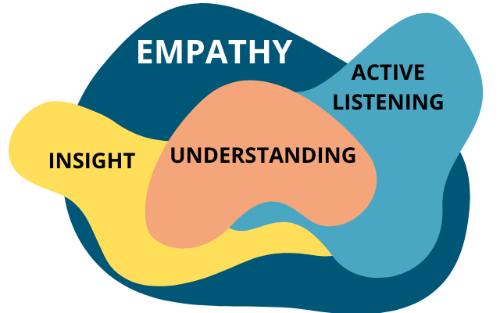
Essential skilles neded for the role of Peer Support Worker
Understanding of your personal recovery journey and being able to use your lived experience in a positive and appropriate way to help others
Excellent communication skills and the ability to relate to a wide range of people
The ability to empathise with others and build positive relationships

Slide 5

Understanding of your personal recovery journey and being able to use your lived experience in a positive and appropriate way to help others
A peer support worker understands their own recovery, including strengths, limitations, triggers, and what strategies help them stay well
They have developed coping mechanisms and resilience to manage their own well-being so they can support others without being harmed themselves.

Slide 6

Excellent communication skills and the ability to relate to a wide range of people
PSWs create safe spaces for service users to discuss their issues by listening and understanding. PSWs listen without judging and repeat what they hear to help people identify their strengths and answers. Self-care and resilience matter..

Slide 7
The ability to empathise with others and build positive relationships
Working with seriously mentally ill persons can be emotionally draining, therefore PSWs must know their triggers, set limits, and obtain help or supervision to avoid burnout. PSWs can reduce stigma by representing service users on diverse teams and working well with others

Slide 8
Evaluating a Source with CRAAP
The CRAAP test assessed my sources' reliability and usefulness. I examined the Derbyshire Healthcare Peer Support Worker Toolkit to see what the trust expects.
Currency: The toolbox displays current trust recommendations.This shows the toolset is still relevant (Derbyshire Healthcare NHS Foundation Trust, n.d.).
Usefulness: The bundle is for Derbyshire Healthcare PSWs only. It outlines my situation-specific values, regulations, orientation activities, supervisory methods, and reflective exercises. It emphasises recovery-focused, non-directive peer assistance, which fits my career and work style.
Correct: The toolbox combines academic and professional definitions from Solomon (2004) and Mead and MacNeil (2003). The Mental Health Commission and peer support literature support its assertions. The paper employs factual language, not anecdotes.
The Derbyshire Toolkit is a good training resource, according to the CRAAP test. I used this tool to analyse additional sources to ensure my study was based on credible, current information.

Slide 9
Challenges Encountered
Internet information quality varied, thus sources had to be evaluated using the CRAAP test and official NHS and academic publications were given the most weight. Finally, balancing work and personal life was difficult. The Derbyshire toolbox advises PSWs to carefully share experiences for the service. This made me consider how to tell my narrative (Pitt, Lowe, Hill, Hetrick, & Ryan, 2013).

Slide 10
Conclusion & Reflection
PSWs can use their personal and professional experiences to benefit others.
I now grap the role's obligations, basic competencies, and work environment after studying.
Taking the CRAAP test ensured my study sources were reliable and current.
Problems have been solved using critical review, reflective practice, and UK frameworks.
Learn more, enhance my skills, make contacts, and create bespoke application materials next.
I'm confident my personal experience, academic background, and passion for mental health make me a suitable candidate for this role.

Slide 11

Thank you

