Slide 1
The Importance Of Emotional Intelligence (EI) And Cultural Intelligence (CQ) In Leadership
Camelia Croitoru
ID: 2247724

Slide 2
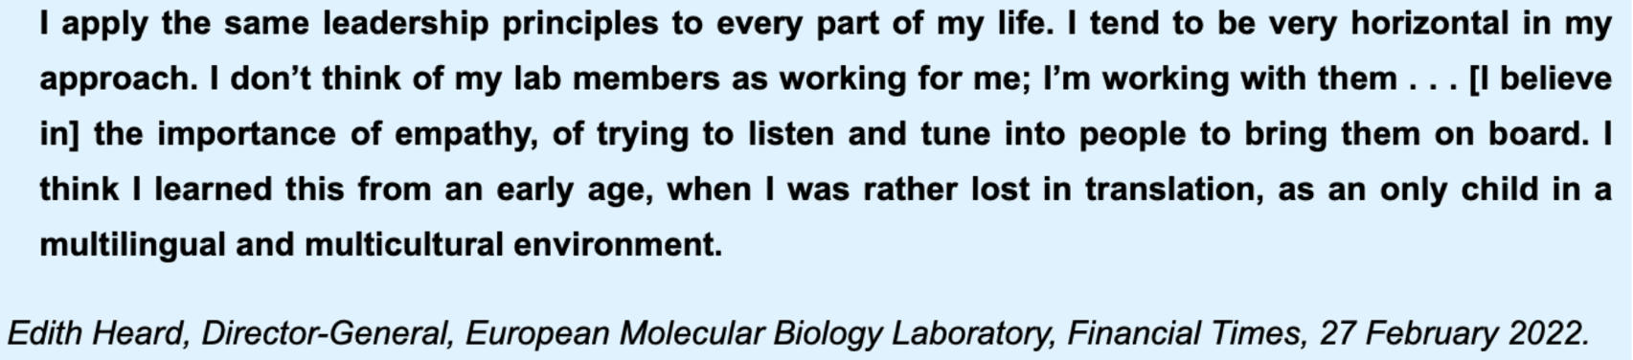
Workforces are more diverse than ever
Diversity drives innovation and problem solving
Global markets demand cultural intelligence

Slide 3
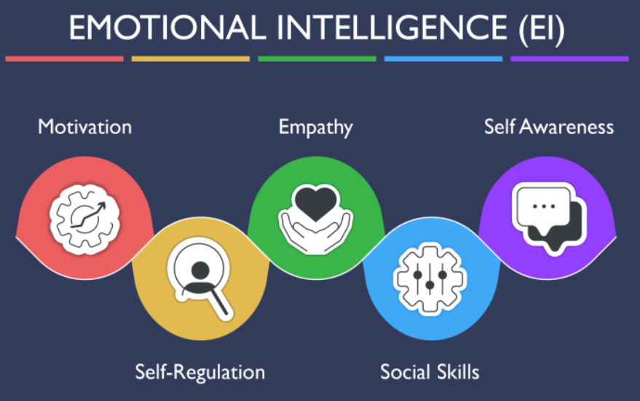
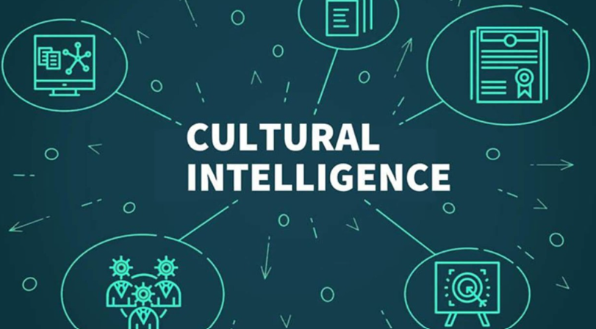
Learning Outcomes and Structure
This presentation is a critical analysis of Emotional Intelligence (EI) and Cultural Intelligence (CQ) with a comparison of theories of leadership and management and application in the instance of multicultural organisations regarding business models and strategic analysis (Sharma, Goyal and Sharma, 2024).
Notes:
The researcher will look at the relevance of Emotional and Cultural Intelligence in modern-day leadership. They will establish the line between leadership and management, generalise on the traditional grounds and critically analyse the models of Goleman and EI and Earley andangs model, CQ. Live exemplification will be made on the business examples. Finally, they will have strategic implications and look into leadership development (Sharma, Goyal and Sharma, 2024). But also, it measures, as opposed to describing, the relevance of EI and CQ in contemporary organisations.

Slide 4

Define Leadership and Management
Leadership is the concept of inspiring and motivating individuals towards a vision, and management is that of planning, organising and controlling resources. Based on multicultural leaders, effective leaders need to be in a position to combine relational and structural levels of coordination (Wangdi and Tobgay, 2022).
Notes:
Management has never been unsystematic, effective and spontaneous. Influence, motivation and vision, on the other hand, are issues that leadership is concerned with. This difference is misunderstood in a multicultural environment. The leaders ought to strategise systems, emotional dynamics, as well as cultural differences. The bureaucratic style of management will serve to keep things in place, but not to work as a team despite the differences (Wangdi and Tobgay, 2022). Structural competence and non-relational intelligence would therefore make a good leader.

Slide 5

Classical Management Foundations
The theories introduced by Fayol were the focus on power, unified command, discipline, and equity (Tidhar, 2023). Despite the usefulness of these mechanistic underpinnings in the organisation structure, thematic leadership of complex organisations in modern organisations, which are emotionally multicultural and multifaceted, is limited.
Notes:
The conceptions that were proposed by Fayol were important in the structuring of the administration that was founded on power and discipline. The concepts remain applicable regarding transparency and accountability. They were, however, industrialised and developed with the emphasis on hierarchy. The existing organisations are inter-global and teamwork involving, therefore demands flexibility and emotional intelligence (Tidhar, 2023). The classical theory cannot then provide a leadership in regard to the management of interpersonal and cultural complexity, giving rise to the thought of EI and CQ.

Slide 6

Management Assumptions About People
Theory X by McGregor says that the employees must be controlled, and Theory Y takes that the employees must be given intrinsic permission and trust (Bwalya, 2023). Theory Z by Ouchi is more founded on collectivism and long-term commitment, which is more consistent with the multicultural leadership ideology.
Notes:
Theory X and Theory Y assume a dictatorial leadership attitude and style. The omnivorous leadership mind, connected with the integrity of theory, the employees are already motivated and accountable. The Theory Y strategy is closely correlated with emotionally intelligent leadership, as it is the theory that lays emphasis on the significance of trust and empowerment. There was another dimension, that is Theory Z, which carries a collectivist dimension that promotes a long-term commitment in relations (Bwalya, 2023). The assumptions are what determine the leadership behaviour. There would be more inclusion and collaboration cultures in the theory of Y and Z leaders.

Slide 7
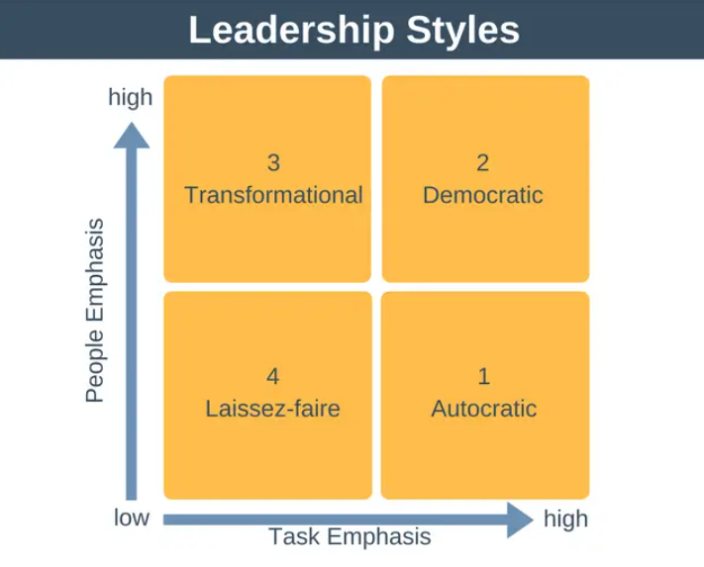
Leadership Styles Spectrum
The autocratic leadership puts every power on the shoulders of one person, the democratic leadership approves the involvement of the followers, the transformational leadership questions change, and the leader-servant leadership promotes the development of servants (Singh, Prabhakar and Kiran, 2022). Multicultural workplaces normally have a participative and relational work style.
Notes:
Autocratic leadership works well during times of crisis, and it limits participation. In democratic leadership, shared decision-making exists. Transformational leadership is an inspirational leadership that resembles vision and servant leadership, which is anchored on empathy and the development of the follower. The style of participative and servant leadership, which builds trust and provides psychological safety, is more suitable in multicultural environments (Singh, Prabhakar and Kiran, 2022). Emotional Intelligence improves the skills of communicating and empathy, and Cultural Intelligence improves the skill of adaptation to groups of opposite personalities.

Slide 8
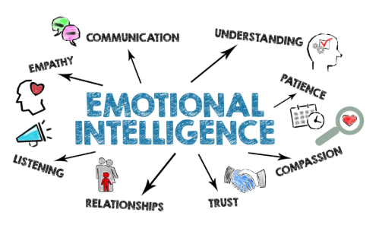
Emotional Intelligence (EI): Concept and Model
Emotional intelligence, created by Goleman, comprises self-awareness, self-regulation, motivation, empathy and social skills, which assist leaders in controlling emotions, as well as the creation of trust and reinforcement of relationships among teams (Husain et al., 2022).
Notes:
Emotional intelligence has five key components. The leaders can know the triggers of emotion with the help of self-awareness. Controlled response is provided by self-regulation. This perseverance is born out of motivation. Skills such as empathy allow one to put themselves in the shoes of other people, and social skills will apply in communication and conflict management. All of these competencies, along with others, promote trust and cooperation (Husain et al., 2022). Multicultural interviewing requires empathy, especially in cases that involve bridging the differences. But also, on the other hand, ethical judgment and cultural awareness are the most relevant to EI.

Slide 9

Critical Evaluation of EI
EI improves trust, engagement and conflict management, but not measurement validity. Overlap among personality traits has also been raised, as well as cultural bias. EI is effective and not adequate (Paul, 2021).
Notes:
Based on the current trend and working environment, Emotional intelligence has its opponents. But also, based on the entire analysis, it intersects with personality problems and does not have valid measuring instruments. The expression of emotions is also not universal since a given expression is different across cultures. On the other hand, the emotional competency may be manipulated. Through this, EI does not provide a holistic solution (Paul, 2021). It is a good leadership trait that is likely to liaise with cultural sensitivity and ethical responsibility.

Slide 10
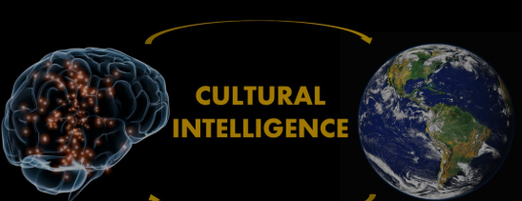
Cultural Intelligence (CQ): Concept and Model
Cultural Intelligence may be defined as having the capability of being able to work within cross-cultural relationships. They are speaking about adaptive leadership (Jackson, 2023). Earley and Ang focus on metacognitive, cognitive, motivational and behavioural aspects that give adaptive leadership a decent description in various contexts.
Notes:
Cultural Intelligence allows leaders to work in a multicultural environment. CQ Metacognitive CQ is associated with cultural awareness. Cognitive CQ represents normative knowledge, system knowledge. The motivational CQ is the concern and confidence in cross-cultural communication. Adaptive actions are of concern for behavioural CQ (Jackson, 2023). A total of these dimensions enables leaders to develop changes in the sphere of communication and form inclusive teams. CQ is indispensable in organisations that are being operated internationally and where cultural incompatibility may partially serve as a deterrent.

Slide 11
Critical Evaluation of CQ
Cultural intelligence facilitates cross-cultural elasticity at the cost of stereotyping and veneer competence (Binsaeed et al., 2023). The process of developing can be achieved through participation of long term experiences studies rather than academic education.
Notes:
Cultural intelligence makes it more flexible; however, there are some risks as well. When over-generalisation of cultural structures takes place, the stereotyping can be realised. Change of behaviour may not always be a result of bare training. The continuous exposure is taken into account, and intercultural experience is gained, only thanks to that, the true development of CQ may be realised (Binsaeed et al., 2023). The cultural contexts are dynamic in that the leaders should be flexible and open-minded instead of basing their beliefs on a fixed cultural understanding.

Slide 12

Integrating EI, CQ, and Leadership Styles
Emotional intelligence believes in servant and democratic leadership since it enables leadership to be empathetic and trustworthy. Cultural intelligence also increases the transformational and participative leadership in the form of flexibility (Tayşir, 2025). Autocratic leadership lacks a relational style, which is needed in multicultural organisations.
Notes:
They are combining Emotional intelligence and Cultural intelligence, which is an effective and sustainable approach to being a leader. EI enhances the process of interpersonal relationships and emotional cognition in the teams. CQ has the flexibility of culture. Servant leadership and democratic leadership are both founded on empathy and EI, with the help of trust (Tayşir, 2025). Transformational leadership embraces CQ in passing information in different circumstances. Autocratic leaders do not fit in as well as the multicultural environment that requires flexibility.

Slide 13

Business Examples (Google and Microsoft)
Emotionally intelligent leadership facilitates psychological safety at Google. The transformation by Microsoft is transformational, and the strategic virtue of relational intelligence is portrayed through the empathetic approach (Wangdi and Tobgay, 2022).
Notes:
Google is one of the leading technological organisations in the global market. and it promotes the concept of psychological safety, and its employees feel free to speak out and share their ideas. These include emotional intelligence leadership that is based on trust and openness. Microsoft is already one of the largest software development companies in the global market, which operates in a highly innovative tech industry (Wangdi and Tobgay, 2022). They are encouraged by the cultural change due to the empathetic leadership. These examples convey that, other than being a part of interpersonal harmony, Emotional Intelligence is our organisational performance and competitive advantage.

Slide 14


Business Examples (Starbucks and Airbnb)
Starbucks also trusts the cultural competency training. Airbnb increased its management in dealing with the problem of discrimination, and they demonstrate that Cultural Intelligence will assist in raising the standards of international legitimacy (Tidhar, 2023).
Notes:
Starbucks is a global corporation that does business in the international market, and in order to achieve inclusiveness in practices, Starbucks invests in cultural competencies. The other issue that Airbnb addressed is discrimination, based on improving the policies and systems of governance with an inclusive approach. As in the cases below, Cultural Intelligence increases the legitimacy of organisations and the confidence of the stakeholders. CQ thus influences the teams and the brand, respectively, both internally and externally (Tidhar, 2023). They both are both working to reduce the various impacts and change the working conditions and policies of the organisation.

Slide 15

Strategy Design and Implementation
The methods that organisations would use to incorporate EI and CQ would be through recruitment of employees, Leadership development programs, cross-cultural experience and performance systems based on the incorporation of behaviours (Bwalya, 2023).
Notes:
They are combining EI and CQ, which has to be systematic. The capabilities are supposed to be defined in the recruitment on the relations. The intercultural learning should be incorporated, and the leadership development programme should be reflected. With cross cultural assignment, the experience is even more profound and supportive for sustainable growth. The systems of performance should address the inclusion behaviours (Bwalya, 2023). Contrary to being connected with the structure, EI and CQ are not serious programs, but they are facing leadership skills, which are necessary for sustainable and helpful for a significant boost.

Slide 16

Conclusion
Effective leadership within a multicultural environment is one of the enablers that can and indeed will be successfully made possible by the existence of Emotional and Cultural Intelligence, and not a guarantee. Sustainable leadership is adaptive and changeable, besides being ethical.
Notes:
The Presentation concludes that EI provides interpersonal confidence and interest in comparison to CQ, which improves cross-cultural flexibility. They are the collected ones that are sourced to correct the drawbacks of classical leadership models. On the other hand, they are not sure of the solutions. Leadership needs an ethical judgement that is invariably clear, holistic and strategic development. So, the results lead to sustainable leadership are emotional perception, flexible culture, and responsible decision-making.

Slide 17
References
Binsaeed, R.H., Yousaf, Z., Grigorescu, A., Condrea, E. and Nassani, A.A. (2023) ‘Emotional intelligence, innovative work behavior, and cultural intelligence reflection on innovation performance in the healthcare industry’. Brain Sciences, 13(7), p.1071. Online available at: https://www.mdpi.com/2076-3425/13/7/1071. Last accessed on 22nd Feb 2026.
Bwalya, A. (2023) ‘Leadership styles’. Global Scientific Journal, 11(8). Online available at: https://www.researchgate.net/profile/Arthur-Bwalya/publication/373068669_LEADERSHIP_STYLES/links/64d6349ab684851d3d9f6d1f/LEADERSHIP-STYLES.pdf. Last accessed on 22nd Feb 2026.
Husain, W., Inam, A., Wasif, S. and Zaman, S. (2022) ‘Emotional intelligence: Emotional expression and emotional regulation for intrinsic and extrinsic emotional satisfaction’. Psychology Research and Behavior Management, pp.3901-3913. Online available at: https://www.tandfonline.com/doi/abs/10.2147/PRBM.S396469. Last accessed on 22nd Feb 2026.
Jackson, T. (2023) ‘Cross-cultural management studies: are we doing more harm than good?. International Journal of Cross Cultural Management, 23(3), pp.501-506. Online available at: https://cyberleninka.ru/article/n/the-role-of-stereotypes-in-cross-cultural-communication. Last accessed on 22nd Feb 2026.
Paul, M. (2021) ‘Cultural Intelligence’. Online available at: https://digitalcommons.unl.edu/qicwdumbrella/26/. Last accessed on 22nd Feb 2026.
Sharma, A.K., Goyal, A. and Sharma, A. (2024) ‘Relevance of classical management concepts in the contemporary era–a case study of Fayol’s principles’. IIMT Journal of Management, 1(1), pp.112-120. Online available at: https://www.emerald.com/iimtjm/article/1/1/112/1223789. Last accessed on 22nd Feb 2026.
Singh, A., Prabhakar, R. and Kiran, J.S. (2022) ‘Emotional intelligence: A literature review of its concept, models, and measures’. Journal of Positive School Psychology, 6(10). Online available at: https://www.researchgate.net/profile/Rajkiran-Prabhakar/publication/365234352_Emotional_Intelligence_A_Literature_Review_Of_Its_Concept_Models_And_Measures/links/636bd4792f4bca7fd0471c4b/Emotional-Intelligence-A-Literature-Review-Of-Its-Concept-Models-And-Measures.pdf Last accessed on 22nd Feb 2026.
Tayşir, N.K. (2025) ‘The Moderating Role of Cultural Intelligence in the Relationship Between Emotional Intelligence and Conflict Management Styles’. International Journal of Commerce and Finance, 11(1), p.62. Online available at: https://search.proquest.com/openview/3004da52a689c7f0eaed899024d0f7ec/1?pq-origsite=gscholar&cbl=2042290. Last accessed on 22nd Feb 2026.
Tidhar, L. (2023) ‘Management and leadership for generation z in an era of changing employee commitment’. Journal of Public Administration, Finance and Law, (27), pp.462-469. Online available at: https://www.ceeol.com/search/article-detail?id=1302370. Last accessed on 22nd Feb 2026.
Wangdi, T. and Tobgay, S. (2022) ‘The impact of Mcgregor’s theory x/y on the level of job satisfaction of teachers and principals’. management, 9(3), pp.34-40. Online available at: https://www.academia.edu/download/88549466/3675.pdf. Last accessed on 22nd Feb 2026.

