Slide 1
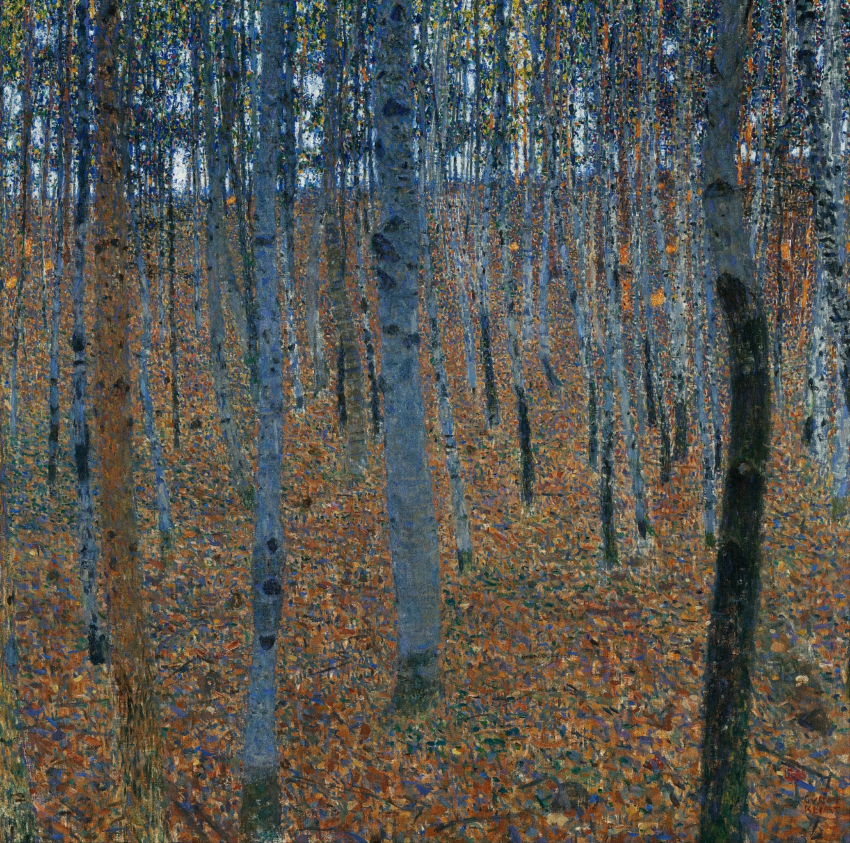
Writing water, writing forest, writing mountain
W H Auden once said that, among scientists, he felt like “a shabby curate . . . [in] a roomful of dukes”. When I am with serious conservationists – the people at the delivery end of saving the planet – I often feel like that shabby curate. I also ask them what switched on their passion for protecting nature and the answer is almost always the same: an encounter with a wild creature and an encounter with a book.
(Robert McFarlane)
Magic consists in this, the true naming of a thing. (Ursula Le Guin)

Slide 2
She forgets who she is.
She could be so small
she almost has no smell.
She feels like anyone at all.
When you walk up to her,
she keeps quite still,
but what she answers to
is never loud enough to know.
Eaten away by outwardness,
her eyes are empty.
They could be watching you
or not. They work indifferently,
like lit-up glass and if you ask
why she won't speak, why should she?
When what she really wants
is silence.
You know what women are like:
Kay, Moira, Sandra.
They move through a dark room,
peering round under
the hoods of their names.
Alcestis, Clytemnestra.
She could be either of those.
She scarcely knows.
She goes on thinking something
just over your shoulder.
This could be the last night
before you lose her.
But what's the use
of saying one thing or another.
When what she's really after
is you to love her.
From Alice Oswald, ‘Full-length Portrait of the Moon’

Slide 3
The same summer I was on Lewis, a new edition of the Oxford Junior Dictionary was published. A sharp-eyed reader noticed that there had been a culling of words concerning nature. Under pressure, Oxford University Press revealed a list of the entries it no longer felt to be relevant to a modern-day childhood. The deletions included acorn, adder, ash, beech, bluebell, buttercup, catkin, conker, cowslip, cygnet, dandelion, fern, hazel, heather, heron, ivy, kingfisher, lark, mistletoe, nectar, newt, otter, pasture and willow. The words taking their places in the new edition included attachment, block-graph, blog, broadband, bullet-point, celebrity, chatroom, committee, cut-and-paste, MP3 player and voice-mail. As I had been entranced by the language preserved in the prose‑poem of the “Peat Glossary”, so I was dismayed by the language that had fallen (been pushed) from the dictionary. For blackberry, read Blackberry.
Robert McFarlane, Landmarks, 2015

Slide 4
Why should this loss matter? You can’t even use crizzle as a Scrabble word: there aren’t two “z”s in the bag (unless, of course, you use a blank). It matters because language deficit leads to attention deficit. As we deplete our ability to denote and figure particular aspects of our places, so our competence for understanding and imagining possible relationships with non-human nature is correspondingly depleted. To quote the American farmer and essayist Wendell Berry – a man who in my experience speaks the crash-tested truth – “people exploit what they have merely concluded to be of value, but they defend what they love, and to defend what we love we need a particularising language, for we love what we particularly know.” Or as Cocker punchily puts it, “If acorn goes from the lexicon, the game is up for nature in England.”
…
For all of these writers, to use language well is to use it particularly: precision of utterance as both a form of lyricism and a species of attention. “I want my writing to bring people not just to think of ‘trees’ as they mostly do now,” wrote Deakin in a notebook, “but of each individual tree, and each kind of tree”.
Robert McFarlane, Landmarks, 2015

Slide 5
The best of the recent writing is ethically alert, theoretically literate and wary of the seductions and corruptions of the pastoral. It is sensitive to the dark histories of landscapes and to the structures of ownership and capital that organise – though do not wholly produce – our relations with the natural world. One might as reasonably expect to meet the geographer Doreen Massey or the philosopher Gilles Deleuze in its pages as Gilbert White or the bar-tailed godwit. Nor does this literature advocate a Luddite environmentalism: it tends to be anti-technocracy but not anti-technology.
Some of this writing is kick-up-the-arse furious, some is elegiac, some is about disease and dispossession, some is about dignity and the deepening of knowledge. Across its range, moral engagement and hope are consistently in evidence. Every contemporary writer about nature of my acquaintance is not “only” a writer but is also involved in political agitation, campaigns and volunteer work on behalf of the living world. This is far from the caricature of the 18th-century picturesque, in which moneyed artists sketch the Wye while peasants expire at their ankles and gouty aristos gaze dreamily through their Claude glasses.
Robert McFarlane, ‘Why we need Nature Writing’, New Statesman, 2015

Slide 6
She is trying to fly away as fast as possible. Brought up short by her jesses she twitters in high-pitched distress as the realisation of her hateful circumstances strikes. She can't get away. I lift her back onto the glove. Under her feathers is sinew, and bone, and that fast-beating heart. She bates again. And again. I hate this. In these first few minutes there's nothing you can do but accept that you are terrifying the hawk when it is the very opposite of everything you desire. After three more bates my heart is beating like a fitting beast. But she's back on the glove, beak open, eyes blazing. Then there is a long moment of extraordinary intensity.
The goshawk is staring at me in mortal terror, and I can feel the silences between both our heartbeats coincide. Her eyes are luminous, silver in the gloom. Her beak is open. He breathes hot hawk breath in my face. It smells of pepper and musk and burned stone. Her feathers are half raised and her wings half open, and her scaled yellow toes and curved black talons grip the glove tightly. It feels like I'm holding a flaming torch. I can feel the heat of her fear on my face. She stares. She stares and stares. Seconds slow and tick past.
Helen Macdonald, H is for Hawk, Jonathan Cape, 2014

Slide 7
The great American activist and writer Rebecca Solnit, a hero of mine, explains the limits of this view. “A lot of activists expect that for every action there is an equal and opposite and punctual reaction,” she writes in Hope in the Dark (2005), in a passage to which I find myself often returning:
  [They] regard the lack of one as failure . . . But history is shaped by the groundswells and common dreams that single acts and moments only represent. It’s a landscape more complicated than commensurate cause and effect. Politics is a surface in which transformation comes about as much because of pervasive changes in the depths of the collective imagination as because of visible acts, though both are necessary . . . Writers need to understand that action is seldom direct. You write your books. You scatter your seeds. Rats might eat them or they might just rot . . .
  Some seeds lie dormant for decades because they only germinate after fire.
Robert McFarlane, ‘Why we need Nature Writing’, New Statesman, 2015
.

Slide 8
Subjects that the author and essayist Rebecca Solnit has written about, some at considerable length, include Irish history, atlases, Alzheimer’s, a traveling medical clinic, natural disasters, urban planning, tortoises, walking, gentrification, Yosemite National Park and Apple Inc.
‘‘There’s something interdisciplinary at best and wildly wandering at worst about how I think,’’ she told me recently over the phone from San Francisco, where she lives and works. ‘‘I am interested in almost everything, and it can sometimes seem like a burden.’’ She cited Virginia Woolf and Henry David Thoreau as the writers most important to her: ‘‘Each of them wrote exquisitely about experiential, immediate encounters with the tangible world but could also be very powerful political polemicists. And the arc of their work describes a space in which you can be both.’’
Alice Gregory, ‘How Rebecca Solnit Became the Voice of the Resistance’, NYT Style Magazine 2017

Slide 9
….
she tries leaning
pouring pure outwardness out of a grey urn
little lapping sounds yes
as of dry grass secretly drinking try again
little lapping sounds yes
as of dry grass secretly drinking try again
Roman bone figurine
year after year in a sealed glass case
having lost the hearing of her surroundings
she struggles to summon a river out of limestone
little shuffling sound as of approaching slippers
year after year in a sealed glass case
a Roman water nymph made of bone
she struggles to summon a river out of limestone
little shuffling sound as of a nearly dried-up woman
not really moving through the fields
having had the gleam taken out of her
to the point where she resembles twilight try again
little shuffling clicking
she opens the door of the church
little distant sounds of shut-away singing try again
little whispering fidgeting of a shut-away congregation
wondering who to pray to
little patter of eyes closing try again
very small and damaged and quite dry
a Roman water nymph made of bone
she pleads she pleads a river out of limestone
….
From Alice Oswald, ‘Dunt: a poem for a dried up river’

Slide 10
discussion

Slide 11
Travel writing
John Harrison, Cloud Road, Parthian, 2010
( Marco Polo – the exotic
George Burrows – the exotic at home)

Slide 12

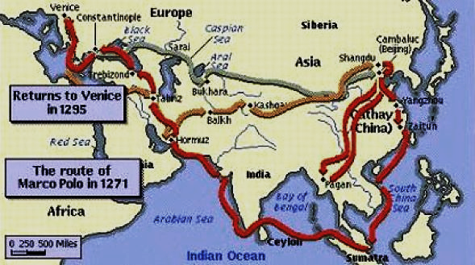
Marco polo

Slide 13
On the Sunday morning, as we sat at breakfast, we heard the noise of singing in the street; running to the window, we saw a number of people, bareheaded, from whose mouths the singing or psalmody proceeded. These, on inquiry, we were informed, were Methodists, going about to raise recruits for a grand camp-meeting, which was to be held a little way out of the town. We finished our breakfast, and at eleven attended divine service at the Cathedral. The interior of this holy edifice was smooth and neat, strangely contrasting with its exterior, which was rough and weather-beaten. We had decent places found us by a civil verger, who probably took us for what we were—decent country people. We heard much fine chanting by the choir, and an admirable sermon, preached by a venerable prebend, on “Tares and Wheat.” The congregation was numerous and attentive. After service we returned to our inn, and at two o’clock dined. During dinner our conversation ran almost entirely on the sermon, which we all agreed was one of the best sermons we had ever heard, and most singularly adapted to country people like ourselves, being on “Wheat and Tares.” When dinner was over my wife and daughter repaired to the neighbouring church, and I went in quest of the camp-meeting, having a mighty desire to know what kind of a thing Methodism at Chester was.
I found about two thousand people gathered together in a field near the railroad station; a waggon stood under some green elms at one end of the field, in which were ten or a dozen men with the look of Methodist preachers; one of these was holding forth to the multitude when I arrived, but he presently sat down, I having, as I suppose, only come in time to hear the fag-end of his sermon. Another succeeded him, who, after speaking for about half an hour, was succeeded by another. All the discourses were vulgar and fanatical, and in some instances unintelligible at least to my ears. There was plenty of vociferation, but not one single burst of eloquence. Some of the assembly appeared to take considerable interest in what was said, and every now and then showed they did by devout hums and groans; but the generality evidently took little or none, staring about listlessly, or talking to one another. Sometimes, when anything particularly low escaped from the mouth of the speaker, I heard exclamations of “how low! well, I think I could preach better than that,” and the like. At length a man of about fifty, pock-broken and somewhat bald, began to speak: unlike the others who screamed, shouted, and seemed in earnest, he spoke in a dry, waggish style, which had all the coarseness and nothing of the cleverness of that of old Rowland Hill, whom I once heard. After a great many jokes, some of them very poor, and others exceedingly thread-bare, on the folly of those who sell themselves to the Devil for a little temporary enjoyment, he introduced the subject of drunkenness, or rather drinking fermented liquors, which he seemed to consider the same thing; and many a sorry joke on the folly of drinking them did he crack, which some half-dozen amidst the concourse applauded.
George Burrows Wild Wales 1854

Slide 14
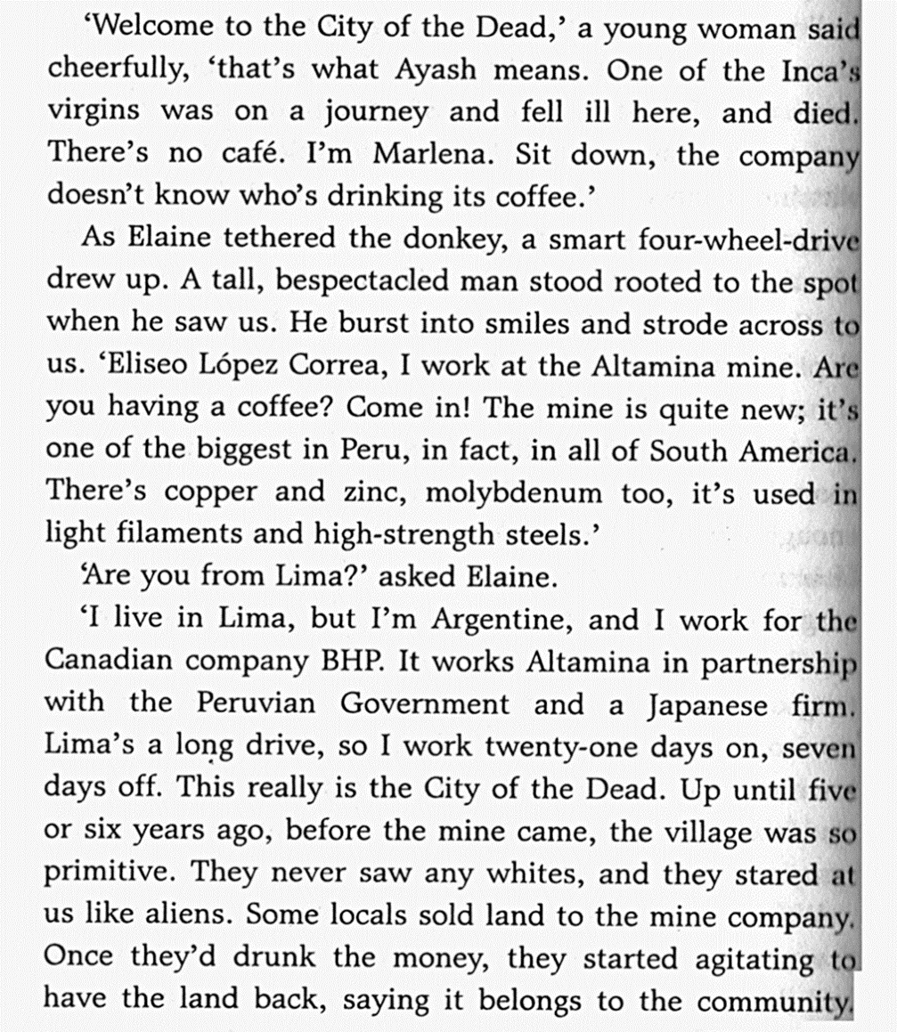
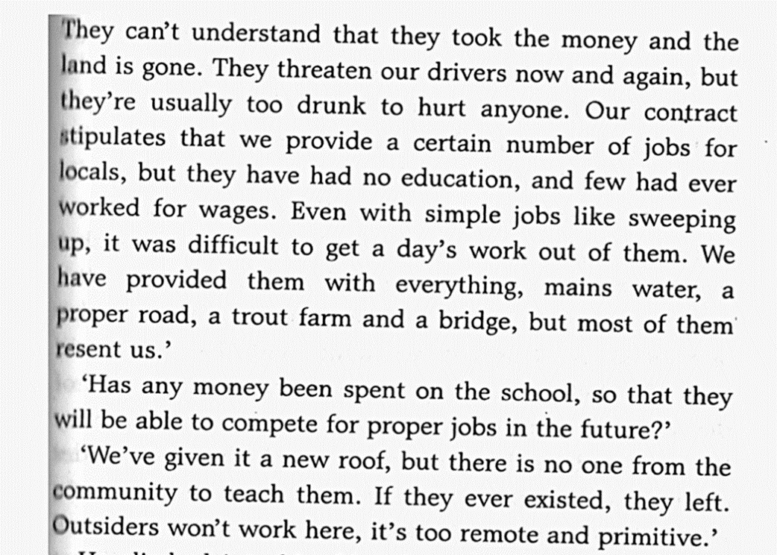
Cloud road 1

Slide 15
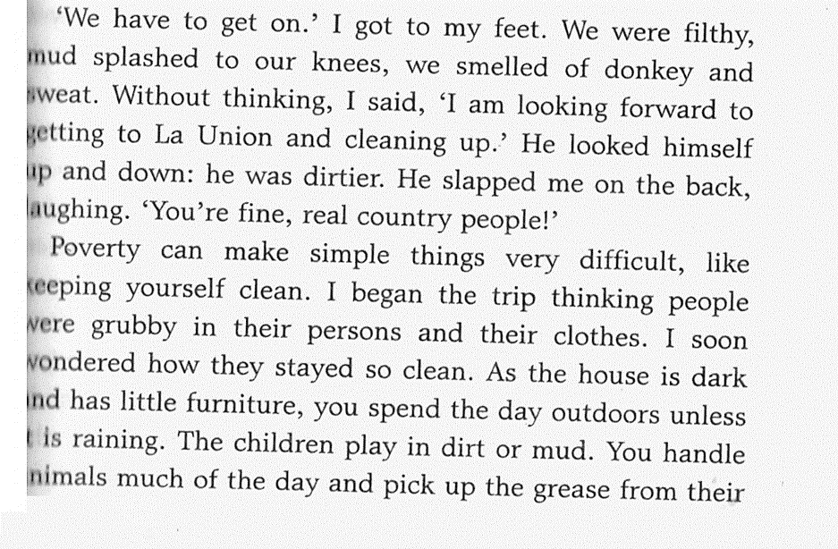
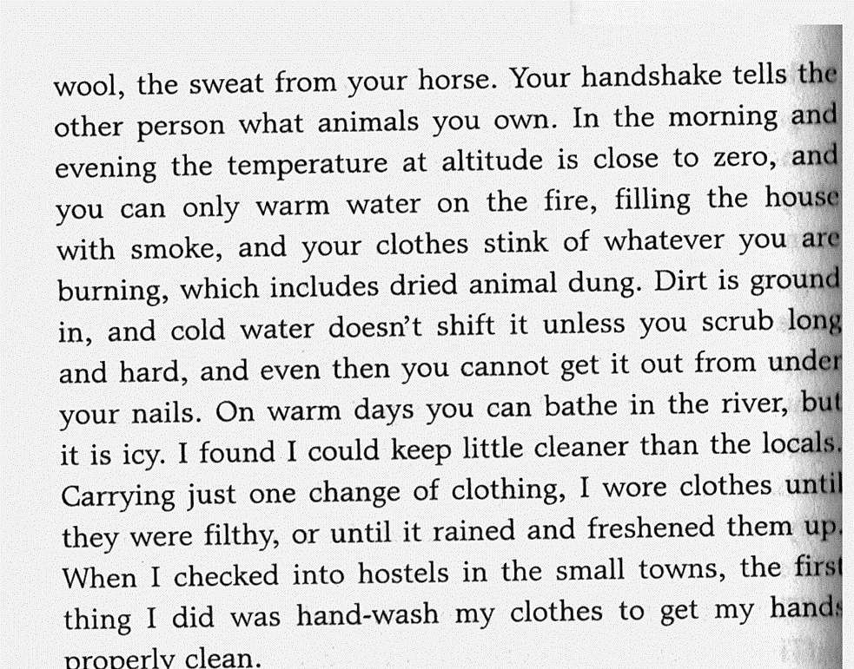
Cloud road 2

Slide 16
Discussion
Whole module?

