Slide 1
Classical Myth and Art
13-14

Slide 2
Tragedy
https://www.youtube.com/watch?v=gjrcNUOS2bc

Slide 3
Catharsis?
What is it?
https://www.youtube.com/watch?v=vNAM3PzGcow

Slide 4
Seven Against Thebes
It concerns the battle between an Argive army led by Polynices and the army of Thebes led by Eteocles and his supporters. The trilogy won the first prize at the City Dionysia.

Slide 5
Antigone
Means "against birth" from Greek αντι (anti) "against" and γονη (gone) "birth, offspring".
Antigone picks up where Oedipus at Colonus leaves off. Oedipus has just passed away in Colonus, and Antigone and her sister decide to return to Thebes with the intention of helping their brothers, Eteocles and Polyneices, avoid a prophecy that predicts they will kill each other in a battle for the throne of Thebes.

Slide 6
Upon her arrival in Thebes, Antigone learns that both of her brothers are dead. Eteocles has been given a proper burial, but Creon, Antigone's uncle who has inherited the throne, has issued a royal edict banning the burial of Polyneices, who he believes was a traitor. Antigone defies the law, buries her brother, and is caught. When Creon locks her away in prison, she kills herself.

Slide 7
Meanwhile, not realizing Antigone has taken her own life, the blind prophet Tiresias, Creon's son and Antigone's fiancé Haemon, and the Chorus plead with Creon to release her. Creon finally relents, but in an instance of too-late-timing, finds her dead in her jail cell. Out of despair, Haemon and Creon’s wife have by now also killed themselves, and Creon is left.

Slide 8
Learn from tragedy
https://www.youtube.com/watch?v=gjrcNUOS2bc

Slide 9
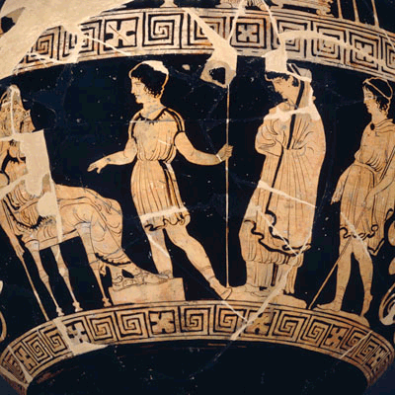
Dolon Painter c. 380-370 B.C.E.; depicts Antigone brought before Kreon by two guards.

Slide 10


Slide 11
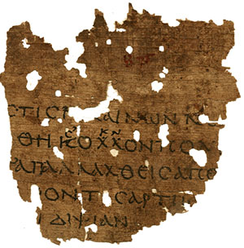
Papyrus Fragment of Antigone

Slide 12
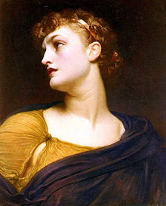
Antigone by Frederic Leighton, 1882

Slide 13
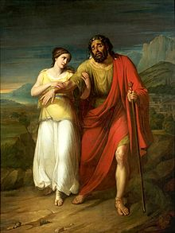
Oedipus and Antigone by Aleksander Kokular (1825-1828), National Museum in Warsaw.

Slide 14
Last speech
Antigone
Tomb, bridal-chamber, deep-dug eternal prison where I go to find my own, whom in the greatest numbers destruction has seized and Persephone has welcomed among the dead! [895] Last of them all and in by far the most shameful circumstances, I will descend, even before the fated term of my life is spent. But I cherish strong hopes that I will arrive welcome to my father, and pleasant to you, Mother, and welcome, dear brother, to you. [900]

Slide 15
For, when each of you died, with my own hands I washed and dressed you and poured drink-offerings at your graves. But now, Polyneices, it is for tending your corpse that I win such reward as this. [And yet I honoured you rightly, as the wise understand. [905] Never, if I had been a mother of children, or if a husband had been rotting after death, would I have taken that burden upon myself in violation of the citizens' will. For the sake of what law, you ask, do I say that? A husband lost, another might have been found, [910]

Slide 16
and if bereft of a child, there could be a second from some other man. But when father and mother are hidden in Hades, no brother could ever bloom for me again. Such was the law whereby I held you first in honour, but for that Creon judged me guilty of wrongdoing [915] and of dreadful outrage, dear brother! And now he leads me thus in his hands' strong grasp, when I have enjoyed no marriage bed or bridal song and have not received any portion of marriage or the nurture of children. But deserted by friends, [920]

Slide 17
in misery I go living to the hollow graves of the dead.] What law of the gods have I transgressed? Why should I look to the gods anymore? What ally should I call out to, when by my reverence I have earned a name for irreverence? [925] Well, then, if these events please the gods, once I have suffered my doom I will come to know my guilt. But if the guilt lies with my judges, I could wish for them no greater evils than they inflict unjustly on me.

Slide 18
Antigone led away
Antigone
O city of my fathers, land of Thebes, and you gods, our ancestors! I am led away now; there is no more delay! [940] Look at me, you who are Thebes' lords—look at the only remaining daughter of the house of your kings. See what I suffer, and at whose hands, because I revered reverence!

Slide 19
Was Antigone right?

Slide 20
The role of the chorus/community
Who judges what is right?
https://www.youtube.com/watch?v=quLkooLxsO4

Slide 21
Madness and Logic
http://www1.union.edu/wareht/gkcultur/guide/2/

Slide 22
Why dis she want to bury her brother?

Slide 23
The role of women to prepare the body for burial
To oppose Creon
Obey the law of the gods
Pride
Early feminism?
The political position of women?

Slide 24
In conclusion…
https://www.youtube.com/watch?v=wwo9LP15oYQ

