Slide 1
CHANGE & STABILITY
MANAGEMENT

Slide 2
About Me:
Name:- Rudra Pankajbhai Patel
Student id:- 2229997

Slide 3
Introduction
Organizational changes are some actions in which a business or company alters a huge component such as underlying technology, organizational culture, internal process, or the infrastructure that it uses to operate.
In this context, the impact of “COVID-19” on a specific organization has been done.
A critical review has been done to evaluate the effectiveness of maintaining the sustainability of the organization.

Slide 4
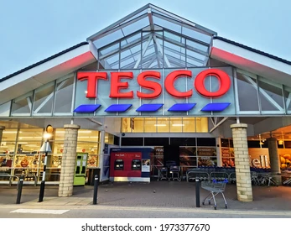
Organization Introduction
Tesco is a multinational retail company based in the UK, the organization carries out its business through both online and offline stores. The company offers a wide range of products such as fresh food. Drinks, clothing, pets, beauty and health products, household appliances, etc. Tesco also provides customers with retail banking, consultancy, and insurance services. The company has stores in more than 4600 locations and has more than 345000 employees all over the world.

Slide 5

Experienced Changes
During the COVID-19 pandemic, the company experienced Low payments to the suppliers.
The company Tesco also faced huge transformational changes such as technological failures.
The company recruited approximately 50000 new temporary staff.
The company also did product improvement and launched new products (Monte, 2021).
Notes:
The COVID-19 pandemic brought various changes to the company Tesco. The company faced difficulty in the implementation of new strategies as well as low payments to the suppliers; this threatened the suppliers to the customers. In the first period of the pandemic, the company faced challenges to implement new technologies in the supply chain market. For the small stores, it was difficult to adapt to new technologies in the first place. However, in the meantime, the company also recruited over 50000 new temporary employees for supporting the workforce on the express supermarket floors. At that time the company also launched approximately 2100 new products as the competitors in the retail market increased. Besides the new products, the existing products’ qualities were also been improved and also introduced with new partners.

Slide 6
Key Factors and Drivers of Change
CULTURE
LEADERSHIP
DIGITALIZATION
New leadership strategies were adopted by the company Tesco during the pandemic period.
The company faced a Change in the organizational culture.
The pandemic has brought technological demand to the retail business.
Notes:
The key factors of change faced by the company Tesco are new leadership, culture, and technology. The adoption of new leadership strategies reduced the carbon intensity and energy operation in the UK by approximately 50%. This change led the company toward collaborative growth and the amount of energy in the supply chain was found to be greater in the company Tesco. The company also faced changes in the organizational culture as the company recruited more than 50000 staff during the COVID-19 pandemic. The organization also decided to expand its online groceries. The pandemic helped the company to transform its retail business more digitally for improving its customer experience, operating model, and business model. The company launched a data-driven and in-store experience customer loyalty platform.

Slide 7
Lewin’s Force Field Analysis
Unfreeze
Refreeze
Change
The “Force Field Analysis” of Tesco follows the current situation, the desired situation, supporting forces and brainstorming, opposing forces, and result review.
Lewin’s three step change management model helps the organization to determine the quality and speed of change and the three steps are unfreeze, change, and refreeze.
Notes:
There are certain aspects that Tesco has changed before the planning worked out. Currently the organization is taking maximum of 8 minutes for each customer to clear the purchase of goods. The company desired to reduce the time of waiting for the customers’ and help them to checkout smoothly. Tesco is using new technologies of “bar code checks” for faster checkouts. Implementation of new technologies is very effective and as a result a couple of new changes have been bought in the stores. Lewin’s three step change management model helped the organization to develop effective strategies of stakeholders, employees, government, and also administrators.

Slide 8
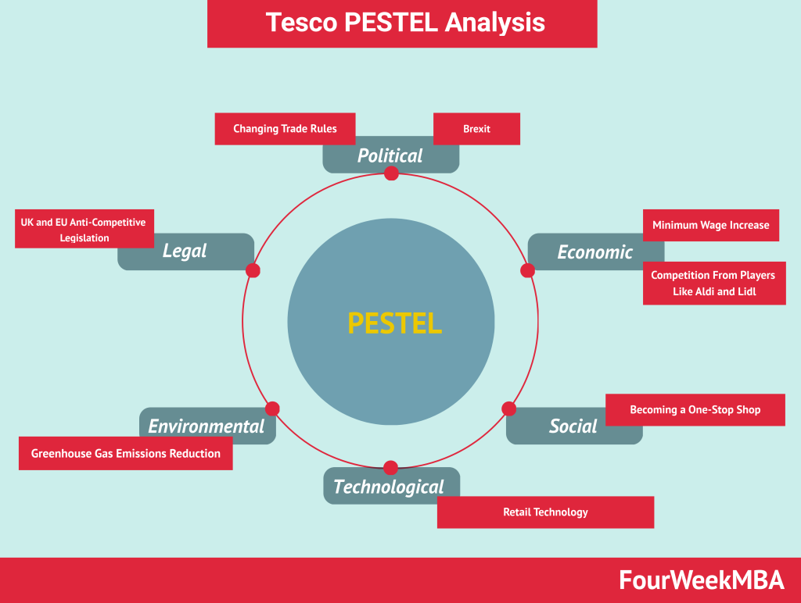
PESTLE Analysis (Cont..)
Political
The company Tesco has been impacted by Brexit.
The company faced FDI restrictions in various countries such as India.
Economical
The company faced fluctuations in Global exchange rates.
Social
Tesco increased its popularity through different social media.
The company becomes the very first retail company to ban wet plastic wipes.
Notes:
The PESTLE analysis has been done to identify the external changes of the company Tesco, which has been impacted by Brexit. The company also faced FDI restrictions in various countries such as India. The company also faced fluctuations in the global exchange rates. The company increased its popularity and sale through various social media advertisements as the company banned the use of wet plastic wipes.

Slide 9
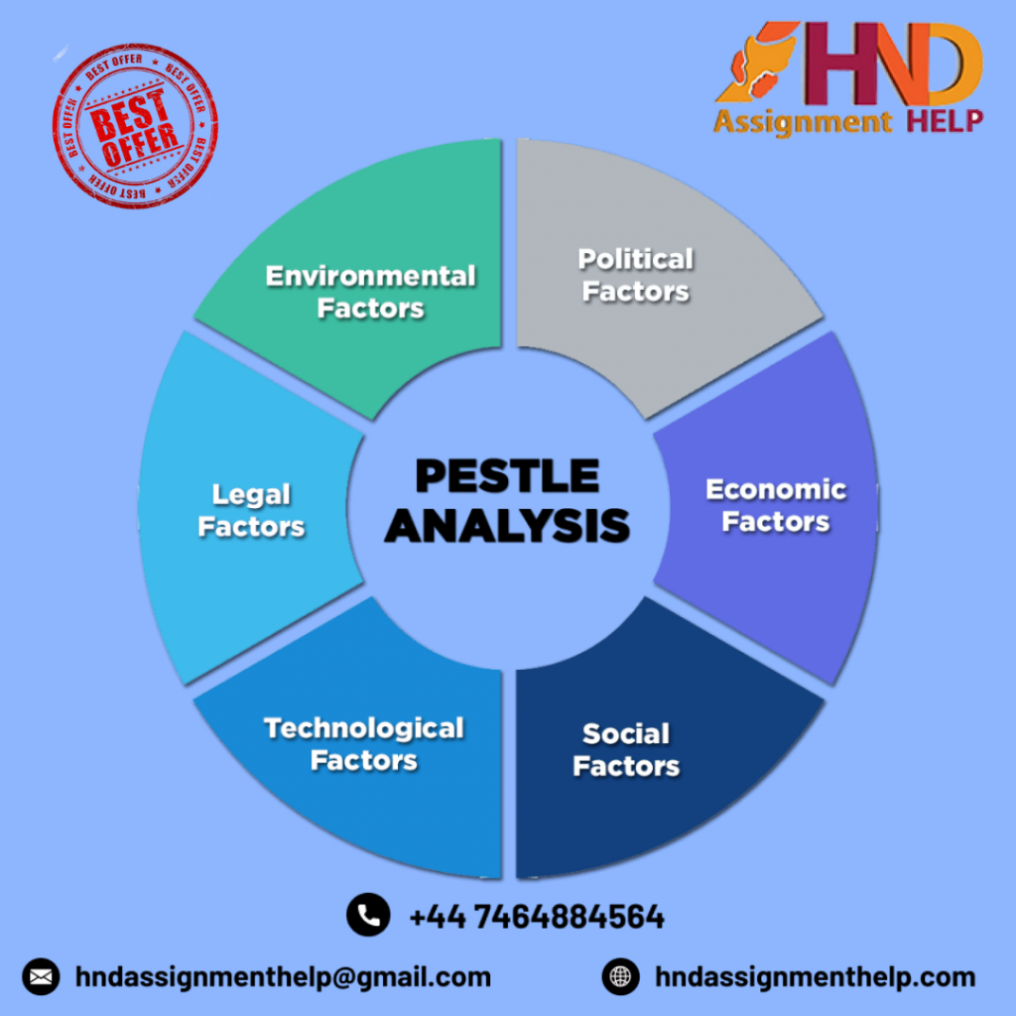
PESTLE Analysis
Technological
The company increased the popularity of RFID technology.
Tesco uses IoT in the retail business to improve the customer experience.
Legal
It has increased stringent rules regarding customer data privacy.
The company faced copyright issues and intellectual property laws.
Environmental
Tesco reduced its dependency on plastics.
The company is committed to addressing environmental challenges.
Notes:
Tesco uses IoT for the retail business to make better improvements in the customer experience. The company Tesco faced some legal issues such as copyright issues and intellectual property law. However, the company reduced its dependency on plastics and committed to addressing environmental challenges.

Slide 10
Effects of Change
Introduction to online shopping is the most significant change of Tesco that affected the way it operate the business.
The change in stores is also noticeable because of “Lack of customer demand”.
The stores are putting an importance on self-serve checkouts.
Online Shopping
Lack of Customer Demand
Self-Serve Checkouts
Notes:
The COVID-19 introduced Tesco to the online shopping which brought significant change in the business but also affected the way it operates. Both the online and offline stores faced changes because of “Lack of customer demand”. The company decided to put self-serve checkouts using new technologies. The company brought two important elements such as “Divergence” and “Convergence” to bring change in the company. This also gives a huge effect to the organization to improve growth and profitability.

Slide 11
Strategies to overcome the Changes
One of the most important strategies is to maintain a reputation.
Identifying the stakeholders is one of the most necessary strategies for analyzing the stakeholders in Tesco.
Tesco has put the marketplace very competitive and strong by cost-training the staff.
MAINTAIN REPUTATION
STAKEHOLDERS
COMPETITORS
Notes:
The company Tesco’s most important strategy is to maintain the brand’s reputation in the market by supplying cost-effective and quality products. The company identifies the stakeholder's details by documenting all the necessary information and their role in the project during the COVID-19 pandemic situation. The company also put high competitiveness in the market which makes the company UK’s number one retailer.

Slide 12
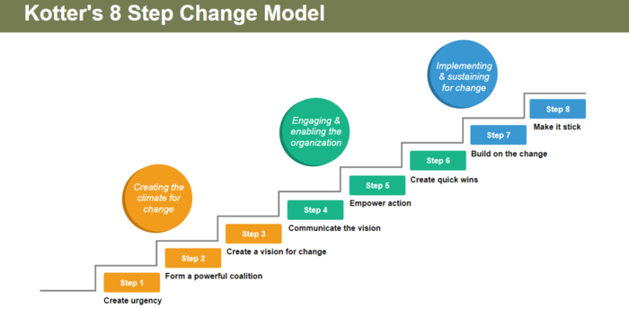
Theoretical Management Model
Kotter’s 8 Steps Change Model
Create Urgency
Form a Powerful Coalition
Create a vision for change
Communicate the vision
Remove obstacles
Create short-term wins
Build on the change
Anchor the Changes in Corporate Culture.
Notes:
Kotter’s 8-step management model can help the company Tesco to achieve the changes that it really wants. The first step of the model is to create urgency, identifying the potential change of the company and developing a scenario. From the second step, the company can identify the true leader who can bring both internal and external change to Tesco. The third step helps the company to determine the value and priority of the change in the company. This step carries out the good practice of future vision within the organization. The fourth step is bringing the discussion of the change vision and leading the changes the examples. The fifth step is revoking the obstacle and the sixth step of the model helps the company Tesco not to choose early targets which are more on the expensive side. The seventh step lets the company set up a goal and keep the idea alive to bring a new change leader. The final and eighth step helps the company Tesco discuss the change progress and create plans to replace the leader of change.

Slide 13
Conclusion
The context concludes that the COVID-19 pandemic brought various changes in the company Tesco.
The company took different effective strategies to manage changes.
The company can use Kotter’s 8-step change model to identify the necessary changes and make the change happen.

Slide 14
References
Burt, S., Coe, N.M. and Davies, K., 2019. A tactical retreat? Conceptualising the dynamics of European grocery retail divestment from East Asia. International Business Review, 28(1), pp.177-189.
Laig, R.B.D. and Abocejo, F.T., 2021. Change management process in a mining company: Kotter’s 8-Step change model. Journal of Management, Economics, and Industrial Organization, 5(3), pp.31-50.
Mariam-Fatima, A. and Shalini, A.A., 2021. Thin layer chromatography identification of flavoprotein compounds in crude local spinach extract. International Journal of Medical Toxicology & Legal Medicine, 24(3and4), pp.216-223.
Monte, A., 2021. A study of value chain reconfiguration processes under Covid-19 pressures: the case of Tesco PLC in the United Kingdom.
Moura, M.B.L.D., 2021. Equity Research in Food & Retail Industry-TESCO PLC (Doctoral dissertation, Instituto Superior de Economia e Gestão).
Paavola, L. and Cuthbertson, R., 2022. Redefining capabilities as drivers of adaptation, incremental change, and transformation: Recognizing the importance of strategic and operational intent on performance. Journal of Management & Organization, 28(3), pp.522-539.
Rosnizam, M.R.A.B., Kee, D.M.H., Akhir, M.E.H.B.M., Shahqira, M., Yusoff, M.A.H.B.M., Budiman, R.S. and Alajmi, A.M., 2020. Market opportunities and challenges: A case study of Tesco. Journal of the Community Development in Asia (JCDA), 3(2), pp.18-27.
Ward, A., Stephen, K., Argo, C., Watson, C., Harris, P., Neacsu, M., Russell, W., Grove-White, D. and Morrison, P., 2021. The human aspect of horse care: How the covid-19 pandemic impacted the wellbeing of equestrian industry stakeholders. Animals, 11(8), p.2163.
Arab-Zozani, M., Pezeshki, M.Z., Khodayari-Zarnaq, R. and Janati, A., 2019. Balancing overuse and underuse in the Iranian healthcare system: a force field theory analysis. Ethiopian journal of health sciences, 29(2).
Awadari, A.C. and Kanwal, S., 2019. Employee participation in organizational change: A case of Tesco PLC. International Journal of Financial, Accounting, and Management, 1(2), pp.91-99.

Slide 15


