Slide 1
Riverdale nursing home
Group 1
Ibrat bi
Aamina Nazakat
Irum Jamal

Slide 2
Riverdale nursing home
Digital skills and research methods
Aamina Nazakat

Slide 3
Staff scheduling and rotas: What it involves for riverdale
What is staff scheduling?
Staff scheduling is made to ensure that staff have a clear understanding about their job role and to make sure they are at the right place at the right time so that the work runs smoothly.
Scheduling ensures:
Enough employees
Fair sharing of work hours
Continuous support for residents

Slide 4

Why microsoft excel is the recommended tool?
What is Microsoft excel?
Excel is a spreadsheet tool used to create schedules for employees, and it is easy to do calculations on by using formulas.
Excel is used for:
Organising data
Planning for workplace
Making plans
Working out hours worked

Slide 5
How excel improves efficiency.
Using Microsoft excel at riverdale nursing home to improve efficiency with staff scheduling and rotas would help with:
Creating weekly plans
Watch the hours their employees have worked
Monitor if staff have worked extra hours
Spread workers out
Creating a set timetable easy for staff to follow so they know what day and times they are working

Slide 6

Advantages and disadvantages of using excel for riverdale nursing home
Advantages:
Easy data management
Affodable
Well known and used
Disadvantages:
Needs to be changed by hand
Risk of making mistakes

Slide 7
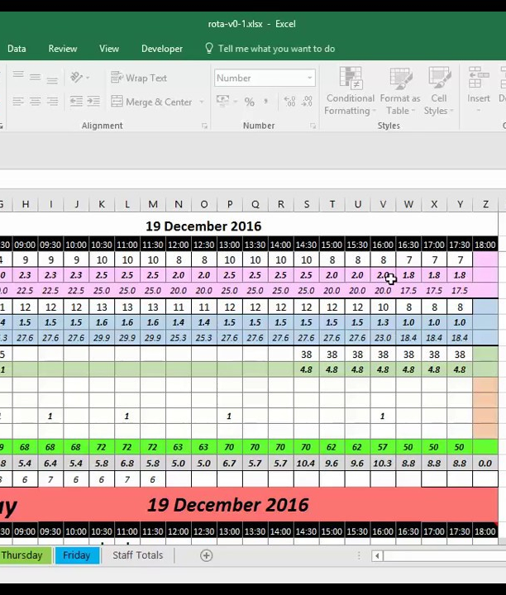
conclusion
By choosing the right Microsoft 365 tools for different tasks the riverdale nursing home can significantly boost their productivity.
Better workforce planning
Better work efficiency
Better quality of care

Slide 8

References/links:
https://planpoint.eu/excel-for-workforce-scheduling/
https://corporatefinanceinstitute.com/resources/excel/excel-definition-overview/
https://www.geeksforgeeks.org/excel/excel-in-business/
https://barrazacarlos.com/advantages-and-disadvantages-of-microsoft-excel/

Slide 9

Riverdale nursing home
Digital Skills and Research Methods
Ibrat bi (2533707)
Masud Siddiqui
Group Presentation

Slide 10

Staff communication
At Riverdale Nursing Home, caregivers, senior caregivers, nurses, and office staff work in both buildings. Effective communication is important for:
Providing update on how residents are being cared for.
Let staff know about shift changes.
Telling about problem and happenings.
Organising workers between different buildings.
Communication between the two buildings
Microsoft Teams improves staff communication in care homes by centralizing shift handovers, secure messaging, and document sharing into one platform. It eliminates fragmented paper notes and prevents vital resident updates from getting lost in personal messaging apps, helping teams coordinate care safely and efficiently from anywhere. (Anas A 2025)

Slide 11

Microsoft team’s tool
Teams allow workers at Riverdale Nursing Home to communicate easily no matter what their schedule is or where they are in the building.
Video meetings
Talk within the group
File sharing
Messaging

Slide 12
Why this Microsoft teams is suitable for staff communication
Inside Microsoft 365, Microsoft Teams is an online tool that helps people work together by:
Secure sharing protects sensitive data
Enables access on mobile phone
Combines audio/video conferencing
Supports remote meetings when staff cannot meet in person
Keeps staff connected regardless of location.
Live communication
Microsoft Teams improves staff communication in care homes by centralizing secure messaging, care planning, and shift management into one easy-to-use digital hub. It ensures instant information relay across shifts, reduces administrative burdens, and enables seamless collaboration with off-site healthcare professionals like GPs. (The inform team 2022)

Slide 13
How do teams improve communication
Microsoft Teams can:
Help residents get quick updates.
Makes it easier for the buildings to work together.
Help residents get quick updates.
Enhance communication between shifts
Microsoft Teams improves efficiency in care homes by centralising communication, automating shift schedules, and streamlining resident care updates into a single platform. By eliminating fragmented systems like paper logging, disjointed emails, and unsecure consumer chat apps, it reduces administrative friction so frontline staff can dedicate more time to residents. (The inform team, 2022)

Slide 14
Advantages and disadvantages
Advantages
Quick communication
Easy teamwork
Access on a smartphone
Links to more Microsoft programs
Disadvantages
Needs to connected to the internet.
Staff may need training

Slide 15
Recommendation
The best tool for communication at River Nursing Home is Microsoft Teams because it
Makes it possible to speak right away.
Makes it easier to communicate with each other.
Improves teamwork between buildings.
Help make resident care better.

Slide 16
conclusion
By choosing the right Microsoft 365 tools for different task, Riverdale Nursing Home can significantly boost its productivity.
Better communication
Fewer missed emails
Better coordination between work shifts Microsoft Teams is an indispensable, all-in-one collaboration hub that consolidates chat, video conferencing, and file sharing. Its seamless integration with Microsoft 365 and robust AI capabilities make it ideal for organizations heavily invested in the Microsoft ecosystem, though it can suffer from platform bloat and rigid software dependencies. (Zenzero 2024}

Slide 17
references
https://www.theinformteam.com/blog/how-microsoft-365-is-saving-the-social-care-sector-from-staff-shortages/
https://goziro.com/benefits-of-microsoft-teams-in-healthcare-transforming-patient-care-through-digital-collaboration/
https://www.theinformteam.com/blog/how-microsoft-365-is-saving-the-social-care-sector-from-staff-shortages/https://zenzero.co.uk/news/microsoft-teams-features

