Slide 1
I confirm that I have not used any AI tools in the research and creation of this assignment. I confirm that I have not presented any AI generated materials as my own work. I confirm I have copies of my drafts, notes, and other resources I used, which I may be asked to provide in evidence.

Slide 2
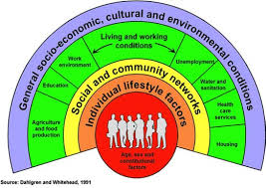
2602515 ECEY5009/C 1,781
Health, Wellbeing and Lifestyle in Early Years
Introduction
Health, wellbeing,, and lifestyle are important concepts within early childhood as all of them contribute to an individual child’s holistic development. These concepts are linked and can affect children’s physical, emotional, social, and cognitive development (WHO, 2022). This poster will explore the definitions and concepts of health, wellbeing, and lifestyle within the early years environment, through exploring theories, models and factors that may affect children’s development and long-term outcomes. The role of early years practitioners in promoting positive health and wellbeing will also be discussed.
Concepts
Health, wellbeing, and lifestyle are complex concepts that may sometimes be viewed differently depending on social, cultural, and environmental factors. These concepts are linked and contribute to children’s holistic development. A holistic approach acknowledges that children’s physical, emotional, social, and cognitive needs are just as important and work together to shape overall wellbeing (Marmot et al.2010). Therefore, early years practitioners and all adults around children should consider all aspects of a child’s development when encouraging positive health and wellbeing.
Health
According to the World Health Organisation (WHO), health is described as “a state of complete physical, mental, and social wellbeing and not merely the absence of disease or infirmity” (WHO, 2022). This shows that health is a complex concept with many parts, rather than simply the absence of illness. A child’s health is not just physical it can be physical, emotional, social and impact mental wellbeing, all of which contribute towards holistic development.
Health can be understood through different models and perspectives.
The medical model focuses on illness, diagnosis, and treatment, while the social model notices the impact of wider social and environmental factors on health (Ewles and Simnett, 2019). Factors such as education, relationships, housing, and income can all impact children’s health and wellbeing within the early years environment.
Positive health during early childhood is important as early experiences can influence how children develop in the future. Naidoo and Wills (2016) suggest that encouraging and promoting healthy routines, safe environments and positive relationships during childhood could help to support long-term health results. As a result, early years practitioners play a key role in supporting children’s overall wellbeing through a holistic approach.
Source: Dahlgren and Whitehead (1991)
Dahlgren and Whitehead’s (1991) model explains that health can be affected by many wider factors like social relationships, education, environment, and employment. This indicates that children’s health and wellbeing may be shaped by issues out of their control, agreeing with the social model of health.

Slide 3
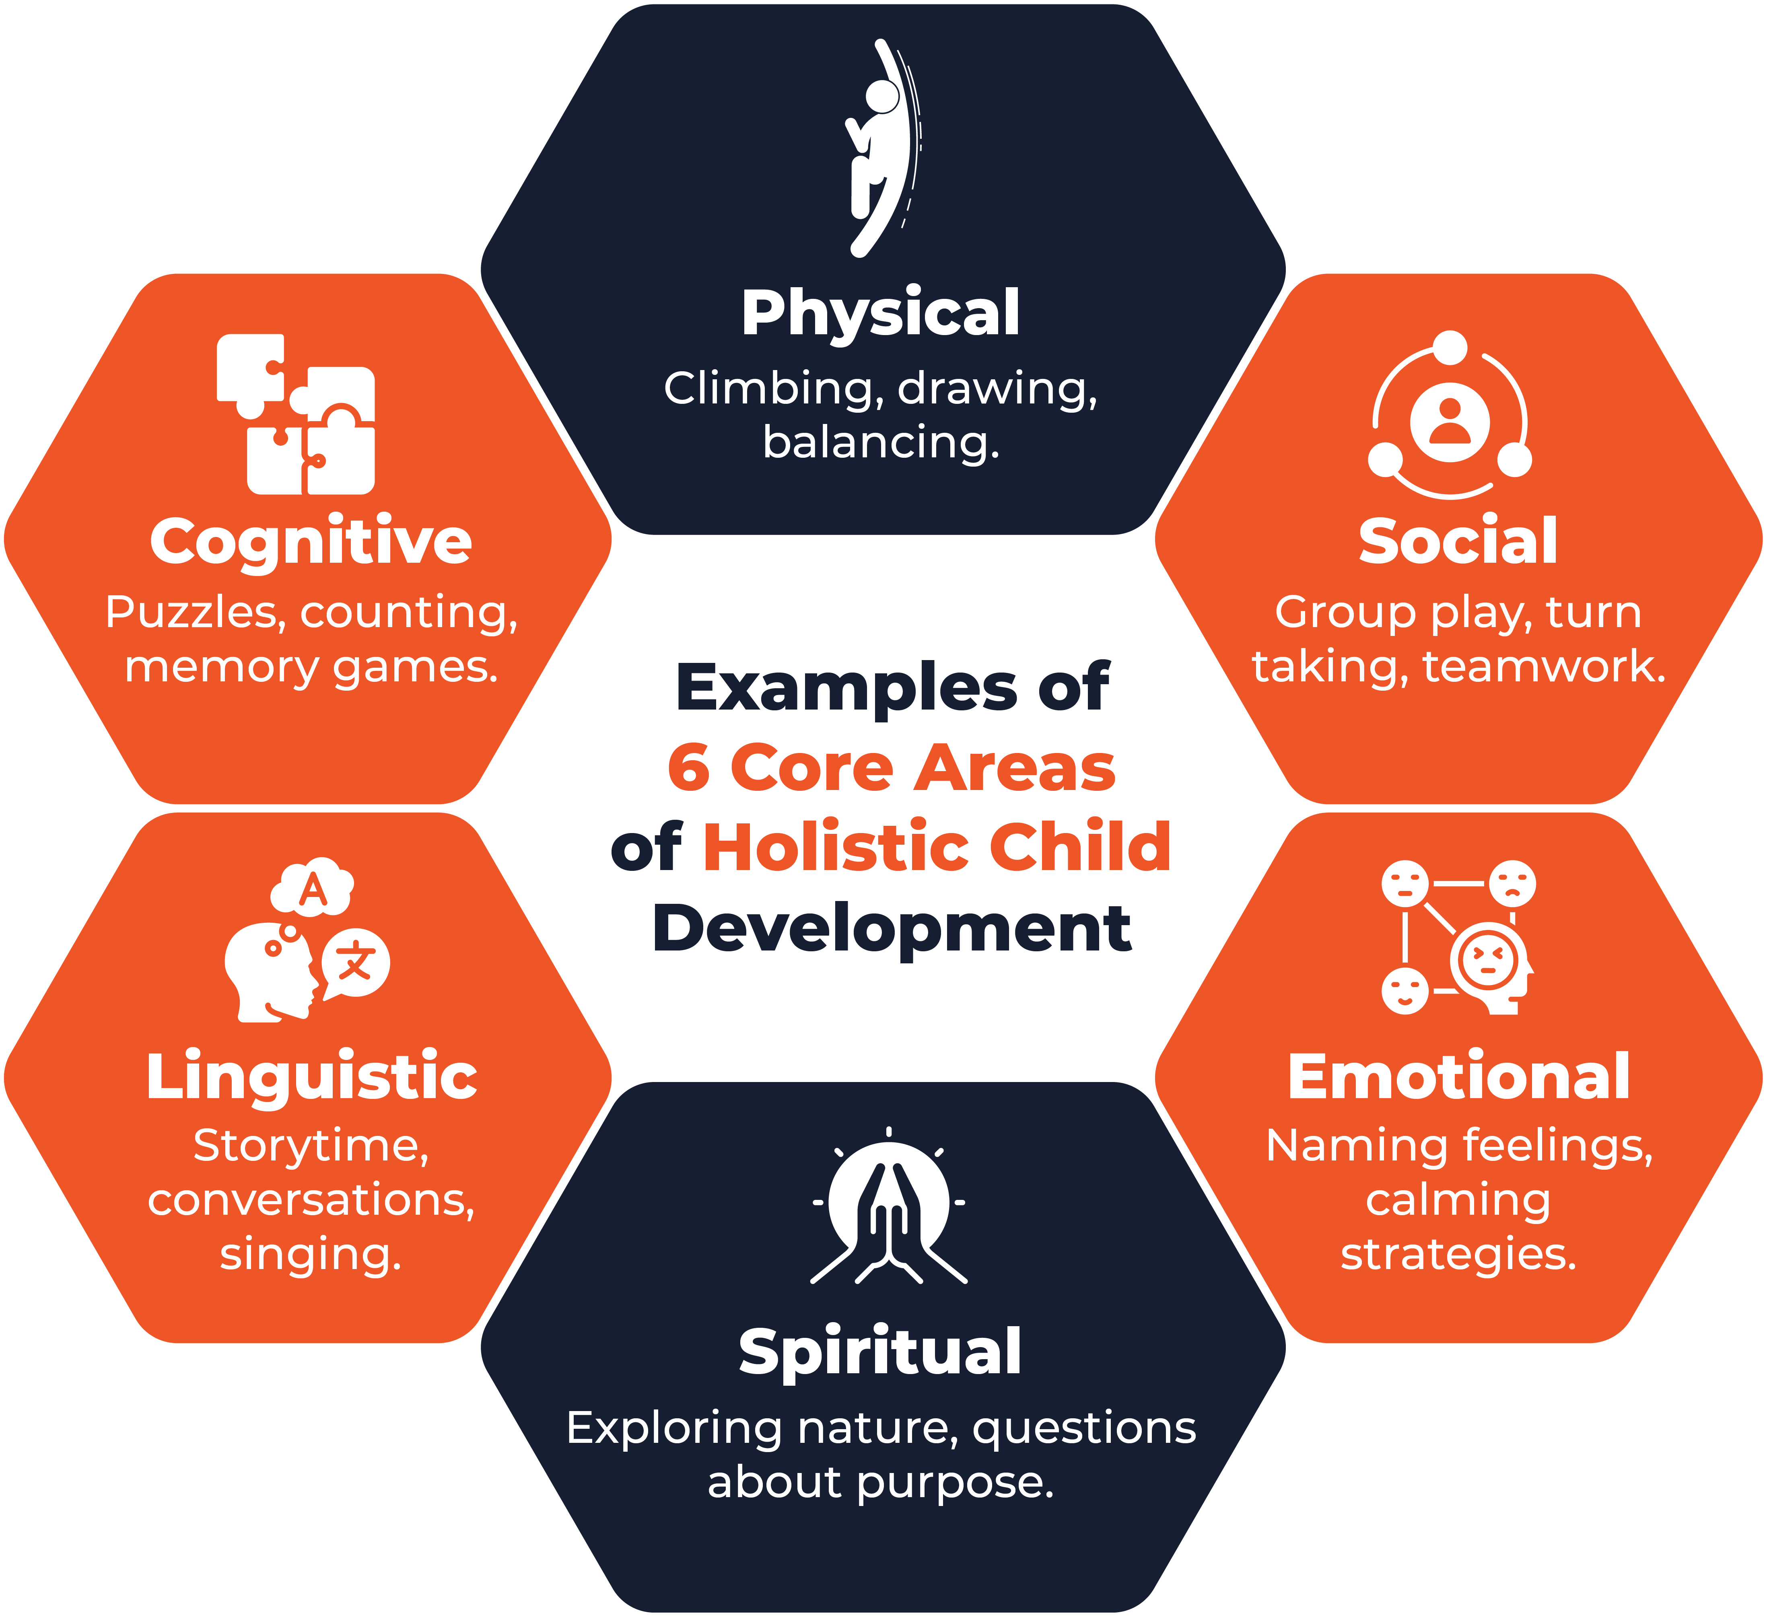
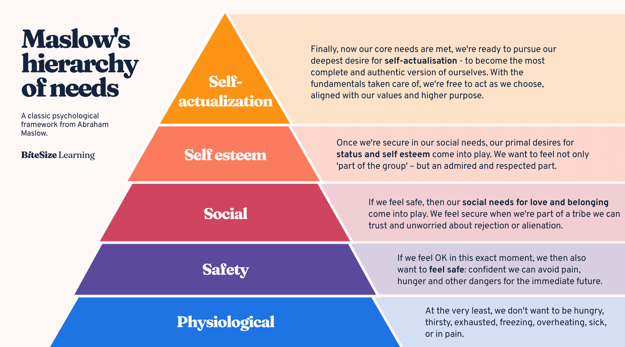
Wellbeing
Source: Britannia School of Academics (2024)
Wellbeing is described as a state of being comfortable, healthy, and happy (Musgrave, 2017). Children’s wellbeing is significantly important within the early years sector as it can affect their social, physical, emotional, and cognitive development. A child with good wellbeing is more likely to feel safe, secure, and confident within their environment. Wellbeing is considered holistic as it includes all development aspects of a child.
Positive relationships and caring settings play a huge role in supporting children’s wellbeing. Bradshaw (2016) indicates that children’s wellbeing can be affected by several reasons like social experiences, family relationships, and education. So, an early year's practitioner's role is vital in creating supportive environments where children feel safe, valued, and included.
Emotional wellbeing is particularly important during early years as the children can gain experiences earlier which could make a difference on children’s future relationships, behaviour and development (Tickell,2011). Ashdown and Bernard (2012) give evidence that positive emotional wellbeing can support children in many ways like giving them ability to form positive relationships with other people and confidence. This highlights the importance of the role of a practitioner creating supportive and loving environments where children feel secure.
Staham and Chase (2010) implies that wellbeing is a complex concept which includes all the developments of a child’s life, not just currently but in the future too. This emphasizes that wellbeing goes above just feeling happy but instead reflects a range of factors that go towards a child’s quality of life. In addition, wellbeing can be highly subjective, children may experience and understand wellbeing differently depending on the individual and their circumstances. This shows there is no single definition of wellbeing, highlighting the complexity of the concept.
Maslow’s hierarchy of needs indicates that children’s essential needs, including safety, belonging and emotional security, should be prioritised before children are able to achieve their full potential (McLoed, 2018). This highlights the significance of supporting and encouraging holistic wellbeing within the early years environment, as children who feel safe and secure are more likely to engage positively within learning experiences.
Wellbeing is strongly associated to resilience and self-esteem. Seligman (2011) implies that positive relationships, emotions, and a sense of achievement can lead to overall wellbeing. Children who experience these positive emotions and relationships are more inclined to develop confidence, cope with challenges and engage effectively in learning opportunities. Therefore, promoting wellbeing should be a key priority within early years settings.
Source: (Bitesize Learning, 2024)

Slide 4
What is Lifestyle?
Lifestyle
Influences on Lifestyle
Lifestyle can be understood as the way in which individuals live their lives and includes the behaviours, habits and decisions that can have an impact on health and wellbeing. Lifestyle aspects can include sleep, diet, relationships and many more factors (Estyn, 2013). These factors can have a positive or negative effect on children’s emotions, physically and mentally. This means that lifestyle is considered an important aspect of overall health, as routines made during childhood can influence future health results.
Thomas and Lewis (2016) state that growing healthy habits, positive mindset and motivation are the main actions to encouraging healthy lifestyles. This shows the importance of promoting positive lifestyle choices from an early age, as children’s behaviours and actions can add to their long-term wellbeing.
Bronfenbrenner (1979) states that children’s development Is affected by all the different environments around the child. These environments include school, family and all relationships around them, which can have an impact on their lifestyle behaviours.
Factors like household income, family support, housing conditions, and access to a positive support system can affect children’s opportunities to take part in healthy eating, exercise, or balanced sleep routines. This is clear that lifestyle choices are not always made by the individual personally but factors around the person can have an effective impact.
The home environment can also have a major influence on children’s lifestyle behaviours and general wellbeing. Schmeer and Yoon (2016) imply that children’s homes and the environment can have a serious impact on the child’s health outcomes. Factors such as the safety of the house and living conditions can affect the children’s opportunities for a healthy lifestyle and development. This shows that children’s health and wellbeing may be shaped not only by the child’s individual choice but also by their surroundings and how they live.
Marmot et al. (2010) argue that health and wellbeing are significantly influenced by wider social factors. Factors such as community environment, household income, education access and quality and family background. This highlights the importance of creating opportunities that support positive health and wellbeing for all children.
Lifestyle factors
Nutrition
Nutrition is a particularly important lifestyle factor as it helps children’s growth, development, and health. A nutritious diet can help with healthy brain development, energy levels, and development. An unhealthy diet during childhood has been linked with greater risks of obesity and long-term health illnesses. (Public Health Wales, 2019). Healthy eating habits created during early years of life are clearly important in encouraging lasting health.
Physical activity
Exercise is identified as an important part of a healthy lifestyle and supports health and wellbeing. Estyn (2013) finds physical activity as a main aspect of healthy living, as well as healthy eating and emotional wellbeing. Regular physical activity could support children’s physical growth, interactions with others and overall health, wellbeing, and lifestyle. Thomas and Lewis (2016) imply that growing positive habits, routines and motivation can promote healthier lifestyle decisions which may have a positive outcome in the future.
Mindell and Williamson (2018) say sleep is an extremely important lifestyle factor and plays a huge role in children’s overall health. Healthy sleep has been connected to better memory, concentration, and emotional regulation, where as lack of sleep may help to behavioural and learning difficulties.
Also, Bathory and Tomopoulos (2017) found that healthy sleep routines are linked with positive cognitive development and learning outcomes in children. This shows that sleep patterns can support a big part of an individual's wellbeing.
Sleep

Slide 5
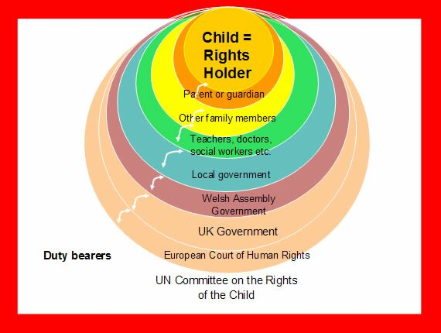
Curriculum and Guidance
According to the Welsh Government (2022), the curriculum for Wales recognises health and wellbeing as one of the six areas of learning and experience. It intends to support children in developing the knowledge, experiences and skills needed to make careful decisions about their physical health, mental wellbeing, and lifestyle choices.
The Health and Well-being Area of Learning and Experience promotes children to develop positive habits, build positive relationships with others and understand how lifestyle choices can affect physical and mental health. It acknowledges that health and wellbeing are linked and extremely important for successful learning and development throughout early years.
The Healthy Child Wales Programme aims to support children’s development and health from birth through regular health reviews and early intervention. The plan is created to encourage healthy lifestyles, physical health, emotional wellbeing, and positive development, recognising the value of early years experiences in supporting lifelong health outcomes. (Public Health Wales, 2023)
Legislation and Policy
Source: UNCRC rights holder and duty model (UNCRC, n.d.)
The United Nations Convention on the Rights of the Child (UNCRC) finds children’s rights to health, development, and wellbeing. Article 24 notes that children have the right to the highest possible standard of health and access to healthcare services, while Article 27 shows the significance of an acceptable standard of living to support children’s development (UNICEF, 1989). This confirms that promoting health, wellbeing and positive lifestyles is not only helpful for the children, but it is also recognised as a basic right.
Conclusion
In conclusion, health, wellbeing, and lifestyle are closely linked and all create an influence on children’s holistic development. The evidence discussed throughout this academic poster shows that factors such as nutrition, physical activity, sleep, relationships and the wider environment can all contribute to children’s health outcomes and overall wellbeing. Theories including Dahlgren and Whiteheads model, Bronfenbrenner’s ecological systems theory and Maslow’s hierarchy shows just how important it is to consider the whole child and the wider factors that affect development.
In addition, guidance and policies such as Curriculum for Wales, the Healthy Child Wales programme and the UNCRC encourage the progression of healthy habits and wellbeing during childhood. Therefore, from this poster it is evident that a holistic approach is essential in supporting children to achieve positive results and longer wellbeing.

Slide 6
Reference list
Ashdown, D.M. and Bernard, M.E. (2012) “Can Explicit Instruction in Social and Emotional Learning Skills Benefit the Social-Emotional Development, Well-being, and Academic Achievement of Young Children?,” Early childhood education journal, 39(6), pp. 397–405. Available at: https://doi.org/10.1007/s10643-011-0481-x.
Bathory, E. and Tomopoulos, S. (2017) “Sleep Regulation, Physiology and Development, Sleep Duration and Patterns, and Sleep Hygiene in Infants, Toddlers, and Preschool-Age Children,” Current problems in pediatric and adolescent health care, 47(2), pp. 29–42. Available at: https://doi.org/10.1016/j.cppeds.2016.12.001.
Bitesize Learning (2024). Maslow’s Hierarchy of Needs. [online] BiteSize Learning. Available at: https://www.bitesizelearning.co.uk/resources/maslows-hierarchy-of-needs-theory.
Bradshaw, J. (ed.) (2016) The Well-being of children in the UK. Fourth edition. Bristol, UK: Policy Press. Available at: https://doi.org/10.56687/9781447325642.
Bronfenbrenner, U. (1996) The ecology of human development : experiments by nature and design. Cambridge, MA: Harvard University Press.
Childrensrightswales.org.uk. (2024). About children’s rights | What are human rights? [online] Available at: https://childrensrightswales.org.uk/what-are-human-rights.aspx.
Dahlgren, G. and Whitehead, M. (1991) Policies and strategies to promote social equity in health. Stockholm: Insititute for Futures Studies
Estyn (2013) Supplementary Guidance: Healthy Living. Cardiff: Welsh Government.
Marmot, M. and Bell, R. (2012) “Fair society, healthy lives,” Public health (London), 126(supplement 1), pp. S4–S10. Available at: https://doi.org/10.1016/j.puhe.2012.05.014.
Marmot, M., Allen, J. and Goldblatt, P. (2010) “A social movement, based on evidence, to reduce inequalities in health,” Social science & medicine (1982), 71(7), pp. 1254–1258. Available at: https://doi.org/10.1016/j.socscimed.2010.07.011.
McLoed, S. (2018) Maslow’s Hierarchy of Needs. Available at :https://www.simplypsychology.org/maslow.html (Accessed: 27 May 2026).
Mindell, J.A. and Williamson, A.A. (2018) “Benefits of a bedtime routine in young children: Sleep, development, and beyond,” Sleep medicine reviews, 40, pp. 93–108. Available at: https://doi.org/10.1016/j.smrv.2017.10.007.
Musgrave, J. (2017) Supporting children’s health and wellbeing. London: SAGE Publications.
Naidoo, J. and Wills, J. (2016) Foundations for health promotion. Fourth edition. London: Elsevier.
Public Health Wales (2019) Healthy Weight: Healthy Wales. Cardiff: Welsh Government.
Public Health Wales (2023) Healthy Child Wales Programme. Cardiff: Public Health Wales.
Schmeer, K. K. & Yoon, A. J. (2016) 'Home sweet home? Home physical environment and inflammation in children' Social Science Review Vol 60 pp.236-248 Available at: Home sweet home? Home physical environment and inflammation in children
School, B. (2026). Supporting Holistic Child Development in Early Years: A Practitioner’s Guide. [online] Britannia School of Academics. Available at: https://schoolofacademics.co.uk/supporting-holistic-child-development-in-early-years?srsltid=AfmBOorPs6NpG8fwygFZudPC5VHfoJ5c7BddvyuSifye1XAGo2Khfuu_ [Accessed 30 May 2026].
Scriven, A. and Ewles, L. (2010) Promoting health : a practical guide. 6th ed. / Angela Scriven; forewords by Linda Ewles, Ina Simnett, Richard Parish. Edinburgh ; Baillière Tindall/Elsevier.
Statham, J and Chase, E (2010) Childhood Wellbeing: A brief overview. Loughborough: Childhood Wellbeing Research Centre.
Thomas, A. and Lewis, A. (2020) An introduction to the foundation phase : EarlyYears curriculum in Wales. London, England: Bloomsbury Academic. Available at: https://doi.org/10.5040/9781474264310.
Tickell, C. (2011). The Early Years: Foundations for life, health and learning An Independent Report on the Early Years Foundation Stage to Her Majesty’s Government. [online] Available at: https://www.education-uk.org/documents/pdfs/2011-tickell-report-eyfs.pdf.
United Nations (1989) Convention on the Rights of the Child. Available at: https://www.unicef.org.uk/what-we-do/un-convention-child-rights/ (Accessed: 3 June 2026).
Van Zyl, L.E. (2013) “Seligman’s flourishing: An appraisal of what lies beyond happiness Flourish: A visionary new understanding of happiness and well-being, Martin E.P. Seligman : book review,” SA Journal of Industrial Psychology. AOSIS, pp. 1–3.
Welsh Government (2022) Curriculum for Wales: Health and Well-being Area of Learning and Experience. Cardiff: Welsh Government.
World Health Organisation (WHO) (2022) Constitution. Available at: https://www.who.int/about/governance/constitution (Accessed: 27 May 2026).

