Slide 1

Name: Hasna Begum
Student ID: 2523256
Module code: LCHS4010
Module: Psychology in Health and Social care
Component: Shona's case study
Lecturer: Prabjot Kaur Sahota
Date submitted: 11 October 2026

Slide 2
Applying Bowlby's Attachment Theory to Shona's Case Study in an Early Years Nursery Setting
Hello, my name is Hasna Begum and my student ID 2523256.
Today, I will be presenting Shona's case study using Bowlby's Attachment Theory.
I will explain the key concepts of the theory, apply the theory to Shona's case study, discuss nature and nurture influences, identify support strategies and evaluate the strengths and limitations of the theory.
I will also explain how nursery practitioners and caregivers can work together to support Shona's emotional, social, cognitive and physical development.

Slide 3
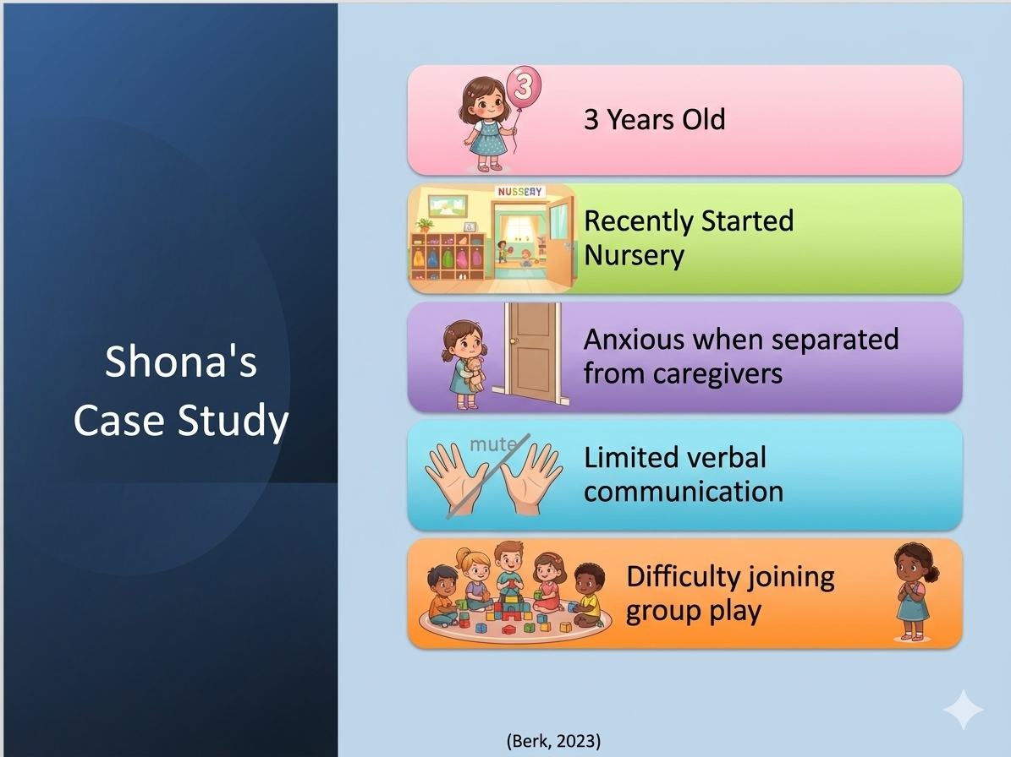

Slide 4
Bowlby's Attachment Theory
Children need secure emotional bonds with caregivers
Safe and secure
Secure base
Separation anxiety
(Bowlby, 1969; Bowlby, 1988)

Slide 5
Applying Bowlby’s Theory to Shona
Other Consideration
Shona shows separation anxiety
May not yet feel secure in nursery
Anxiety may affect confidence and play
The exact cause of Shona's behaviour is unknown.
There may have been changes at home or in caregiving arrangements.
Practitioners should avoid assumptions.
Ongoing observation and assessment are needed.

Slide 6
Nature and Nurture Influences
Nature: temperament, communication development, individual differences
Nurture: nursery environment, caregiver relationships, support from staff

Slide 7
Support Plan for Shona
Emotional: key person, reassurance
Social: small group play, peer buddy
Cognitive: stories, picture cards
Physical: outdoor play, routines

Slide 8
Support for Caregivers and Staff
Daily communication
Regular review meetings
Consistent routines
SALT, SENCO, GP if concerns continue

Slide 9
Strengths and Limitations of Bowlbys Theory
Strengths: explains separation anxiety supports key-person approach
Limitations: does not explain all behavior case study lacks full information

Slide 10
Conclusion
Bowlby's theory helps explain Shona's separation anxiety.
Secure attachments help children feel safe and confident.
Positive relationships with caregivers and nursery practitioners can support emotional and social development.
Consistent support and secure relationships may help Shona settle into nursery and develop confidence.
(Bowlby, 1969; Bowlby, 1988)

Slide 11
References
Berk, L.E. (2023) Development through the lifespan. 8th edn. Boston: Pearson
Bowlby, J. (1969) Attachment and loss: Vol. 1. Attachment. London: Hogarth Press.
Bowlby, J. (1988) A secure base: parent-child attachment and healthy human development. London: Routledge.
Broderick, P.C. and Blewitt, P. (2020) The life span: human development for helping professionals. 5th edn. New York: Pearson.
Department for Education (2026) Early years foundation stage (EYFS) statutory framework. Available at: www.gov.uk (Accessed: 28 September 2026).
Howe, D. (2011) Attachment theory for social work practice. London: Palgrave Macmillan.

