Slide 1
Module Name : Signals and System
Module Code : ACDA4009
Topic : Revision 1

Slide 2
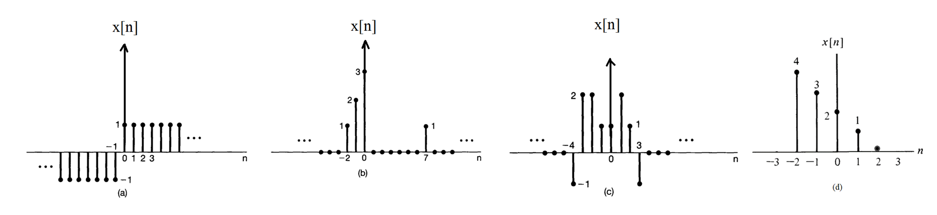
Revision 1
Exercise 1
ACDA4009 – Signals and System

Slide 3
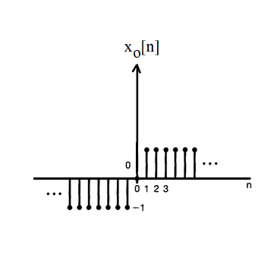
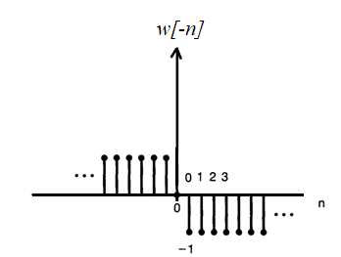
Revision 1
Exercise 2
a.
ACDA4009 – Signals and System

Slide 4

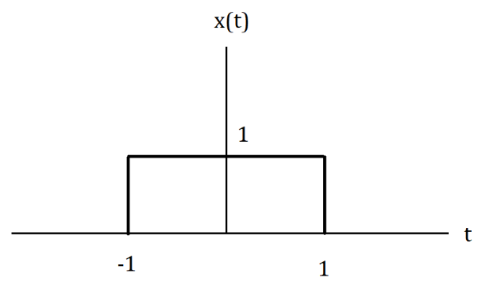
Revision 1
Exercise 3
Exercise 4
Consider the rectangular pulse below
Illustrate the time shift and time variant representation for rectangular function y(t)=x(2t+3)
ACDA4009 – Signals and System

Slide 5
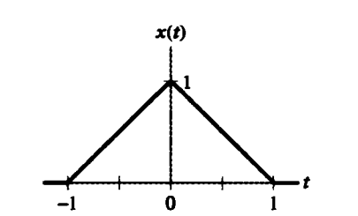
Revision 1
Exercise 5
For the triangular pulse x(t) shown below, sketch the time scaling for each of the following derived from x(t)
x(3t)
x(3t+2)
x(3t)+x(3t+2)
ACDA4009 – Signals and System

Slide 6
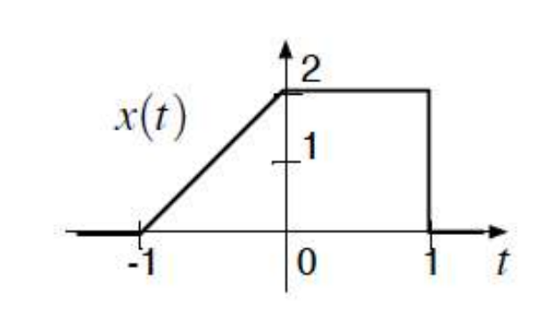
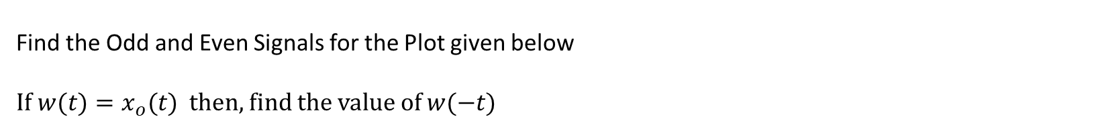
Revision 1
Exercise 6
Find the Odd and Even Signals for the Plot given below
If $w(t)=x_{o}(t)$ then, find the value of $w(−t)$
ACDA4009 – Signals and System

Slide 7
Thank You

