Slide 1
The spread of the Cistercians
Why so popular and successful?
How did non-Cistercians see them?
Orderic Vitalis

Slide 2
William of Malmesbury
English monk
Writing by 1124 at the latest
Much said about Stephen Harding

Slide 3
William of Malmesbury
How he characterizes the Cistercians (as seen from the outside)
Clothing simple
Emphasis on the RSB
Silence
No gold or silver

Slide 4
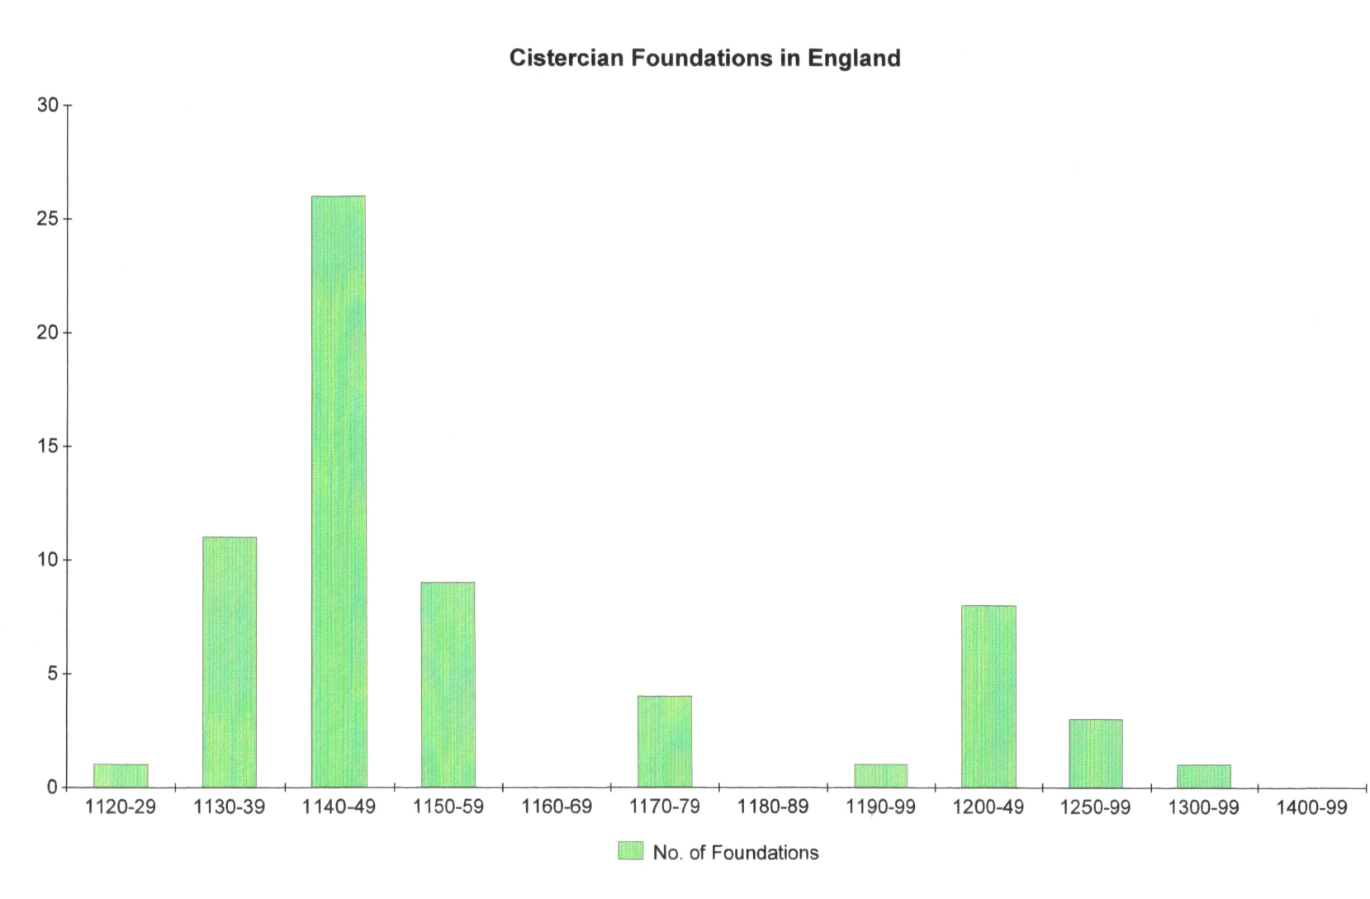
Cistercian Foundations in England

Slide 5
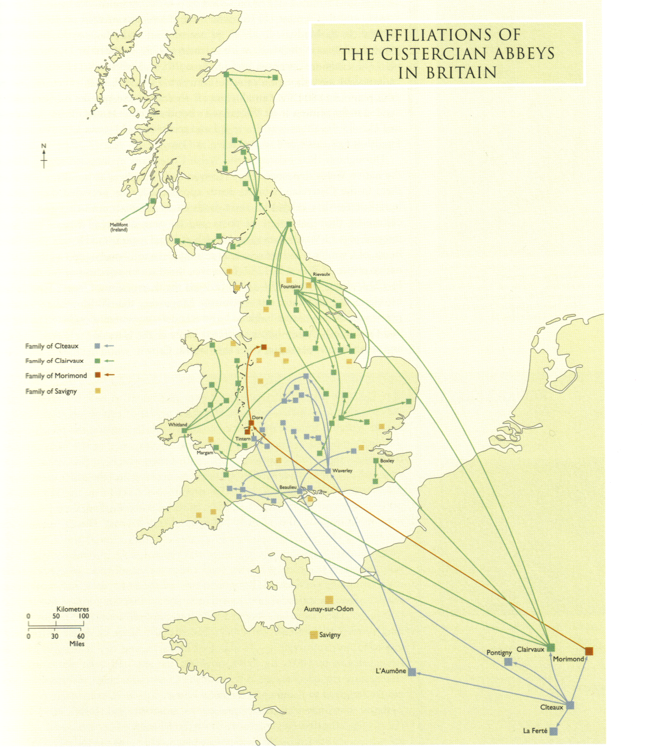
Cistercian abbeys in Britain
Blue: from Cîteaux, via L’Aumöne
Red: from Morimond
Green: from Clairvaux
Houses marked with yellow squares are those which belonged to the congregation or order of Savigny. The order merged with the Cistercian Order in 1147.

Slide 6
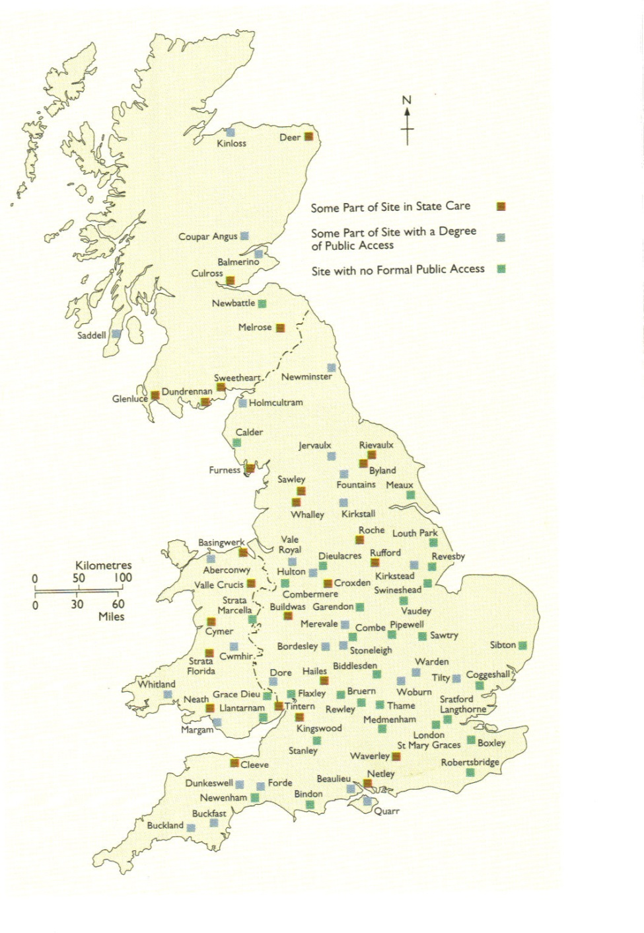

Slide 7
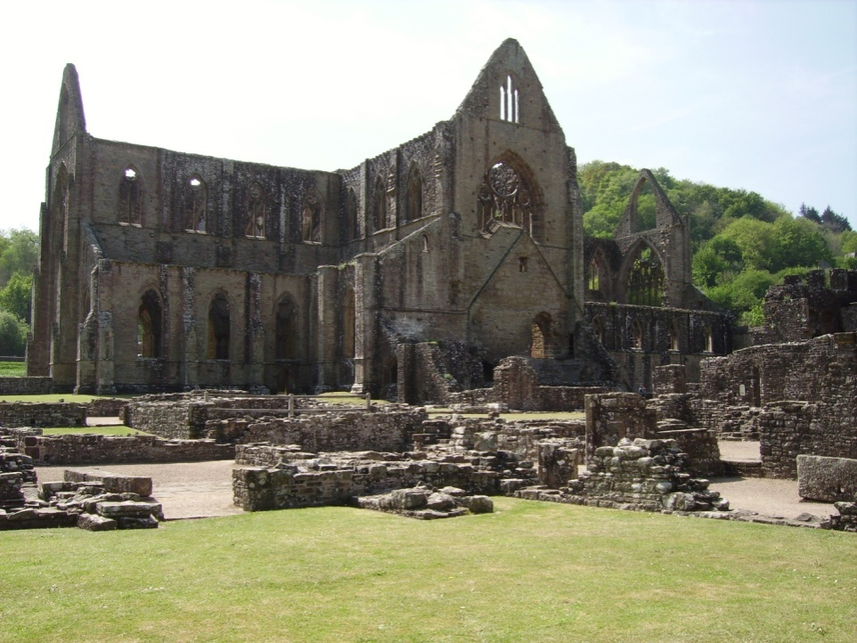
The Cistercians in England and Wales: the first foundations, from L’Aumöne
1128 Waverley Abbey, founded by William Giffard, bishop of Winchester
1131 Tintern Abbey, founded by Walter fitz Richard de Clare

Slide 8
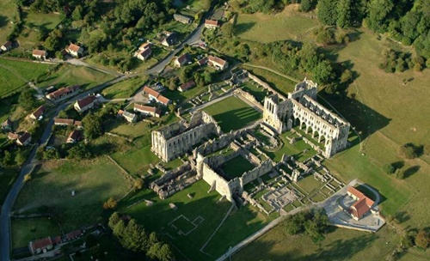
Rievaulx Abbey: aerial view

Slide 9
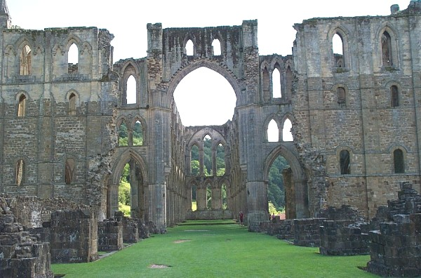
Rievaulx Abbey: nave and transepts

Slide 10
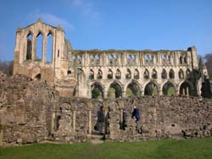
Rievaulx Abbey: the church

Slide 11
Rievaulx Abbey: sources
Letter of St Bernard
Narratio de Fundatione of Fountains Abbey
Foundation charter

