Slide 1


Entrepreneurship
GROUP PROJECT
TOPIC :
Fund raising for start-ups, challenges & opportunities
Presented By:
Apurva Jignesh Parmar (2211066)
Viralkumar Pravinbhai Panchal (2210866)
Vidhita Arora (2213518)
Professor Name:
Jaya Gopalkrishnan

Slide 2
Introduction
To define startup fundraising as: Fundraising is the practise of gathering financial support from a variety of donors (Eggers, 2020)
A few examples of sources of funding for a startup's growth and advancement are venture capitalists, angel investors, and crowdsourcing platforms.
Fundraising is crucial for new businesses: Large sums of money are typically needed by new businesses in order to refine their offerings, attract and retain customers, and launch successfully into the marketplace (Cohen et al. 2019)
Successful fundraising can supply the capital required to reach these objectives, paving the way for the startup's development and growth.
On the other hand, there is a lot of competition for few financing sources, making the fundraising process difficult.
Notes:
The presentation's opener should introduce the topic and provide context for what will follow. Acquiring funds through a variety of sources, or "fundraising," is an essential part of a startup's development and growth. This can be difficult for new enterprises to overcome, since many potential investors and sources of finance may be wary of putting money into an unknown entity. However, in order to grow and reach their objectives, startups need to raise capital. In this talk, we'll discuss the advantages and disadvantages of several fundraising approaches for startups and give some instances of what works. We are going to also examine the essential entrepreneurial talents and attributes needed for successful raising money, and talk about the academic theories and encouragement systems associated with start-up formation and growth.

Slide 3
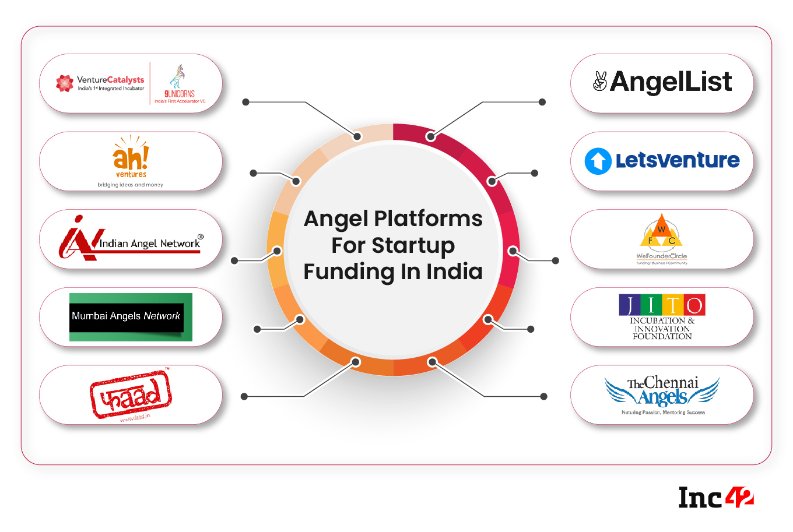
Academic theory relating to business start-up, development and growth
The notion of economic entrepreneurship places premium on market circumstances (Bonini and Capizzi, 2019).
According to the resource-based view of entrepreneurship, a company's strengths lie inside its own resources and talents (Kuckertz, Berger and Gaudig, 2019)
Growth phases for a company: There is a beginning, development, expansion, peak, and fall.
Notes:
The academic idea of business creation, growth, and maturity can be used as a guide through the fluctuating state of a company's history. The notion of economic entrepreneurship places a premium on both favourable market conditions and the entrepreneur's ability to spot and capitalise on those conditions. But the Resource-based view of entrepreneurship stresses the importance of a company's internal resources and competencies in achieving success. In the context of new businesses, wherein the entrepreneur's ability to spot market opportunities is paramount, it makes sense to link these ideas with the importance of the company's assets and capabilities in capitalising on those opportunities. Apple, Amazon, and Facebook are just a few examples of companies that have gone through many stages of development and utilised a wide range of financing methods to fuel their expansion. Apple's IPO in 1980 raised $100,000, and the company is today worth more than $2 trillion. Amazon went public in 1997, it was determined raising $54 million; today, the company is worth more than $1.5 trillion. After its initial public offering in 2012, Facebook raised $16 billion, giving it a market valuation of over $1 trillion. These businesses have grown by employing a wide range of financing strategies, including initial public offerings, secondary markets, and mergers and acquisitions.

Slide 4
Debt finance, equity financing, and convertible debt financing are all viable options for young businesses (Andoni et al. 2019).
The part played by angel investors and venture capitalists: That which they bring to new businesses, and how they vary (Park, Shin and Choy, 2020)
Real-world instances of effective startup funding: Examples of successful bootstrapped businesses include Basecamp, Mailchimp, and Hootsuite.
Notes:
To penetrate the supermarket sector, Amazon, for instance, spent $13.7 billion to acquire Whole Foods in 2017. Companies like Google, Twitter, and LinkedIn wouldn't exist without the funding provided by venture capitalists and angel investors. Success may be achieved in a variety of ways, and bootstrapping has been demonstrated by organisations such as Basecamp, Mailchimp, and Hootsuite. These real-world cases illustrate why it's crucial to have a firm grasp of the theory underlying the genesis, maturation, and expansion of businesses before deciding how to allocate seed capital.

Slide 5
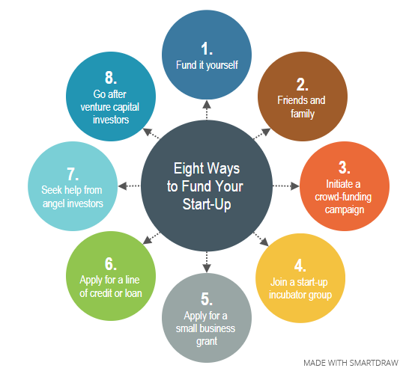
Support systems for business start-up
Financial backing, tax breaks, and other resources are all available through government programmes that encourage new businesses.
Mentorship, access to a broad network, and other services are just some of the ways in which incubators and accelerators help startups succeed (Ghosh, Mehta and Avittathur, 2021)
Crowdfunding sites make it possible for startups to get financial backing from many individuals.
Support systems have been shown to have a favourable effect on the success of startups by looking at case studies of companies that have used them (Russell, Skinner, and Fowler, 2022)
Notes:
As a result of the COVID-19 pandemic, many governments have introduced new programmes to assist new businesses. To help new businesses get off the ground, countries like Sri Lanka and India have implemented credit guarantee schemes and Start-up India initiatives, respectively. In addition, incubators and accelerators have helped numerous start-ups get off the ground; Dropbox, for example, was once part of the Y Combinator accelerator programme. The smartwatch company Pebble was able to raise a total of $10 million in 2012 thanks to crowdfunding websites like Kickstarter.

Slide 6
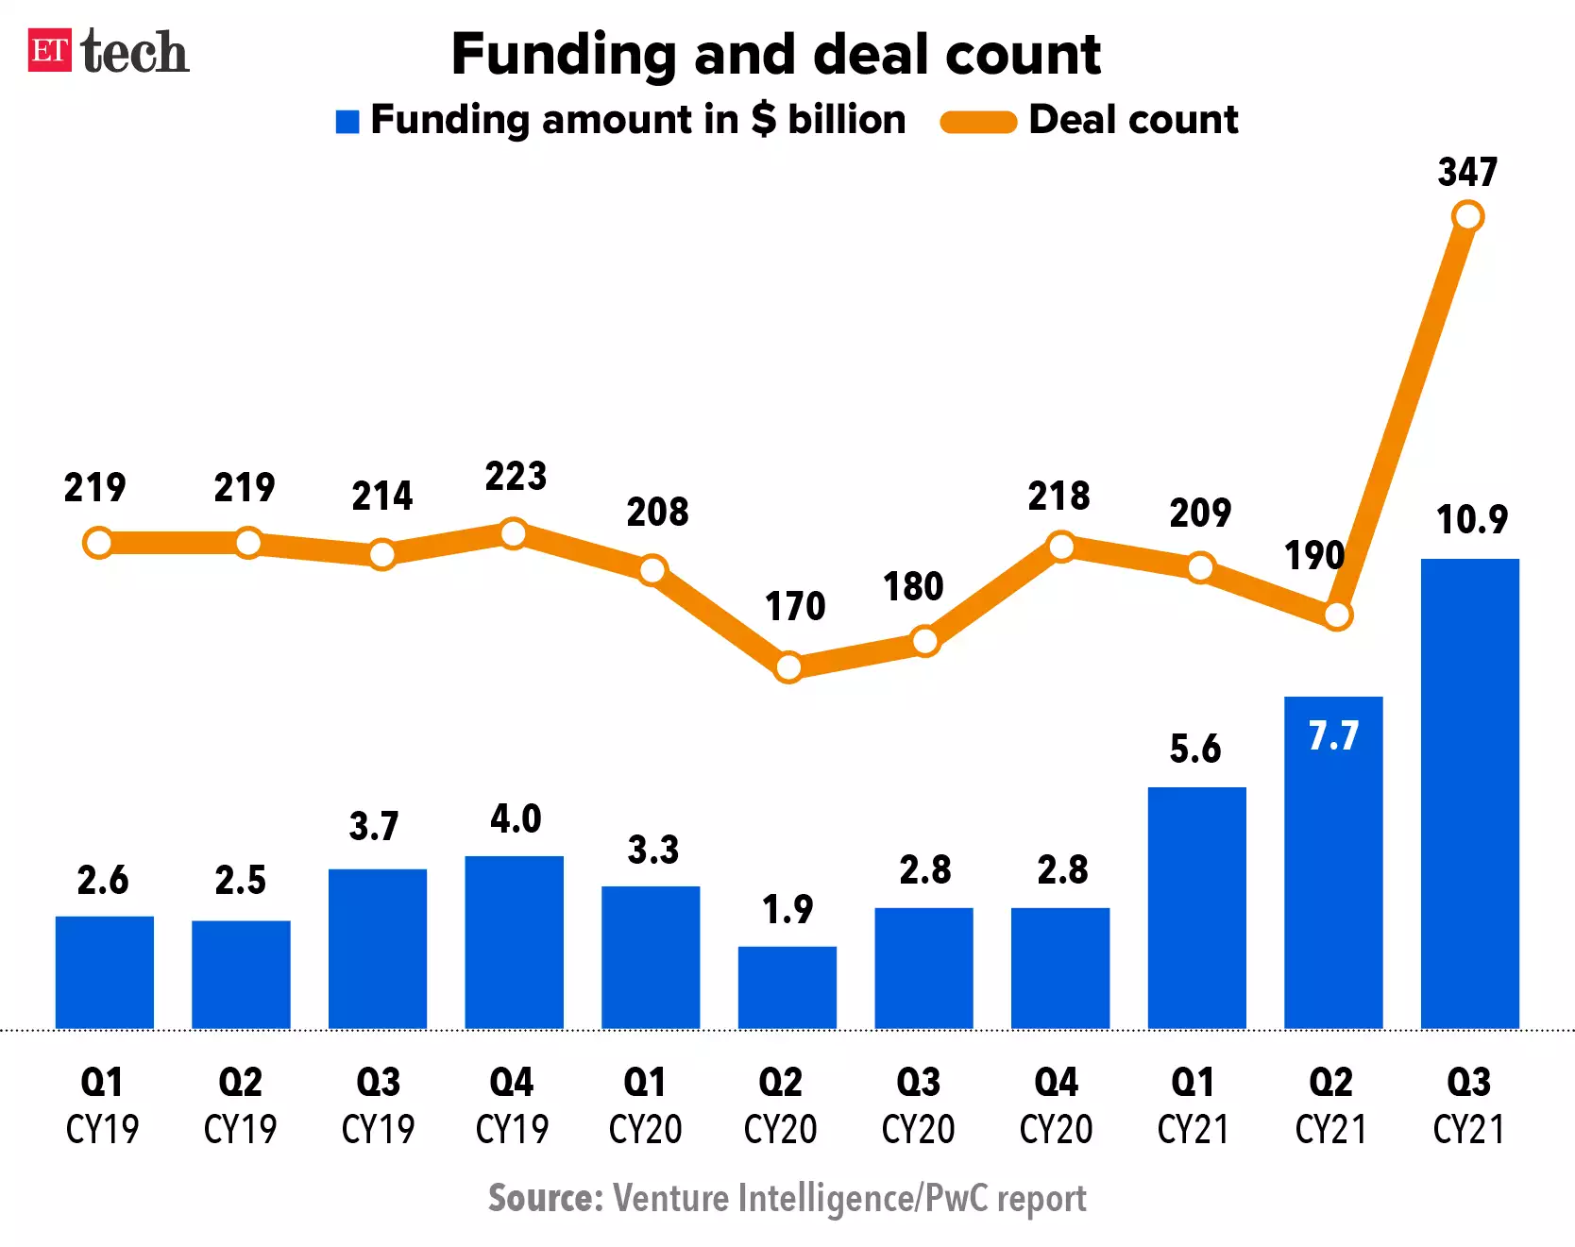
The processes of growth and development
The goal of any effective scaling strategy is to maximise productivity and revenue as a company grows. Vertical integration and strategic alliances are two such examples (Kalogiannidis, and Chatzitheodoridis, 2021)
Rapid expansion can cause issues including decreased quality of service provided to customers, dissatisfied workers, and financial instability.
Strategies for leaving a business include going public, merging, or going out of business entirely.
Lessons like the significance of a robust corporate culture and careful cash management can be gleaned from growth schemes that ultimately fail (Korreck, 2019)
One successful departure scenario is the 2014 acquisition of WhatsApp by Facebook for $19 billion.
Notes:
Having a well-defined plan in place is crucial while expanding your company. Scaling solutions help firms grow sustainably, but there are several potential hazards associated with rapid expansion. For instance, when the original leaders of TOMS Shoes decided to retire, they conducted a management buyout in which the company's current CEO and other top executives acquired a majority share in the company. Having a plan for when you want to leave the firm, whether that's through going public or merging, is crucial. Case studies of both effective and unsuccessful growth strategies can teach entrepreneurs important insights and improve their decision-making. Examples of companies that did not adjust to shifting market conditions and technological preferences include Blockbuster and Kodak.

Slide 7
Entrepreneurial skills, traits and characteristics
Entrepreneurs that have found early and sustained success share certain traits and competencies (David, Gopalan. and Ramachandran, 2021)
According to research conducted at Harvard Business School, successful business owners have a number of character qualities.
In order to manage and inspire their people, entrepreneurs must hone their leadership abilities (Schückes, and Gutmann, 2021).
The ability to bounce back from setbacks is essential for any business. It calls for tenacity and the capacity to grow from setbacks.
Notes:
Successful entrepreneurs share a specific set of traits and abilities that have allowed them to establish sustainable businesses. Entrepreneurs need a diverse set of skills, but among the most crucial are a tolerance for risk, enthusiasm, originality, and perseverance. Entrepreneurs may better manage their employees and accomplish their goals if they invest time in developing their leadership abilities.

Slide 8
Jeff Bezos of Amazon and Mark Zuckerberg of Facebook are just two examples of successful business owners who have shown the importance of traits like perseverance, vision, and flexibility. (Eggers, 2020)
The founder of Spanx, Sara Blakely, is a great example of an entrepreneur who overcomes adversity. She believes that her ability to take calculated risks and grow from her setbacks is crucial to her success.
Elon Musk, CEO of SpaceX and Tesla, is famous for being a risk taker and innovator. Additionally, he has proven the value of not giving up in the face of adversity (Hendrikse, Van Meeteren, and Bassens, 2020)
Notes:
Since failure is an integral part of starting and running a business, successful entrepreneurs must be able to pick themselves up after falling down. Jeff Bezos, Mark Zuckerberg, Sara Blakely, and Elon Musk are just a few examples of great entrepreneurs who have shown the importance of traits like perseverance, vision, and flexibility.

Slide 9
Challenges in fundraising for start-ups
Market Volatility: Due to market uncertainty, it might be difficult for startups to get financing (Liguori, and Winkler, 2020)
Strong rivalry: Competition for investment is fierce due to a rise in new businesses but a decrease in available capital.
Problems with the law and regulations: Due to legal and regulatory constraints, startup fundraising can be time consuming and costly.
Regulatory hurdles hampered Turo's attempts to acquire $50 million in finance in 2017 (Chang et al. 2019).
Despite Nucleus's success in obtaining $5.6 million, the company struggled owing to limited consumer demand and intense competition.
Nucleus, despite raising $5.6 million in funding, the company faced challenges due to a slow adoption rate and high competition
Notes:
Taking into account all of the red tapeStartups need to follow the rules and make sure their fundraising is done in a moral and legal way. Investors are typically wary of companies that either have a short track record or that operate in highly competitive markets. In order to win over investors, new businesses need to set themselves out from the pack by showcasing their distinctive value propositions. Fundraising is a major obstacle for startups, and a firm grasp of the market, the competition, and the rules is essential.

Slide 10

Start-ups can leverage their unique value propositions and innovative ideas to attract investors
Examples of case study: Turo, a peer-to-peer car rental company, $50 million in funding (Kalogiannidis, and Chatzitheodoridis, 2021)
Nucleus, a home intercom system start-up, funding target to $30 million (Russell, Skinner, and Fowler, 2022)
Notes:
Despite these obstacles, start-ups can build their businesses with the help of investors who see the particular value they provide. Peer-to-peer car rental startup Turo is an example of a company that has struggled to raise capital. The startup tried to raise $50 million in 2017, but ran into roadblocks from regulatory concerns and stiff competition from established automobile rental agencies. Turo was forced to reduce its funding goal from $50 million to $30 million and settle for a higher valuation as a result. Nucleus, a startup home intercom system, is yet another such. The company struggled in spite of its $5.6 million in funding because of low acceptance and intense competition.

Slide 11
Opportunities in fundraising for start-ups
Increased interest in impact investing reflects the growing trend of individuals and institutions seeking financial returns while also making a beneficial contribution to society and the environment (Korreck, 2019)
Technological progress: Emerging technologies like blockchain, AI, and IoT present fresh openings for startups to create game-changing solutions and shake up established markets (David, Gopalan, and Ramachandran, 2021)
Notes:
Despite the difficulties, there are several openings for new enterprises to get funded and expand. The advent of impact investment, which seeks financial returns while also furthering social or environmental goals, is one such development. New and creative solutions can be created thanks to technological progress, which presents another chance. Furthermore, growing markets offer new clients and marketplaces for companies to tap into. Impossible Foods, Tesla, and Airbnb are just a few examples of thriving firms that have taken advantage of these trends.

Slide 12
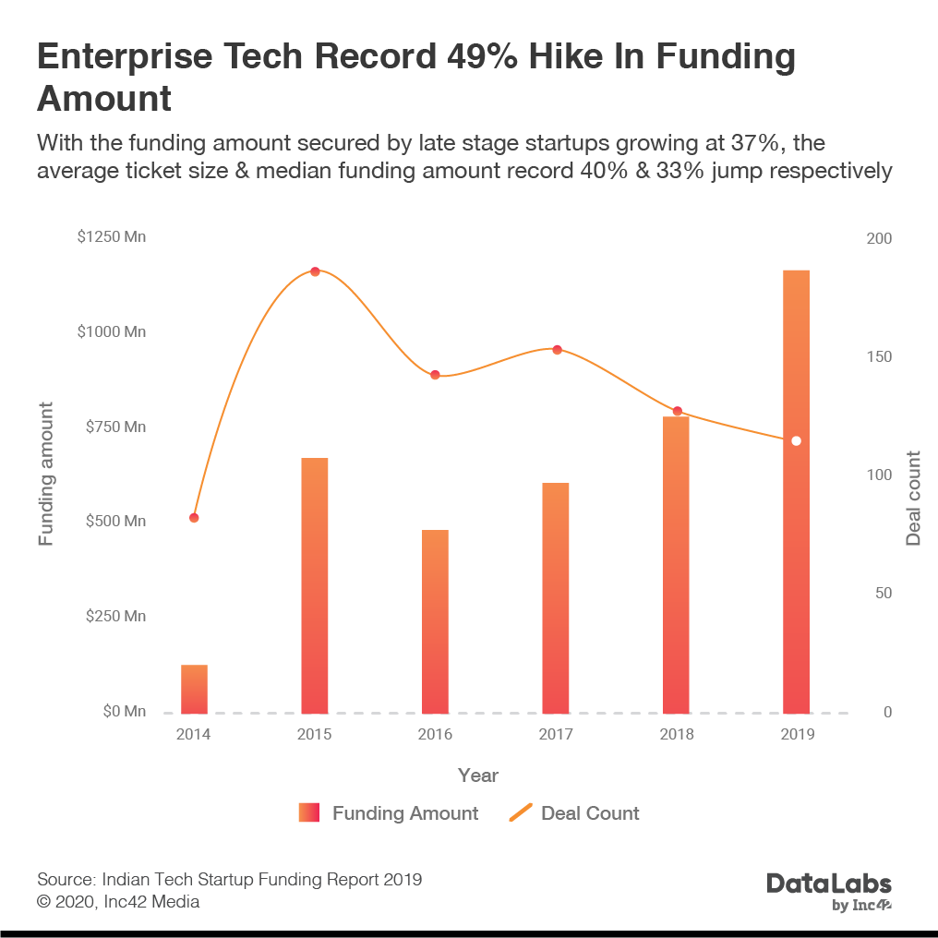
Growth economies in places like Asia, Latin America, and Africa present fresh opportunities for entrepreneurs to expand their consumer bases and raise capital.
Here are some thriving new businesses: Businesses like Impossible Foods, Tesla (Liguori, and Winkler, 2020)
Airbnb have grown through capitalising on impact investing, technological advancements, and expansion into emerging regions (Chang et al. 2019).

Slide 13
Innovation in fundraising for start-ups
Online donation and crowdfunding sites, such as Kickstarter and Indiegogo
Models of nonconventional financing: funding their operations using royalty payments, venture debt, and revenue-based finance (Hendrikse, Van Meeteren, and Bassens, 2020)
Innovation for social good: Investors increasingly choose businesses with a positive social impact when deciding where to put their money.
Start-ups that have used unconventional funding strategies include the following: Every time a pair of TOMS shoes is purchased, a new pair of shoes are given to a child in need (Eggers, 2020)
Notes:
Websites like Kickstarter and Indiegogo have made it easier for new businesses to solicit financial backing from a sizable internet audience. Models of nonconventional financing: Revenue financing, venture debt, and royalty finance are just a few examples of the new types of financing that startups are looking into. Investors who want to back businesses with a good social impact are increasingly interested in startups with a social mission built right into their business plan. TOMS Shoes, which donates a pair of shoes to a child in need for every pair of shoes sold, Charity: Water, which uses 100% of public donations to fund clean water projects, and Kiva, which provides microloans to entrepreneurs in developing countries through its online platform, are just a few examples of startups that have used innovative fundraising methods.

Slide 14
Insights from experts in the subject area
Fundraising examples for new businesses: New businesses like BugBase and Dextroware Devices are good examples.
What we can learn from fundraising failures: Entrepreneurs can improve their fundraising efforts by learning from their previous missteps and crafting tactics that are more likely to succeed (David, Gopalan, and Ramachandran, 2021)
Forecasts and current tendencies: Entrepreneurs may get ahead of the curve and spot new funding opportunities by learning about fundraising trends including the increase in impact investing and the usage of digital platforms.
Experts' thoughts on the matter: Fundraising techniques and best practises can benefit greatly from the input of seasoned investors and business owners (Kalogiannidis, and Chatzitheodoridis, 2021.)

Slide 15
Justification of arguments and judgements
Evidence-based reasoning for justifying arguments and judgements discussed earlier
Analysis of different perspectives based on the previous discussion
Reflection on personal experiences based on the previous discussion
Example of successful start-up fundraising and the approach taken to justify it
Successful entrepreneurship requires a unique set of skills and qualities that have helped entrepreneurs build successful ventures.
Notes:
Successful business owners have a number of character traits, including the ability to take initiative, embrace uncertainty, be driven by a deep sense of purpose, and bounce back quickly from setbacks. Perseverance, vision, and flexibility are all attributes exemplified by Amazon's and Facebook's and Tesla's and SpaceX's respective founders, Jeff Bezos, Mark Zuckerberg, Sara Blakely, and Elon Musk. Start-ups experience difficulties in attracting funding due to market uncertainty, strong competition, and legal and regulatory impediments; yet, fundraising is an essential part of entrepreneurship. In order to win over investors, they need to set themselves apart from the competition. Despite obstacles, fresh opportunities for startups to expand their businesses exist thanks to impact financing, technological breakthroughs, and developing markets. Consequently, arguments and judgements regarding start-up fundraising need to be supported by analysis of other views, consideration of one's own experiences, and a commitment to an evidence-based approach.

Slide 16
Conclusion
Significant shifts have occurred in the startup funding market in recent years.
It's no longer necessary to rely on VC firms and other antiquated funding mechanisms.
Crowdfunding platforms are now widely recognised as a competitive source of capital for new businesses.
Startups can obtain capital, interact with potential clients, and increase brand recognition through crowdfunding.
However, the quality of the product or service, the strength of the team, and the efficacy of the marketing approach are all crucial to the success of a crowdfunding campaign.
Success factors for crowdsourcing campaigns and how startups can effectively utilise this funding option should be studied further in future studies.
Start-ups debating whether or not to use crowdfunding should weigh the benefits against the risks before making a final decision.
Crowdfunding, when used properly, can help startups raise capital for expansion and growth.

Slide 17
References
Chang, V., Baudier, P., Zhang, H., Xu, Q., Zhang, J. and Arami, M., 2020. How Blockchain can impact financial services–The overview, challenges and recommendations from expert interviewees. Technological forecasting and social change, 158, p.120166.
Liguori, E. and Winkler, C., 2020. From offline to online: Challenges and opportunities for entrepreneurship education following the COVID-19 pandemic. Entrepreneurship Education and Pedagogy, 3(4), pp.346-351.
Hendrikse, R., Van Meeteren, M. and Bassens, D., 2020. Strategic coupling between finance, technology and the state: Cultivating a Fintech ecosystem for incumbent finance. Environment and Planning A: Economy and Space, 52(8), pp.1516-1538.
Eggers, F., 2020. Masters of disasters? Challenges and opportunities for SMEs in times of crisis. Journal of business Research, 116, pp.199-208.
Schückes, M. and Gutmann, T., 2021. Why do startups pursue initial coin offerings (ICOs)? The role of economic drivers and social identity on funding choice. Small Business Economics, 57(2), pp.1027-1052.
David, D., Gopalan, S. and Ramachandran, S., 2021. The startup environment and funding activity in India. In Investment in Startups and Small Business Financing (pp. 193-232).
Korreck, S., 2019. The Indian startup ecosystem: Drivers, challenges and pillars of support. ORF Occasional Paper, 210.
Kalogiannidis, S. and Chatzitheodoridis, F., 2021. Impact of Covid-19 in the European Start-ups Business and the Idea to Re-energise the Economy. International Journal of Financial Research, 12(2), pp.56-61.
Russell, E., Skinner, M.W. and Fowler, K., 2022. Emergent challenges and opportunities to sustaining age-friendly initiatives: Qualitative findings from a Canadian age-friendly funding program. Journal of Aging & Social Policy, 34(2), pp.198-217.
Ghosh, D., Mehta, P. and Avittathur, B., 2021. Supply chain capabilities and competitiveness of high-tech manufacturing start-ups in India. Benchmarking: An International Journal, 28(5), pp.1783-1808.
Park, G., Shin, S.R. and Choy, M., 2020. Early mover (dis) advantages and knowledge spillover effects on blockchain startups’ funding and innovation performance. Journal of Business Research, 109, pp.64-75.
Andoni, M., Robu, V., Flynn, D., Abram, S., Geach, D., Jenkins, D., McCallum, P. and Peacock, A., 2019. Blockchain technology in the energy sector: A systematic review of challenges and opportunities. Renewable and sustainable energy reviews, 100, pp.143-174.
Kuckertz, A., Berger, E.S. and Gaudig, A., 2019. Responding to the greatest challenges? Value creation in ecological startups. Journal of Cleaner Production, 230, pp.1138-1147.
Bonini, S. and Capizzi, V., 2019. The role of venture capital in the emerging entrepreneurial finance ecosystem: future threats and opportunities. Venture Capital, 21(2-3), pp.137-175.
Cohen, S., Fehder, D.C., Hochberg, Y.V. and Murray, F., 2019. The design of startup accelerators. Research Policy, 48(7), pp.1781-1797.
Eggers, F., 2020. Masters of disasters? Challenges and opportunities for SMEs in times of crisis. Journal of business Research, 116, pp.199-208.

Slide 18
Thank You !

