Slide 1
Using Medieval Records
How records were created
Issues related to survival and completeness
Issues relating to use
  Handwriting
  Abbreviation and contraction
  Dating undated records
  Converting medieval dates to modern dates

Slide 2
How and why records were created
The influence of the church
Law codes written down under church influence
Solemn diplomas relating to the transfer of land and the obligations of landholding
Taxation records
Records of government – transmission of royal orders

Slide 3
Survival and completeness
Why are records kept?
Why may they NOT be kept (note: this question does not just apply to the medieval period)
Durability and conditions of storage

Slide 4
Issues relation to use: palaeography
The study of old handwriting

Slide 5
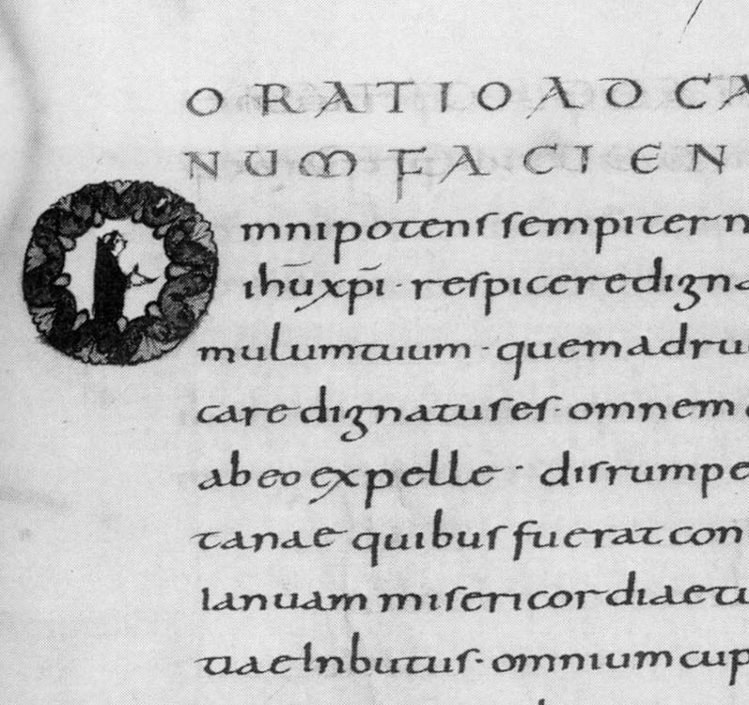
Carolingian miniscule

Slide 6
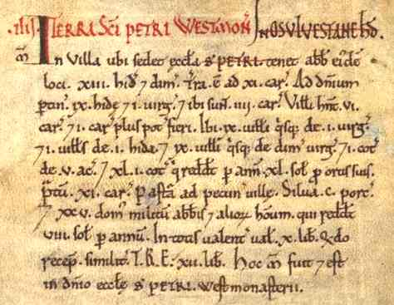
Domesday Book

Slide 7
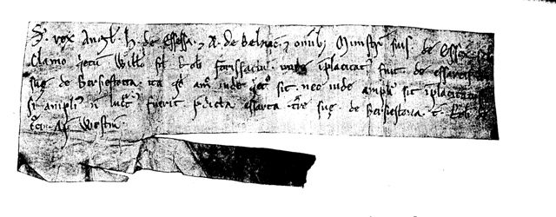
Writ of King Stephen

Slide 8
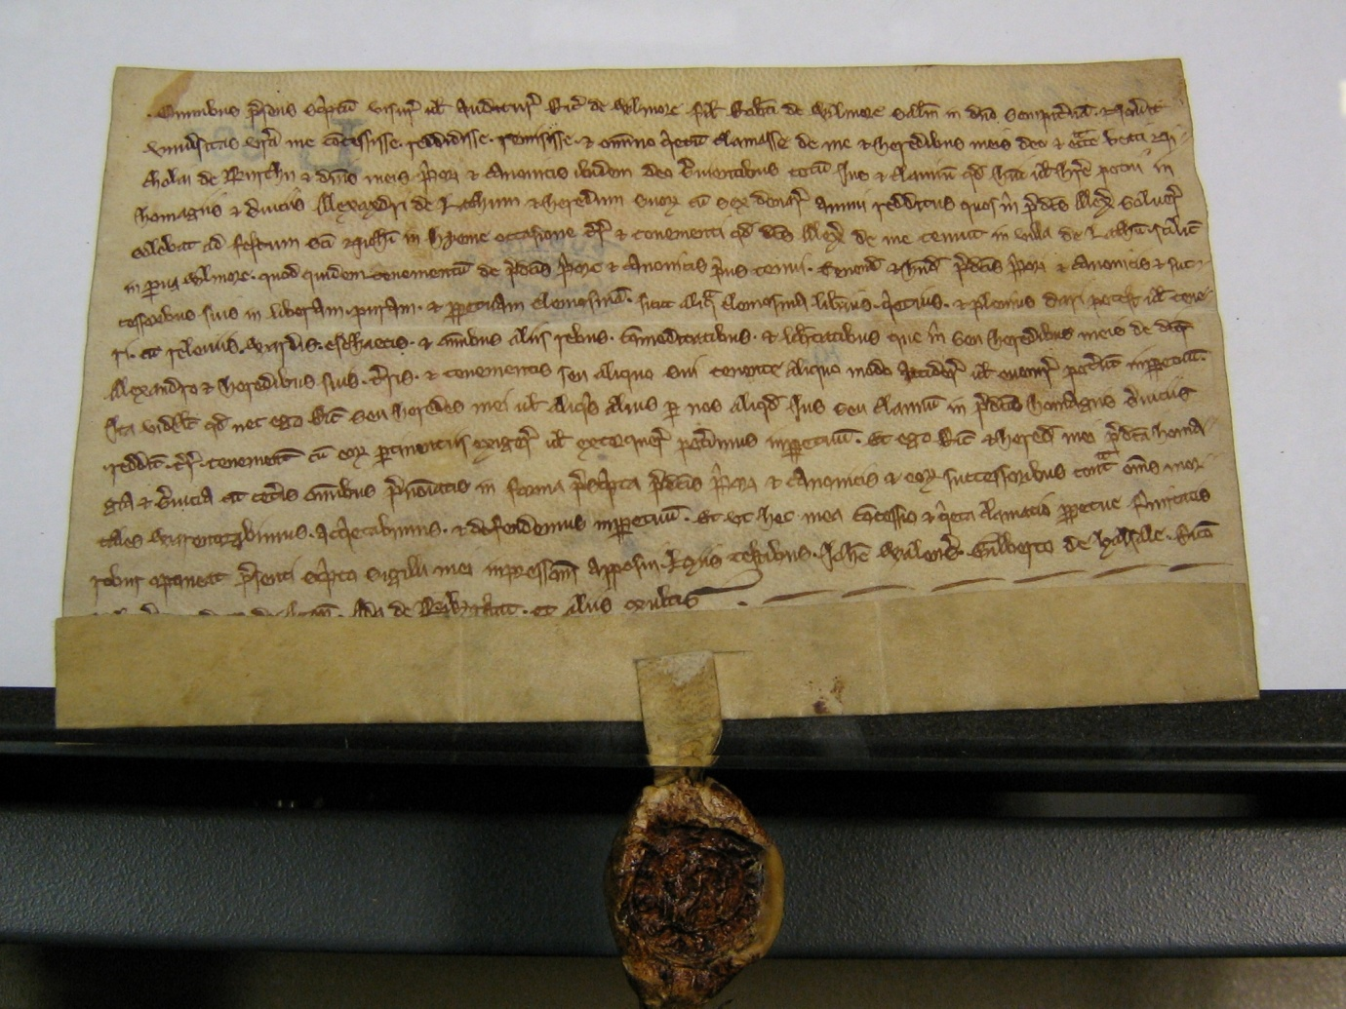
Charter of Burscough Priory

Slide 9
Scribal practices I
Abbreviation
  sce = sancte
  mat^{i}s = matris
  p with curly tail = pro = on behalf of

Slide 10
Scribal practices II
Making corrections:
  Crossing through a word and replacing
  Interlineation: writing a missing word between the lines

