Slide 1
Fundamentals of Electrical
And Electronic Systems
(ACDA4018)
Lecture - 5

Slide 2
Content
Kirchhoff's Voltage law
Kirchhoff's current law

Slide 3
Learning Outcome
The student upon completion of the lecture will be able to:
Define KCL and KVL.
Apply KVL and KCL in circuits

Slide 4
Introduction
Node:
A node is a junction in a circuit where two or more circuit elements are connected.
Branch:
A part of the network which connects the various parts of the network with one another is called a branch. A branch may consist of one or more elements.
A part of a network which lies between two junction is called a branch.
Loop:
Loop is any closed path in the circuit formed by branches.

Slide 5
Kirchhoff's law
Gustav Robert Kirchhoff (1824-1887), defined the Kirchhoff's current and Voltage law.
Kirchhoff’s law is helpful in determining the equivalent resistance of a complex network and the current flowing through the various branches of the network.
The two Kirchhoff’s laws are
  Kirchhoff’s Current law (KCL)
  Kirchhoff’s Voltage law (KVL)

Slide 6
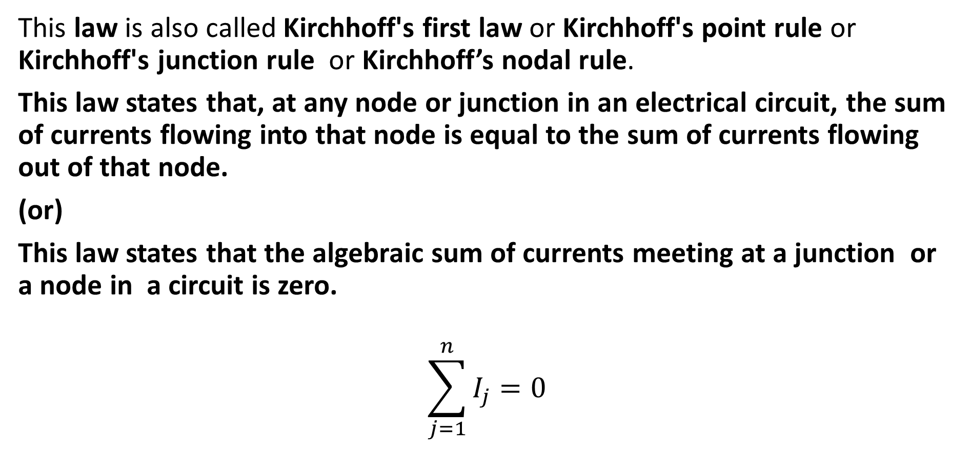
Kirchhoff's Current law (KCL)
This law is also called Kirchhoff's first law or Kirchhoff's point rule or Kirchhoff's junction rule or Kirchhoff’s nodal rule.
This law states that, at any node or junction in an electrical circuit, the sum of currents flowing into that node is equal to the sum of currents flowing out of that node.
(or)
This law states that the algebraic sum of currents meeting at a junction or a node in a circuit is zero.
$$\sum_{j=1}^{n}{I_{j}=0}$$

Slide 7
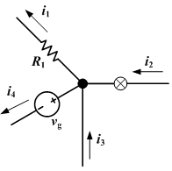
Kirchhoff's Current law
This law can be applied in the node of the network.
The current entering any junction is equal to the current leaving that junction.
i₁ + i₄ = i₂ + i₃
i₁ + i₄ - i₂ - i₃ = 0

Slide 8
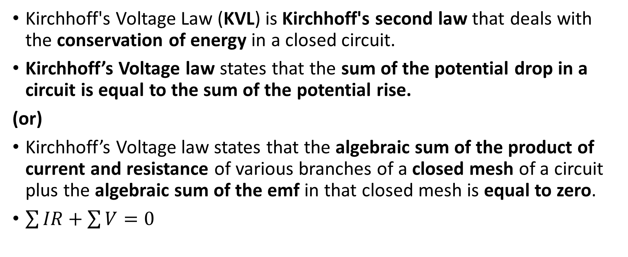

Kirchhoff’s Voltage law (KVL)
Kirchhoff's Voltage Law (KVL) is Kirchhoff's second law that deals with the conservation of energy in a closed circuit.
Kirchhoff’s Voltage law states that the sum of the potential drop in a circuit is equal to the sum of the potential rise.
(or)
Kirchhoff’s Voltage law states that the algebraic sum of the product of current and resistance of various branches of a closed mesh of a circuit plus the algebraic sum of the emf in that closed mesh is equal to zero.
$\sum{IR}+\sum{V}=0$

Slide 9
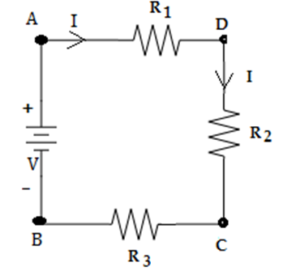
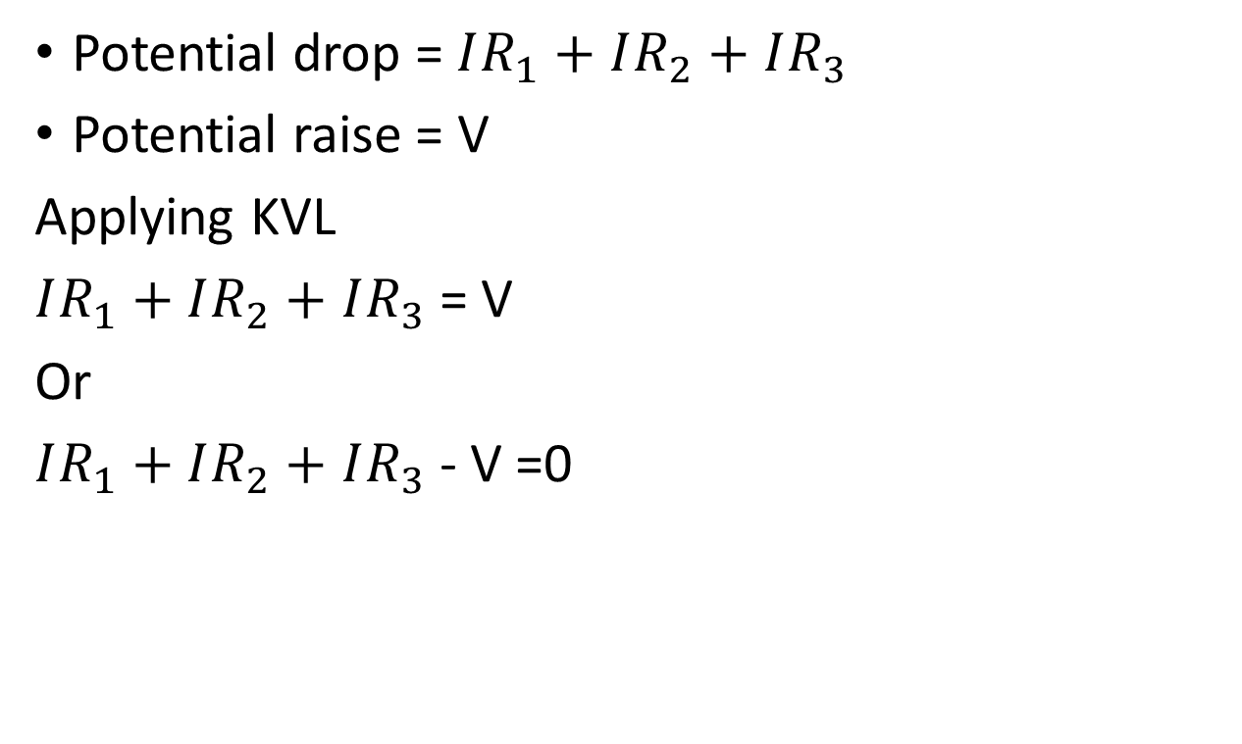
Kirchhoff’s Voltage law (KVL)
Potential drop = $IR_{1}+$ $IR_{2}+$ $IR_{3}$
Potential raise = V
Applying KVL
$IR_{1}+$ $IR_{2}+$ $IR_{3}$ = V
Or
$IR_{1}+$ $IR_{2}+$ $IR_{3}$ - V =0

Slide 10
Sign conversion
Rise in potential - positive (+)
Fall in potential - Negative (-)
The reverse is also possible, both the conversion gives the same result.
If we move from a positive terminal of the source to the negative terminal is considered as fall in potential. So, Negative sign is assigned for EMF.
+
_
-V (Negative)

Slide 11
Sign conversion
If we move from a negative terminal of the source to the positive terminal it is considered as rise in potential). So, positive sign is assigned for EMF.
The sign of the emf is independent of the direction of the current flow.
_
+
+V (Positive)

Slide 12


Sign conversion
If we move through the resistance in the same direction as the current there will be a fall in potential. So negative (-) sign is assigned.
If we move in a direction opposite to the direction of current flow, there is a rise in potential and hence the sign is positive (+).

Slide 13
Steps to apply Kirchhoff’s law to get network equation
Step 1: Draw the circuit diagram from the given information and insert all the values of sources and resistors with appropriate polarities.
Step 2: Mark all the branch currents with some assumed directions using KCL at various node and junction.
Step 3: Choose any closed loop and find the algebraic sum of voltage drop and emf.
Step 4: Equate the algebraic sum of voltage drops and the algebraic sum of emf’s to zero and obtain the equations interms of unknown current.

Slide 14
Steps to apply Kirchhoff’s law to get network equation (cont…)
Step 5: Now obtain the unknown current by solving the equations.
Step 6: If the value of the assumed current comes out to be negative, it means that actual direction of current is opposite to that of assumed direction.

Slide 15
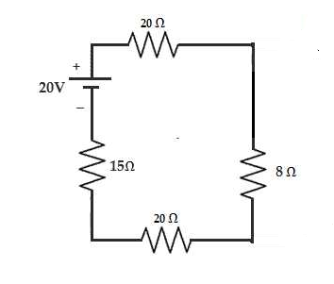
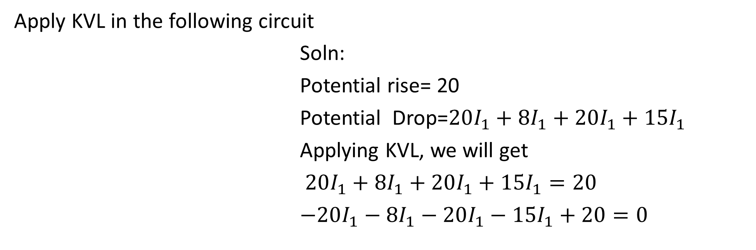
Exercise 1
Apply KVL in the following circuit
Soln:
Potential rise= 20
Potential Drop=$20I_{1}+8I_{1}+20I_{1}+15I_{1}$
Applying KVL, we will get
$20I_{1}+8I_{1}+20I_{1}+15I_{1}=20$
$−20I_{1}−8I_{1}−20I_{1}−15I_{1}+20=0$

Slide 16
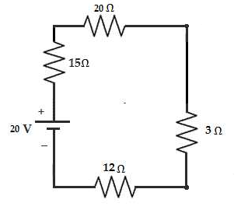
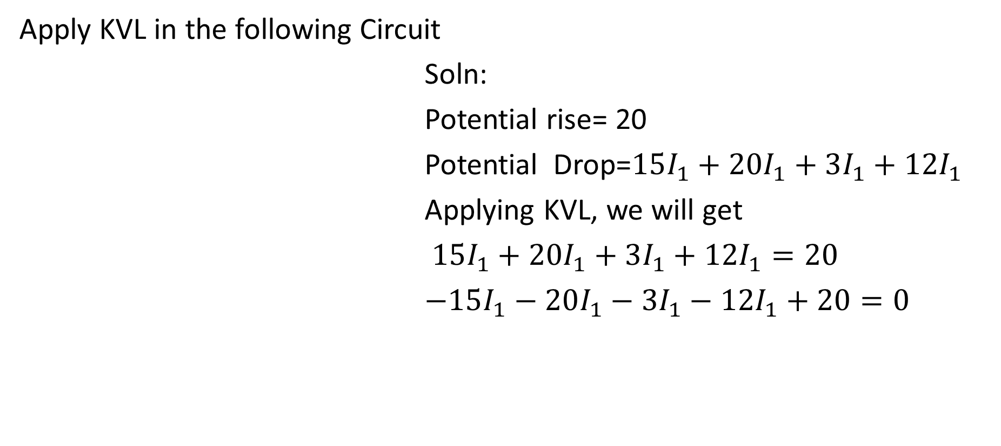
Exercise 2
Apply KVL in the following Circuit
Soln:
Potential rise= 20
Potential Drop=$15I_{1}+20I_{1}+3I_{1}+12I_{1}$
Applying KVL, we will get
$15I_{1}+20I_{1}+3I_{1}+12I_{1}=20$
$−15I_{1}−20I_{1}−3I_{1}−12I_{1}+20=0$

Slide 17
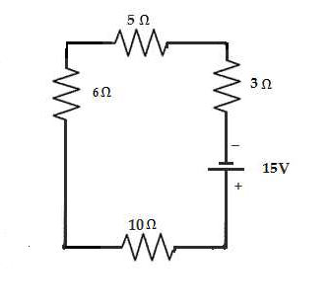
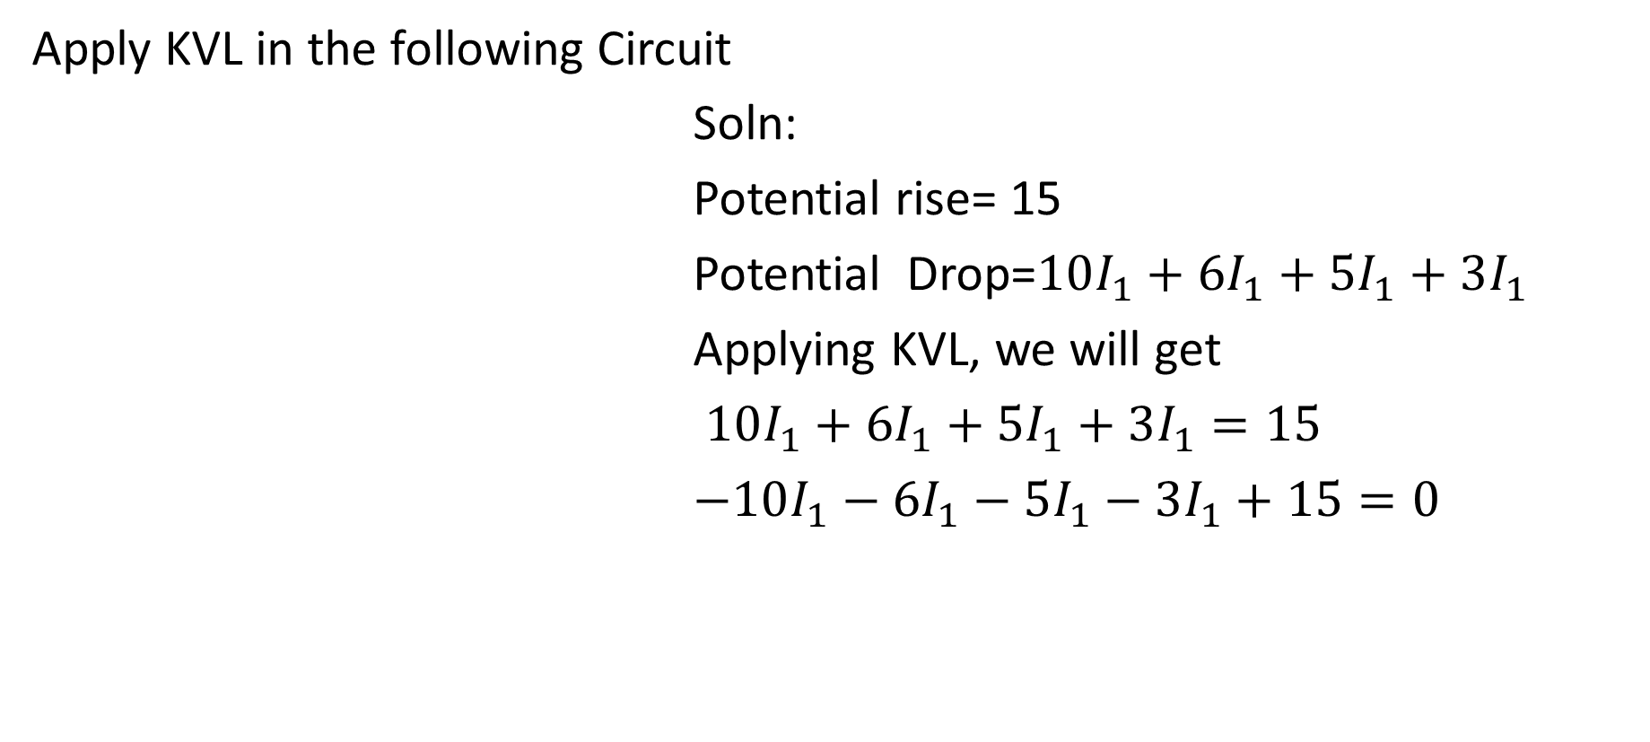
Exercise 3
Apply KVL in the following Circuit
Soln:
Potential rise= 15
Potential Drop=$10I_{1}+6I_{1}+5I_{1}+3I_{1}$
Applying KVL, we will get
$10I_{1}+6I_{1}+5I_{1}+3I_{1}=15$
$−10I_{1}−6I_{1}−5I_{1}−3I_{1}+15=0$

Slide 18
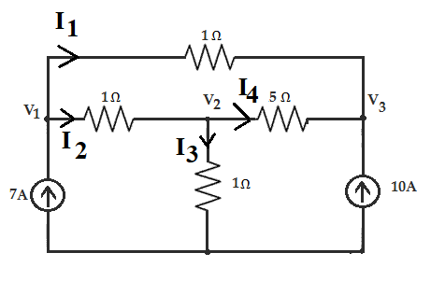
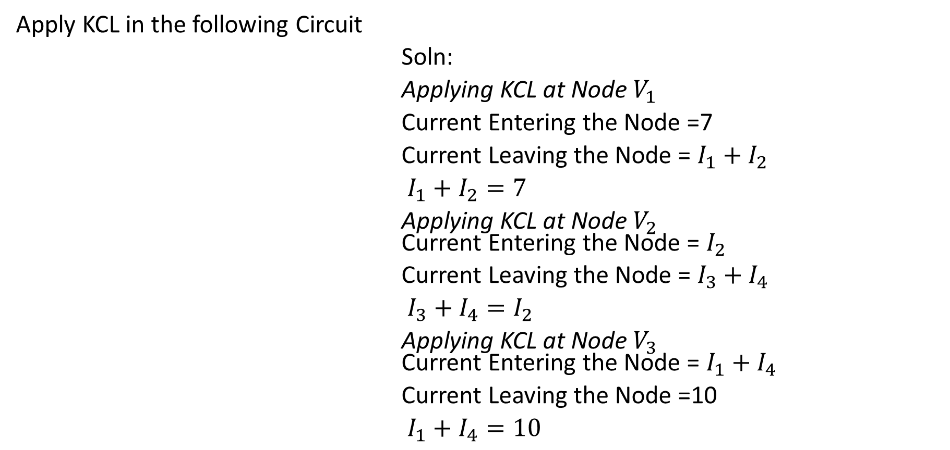
Exercise 4
Apply KCL in the following Circuit
Soln:
Applying KCL at Node $V_{1}$
Current Entering the Node =7
Current Leaving the Node = $I_{1}+I_{2}$
$I_{1}+I_{2}=7$
Applying KCL at Node $V_{2}$ Current Entering the Node = $I_{2}$
Current Leaving the Node = $I_{3}+I_{4}$
$I_{3}+I_{4}=I_{2}$
Applying KCL at Node $V_{3}$ Current Entering the Node = $I_{1}+I_{4}$
Current Leaving the Node =10
$I_{1}+I_{4}=10$

Slide 19

Thank You

