Slide 1
Lecturer: Rebecca Stewart
Module Code: Bmsw6101
Student Number:1913491
Emergent Leadership Skills…
By Eltaf Mockbil

Slide 2
Emergent leadership skills
Introduction
Leadership Styles
Importance of leadership skills
Different types of leadership styles
Reflection
Conclusion
*References*

Slide 3
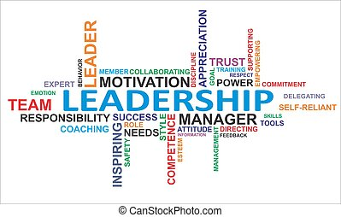
Introduction…
Leadership is a continuous method of altering behaviour. It can be viewed from a leader's connection with his followers. To produce the desired outcomes, the leader employs a specific leadership style to influence the behaviour of individuals or groups around him. The methods, characteristics, and conducts a leader uses to direct and motivates their teams are their leadership style. Their leadership style also influences how leaders build strategy, create an action plan, and react to changes while maintaining stakeholders' expectations and their group's well-being.

Slide 4

Leadership Styles…
There are numerous leadership styles from which to pick. Authoritarian (autocratic), participative (democratic), delegating (laissez-faire), transformational, transactional, and situational are some of the most widely addressed. Power structures and social change can be inspired by great leaders. They can also inspire others to succeed, develop, and innovate. Researchers have produced numerous theories and models that allow us to better identify and comprehend these distinct leadership styles; nevertheless, we will only focus on three primary forms in this talk. Autocratic, authoritarian, democratic, and laissez-faire.

Slide 5

Importance of leadership styles...
There are numerous reasons why leadership style matters and has a direct impact on your organization's bottom line. When it comes to leadership, the strategy you adopt is essential. Knowing your personality and learning how to adjust to changing situations will put you ahead of the competition. This will increase employee engagement and loyalty, improve communication and teamwork, and present you as a great manager and value to the organisation.

Slide 6
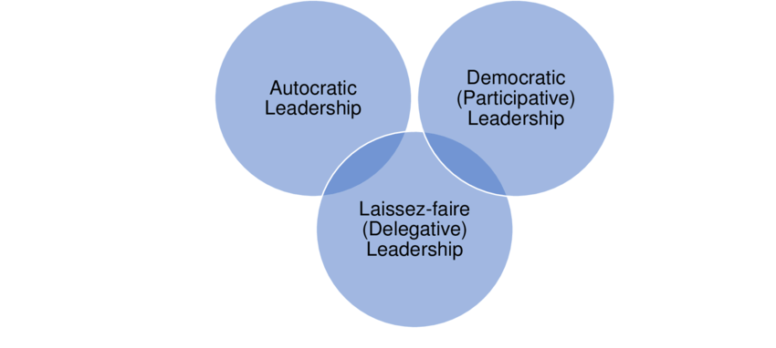
Different types of leadership…
In 1939, a research team led by Kurt Lewin set out to find diverse leadership styles. While subsequent research has revealed more distinct types of leadership, this early study was critical in distinguishing three main leadership styles. Students were separated into three groups in Lewin's study, each directed by an authoritarian, democratic, or laissez-faire leader. The students were then led in an arts and crafts project while researchers monitored their behaviour in response to the various leadership styles. The study discovered that democratic leadership successfully motivated most successful in motivating people to perform well.

Slide 7
Authoritarian Command (Autocratic) Authoritarian leaders, also known as autocratic leaders, define what must be done, when it must be done, and how it must be done. This leadership style emphasises both the leader's command and the followers' control. There is also a significant schism between the leader and the staff. Authoritarian leaders make decisions with little or no input from others. Researchers discovered that decision-making under authoritarian leadership was less innovative.
Leadership Through Participation (Democratic)According to Lewin's research, the most effective leadership style is participative leadership, often known as democratic leadership. Democratic leaders direct group members while simultaneously participating in the group and allowing other members to contribute. Democratic leaders encourage group members to participate while retaining final decision-making authority. Because they are participating in the process, members of the group are more driven and innovative. Democratic leaders make followers feel significant members of the team, which increases devotion to the group's goals.

Slide 8
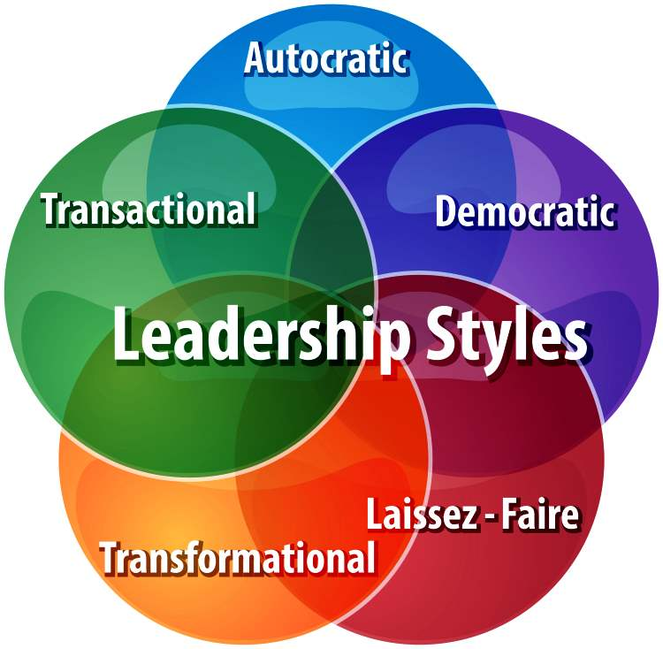
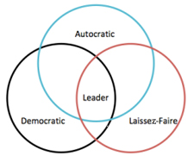
Delegation of Power (Laissez-Faire) Children subjected to delegated leadership, often known as laissez-faire leadership, were the least productive of the three groups, according to Lewin. The children in this group were also more demanding of the leader, showed little teamwork, and couldn't work alone. Delegative leaders give group members little or no guidance and delegate decision-making to them. While this strategy might be advantageous when dealing with highly skilled experts, it typically results in poorly defined duties and a lack of drive. Lewin noted that laissez-faire leadership resulted in disordered organisations whose members blamed each other for mistakes, failed to accept personal responsibility, made less progress, and did less work.

Slide 9

Reflection…
After thinking about the lecture, I realised that I identified as a Democratic leader. I arrived at this conclusion because I prefer a participative management style with Democratic leadership. While managing a group of employees, I advocate collaboration between management and workers because I believe there are multiple benefits to incorporating everyone in workplace decisions. I am a firm believer that decision-making impacts everyone, and that involving employees in decision-making can result in a more positive work environment if everyone feels participated. Democratic leadership, like all leadership styles, has benefits and drawbacks.

Slide 10

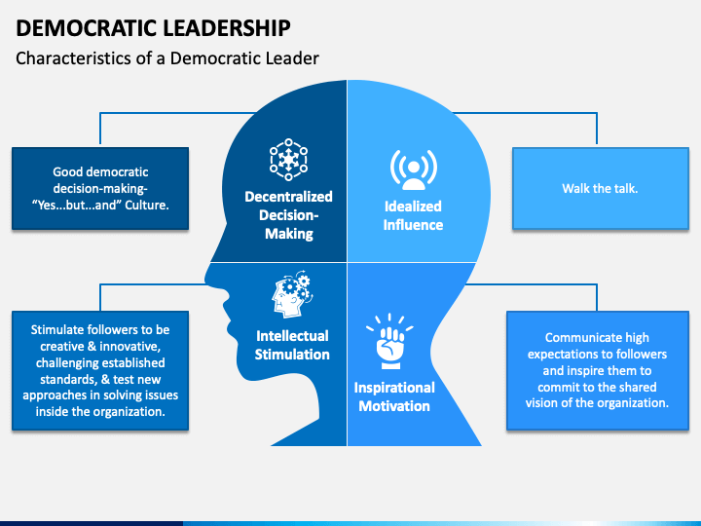
This form of leadership greatly motivates employees who feel empowered, allowing the individual to become better equipped for promotion, and I have discovered that being involved in decision-making encourages the employee to be more accepting of change in the environment. There are always drawbacks where there are advantages. For example, this model requires significantly more time and a strong leader to lead talks and manage personnel.
One of the most difficult challenges of democratic leadership is that leadership must come from the bottom. If the group's decision conflicts with management's decision, those individuals must be willing to accept the outcome. If they overturn the group's choice, the group will likely conclude that management is simply pretending to practise democratic leadership, and the organisation will suffer as a result.

Slide 11

In conclusion…
Leadership is defined as the process of guiding, teaching, motivating, and directing the activities of others in order to achieve a goal. Leadership frequently involves stepping into a position due to great abilities and skills and can be formal or informal within the business. It can be shown that numerous leadership styles exist, most of which are based on the premise that there are unique behaviours that have evolved into leadership styles. Each style has an unique purpose and goal, and its effectiveness varies depending on the situation, characteristics of the leader, and followers in which they operate. Based on the studies, each leadership style has advantages and disadvantages and can be used successfully depending on the situation.

Slide 12
Thank you

Slide 13
References
Hunt, J.G.J., 2004. What is leadership?.
Bolden, R., 2004. What is leadership?. Centre for Leadership Studies, University of Exeter.
Iqbal, N., Anwar, S. and Haider, N., 2015. Effect of leadership style on employee performance. Arabian journal of business and management review, 5(5), pp.1-6.
Gandolfi, F. and Stone, S., 2018. Leadership, leadership styles, and servant leadership. Journal of Management Research, 18(4), pp.261-269.
Gandolfi, F. and Stone, S., 2017. The emergence of leadership styles: A clarified categorization. Revista De Management Comparat International, 18(1), p.18.
Khan, M.S., Khan, I., Qureshi, Q.A., Ismail, H.M., Rauf, H., Latif, A. and Tahir, M., 2015. The styles of leadership: A critical review. Public Policy and Administration Research, 5(3), pp.87-92.
Wheeler, L., 2008. Kurt Lewin. Social and personality psychology compass, 2(4), pp.1638-1650.

Slide 14
Bhatti, N., Maitlo, G.M., Shaikh, N., Hashmi, M.A. and Shaikh, F.M., 2012. The impact of autocratic and democratic leadership style on job satisfaction. International business research, 5(2), p.192.
Goldman, E., 1998. The Significance of Leadership Style. Educational leadership, 55(7), pp.20-22.
Iqbal, N., Anwar, S. and Haider, N., 2015. Effect of leadership style on employee performance. Arabian journal of business and management review, 5(5), pp.1-6.

