Slide 1

BMHP6029
Psychopathological Classifications and Provisions Component
student name: Marie Louise Audrey Sombo Niamie
student number:2335747
Acknowledgement of the use of AI tools
I confirm that I have not used any AI tools in the research and creation of this assignment. I confirm that I have not presented any AI generated materials as my own work. I confirm I have copies of my drafts, notes, and other resources I used, which I may be asked to provide in evidence

Slide 2

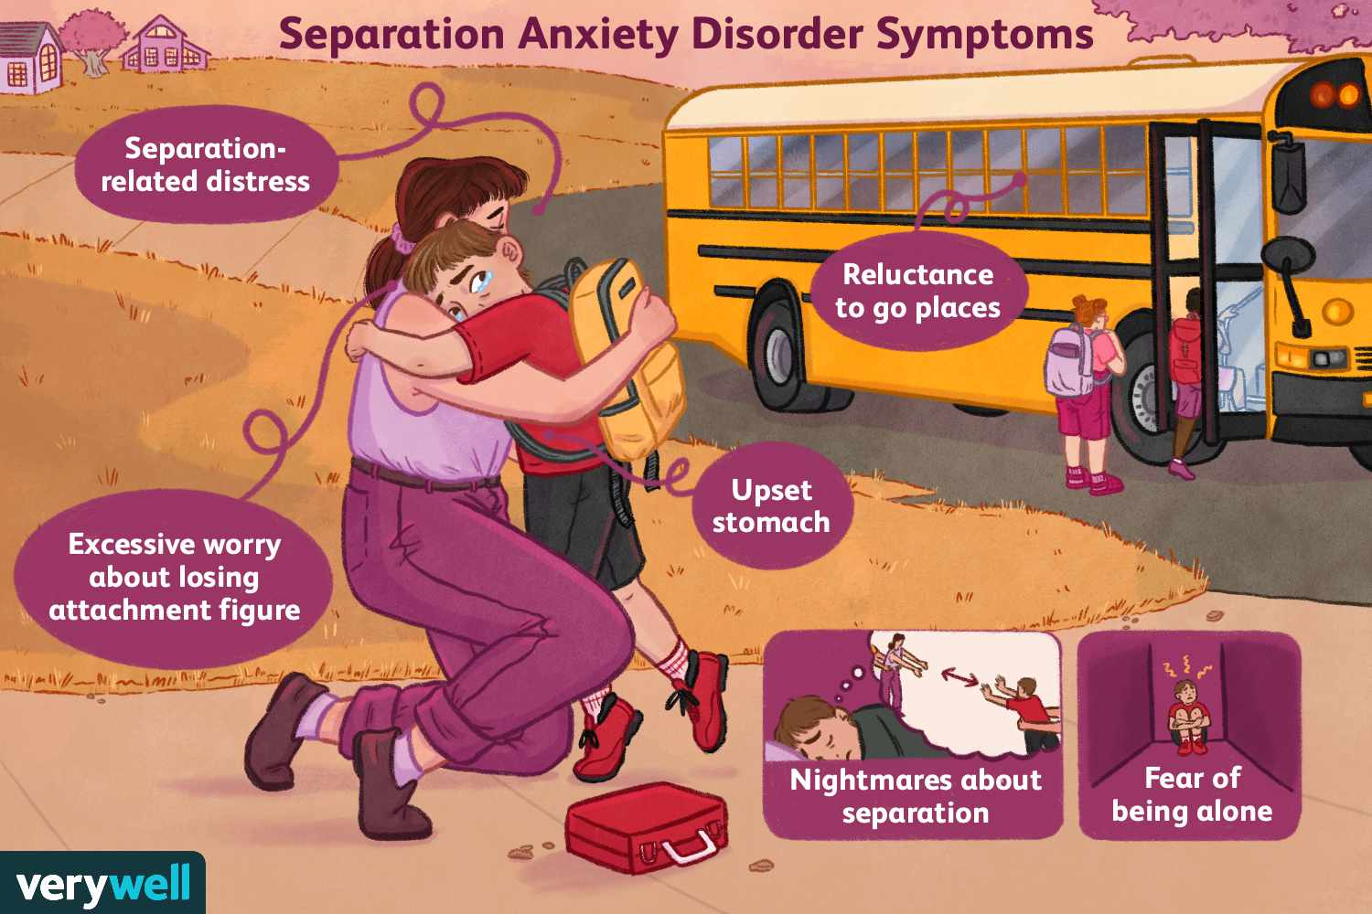
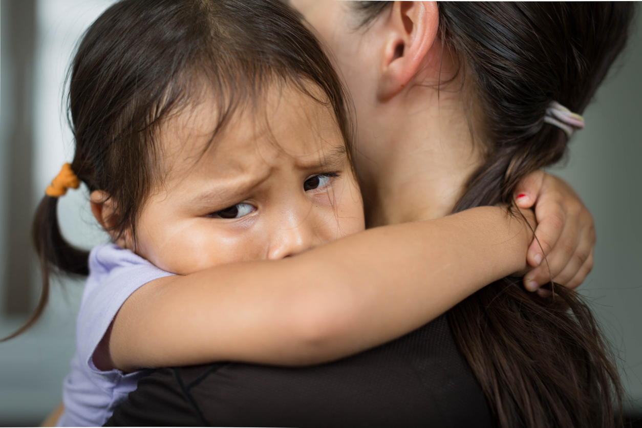
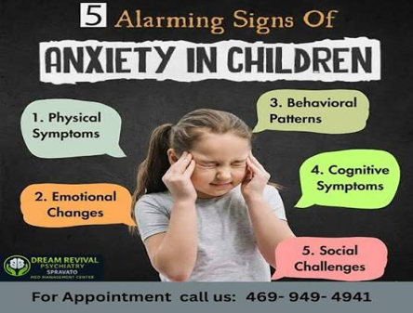
Anxiety or fear-related disorders. 6B05 Separation Anxiety Disorder (children)
The defining characteristic of separation anxiety disorder Separation anxiety disorder is defined by a severe and overwhelming fear of being separated from a specific attachment. (WHO,2019) (Dabkowska et al.,2011).
Introduction
Separation Anxiety Disorder (SAD) is common for children to experience anxiety or worry at times, such as when they are moving to a new place or starting school or nursery. Also, SAD is considered as one of the mental health challenges (Thomas,2025; NHS,2025).
Treatment of SAD in a Child
The course of treatment will be determined by the child's age, general health, and symptoms. The use of
Cognitive behavioural therapy.
Medication Family therapy.
Parents rolls are essential to any type of treatment.
School input.
Care be provided by a child's school (Dickson et al.,2022).
Nationwide Children (2021) (Dof,2023)
Diagnosis
Doctors carry out physical examination to rule out physical problem that might be causing the symptoms. If there are none the child psychiatrist or mental health professional is required to complete the SAD diagnose. It will be followed with mental health assessment on the child ( Nhs,2025; Dickson et al.,2022).
Changing medical professional views and treatment
SAD has been acknowledged as a separate anxiety disorder since the DSM-III was published in 1980. Medical experts now recognise that it is caused by environmental, psychological, and biological causes. (Rapee et al.,2023).
(DoE,2023).
Recommendation
Proper diagnosis not assumption. Effort should be made in managing the issue based on the child's needs. Professionals are to explore different treatment theories. Application of somatic coping skills. Parent-Child Interaction Therapy (PCIT) supports building a secured attachment. Academic and school-based strategies: (RCHF, 2023).
Conclusion
Separation Anxiety Disorder (SAD) is viewed as a difficult and complicated childhood anxiety disorder that demands timely detection and evidence-based intervention in a measure to prevent long-term psychological, social, and learning consequences.
Causes
Biological and environmental factors contribute to SAD.
Anxiety may run in the family. Change in environment.
Encountering stressful situation.
Insecure attachment.
Trauma Imbalance of two chemicals in the brain (norepinephrine and serotonin) encourage such health challenge (etc) (Education gateshead,2023; nhs,2025).
Symptoms in Children
Refuse sleeping alone. Nightmares that reoccurrence.
Overwhelming concern for a family member's safety.
Crying at night
Trouble in focusing to task.
Eating poorly.
Angrier and more Irritable quickly.
Unwilling to attend school.
Becoming angry or irritable quickly.
Tantrums (NHS,2025; Educationgateshead,2023).
Champaigne-Klassen, (2024).
Separation anxiety disorder affects between 1% to 6% of children below the age of 13, based on national epidemiological statistics and longitudinal cohorts mapped across England. Anxiety disorders are estimated to impact 5% to 10% of children. (NHS,2019).
Some argued that” Separation anxiety disorder is the most common anxiety condition in children under the age of twelve, affecting 4% of children and 1.6% of adolescents” (Beesdo et al.,2019; RCPCH,2025)
References
Beesdo, K., Knappe, S. and Pine, D.S. (2022). Anxiety and anxiety disorders in children and adolescents: developmental issues and implications for DSM-V. The Psychiatric Clinics of North America, 32(3), p.483.
Champaigne-Klassen, E. (2024). The DREAM program: developing resilience through emotions, attitudes, & meaning–a community-based program to enhance child mental health for gifted children and their families.
Dabkowska, M., Araszkiewicz, A., Dabkowska, A. and Wilkosc, M. (2011). Separation anxiety in children and adolescents. In Different views of anxiety disorders. IntechOpen.
Department of Education (2023). Mental health for early years children. https://help-for-early-years-providers.education.gov.uk/health-and-wellbeing/mental-health-for-early-years-children. Accessed on 20/07/2026.
Dickson, S. J., Kuhnert, R.-L., Lavell, C. H., & Rapee, R. M. (2022). Impact of psychotherapy for children and adolescents with anxiety disorders on global and domain-specific functioning: A systematic review and meta-analysis. Clinical Child and Family Psychology Review, 25(4), 720–736. https://doi.org/10.1007/s10567-022-0040.
Education gateshead (2023) Supporting Primary Children with Separation Anxiety Disorder in School. Available on https://educationgateshead.org/wp-content/uploads/2020/06/2991f-JH-Supporting-Separation-Anxiety-Disorder-1.pdf Accessed on 21/07/2026.
John Bowlby. (1969). Attachment and Loss: Vol. 1. Attachment. Basic Books.
National Health Service (2025). Separation anxiety. Available https://www.nhs.uk/baby/babys-development/behaviour/separation-anxiety/. Accessed on 19/07/2026.
Nationwide Children (2021).Separation Anxiety Disorder in Children.Avaible on https://www.nationwidechildrens.org/conditions/health-library/separation-anxiety-disorder-in-children. Accessed on 20/07/2026.
Rapee, R.M., Creswell, C., Kendall, P.C., Pine, D.S. and Waters, A.M. (2023). Anxiety disorders in children and adolescents: A summary and overview of the literature. Behaviour research and therapy, 168, p.104376.

