Slide 1

Case Study – Family C
Gzala Saddique 1808935
Iram Shezadi 1807072
Samina Jhangeer 1810228
Nazmin Kauser 1710502
Tahira Jabeen 1715952

Slide 2
introduction
There was a mother who had four children living with her
She also had two independent adults, who lived away from home
The children were aged between three and seventeen who lived with her
The mother was suffering from mental health issues

Slide 3

How vulnerable was the family?

Slide 4
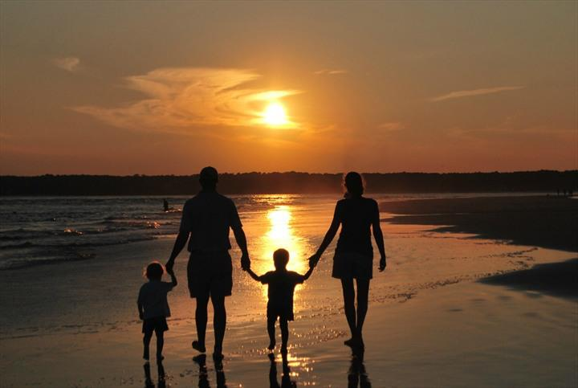
What problems this family dealt with in comparison to the average family

Slide 5
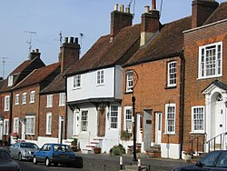
What circumstances they were living in

Slide 6

What were the risk factors?

Slide 7

When did health and social care agencies find concerns in the family?

Slide 8

What actions did the agencies take and what policies did they follow?

Slide 9
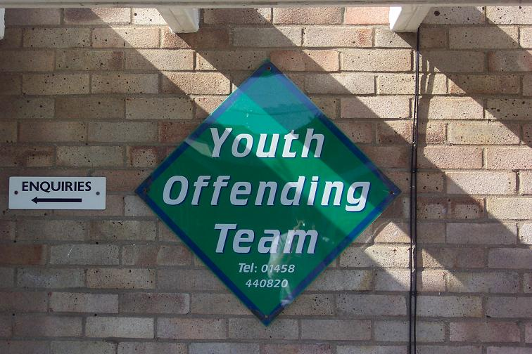
What could the agencies have done differently?

Slide 10

What we think could have been done differently and why:
This Photo by Unknown Author is licensed under CC BY

Slide 11



CONCLUSION

Slide 12
Income, house, kids, hours’ sleep per night: What does the average UK family look like? (online - accessed on 05/03/2020) available at:
https://www.madeformums.com/news/income-house-kids-hours-sleep-per-night-what-does-the-average-uk-family-look-like/
Living circumstances of children and adults with mental retardation or developmental disabilities in the United States, Canada, England and Wales, and Australia. (online - accessed on 04/03/2020) available at:
https://www.ncbi.nlm.nih.gov/pubmed/11389566
Professionals: helping families with vulnerabilities (online - accessed on 05/03/2020) available at:
https://raisingchildren.net.au/for-professionals/working-with-parents/families-with-vulnerabilities/families-with-vulnerabilities
Writing safeguarding policies and procedures (online – accessed on 03/03/2020 available at:
https://learning.nspcc.org.uk/safeguarding-child-protection/writing-a-safeguarding-policy-statement/

