Slide 1

AS3 Source Evaluation
Student Number: 2533886
Masum Chowdhury

Slide 2
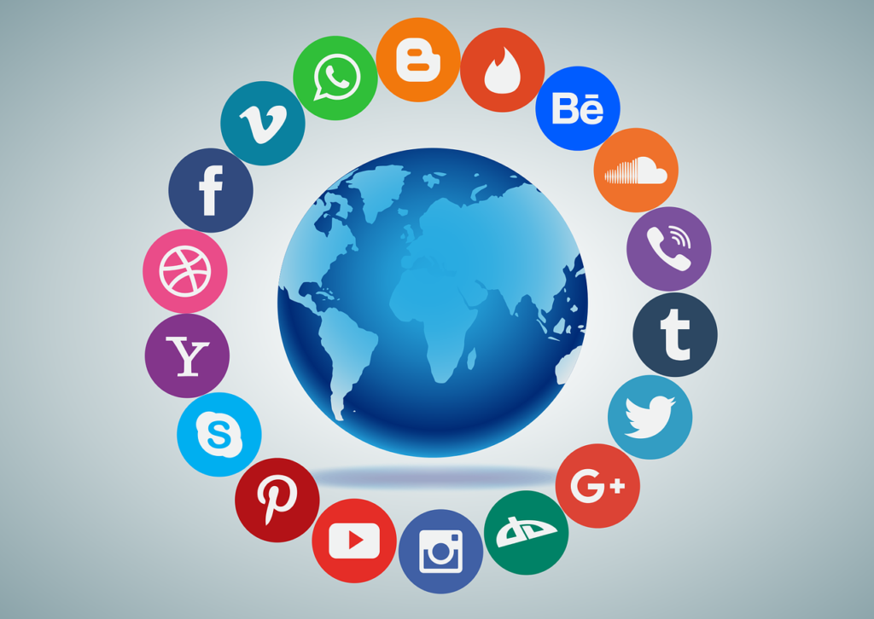
Chosen Topic
"The use of social media to promote businesses"

Slide 3
Title of the Source
'The Power of Social Media in Modern Marketing'

Slide 4

Title of Source: Levaraging Capabilites of Social Media Marketing for Business Success
Authors: Sadiane Laradi, Amina Elfekair, Mahmoad Alrawad, Mujtaba Hashim and Faten Derouez
Year Published: December 2024

Slide 5
Quote
How Did You Find This Source?
Google Search

Slide 6
Why did I choose this source?
Credibility : This source is credible because it is published in a peer-reviewed academic journal (Computers in Human Behavior Reports) by Elsevier and written by university-affiliated researchers in Saudi Arabia using many citations and different sources to back up their statement.
Relevance: The article is highly relevant because it directly studies how social media marketing capabilities affect business performance and brand equity therefore being directly relevant.
Usefulness: This source is useful because it provides real data, research findings, and evidence showing that social media positively influences businesses. This further adds onto the credibility of the article.

Slide 7
Why did I choose this source?
Is it an academic source? Yes, it is an academic source because it is a scholarly journal article using research methods, data analysis, and citations as well as there being multiple academics who wrote the article adding onto the credibilty.
When was it published & is it recent enough?
It was published in 2024, which makes it very recent and suitable for current research as the age of social media was still at its height 2 years ago.
Who are the authors & their credibility?
As mentioned, the authors (Sofiane Laradi, Amina Elfekair, Mahmaod Alrawad, Mujtaba Hashim, and Faten Derouez) are academics from multiple universities in Algeria, Jordan, Saudi Arabia, and Sudan, which supports their credibility as researchers.

Slide 8
Reviews, citations & overall credibility of the article
The article is credible because it is peer-reviewed, includes many academic references, uses established theories (like Resource-Based View), and statistical analysis to support its findings. This finding are measures not just in the Western World but across the entire world
What is this article about (briefly)?
This article investigates how social media marketing capabilities (like posting, interaction, and monitoring) influence brand equity and overall business performance which in turn raises the business profits. The article also highlights the power and importance that social media such as YouTube and Instagram has and the reliability that business have over this.

Slide 9
Conclusion
Overall, I found this task useful because it helped me understand how to evaluate a source properly.
What I found difficult was deciding which information was most important and explaining why the source was credible.
What I learned was how to check a source’s credibility, relevance, and usefulness, and why using reliable academic sources is important. However this was difficult to navigate at first due to the fact that there was complex language being used as a result of this.

Slide 10
References
Laradi, S., Elfekair, A., Alrawad, M., Hashim, M. and Derouez, F. (2024) Leveraging capabilities of social media marketing for business success. Computers in Human Behavior Reports, 16, Article 100524.

