Slide 1

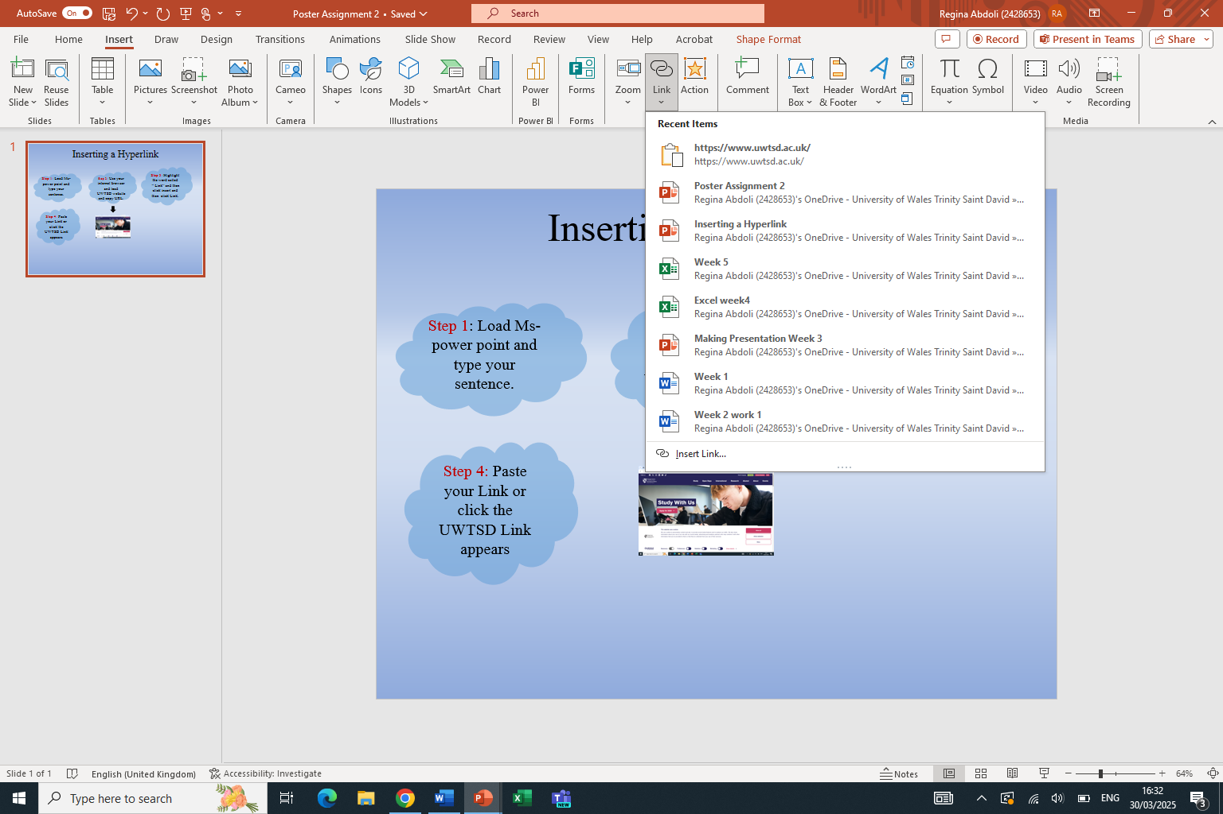
Inserting a Hyperlink
Step 3: Highlight the word called
“ Link” and then click insert and then click Link.
Step 1: Load Ms-power point and type your sentence.
Step 2: Use your internet browser and load UWTSD website and copy URL.
Step 4: Paste your Link or click the UWTSD Link appears
c
Regina Abdoli
ID No 2428653

