Slide 1
Component 2
2319062
Latimah Shoukat
Robert Nartowski
BMHP5023
Component 2: presentation
(Powerpoint with voice password

Slide 2
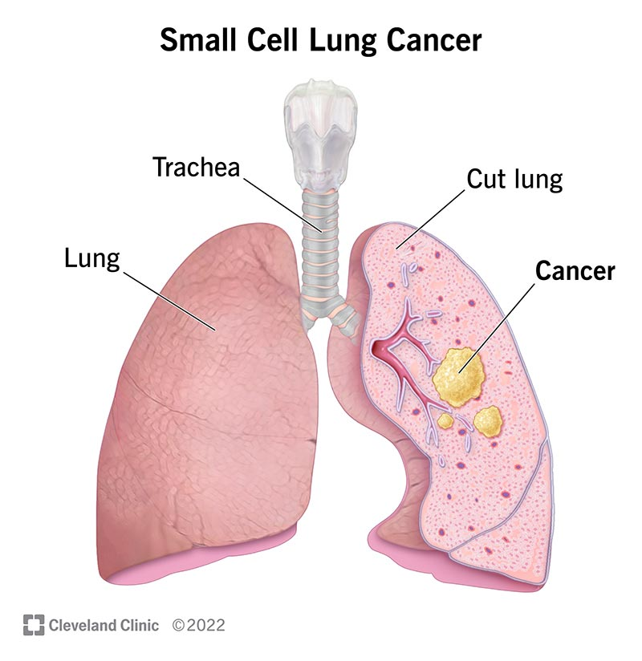

Small cell Lung cancer
Small cell carcinoma (also known as oat cell cancer) is a kind of lung cancer that can enlarge and disseminate rapidly, often resulting in the cancer spreading to other parts of the body early in the disease process. This is the increasingly common kind of small lung cancer.
Combined "oat cell" carcinoma is a unqiue form of lung cancer that has features of small cell lung cancer and non-small cell lung cancer in the same neoplasm.
Small-cell lung cancer is a lethal cancer linked with passive smoking that has neuroendocrine (NE) cellular attributes and is pathologically, biologically, molecularly and clinically very diverse from other lung cancers. (Gazdar 2017)

Slide 3
Medical intervention for small cell lung cancer
Treatment of advanced stage small cell lung cancer may involve:
Immunotherapy (atezolizumab or durvalumab)
Polychemotherapy
Radiation therapy to the brain, bone, spine or other parts of the body where the cancer has developed, as palliative therapy to ease symptoms and enhance standard of living.
Radiation therapy to the chest if the cancer reacted to chemotherapy.
Radiation therapy to the brain following a full reaction to chemotherapy, to avoid the expansion of cancer to the brain.

Slide 4
The respiratory system- Anatomy and Physiology
Anatomy of the respiratory system :
Upper respiratory tract: involves the nasal cavity, nose, paranasal sinuses and pharynx, which , moisten, warm and filter approaching air.
Lower respiratory tract: contains the lungs, trachea (windpipe), bronchial tree and larynx (voice box).
Trachea and Bronchi: The trachea divides into the right and left main bronchus, which further separate into tiny bronchioles, creating the "conducting airways".
Lung & alveoli: the lungs are situated in the chest cavity, with the right lung having three lobes and the left having two. The bronchioles eliminate in alveoli, which is encircled by capillaries where external respiration happens.
Muscles of respiration: the diaphragm is the main muscle, facilitated by external intercostal muscles throughout inspiration.
• physiology of respiratory system:
•Ventilation (breathing): inspiration is an active process where the diaphragm and intercostals contract, enhancing thoracic capacity and reducing pressure, causing air to rush. Expiration is generally passive, depending on the elastic recoil of the lungs.
•Gas exchange (Respiration): oxygen is inspired and travels to the alveoli, where it spreads into the alveolar capillaries. Carbon dioxide spreads from the blood into the alveoli to be respired.
Functionality: alongside gas exchange, the system also assists in olfaction (smell), vocalization (larynx) and depending against bacteria (mucus/cilia).

Slide 5
How the functioning of the Respiratory System is affected by small cell lung cancer
Small cell lung cancer (SCLC) seriously damages the respiratory system by causing quick tumour growth in the central airways, resulting in obstruction, wheezing and persistent coughing. It leads to serious breathlessness (dyspnea) through buildup of fluid around the lungs (pleural effusion), decreased lung volume and reduced oxygen supply in the blood.
Blocked airways: lung tumours can develop into or press against the airway, shrinking the passage and making it hard to get sufficient oxygen in and out of the body.
Fluid buildup: in some service users with lung cancer, lung cancer cells invades the room between the lungs and the thoracic wall, named the pleural space. This condition, named pleural effusion, leads to fluid buildup around the lungs, making it more difficult for the lung to expand fully and take in sufficient oxygen.
•Low levels of oxygen in the blood: lung cancer can reduce red blood cells, which are dependable for supplying oxygen from the lungs up to the heart and the rest of the body.
•Structural damage and infection: SCLS can trigger chronic coughing (often with blood), recurring infections such as pneumonia or bronchitis and in progressive cases, severe chest pain.
•Respiratory muscle weakness: cachexia (muscle wasting) linked with cancer can weaken the muscles required for ventilation.
Obstruction of breathing mechanics: Along with internal obstructions, tumours can cause superior vena caval compression or shrink the airway from the outside.

Slide 6
Care plan for chloe
Name: chloe
Age: 65 years old
Diagnosis: small cell lung cancer (extensive stage)
Living situation: lives in a residential care home
Primary needs: breathing difficulty, fatigue, psychological support, pain control and support with daily activities.

Slide 7
Care plan-physical needs
Breathing and respiratory support :
Care interventions:-
Encourage chloe to sit in an upright or supported position to improve breathing.
Assure frequent rest periods to control chloe's fatigue.
Supply oxygen therapy.
Observe chloe's breathing rate and report any intensifying symptoms to the medical team.
Nutrition and hydration:
Care intervention:
Supply small, frequent, nourishing meals instead of large meals.
Encourage consumption of high- protein foods to sustain strength.
Assist chloe with eating as her fatigue makes it hard.
Track food consumption and hydration levels.
Mobility and safety:
Care interventions-
Assist chloe with walking and transferring when required.
Supply chloe with a walking frame as required.
Ensure the care home environment is secure and nonhazardous.
Encourage moderate movement where attainable to sustain her mobility.

Slide 8
Care plan
Personal care and hygiene
Care interventions:
Help with bathing, dressing and grooming while fostering autonomy.
Sustain good skin care to avoid irritation or pressure ulcers.
Assure privacy and dignity during personal care duties.
Pain and symptom management
Care interventions-
Supply medication as advised by healthcare professionals.
Observe pain levels utilizing a pain assessment scale.
Record and report any symptom fluctuations.

Slide 9
Care plan
Emotional and psychological support
Person-centred care and communication
Care interventions-
Supply opportunities for chloe to communicate her feelings and worries.
Encourage frequent contact with her family and friends.
Refer her to counselling for her depression and anxiety.
Care interventions-
Include chloe in decision-making about her care.
Respect her cultural, spiritual preferences.
Sustain confidentiality and professional limits.

Slide 10
Risk factors for small cell lung cancer
Exposure to radiation from cancer treatments or imaging scans.
Exposure to radon gas. Radon is a colorless dangerous gas that may excrete into homes and other buildings.
Exposure to workplace dangers such as nickel, tar, arsenic, asbestos or toxic chemicals.
Having a family history of lung cancer.
Having human immunodeficiency virus (HIV).
The primary risk for developing small cell lung cancer is smoking tobacco. The more you smoke and the younger you were when you started smoking, the higher your risk for small cell lung cancer.
Passive smoking: frequent, long-term exposure to tobacco from individuals.
Air pollution: long-term exposure to extreme pollution.
In chloe's case the main risk factor that led to her developing small cell lung cancer was smoking from a young age. Years of smoking affected her lungs and caused her to develop the disease which progressed as time went on.

Slide 11
Evidence based-recommendations
Sleep | Cognitve behavioural therapy for insomnia. sustaining a persistent bed time and rise time. Creating a dark, quiet environment.
Diet | Increased protein consumption (1.2-1.5g/kg/day) to combat muscle wasting. supply small meals (5-6 meal) everyday instead of three large ones to combat poor appetite and fatigue. Assure sufficient fluid intake to manage possible treatment-related complications.
Exercise | Tailored exercise-encourage frequent aerobic and resistance exercises, like walking or seated exercises to enhance fatigue, muscle strength and self-reliance Pulmonary rehabilitation-consider exercises for better respiration management.
Pharmaceutical interventions | The best treatment option for chloe is chemotherapy along immunotherapy. Supplying low dose opioids for her breathlessness. Proactive assessment and pharmacological treatment, like SSRIs are recommended for her depression. Pain- regular, scheduled analgesic regimens (e.g. opioid ladder) instead of just "as needed" for persistent control.

Slide 12
Ethical considerations
Ethical considerations for an elderly individual with small cell lung cancer (SCLC) in a residential care home concentrate on balancing top quality, person-centred care with the reality of an end-stage, acutely symptomatic disease. Important ethical challenges include respecting autonomy during potential cognitive impairment, balancing treatment advantages with severe toxicity and assuring dignity in care.
In chloe's case, important ethical considerations that should be acknowledged within the residential care home following NICE guidelines include, ensuring that she is involved in discussions about her care and allow her to make informed decisions. Due to her aggressive disease it's important to make early conventions about prognosis and treatment options such as palliative chemotherapy vs best supportive care and considering her preferred place of care is essential. Another ethical consideration for chloe is ensuring she has access to a lung cancer clinical nurse specialist to support her communication with healthcare services. Her information should be shared sensitively between the residential care home, clinical nurse specialists, GPs and families to ensure seamless care. Lastly, early identification of the need for palliative care for chloe is vital. This involves recording advance choices, such as Do Not Attempt Cardiopulmonary recuscitation (DNACPR) orders, to prevent inappropriate, futile interventions and assure a dignified death, potentially in the residential care home.

Slide 13
Conclusion
Overall, small cell lung cancer is a serious disease that requires professional care to help service users like chloe overcome their challenges and help them manage their symptoms. Extensive-stage small cell lung cancer is an aggressive-fast growing malignancy that has diffused past one lung, often including the other lung, distant organs or causing fluid around the heart/lungs. It portrays roughly 70% of SCLC occurrences at diagnosis, with treatment mainly concentrating on systemic chemotherapy along with immunotherapy to extend survival and manage symptoms, instead of cure.
Care planning for small cell lung cancer (SCLC) service users is crucial due to the disease’s aggressive nature, rapid dissemination and high symptom burden which often needs immediate, multidisciplinary and palliative intervention. Because SCLC is often diagnosed at an advanced stage with a negative prognosis, complete care planning-involving early palliative care and advanced care planning- is crucial to enhancing quality of life, controlling complex symptoms and adjusting care with patient wishes.

Slide 14
References
NIH (2025), Small cell lung cancer treatment (PDQ) -patient version, Available at: https://www.cancer.gov/types/lung/patient/small-cell-lung-treatment-pdq#:~:text=cancer%20is%20increased-,Signs%20and%20symptoms%20of%20small%20cell%20lung%20cancer%20include%20coughing,and%20veins%20in%20the%20neck. (Accessed: 22 March 2026)
Cleveland Clinic (2022), Small cell lung cancer, Available at: https://my.clevelandclinic.org/health/diseases/6202-small-cell-lung-cancer. (Accessed: 22 March 2026)
Yale medicine (2026), Small cell lung cancer, Available at: https://www.yalemedicine.org/conditions/small-cell-lung-cancer. (Accessed 22 March 2026)
Nature reviews cancer (2017), Small cell lung cancer: what we know, what we need to know and the path forward, Available at: https://www.nature.com/articles/nrc.2017.87. (Accessed 22 March 2026)
Johns Hopkins medicine (2026), Manage shortness of breath with lung cancer, Available at: https://www.hopkinsmedicine.org/health/conditions-and-diseases/lung-cancer/manage-shortness-of-breath-with-lung-cancer#:~:text=What%20causes%20shortness%20of%20breath,the%20rest%20of%20the%20body. (Accessed 22 March 2026)
Cancer research UK (2026), Limited and extensive stage (small cell lung cancer), Available at: https://www.cancerresearchuk.org/about-cancer/lung-cancer/stages-types/limited-extensive. (Accessed 22 March 2026)
Osmosis from Elsevier (2018) Anatomy and Physiology of the respiratory system (online). Youtube. Available at: https://www.youtube.com/watch?v=0fVoz4V75_E. (Accessed 22 March)

