Slide 1
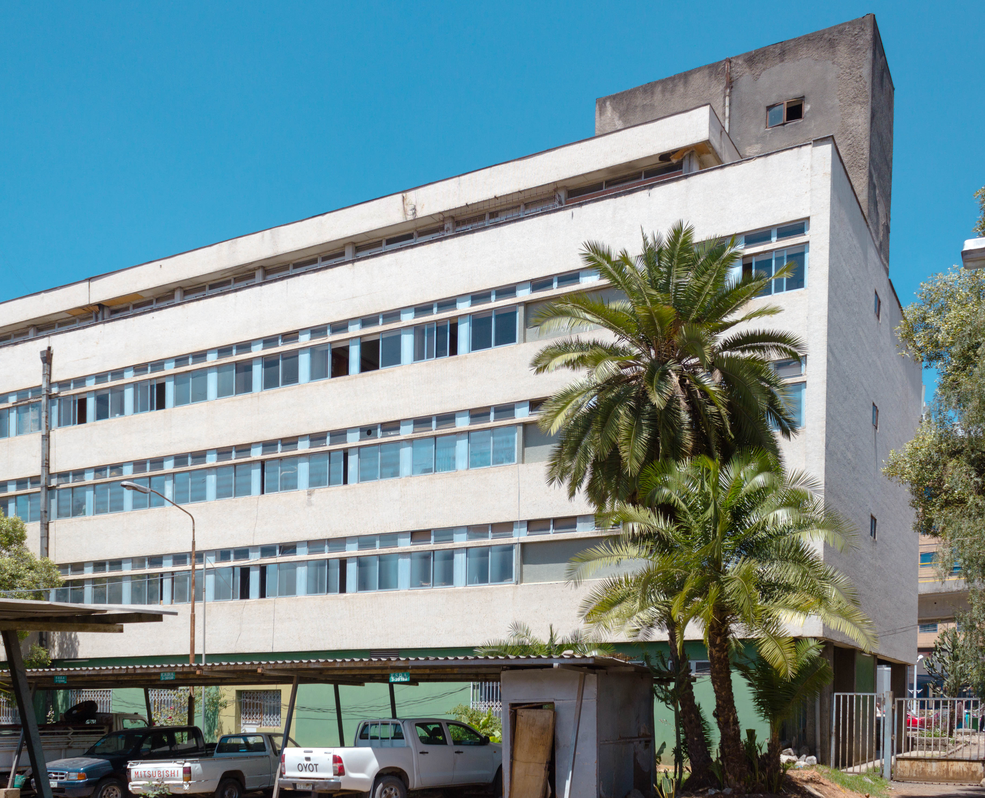

Name:(Group 3)Kwabena, Addis and Maide student's number: (2027768), (2028001) and (2026745)
Module: BMSW 4002
Lecturer: Jonathan Wyatt
This Photo by Unknown author is licensed under CC BY-SA.

Slide 2

Introduction
This presentation is produced by the group 3 team led by Kwabena, Addis and Maide to be used as a training and development tool for new employees in Rainbow children Hospital to support families throughout their treatment. The task is focused on what communication is all about, the definition of communication as well as the function of communication. The effectiveness, model, channel, barriers and impact of communication have all been covered by the subsequent slides to be able to understand diverse ways of communication.

Slide 3
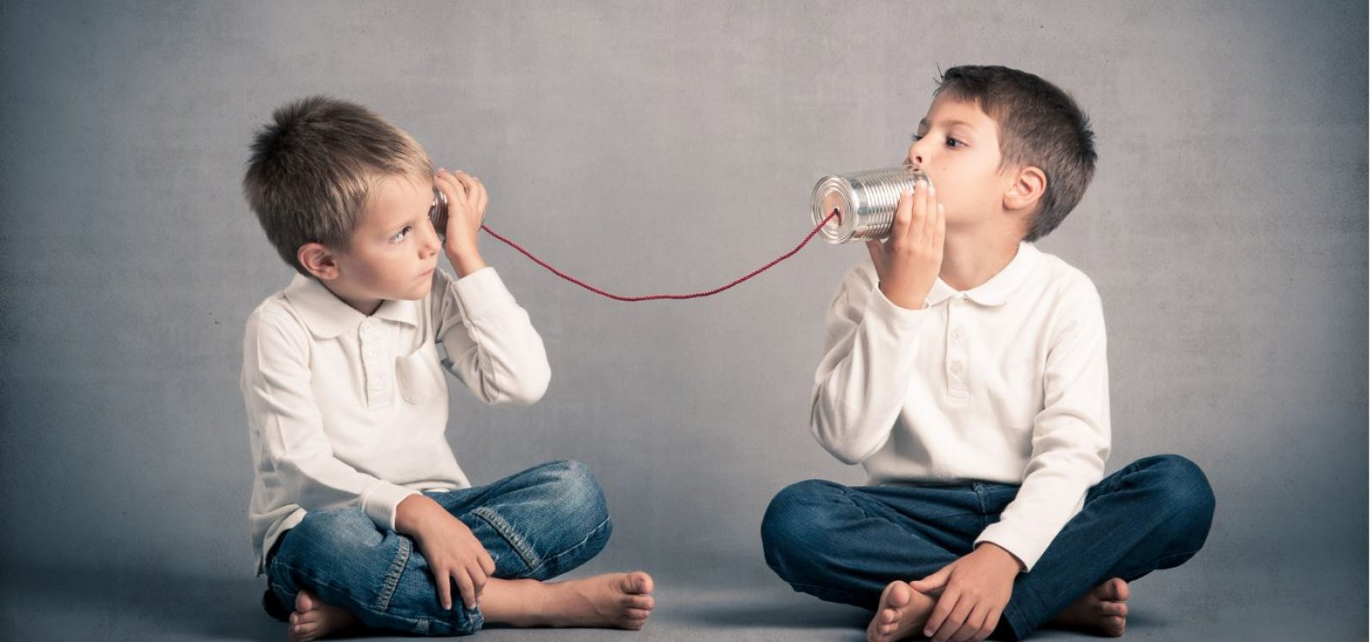
Before we look at functions of communication, what is communication?
Communication is the meaningful exchange of information between two or a group of people.
There are four main functions of communication
Basically, our functions of communication is to:
1- motivate workers of Rainbow hospital to give out their best
2- inform workers and management of any new information
3- control the dos and don'ts of our staff members
4- finally to monitor the emotional expressions of our employees.
MOOC ICS, (2013).
This Photo by Unknown author is licensed under CC BY-NC-ND.

Slide 4
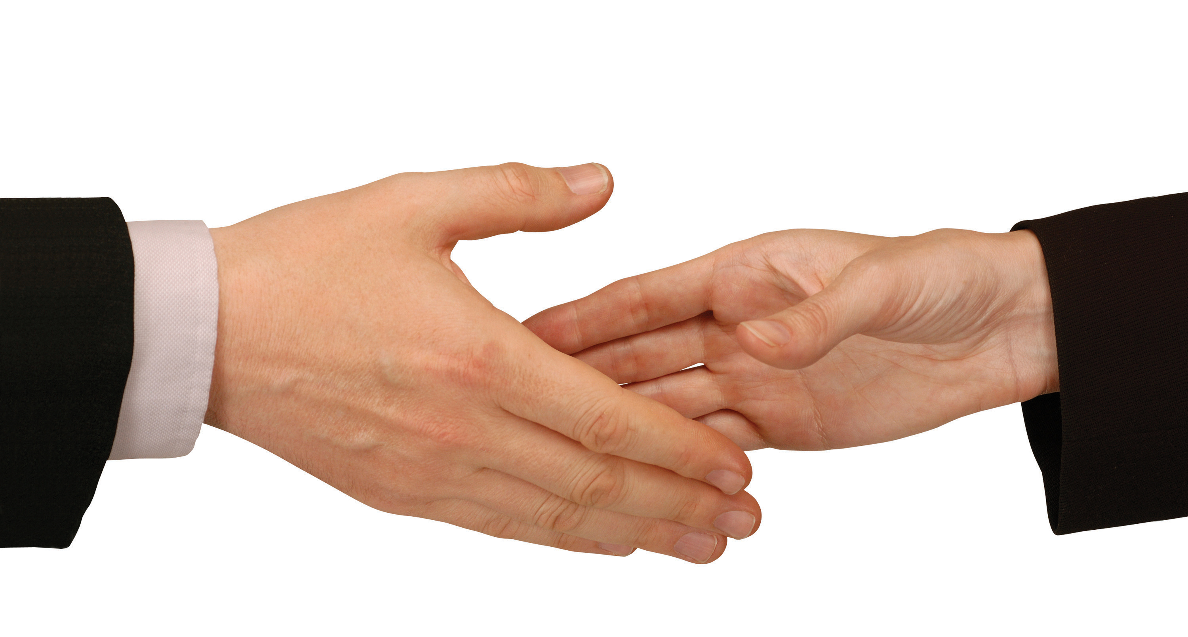
Theories linking to models of communication
Communication model simply means the stages in which communication takes place. There are three main communication models namely, Shannon and Weaver model, Berlo’s model of communication and Schramm’s interactive model. Generally, all the models aim at the:
Sender-message-medium-receiver-feedback
Focusing on Berlo’s Model, there are four components as factors that describe this process. They are sender, message, channel, and receiver.
Sender
The sender which is the source focuses on Communication skills of a person, attitude of the sender, Knowledge on the subject matter, social factors affecting the sender and
cultural differences with the message.
Message
The message factor includes the content of the message, elements of the message such as gestures, signs, and language. Treatment is the way the message is conveyed to the receiver; the structure of the message and the code represent the form in which the message is sent.
Channel
The channel receives the message through hearing, perceive through seeing,
the non-verbal communication through touching and holding, collecting information from smelling and taste also provides the information to be sent as a message.
Receiver
The receiver represents the ability to speak, write, read, and listen, attitudes towards the audience, subject and oneself, knowledge about the subject that will be communicated
Social values, beliefs, and culture where communication takes place, cultural differences make messages different.
Velentzas and Broni, (2014).

Slide 5
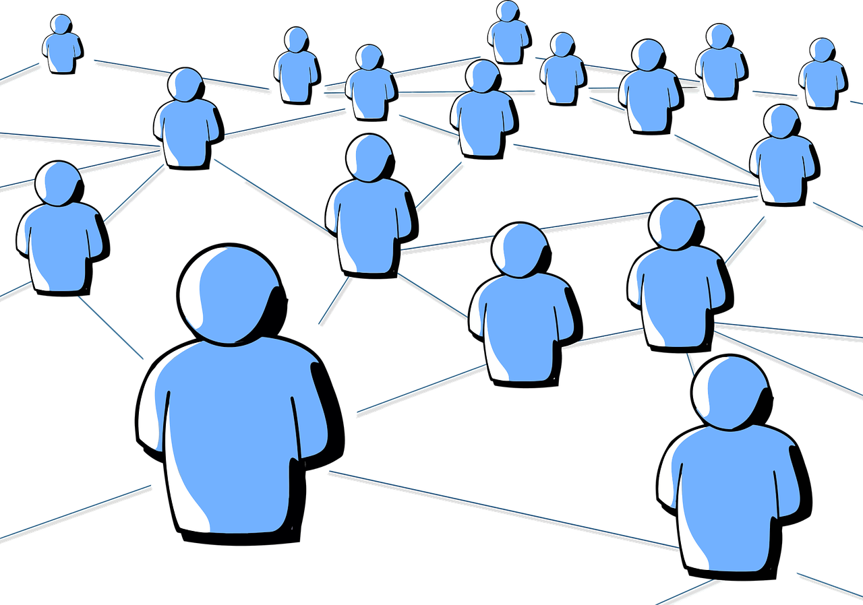
Channels of communication
There are several channels to communicate which have been categorized into low richness and high richness.
Low richness channel
It has to do with impersonal interactive such as email, text messages, social media, letters, newsletters, updates, and reports. It is difficult to get quick feedback if the receiver is not available immediately.
High richness channel
This includes physical presence such as face to face or one to one meeting, events, personal interactive such as phone video conferencing calls, webinars, and some social media. High richness channel gives you instant or immediate feedback. E.g., how are you? I am fine immediately or instantly.
Some communications have both the low and high richness channels depending on the type of information given out. Example, you can do video call and texting at the same time. Johnson, Donohue, Atkin, and Johnson, (1993).

Slide 6
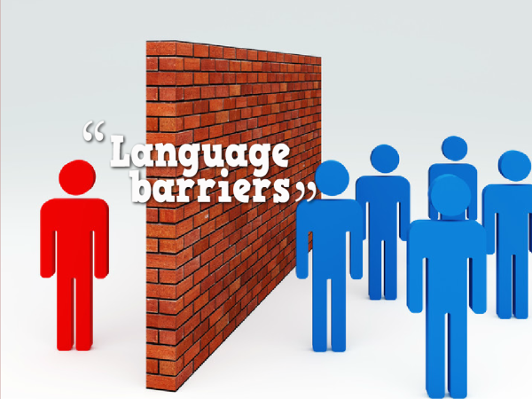
Barriers of effective communication
Factors relating to nurses and patients includes language differences, environmental issues such as noise and lack of privacy, completing demands, cultural differences, gender and age.
Factors relating to nurses are work overload, lack of knowledge regarding common communication skills, negative attitudes towards patient, reluctancy to communicate with patient, low self-esteem and unpleasant experiences of previous encounters with patients.
Factors relating to children patients includes environmental factors such as critically ill patients in ward, hectic environment in ward, unsuitable environment conditions, family interference, lack of attention, patient safety, length of time in hospital, physical barriers to non-verbal communication and physical disabilities such as hearing difficulties and speech difficulties.
Bumpers, et.al,(2019)
This Photo by Unknown author is licensed under CC BY-SA.

Slide 7
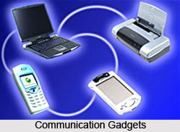
The impact of effective communication on staff and patients
Impact of communication on staff includes:
Reduce stress and fatigue
High job satisfaction
Effective teamwork
Employee relationship improvement
Job motivation
Impact of communication on patients are:
Reduction of stress and anxiety
Improves communication between children's family and staff
Parents satisfaction or supporting parents
Improves relationship between children, parents and staff.
Griffith and Dunham, (2015).
This Photo by Unknown author is licensed under CC BY-NC-ND.

Slide 8
Conclusion
Communication is a fundamental skills in all living things, good communication skills leads to better understanding to the receiver. To over-come the negative barriers in Rainbow's children Hospital, management need to create workshops that are related to communication between staff to staff and staff to patients.
Although there are many barriers within communication. Finding effective solutions to promote communication skills will help:
1- Reduce stress both within patients and staff.
2- Happier working environment
3- Give constructive feedback where necessary
4- Children and parents' satisfaction
As humans we need to express and understand the expressions of others especially children who are ill and fear what may happen next.
Having well trained educated nurses boost, company turn-over, patient satisfaction, happier environment and fulfilling teamwork objectives.

Slide 9
Reference List 1
John Velentzas and Georgia Broni, (2014). Communication cycle: Definition, process, models and examples. [ online]. Available at: wseas.us/e-library/conferences/2014/Istanbul/FINANCE/FINANCE-17.pdf
(Accessed: 15 December 2014).
J. David Johnson, William A. Donohue, Charles K. Atkin and Sally Johnson,(1993). Differences between formal and informal communication channels [online].Available at:http://course.sdu.edu.cn/G2S/eWebEditor/uploadfile/20131201162906010.pdf. (Accessed:14 October 1993).
Boddy, D. (2016). Management : An Introduction, Pearson Education Limited, Harlow, United Kingdom.
Griffith, B., and Dunham, E. (2015).Working in Teams: moving from high potential to high performance, Los Angeles, SAGE Publications.
Hoppe, MH. (2007). Active Listening: Improve Your Ability to Listen and Lead, First Edition, Center for Creative Leadership, Greensboro
Mehrabian, A. (1981). Silent Messages: Implicit Communication of Emotions and Attitudes, Boston: Wadsworth Publishing Company

Slide 10
Reference List 2
Quintanlla and Wahl, (2017). ‘Listening’, in Maund, A.,Schriek, M. and Tinkler P.K. (ed.) Certificate in Higher Education: Skills for the workplace student yearbook. London, Sage, 47-64.
Davis Foulger, (2004). Models of the communication process. [online]. Available at:https://d1wqtxts1xzle7.cloudfront.net/45035040/comm-with-cover-page-v2.pdf?Expires=1636242077&Signature=EAkciZnp4WbxfJECt73j5zPLO9FHDYPIO-bYIe6tCYNVvhgk6p3kNESCNVN8mEQkJtY786A5hMENa1TUW7RIIOPKkXGQsaRXetDCBDO3TkwU9K. (Accessed: 25 February 2004).
Grant, Mary Jo.C, Donaldson, Amy.E, Larsen, Gitte.Y, (2006). The safety culture in a children's Hospital.[online]. Available at:https://scholar.googleusercontent.com/scholar.enw?q=info:8RVNmobzCCEJ:scholar.google.com/&output=citation&scisdr=CgXT-pk-EPLi0wjLOl0:AAGBfm0AAAAAYYLNll2NSLQlHxtOv4bn4nUTn9WkttwY&scisig=AAGBfm0AAAAAYYLNIrQuPy bB69tSjoiiZcogaKd5ju&scisf=3&ct=
Bumpers, Bernadette, Dearmon, Valorie, Dycus, Paula, (2019). Impacting the patients Experience in a Children's Hospital Using a Communication Bundle Strategy. [online]. Available at: www.patientprovidercommunication.org

Slide 11
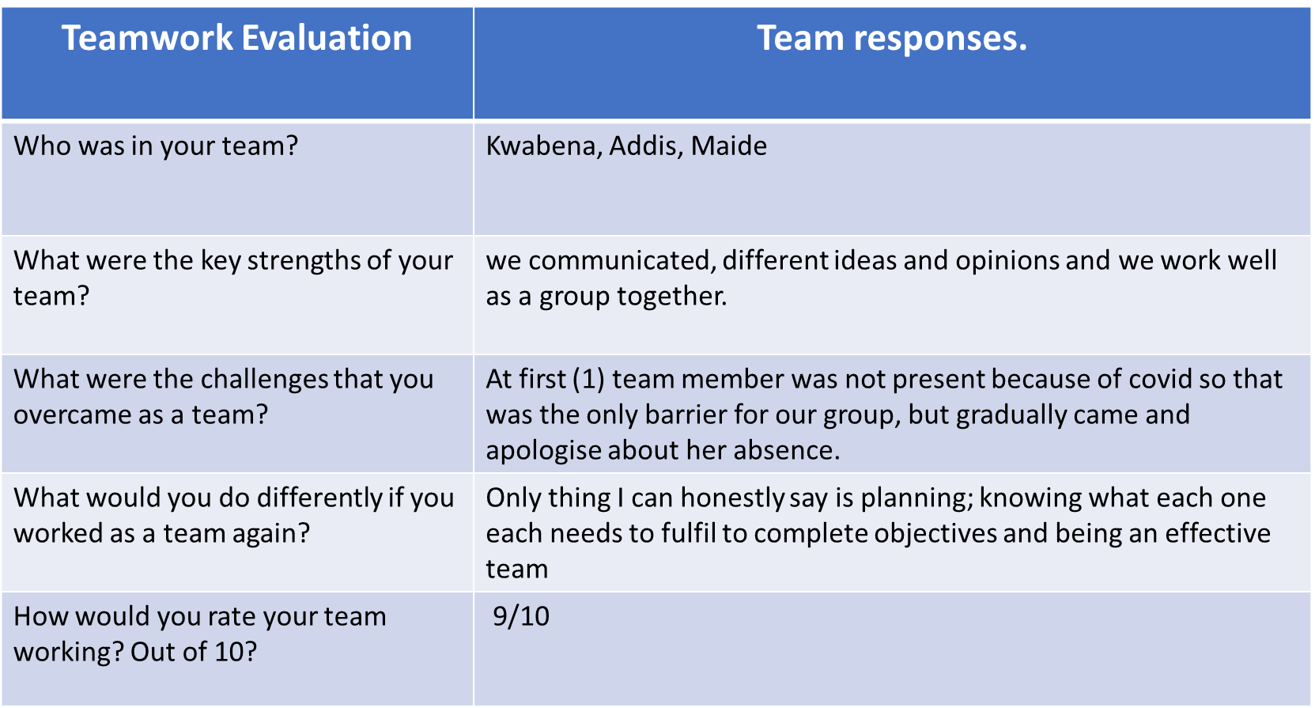
Group Evaluation Form

