Slide 1
ECEY5005/C
Syndod a rhyfeddod – gwyddoniaeth, mathemateg a’r awyr agored
Awe and Wonder: science, mathematics and the outdoors
Canllawiau Aseinaid Assignment Guidance

Slide 2
Croeso nol! / Welcome back!
I ddechrau fe fydd y sesiwn yma yn cynnys manylion yr aseinaid ar gyfer y modiwl ECEY5005C
This session will initially contain detailed assignment guidance for the ECEY5005 module.

Slide 3
NOS
Wythnos 1 / Week 1-
0401-K56, P11; 0403-K59; 0408-K70, K73, P8; 0409-K70, K72; 0411-K64, K65, K66; 0412-P7, P8, P10; SPW9- K24; Core-K8, K53, K55
Wythnos 2 / Week 2-
0403- K59; 0408-K59, K63, K67, K68, K69,K70, K71, K73, K75, P8; 0409-K70, K72; 0411- K64, K65, K66; 0412- P7, P8, P10; 0042- K41-K50; SPW9-K16, K24; Core K31-K32,K53-K55.
Wythnos 3 / Week 3-
0403-K59 ; 0408- K59, K69, K70, K71, K73, K75, P8, 0409- K70, K72; 0411- K64, K65, K66; 0412-P7, P8, P10; 0042-K41-K50; SPW9-K16, K24; Core-K8, K31, K32, K53, K54, K55
Wythnos 4 / Week 4- 0408-K59, K69, K70, K73, K75, P8; 0409-K70, K72; 0411-K64, K65, K66; 0412-P7,P8, P10; 0042-K41-K50; SPW9- K16, K24; Core-K31, K32,K53, K54, K55

Slide 4
Amcanion Dysgu
Ar ôl cwblhau’r modwl hwn yn llwyddiannus, dylai’r myfyriwr allu:
gwerthuso’r egwyddorion a’r arfer o ddarparu amgylcheddau dysgu awyr agored heriol i blant ifanc sy’n cefnogi dysgu cyfannol, chwilfrydedd, darganfod, archwilio ac arbrofi;
dadansoddi ymagweddau at ddatblygu cysyniadau gwyddonol, mathemategol a rhifedd a sut mae’r ymagweddau hyn yn cefnogi fframweithiau a chwricwla blynyddoedd cynnar;
gwerthuso rôl plant, oedolion a systemau ehangach wrth ddatblygu sgiliau gwyddonol, mathemategol a rhifedd
trefnu eu gwybodaeth a’r hyn y maent wedi’i ddysgu drwy ddefnyddio amrywiaeth o adnoddau gwybodaeth, a chyflwyno’u gwaith ar y lefel briodol.

Slide 5
Learning Outcomes
Upon the successful completion of this module, the student should be able to:
evaluate the principles and practice of providing young children with challenging outdoor learning environments which support holistic learning, curiosity, discovery, exploration and experimentation;
analyse approaches to developing science, mathematical and numeracy concepts and how these approaches support early years frameworks and curricula;
evaluate the role of children, adults and wider systems when developing early science, mathematical and numeracy skills
organise their knowledge and learning through use of a range of information resources and present their work at the appropriate level.

Slide 6
Aseiniad
Assignment
Portffolio
4000 gair
Dyddiad cau- gweler y llawlyfr a thrafodaeth darlithoedd
Gweler y cefnogaeth aseiniad sy’n dilyn
Dyddiad cyflwyno
02.04.2023- 23.59pm
Portfolio
4000 words
Hand in date- see handbook and discussed in lectures
See following assignment guidance
Presentation Date 02.04.2023- 23.59pm

Slide 7
Aseiniad / Assignment
Darparu portffolio o dystiolaeth yn amlinellu sut y byddech yn defnyddio amgylchedd awyr agored i hyrwyddo a chefnogi meddwl gwyddonol / mathemategol plant.
Provide a portfolio of evidence outlining how you would use an outdoor environment to promote and support children’s scientific / mathematical thinking.

Slide 8
Yn fyr / In brief
1. – Dewiswch ffotograff (10 marc)
2. - Trafodwch sut gallai'r amgylchedd yn y ffotograff gael ei ddefnyddio gan blant ifanc i ddatblygu cysyniadau gwyddonol neu fathemategol (1200 gair- 30 marc)
3.Lluniwch asesiad budd-risg ar gyfer y gofod awyr agored a ddarperir yn eich ffotograff. (tua 600-1000 gair). – 20 marc)
4.- Darn o ysgrifennu academaidd - oedolion yn cefnogi gwyddoniaeth, mathamateg- tu-allan (1800 gair- 30 marc)
Rhestr cyferinodi- (10 marc)
1. Choose a photograph (10 marks)
2. - Discuss how the environment in the photograph could be used by young children to develop specific scientific or mathematical concepts (1200 words- 30 marks)
3.- Produce a risk-benefit assessment for the outdoor space provided in your photograph. (approx. 1000 words – 20 marks)
4.- Academic writing- adults supporting science and mathematics outdoors (1800 words- 30 marks)
Reference list- (10 marks)

Slide 9
Portffolio
Portfolio
Dewiswch ffotograff o ofod awyr agored neu tynnwch lun (ffotograff) o ofod awyr agored sy'n rhoi cyfleoedd i blant archwilio drwy chwarae. Mae angen rhoi’r ffotograff fel rhan 1 eich portffolio (Darperir enghreifftiau yn eich darlithoedd).
Choose a photograph of an outdoor space or take a photograph of an outdoor space which has opportunities for children to explore through play. You need to put the photograph as part 1 of your portfolio (Examples will be provided in lectures).

Slide 10
Portffolio
Portfolio
2. Trafodwch sut gallai'r amgylchedd yn y ffotograff gael ei ddefnyddio gan blant ifanc i ddatblygu cysyniadau gwyddonol neu fathemategol penodol megis grymoedd, maint, pwysau, cylchoedd bywyd, priodweddau deunyddiau ac yn y blaen............ (1200 gair)
2. Discuss how the environment in the photograph could be used by young children to develop specific scientific or mathematical concepts or ideas such as forces, size, weight, life cycles, properties of materials and so on…...…. (1200 words)

Slide 11
Portffolio
Portfolio
3. Lluniwch asesiad budd-risg ar gyfer y gofod awyr agored a ddarperir yn eich ffotograff. Darperir templed ar gyfer yr adran hon (tua 600-1000 gair).
3. Produce a risk-benefit assessment for the outdoor space provided in your photograph. A template for this section will be provided (approx. 600-1000 words).

Slide 12
Portffolio
Portfolio
4. Gan gyfeirio at ddamcaniaeth ac ymchwil gwerthuswch sut mae oedolion sy'n gweithio gyda phlant y blynyddoedd cynnar yn cefnogi ac yn annog plant i ymgysylltu â chysyniadau mathemategol a gwyddonol mewn amgylchedd awyr agored (1800 o eiriau).
4. With reference to theory and research evaluate how adults working with early years children support and encourage children engage with mathematical and scientific concepts in an outdoor environment (1800 words).

Slide 13
1. Dewis ffotograff
Choosing a photograph
Dewiswch neu tynnwch ffotograff lle byddai'r amgylchedd awyr agored yn annog chwilfrydedd, darganfod ac arbrofi.
Dewiswch ffotograff sy'n darparu tirwedd ddiddorol ac amrywiol- er enghraifft, arwynebau gwahanol, graddiant gwahanol, nodweddion gwahanol.
Dewiswch ffotograff gyda rhai nodweddion 'naturiol'
Dewiswch ffotograff a allai ddarparu cyfleoedd dysgu cyfannol.
Choose or take a photograph where the outdoor environment would encourage curiosity, discovery and experimentation.
Choose a photograph which provides an interesting and diverse landscape- for examples, different surfaces, different gradients, different features.
Choose a photograph with some ‘natural’ features
Choose a photograph that could provide holistic learning opportunities.

Slide 14
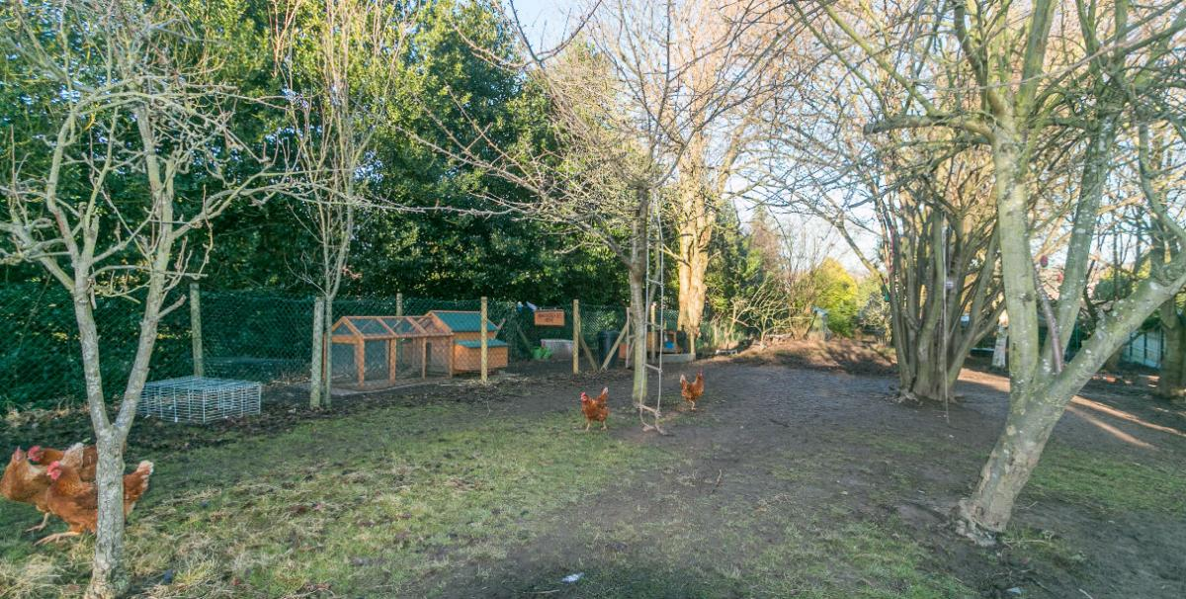
http://handkerchiefnursery.co.uk/learning-environment/forest-school

Slide 15
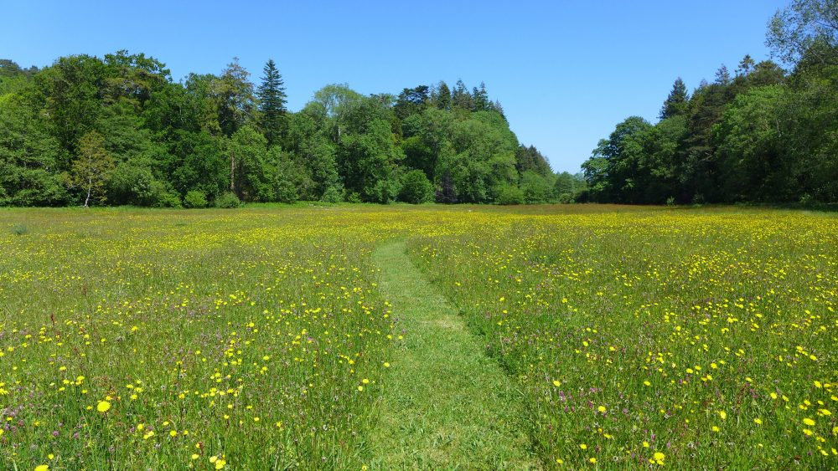

Slide 16
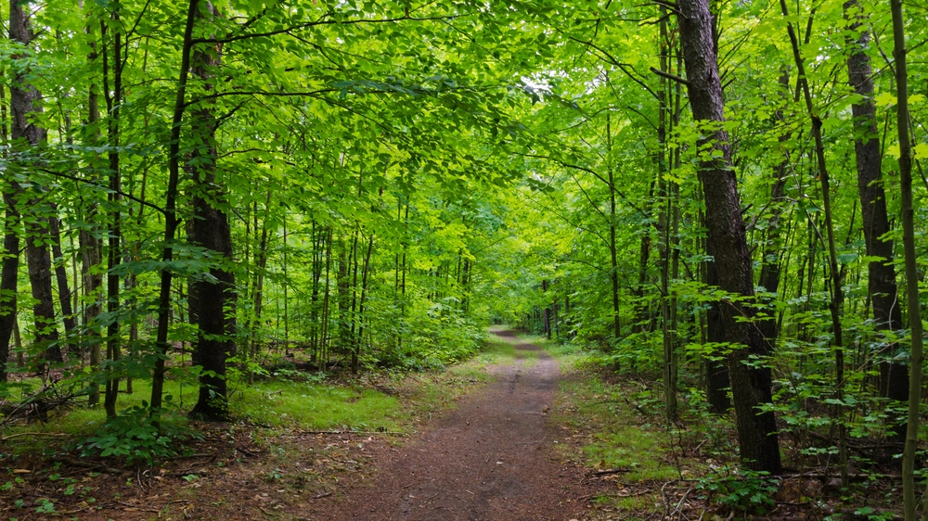

Slide 17
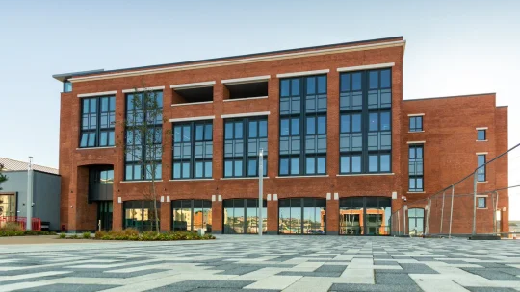

Slide 18
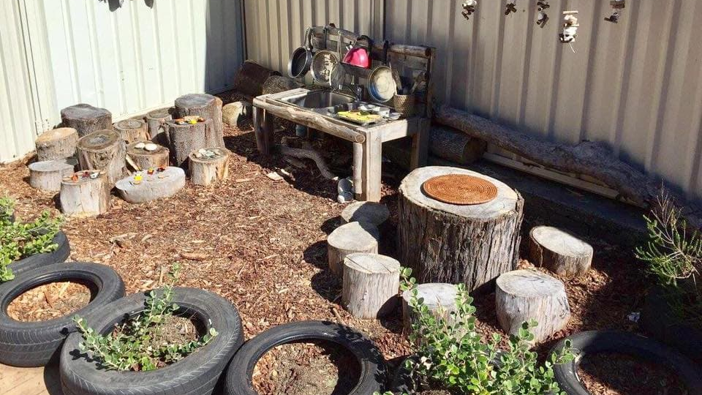

Slide 19
2. Trafodwch sut gallai'r amgylchedd yn y ffotograff gael ei ddefnyddio gan blant ifanc i ddatblygu cysyniadau gwyddonol neu fathemategol penodol megis grymoedd, maint, pwysau, cylchoedd bywyd, priodweddau deunyddiau ac yn y blaen............
Profiad personol
Darllen
Cwricwlwm i Gymru
Dolen Gwyddonaieth a Thecholeg Cwricwlwm Cymru
Dolen i Mathamateg a Rhifedd Cwricwlwm Cymru
Cyfannol a thraws-cwricwlaidd

Slide 20
2. Discuss how the environment in the photograph could be used by young children to develop specific scientific or mathematical concepts or ideas such as forces, size, weight, life cycles, properties of materials and so on…...
Your own experience
Your reading
Curriculum for Wales
Link to Science and Technology in Curriculum for Wales
Link to Mathematics and Numeracy Curriculum for Wales
Holistic and cross-curricular

Slide 21
2. Trafodwch sut gallai'r amgylchedd yn y ffotograff gael ei ddefnyddio gan blant ifanc i ddatblygu cysyniadau gwyddonol neu fathemategol penodol megis grymoedd, maint, pwysau, cylchoedd bywyd, priodweddau deunyddiau ac yn y blaen............
Dychmygwch y bydd yr amgylchedd yn cael ei ddefnyddio gan grŵp o blant o leoliad blynyddoedd cynnar, gydag ymarferwyr yno i arsylwi a chefnogi eu chwilfrydedd. Gallwch hefyd ystyried pa adnoddau ychwanegol y byddech yn eu hychwanegu i'r amgylchedd i annog plant i archwilio a darganfod.
Ceisiwch ddadansoddi syniadau'n fanwl yn hytrach na thrafod sawl cysyniad gwyddoniaeth neu fathemateg wahanol. Er enghraifft, os yw eich llun yn cynnwys gardd neu goedwig byddai'n gwneud synnwyr archwilio tyfiant planhigion, cylchoedd bywyd a phethau byw. Os oes gan y safle dir neu lethrau anwastad iawn byddai'n gyfle da i archwilio grymoedd fel disgyrchiant neu ffrithiant.

Slide 22
2. Discuss how the environment in the photograph could be used by young children to develop specific scientific or mathematical concepts or ideas such as forces, size, weight, life cycles, properties of materials and so on…...
Imagine the environment will be used by a group of children from an early years setting with practitioners there to observe and support their curiosity. You can also consider what extra resources you would add to the environment to encourage children to explore and discover.
Try to dig into an idea in depth rather than discussing several different science or maths concepts. For example, if your photograph includes a garden it would make sense to explore plant growth, life cycles and living things. If the site has very uneven ground or slopes it would be a good opportunity to explore forces such as gravity or friction.

Slide 23
2. Trafodwch sut gallai'r amgylchedd yn y ffotograff gael ei ddefnyddio gan blant ifanc i ddatblygu cysyniadau gwyddonol neu fathemategol penodol megis grymoedd, maint, pwysau, cylchoedd bywyd, priodweddau deunyddiau ac yn y blaen............
Nid yw hon yn adran academaidd ac felly gall eich ateb gymryd ffurf cyfnodolyn dysgu neu stori ddysgu ac felly cynnwys darluniau, diagramau, sgyrsiau posibl gyda phlant neu gwestiynau y gallai oedolion eu gofyn i gefnogi chwilfrydedd y plant.
Mae'n rhaid i chi wneud cysylltiadau â'r cwricwlwm neu fframweithiau perthnasol fel Cwricwlwm Cymru / Cwricwlwm lleoliadau nas cynhelir.

Slide 24
2. Discuss how the environment in the photograph could be used by young children to develop specific scientific or mathematical concepts or ideas such as forces, size, weight, life cycles, properties of materials and so on…...
This is not an academic section and so your answer can take the form of a learning journal or learning story and therefore include illustrations, diagrams, possible conversations with children or questions adults could ask to support the children’s curiosity. You must make links to relevant curriculum or frameworks such as the Curriculum for Wales / Curriculum for non-maintained settings.

Slide 25
2. Trafodwch sut gallai'r amgylchedd yn y ffotograff gael ei ddefnyddio gan blant ifanc i ddatblygu cysyniadau gwyddonol neu fathemategol penodol megis grymoedd, maint, pwysau, cylchoedd bywyd, priodweddau deunyddiau ac yn y blaen............
Efallai y byddwch yn nodi pa agweddau ar y ffotograff sy'n cefnogi syniad neu gysyniad penodol
Gallwch drafod pa fathau o brofiadau y gallech eu hannog neu eu rhagweld y bydd plant yn chwarae a fyddai'n cefnogi'r cysyniad a ddewiswyd
Efallai y byddwch yn cynnwys diagramau neu ddarluniau- os yw hyn yn helpu eich esboniad.
Gallwch nodi pa adnoddau eraill y gallech eu hychwanegu, megis peli, cylchoedd, teiars, basgedi, chwyddwydrau, bwcedi, potiau, sosbeni, papur, deunyddiau gwneud marciau i gefnogi darganfod ac archwilio’r plant.
Os ydych yn cyfeirio at ddogfennau'r cwricwlwm neu adnoddau arall i gefnogi eich syniadau – mae angen cyfeirnodi.

Slide 26
2. Discuss how the environment in the photograph could be used by young children to develop specific scientific or mathematical concepts or ideas such as forces, size, weight, life cycles, properties of materials and so on…...
You might indicate what aspects of the photograph supports a particular idea or concept
You can discuss what types of experiences you might encourage or envisage children playing, which would support the chosen concept
You might include diagrams or illustrations- if this helps your explanation.
You can note what other resources you might add, such as balls, hoops, tyres, baskets, magnifiers, buckets, pots, pans, paper, mark marking materials to support children’s discovery and exploration.
If you refer to curriculum documents or other reading to support your ideas – referencing is required.

Slide 27
http://handkerchiefnursery.co.uk/learning-environment/forest-school

Slide 32
Fathau o syniad / Types of ideas
Arwynebau goleddfol ac anwastad
Grymoedd, cydbwysedd, symudiad, ynni…
Patrymau a gwead gwahanol o rhisgl, creigiau, dail...
Grwpio, patrymau, siapau, lliwiau…
Bywyd y planhigyn a'r anifail
Cylchoedd Bywyd, adnabdo gwahanol anifeiliaid a phlanhigion…
Sloping and uneven surfaces
Forces, balance, movement, energy
Different patterns and texture of bark, rocks, leaves…
Grouping, pattens, shapes, colours
The plant and animal life
Live cycles, identifying different plants and animals…

Slide 33
3. Lluniwch asesiad budd-risg ar gyfer y gofod awyr agored a ddarperir yn eich ffotograff. Darperir templed ar gyfer yr adran hon (tua 600-1000 gair).
3. Produce a risk-benefit assessment for the outdoor space provided in your photograph. A template for this section will be provided (approx. 600-1000 words).
Darperir templed ar gyfer yr adran hon a bydd canllawiau mewn darlithoedd
Defnyddiwch eich ffotograff o ran 1. fel yr ardal sy'n sail i'ch asesiad risg-budd.
Mae angen rhywfaint o ddychymyg yma.
A template for this section will be provided and guidance in lectures
Use your photograph from part 1. as the area which is the basis for your risk-benefit assessment.
Some imagination required here.

Slide 34
3. Lluniwch asesiad budd-risg ar gyfer y gofod awyr agored a ddarperir yn eich ffotograff. Darperir templed ar gyfer yr adran hon (tua 600-1000 gair).
3. Produce a risk-benefit assessment for the outdoor space provided in your photograph. A template for this section will be provided (approx. 600-1000 words).
Meddyliwch am yr hyn y gallai'r plant ei wneud yn yr amgylchedd awyr agored yn eich ffotograff.
Beth allai'r manteision fod?
Beth allai'r peryglon fod?
Sut y byddwch yn rheoli'r risg o'r perygl?
Ystyried ffiniau
Ystyried dillad
Ystyried 'rheolau euraidd'
Think about what the children might do in the outdoor environment in your photograph.
What might the benefits be?
What might the hazards be?
How will you control the risk of the hazard?
Consider boundaries
Consider clothing
Consider ‘golden rules’

Slide 35
Enghraifft asesiad risg
See example of risk assessment
Link to risk assessment example partically completed

Slide 36
4. Gan gyfeirio at ddamcaniaeth ac ymchwil gwerthuswch sut mae oedolion sy'n gweithio gyda phlant y blynyddoedd cynnar yn cefnogi ac yn annog plant i ymgysylltu â chysyniadau mathemategol a gwyddonol mewn amgylchedd awyr agored (1800 o eiriau).
Dyma ddarn academaidd o ysgrifennu- lle ar lefel 5 mae angen i chi gynnwys:
cyfeirnodau
cyfosod /synthesis
gwerthuso
dadansoddi
defnyddio'r adnoddau ar Moodle, yn y rhestr ddarllen Leganto a deunydd arall y byddwch wedi'i ddarllen i gefnogi eich ateb.

Slide 37
4. With reference to theory and research evaluate how adults working with early years children support and encourage children engage with mathematical and scientific concepts in an outdoor environment (1800 words).
This is an academic piece of writing- where at level 5 you need to include:
references
synthesis
evaluation
analysis
use the resources on Moodle, in the Leganto reading list and other material you may have read to support your answer.

Slide 38
4. Gan gyfeirio at ddamcaniaeth ac ymchwil gwerthuswch sut mae oedolion sy'n gweithio gyda phlant y blynyddoedd cynnar yn cefnogi ac yn annog plant i ymgysylltu â chysyniadau mathemategol a gwyddonol mewn amgylchedd awyr agored (1800 o eiriau).
Er enghraifft, gallai'r adran hon wneud dolenni i syniadau fel
ychwanegu darnau rhydd ‘loose parts’
fforddiadwyedd,
chwarae penagored a chwarae dan arweiniad y plant
meddwl parhaus ar y cyd,
arsylwi,
chwilfrydedd a darganfyddiad

Slide 39
4. With reference to theory and research evaluate how adults working with early years children support and encourage children engage with mathematical and scientific concepts in an outdoor environment (1800 words).
For example, this section could make links to ideas such as
adding loose parts,
affordance,
open ended and child-led play
sustained shared thinking,
observation,
curiosity and discovery.

Slide 40
4. Gan gyfeirio at ddamcaniaeth ac ymchwil gwerthuswch sut mae oedolion sy'n gweithio gyda phlant y blynyddoedd cynnar yn cefnogi ac yn annog plant i ymgysylltu â chysyniadau mathemategol a gwyddonol mewn amgylchedd awyr agored (1800 o eiriau).
Er enghraifft, gallai'r adran hon wneud cysylltiadau â:
dulliau fel Reggio Emilia,
damcaniaethau fel Bruner, Piaget, Vygotsky, Froebel neu syniadau eraill a drafodir yn eich darlithoedd.
Dogfennau ymchwil penodol gwyddoniaeth / a mathamateg blynyddoedd cynnar a chwricwlwm fel Cwricwlwm i Gymru.
Mae angen osgoi disgrifio- ystyriwch yr heriau a’r dadleuon yn y llenyddiaeth hefyd. Beth allai atal oedolion rhag defnyddio'r awyr agored neu gefnogi gwyddoniaeth a mathemateg?

Slide 41
4. With reference to theory and research evaluate how adults working with early years children support and encourage children engage with mathematical and scientific concepts in an outdoor environment (1800 words).
For example, this section could make links to:
approaches such as Reggio Emilia,
theorists such as Bruner, Piaget, Vygotsky, Froebel or other ideas discussed in your lectures.
specific early years science / mathematical research documents and curriculum such as Curriculum for Wales.
Avoid describing- consider challenges and arguments in the literature as well. What might prevent adults using the outdoors or supporting science and mathematics?

Slide 42
Nodyn / Note
Ni ellir trafod pob mater ac felly mae'r rhestr uchod ar gyfer syniadau yn unig. Dylech ddefnyddio eich ymchwil a'ch syniadau personol o ran beth fyddwch am ei archwilio'n fanwl.
Not all issues can be discussed and therefore the list above is for ideas. Use your own research and discretion on what you want to explore in depth.

Slide 43
Meini Prawf Asesu 1 - Ymgysylltu â Llenyddiaeth
= 10 marc
Cyfeirnodi yn y testun ac yn y rhestr cyfeirnodi.

Slide 44
Assessment Criteria 1 – Engagement with Literature
= 10 marks
In text referencing and reference list

Slide 45
Ymchwil, cyfeirnodi, rhestr cyfeirnodi Research, referencing , reference list
Mae'r rhestr cyfeirnodi yn cynnwys unrhyw gyfeiriadau a nodir trwy gydol y gwaith.
Rhaid i chi ddyfynnu cyfeiriadau yn y testun yn gywir.
Rhan 3 asesiad risg-budd- dim angen cyfeirnodi
Defnyddiwch canllaw cyfeirnodi Harvard
Peidiwch or-ddefnyddio dyfyniadau- gwell aralleirio
Reference list includes any references noted throughout work.
Section 3 risk-benefit assessment does not need references
You must cite references in text correctly.
Use your Harvard referencing guide
Do not overuse direct quotations- paraphrase instead

Slide 46
Meini Prawf Asesu 2 - Gwybodaeth a Dealltwriaeth
= 20 marc
Lluniwch asesiad budd-risg ar gyfer y gofod awyr agored a ddarperir yn eich ffotograff. Darperir templed ar gyfer yr adran hon (tua 600-1000 gair).

Slide 47
Assessment Criteria 2 – Knowledge and Understanding
= 20 marks
Produce a risk-benefit assessment for the outdoor space provided in your photograph. A template for this section will be provided (approx. 600-1000 words).

Slide 48
Meini Prawf Asesu 3 – Sgiliau Gwybyddol a Deallusol
= 30 marc
Gan gyfeirio at ddamcaniaeth ac ymchwil gwerthuswch sut mae oedolion sy'n gweithio gyda phlant y blynyddoedd cynnar yn cefnogi ac yn annog plant i ymgysylltu â chysyniadau mathemategol a gwyddonol mewn amgylchedd awyr agored (1800 gair).
.

Slide 49
Assessment Criteria 3 – Cognitive and Intellectual Skills
=30 marks
With reference to theory and research evaluate how adults working with early years children support and encourage children engage with mathematical and scientific concepts in an outdoor environment (1800 words).

Slide 50
Meini Prawf Asesu 4
Sgiliau Ymarferol
= 30 marc
Trafodwch sut gallai'r amgylchedd yn y ffotograff gael ei ddefnyddio gan blant ifanc i ddatblygu cysyniadau gwyddonol neu fathemategol penodol megis grymoedd, maint, pwysau, cylchoedd bywyd, priodweddau deunyddiau ac yn y blaen............

Slide 51
Assessment Criteria 4 – Practical Skills
= 30 marks
Discuss how the environment in the photograph could be used by young children to develop specific scientific or mathematical concepts or ideas, such as forces, size, weight, life cycles, properties of materials and so on…...

Slide 52
Meini Prawf Asesu 5 –
Sgiliau Trosglwyddadwy
= 10 marc
Dewis o ffotograff addas.
Dewiswch ffotograff o ofod awyr agored neu tynnwch lun (ffotograff) o ofod awyr agored sy'n rhoi cyfleoedd i blant archwilio drwy chwarae. Mae angen rhoi’r ffotograff fel rhan 1 eich portffolio (Darperir enghreifftiau yn eich darlithoedd).

Slide 53
Assessment Criteria 5 – Transferable Skills
= 10 marks
Choice of appropriate photograph.
Choose a photograph of an outdoor space or take a photograph of an outdoor space which has opportunities for children to explore through play. (Examples will be provided in lectures).

Slide 54
Cofiwch
Remember
Prawf ddarllen a golygu gwaith yn ofalus.
Defnyddio canllaw cyfeirio Harvard a chymorth sgiliau academaidd arall ar Moodle i gyflwyno gwaith yn gywir.
Dylech gynnwys y ffotograff yn rhan 1 yn eich prif ddogfen aseiniad - un ddogfen i'w chyflwyno yn unig.
Cadw fel PDF cyn cyflwyno
Cyflwyno i Turnitin mewn digon o amser.
Proofread and edit work carefully.
Use Harvard referencing guide and other academic skills support and Moodle to present work accurately.
Include the photograph in part 1 in your main assignment document- one document only to submit.
Save as PDF before submitting
Submit to Turnitin in plenty of time.

Slide 55
Cofiwch
Remember
Cofiwch defnyddio’r system amgylchiadau esgusodol os fydd angen.
Pob lwc ac os oes angen cefnogaeth cysylltwch gyda’ch darlithydd neu Cydlynydd y Modiwl
Remember to access the extenuating circumstances system if you need to.
Best of luck and if you need any support please contact your lecturer or Module Coordinator

