Slide 1
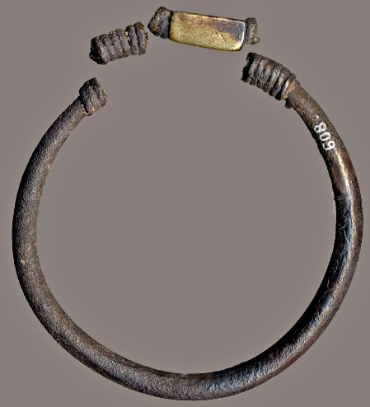

Object analysis: Iron Ring
Jack Glascott
– 1901783
Level 6
Entanglements: Exploring Interactions between the Aegean and the Near East (HPAH5010, HPAH6010)

Slide 2
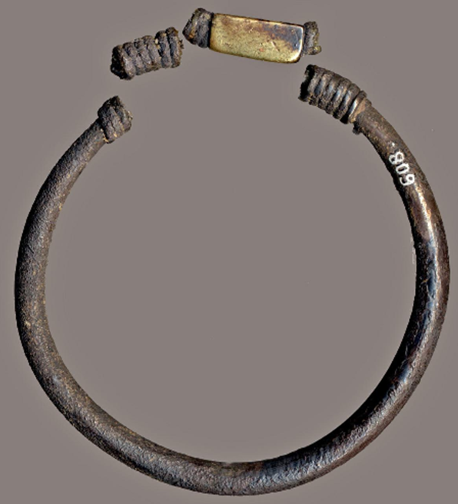
Object: bracelet
Acquisition by the British Museum
Museum number: 1898, 1201.32
Description: silver bracelet composed of a rounded hoop tapering the ends, which over lap at the top and are twisted around the hoop in spiral wires; between the spirals is placed a prism of gold that is not broken off
Material: iron
Dimensions:
diameter: 5.40 cm
Weight: 23 g
Thickness: 1 cm
Iron value
Origen: Cyprus (Larnka)
Found in: maroni
Culture/periods: Late Bronze Age
Production: 1650 BC – 1200 BC

Slide 3
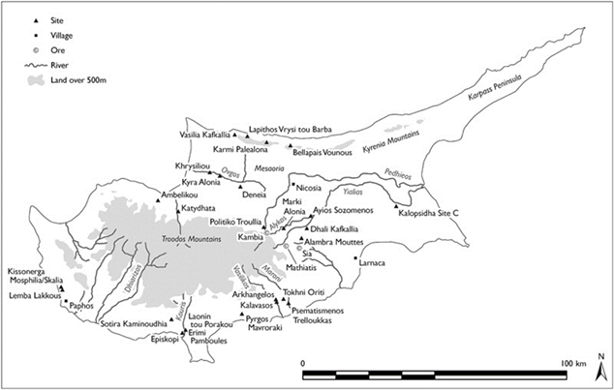
Fig. 1. Late Bronze Age Cyprus: sites, (modern) towns, and other areas mentioned in the text (modified from Knapp, 2008)

Slide 4
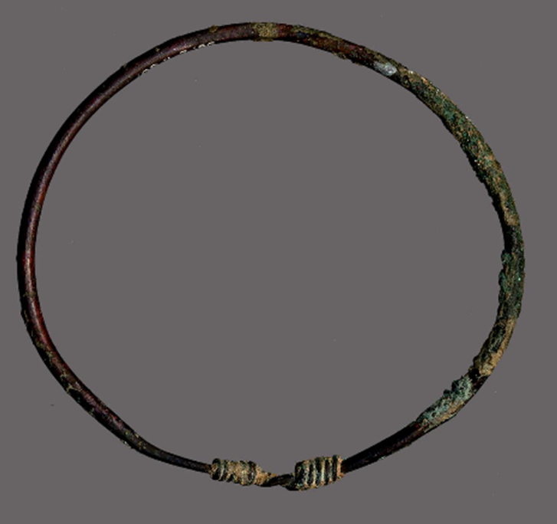
value
To a different extent, the Minoans, the later Mycenaeans, had been investors and therefore could have treated silver a lot. Hence, we see a large amount of early Greek silver earrings from archaeological sites on the Greek mainland, Crete, and Cyprus. The Phoenicians have performed a unique position withinside the improvement of the Mediterranean civilizations via their colonization and change with all corners of the area. It changed into the Phoenicians who commenced the take advantage of the Spanish silver deposits and distribution in the classical world. Their incentives pulled silver from its specific and uncommon repute, and its availability rose to ranges by no means visible before
Gold is similar and has great value and meaning both in its usage and its presence in objects. This is exacerbated by the origin of this artifact from Cyprus. As a non originated material from the region
This value can also be observed though the presentation of the bronze and more numarous example of a bracelet seen in a similar area

Slide 5
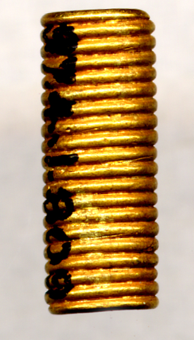
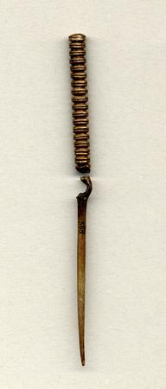
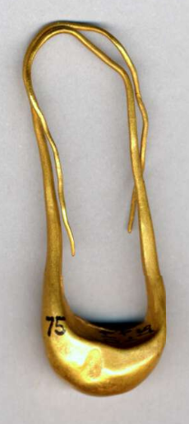
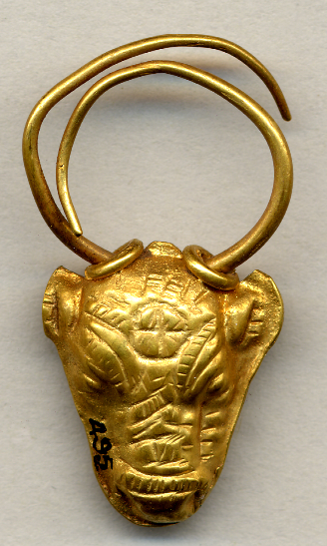
value
The jewellery of this era indicates the talent of the Cypriot craftsman and goldsmith in combining Aegean factors with oriental and nearby traditions. Frontlets, diadems, mouthpieces, even jewellery, of oriental shape is adorned with embossed or stamped motifs of Aegean origin: figures of 8 formed shields, spirals, rosettes, sphinxes in addition to bulls or bull’s heads, a Cypro-Aegean inspiration.
There is the elongated boat-formed ear-ring of oriental origin, the crescent-formed ear-ring with overlapping ends simple or with a pendant of globules below, an aggregate of Near Eastern and Cretan factors, the ear-ring withinside the form of a bull’s head, a Cypriot invention. In the jewellery of this era, there are fantastic examples of granulated decoration: at the gold pendant withinside the form of a pomegranate from Enkomi and on jewellery located in tombs at Kalavassos, Kouklia “Evreti” and withinside the Hala Sultan Tekke hoard.
The readorning fixtures and apparel exercise with gold mountings include one from the preceding period. Gold mountings with perforated edges have been sewn onto clothes, unperforated mountings with embossed multi-petalled rosettes have been probably caught on perishable material. The rectangular gold mounting plaques with embossed heads or the parent of a nude goddess located in a tomb at Lapithos across the cranium of a woman skeleton endorse that they fashioned a part of a headdress.
They have been bolstered with bronze cord via their folded edges and have been then sewn onto different material, as cautioned through the perforations at every corner. The maximum distinguished examples located up to now in Cyprus are the gold square plaques determined in a tomb at Kouklia “Skales” and in the object of this analysis.
Another theme of Cypriot jewellery is that of spirals seen on most of the metal work especially jewellery

Slide 6
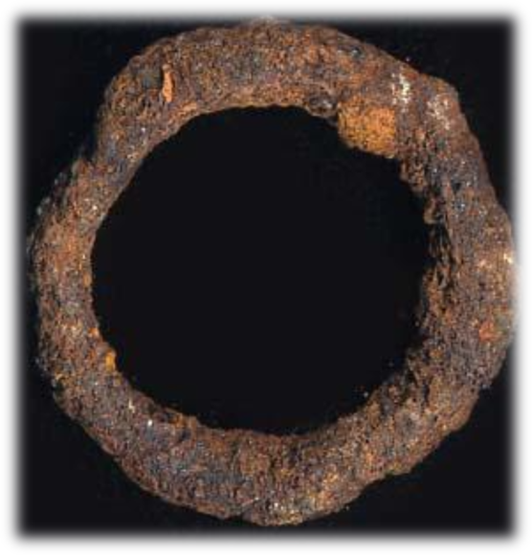
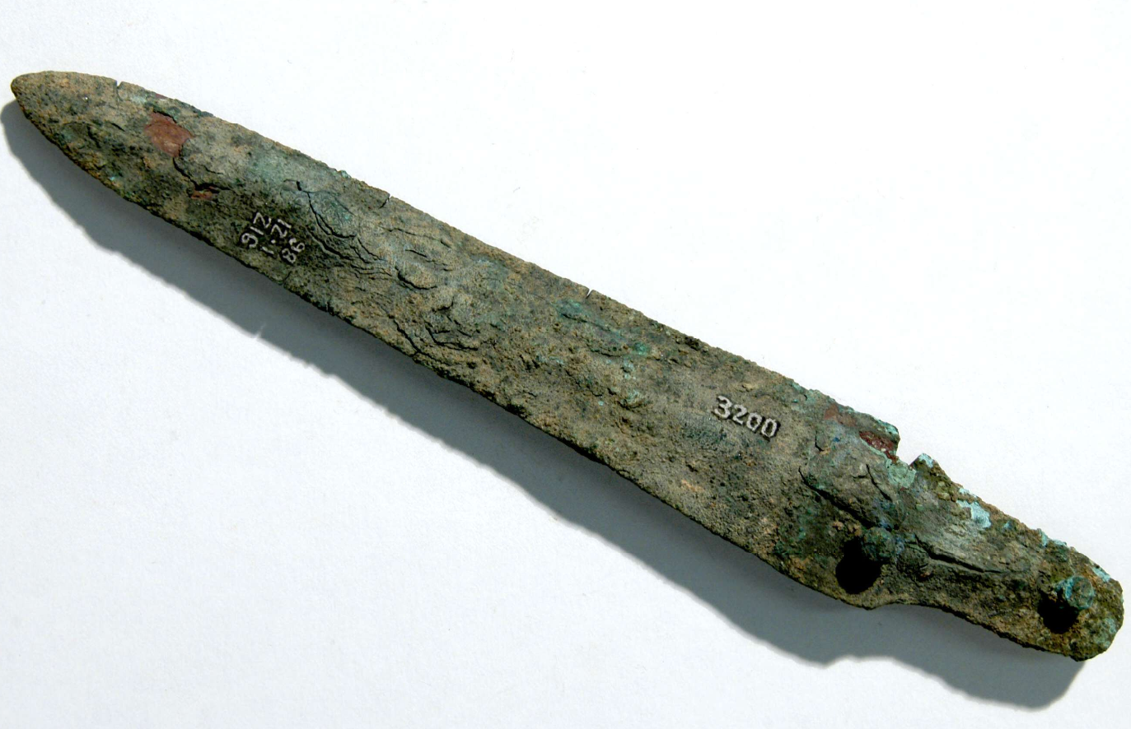
Hybridisation
To conceptualise cultural Hybridisation in archaeology, Instead of Maran, Stockhammer’s basis for his theoretical approach is exploring the term Hybridisation. A multi-disciplinary focus can be applied for a comprehensive understanding. (Bhabha, 1994).
‘The Enkomi metalworking dispersion, the emergence of houses where previously the Fortress stood, and the contemporaneous proliferation of newly established prestigious town houses suggests that the LC IIIA represents the culmination of a long-term trend towards the dissolution of central control of metals’ (Pickles & Peltenburg 1998)
This indicates a good framework for viewing the interconnected and intertwined world, especially for cultural exchanges within the Mediterranean and Aegean, allowing for a broader interpretation of both materials and their associated interactions.
Objects, particularly those invested with exceptional value, as evident from the number of resources, energy, and time allocated to luxury production, can act as participants in the definition of relations utilising the symbolic encoding ascribed to them by their human counterparts. Feldman expands that what has been called “internationalism” were directed internally and were intentionally chosen for their symbolic potential; thus, their cultural origin served an essential function in contributing to the reading of the imagery within its new context.
An example of a levant finger ring form about the same time and the same for of iron
An example of a hybridised of a standardised form of a knife for trade but from iron

Slide 7
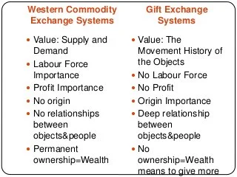
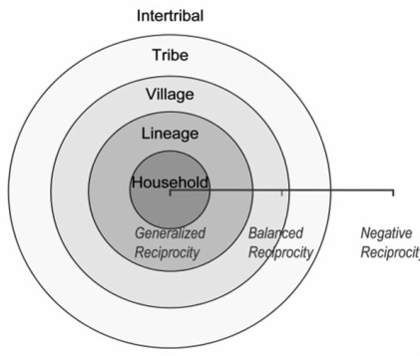
Gift exchange
The transformative model of metallurgy and created value through representation
Economic papers from 1974 often focused on the development of treading connections and capitalism working with long-distance trade, this subject related massively to this object. •Areas, especially those who focus on the innovation and trade of metals, become increasingly interconnected and reliant on trade due to lacking resources, leading to innovation in culture and exacerbating conflict and change, all creating ’a large scale interregional exchange system.’
The emotions of communities alongside writing in taxation this accumulation of surplus specialist crop production for elite consumption to the periphery itself providing raw materials to the core overall becoming ’a large scale into relational exchange system (stein, 1998)
creating a social and cultural connection with control over state control of material and production closer to their nerve centre, leaving the raw materials sticks with no uses. Core, as termed, is often the centre of the political and governmental body structuring and directing other facets of society. It must also be one of the prominent trade directors outside of the state itself.

Slide 8
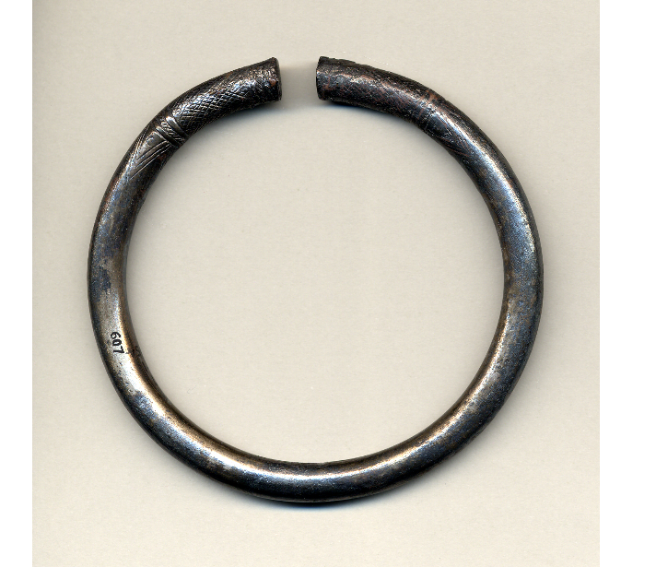
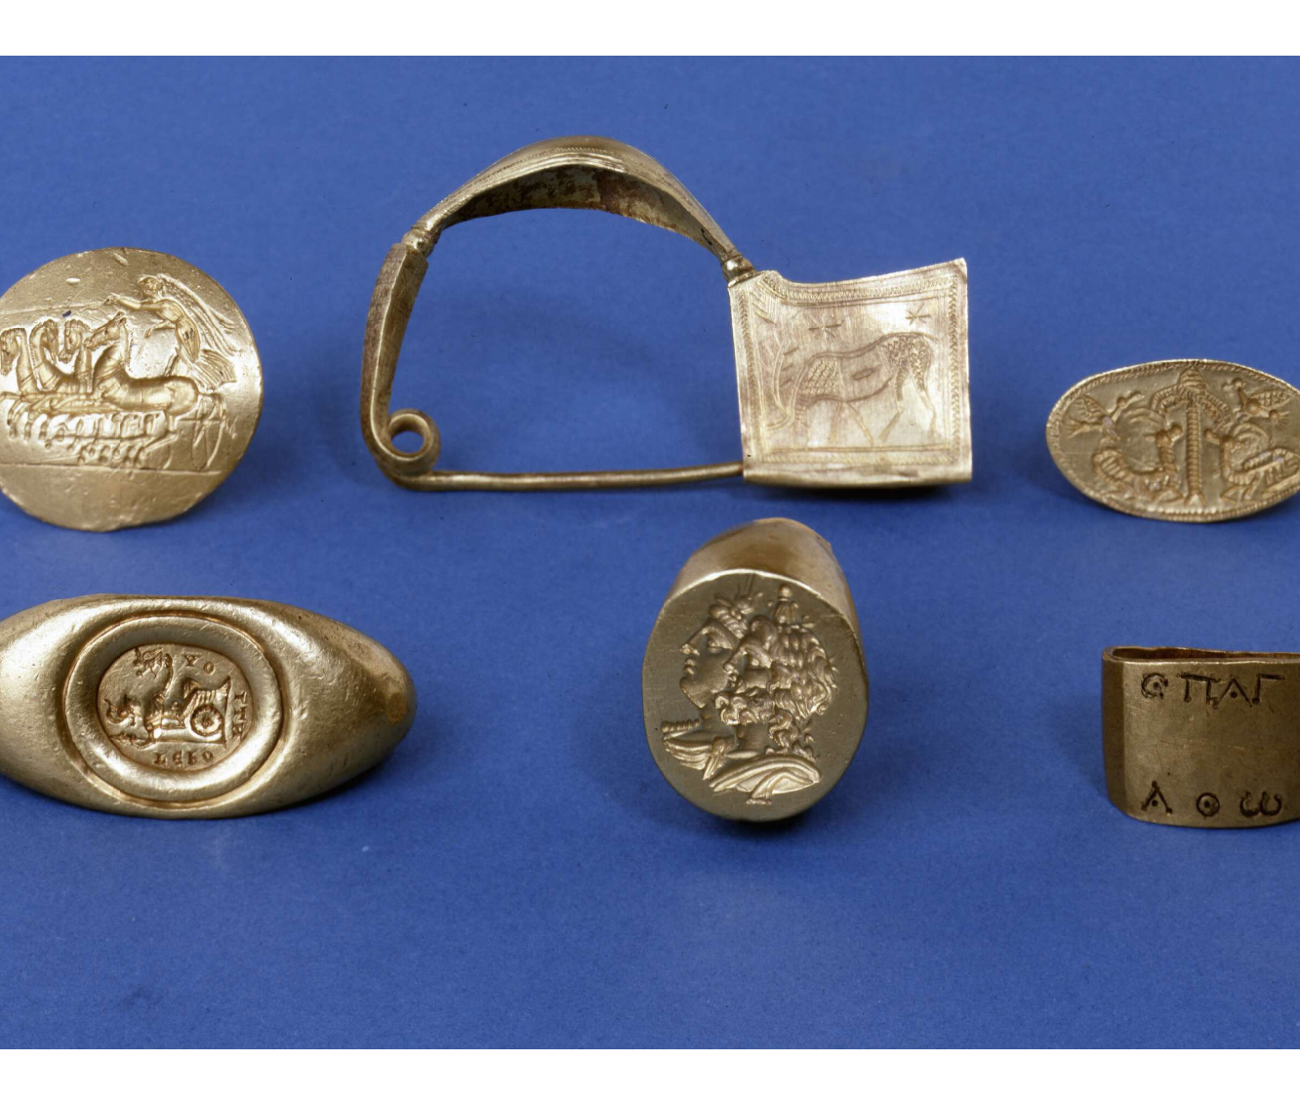
Objects made out of these valued substances carried over distance distances create value for the object, and whilst agency baby within the material and the object itself, there is also an agency of the creator been placed with the object forming an intellectual relationship of the world itself (Gell, 1992).
Objects, particularly those invested with exceptional value, as evident from the number of resources, energy, and time allocated to luxury production, can act as participants in the definition of relations utilizing the symbolic encoding ascribed to them by their human counterparts.
Feldman expands that what has been called "internationalism" were directed internally and were intentionally chosen for their symbolic potential; thus, their cultural origin served a vital function in contributing to the reading of the imagery within its new context. If not seen in the design, internationalism can be viewed in the shape and material used like finance in Egypt and greater use of ivory for the near east. A precious material like iron, this internationalism is reflected in its presentence in a designed and warn object (Gell, 1992).
However, another set of values is the difficulty it is to obtain object control access to specific material is accruing material wealth for the potential value of the object to others when disseminating it for a specific price for specific pieces of a certain level of skill and their associations with religion and temples allows for a greater sense of value between objects trade.
Cast Silver Engraved Armlet Found on Cyrpus, c.1000 BC.

Slide 9
Questions?

Slide 10
Bibliography
Åström, P. 1972 ‘The Swedish Cyprus Expedition. Vol. IV. Part 1D. The Late Cypriot Bronze Age. Other arts and crafts’ SCE IV/1D, Swedish Cyprus Expedition, Lund
Åström, P. Bailey, D. Karageorghis. 1976. Hala Sultan Tekke I. Excavations 1897-1971, (SIMA XLV:1), P. Åström, Göteborg avalible at: ’https://www.britishmuseum.org/collection/object/G_1898-1201-246’ [accessed: 06/03/2022]
Bhabha, H, K. 1994. ‘The Location of Culture’. London: Routledge
Knapp, A. 2013. ‘Revolution Within Evolution: The Emergence of a ‘Secondary State’ on Protohistoric Bronze Age Cyprus, Levant, 10.1179/0075891413Z.00000000015, 45, 1, (19-44).
Knapp, A. Bernard, and John F. Cherry. Provenance Studies and Bronze Age Cyprus: Production, Exchange, and Politico-Economic Change. Monographs in World Archaeology, no. 21. Madison, Wis.: Prehistory Press, 1994. (This scientifically based study provides the most comprehensive overview available on "provenance" [origins] on Cypriot pottery, metals, and oxhide ingots, together with a lengthy discussion of Bronze Age trade.)
Muhly, J.D. 2006. Texts and technology. ‘The beginnings of iron metallurgy in the eastern Mediterranean’. Ancient Greek Technology: Proceedings of the 2nd International Conference, Athens, October 17-21, 2005. 19-31.
Muhly, James D. "The Nature of Trade in the Late Bronze Age Eastern Mediterranean: The Organization of the Metals Trade and the Role of Cyprus." In Early Metallurgy in Cyprus, 4000–500b.c. Edited by James D. Muhly, Robert Maddin, and Vassos Karageorghis, pp. 251–266. Nicosia: Pierides Foundation, 1982.
Myres, John L. 1914. Handbook of the Cesnola Collection of Antiquities from Cyprus. no. 4871, New York: The Metropolitan Museum of Art.
Niemeier Wolf-Dietrich, and Barbara Niemeier. "Minoan Frescoes in the Eastern Mediterranean." In The Aegean and the Orient in the Second Millennium. Edited by Eric H. Cline and Diane Harris-Cline, pp. 281–289. Aegaeum 18. Liège, Belgium: Université de Liège, 1998.
Peltenburg, E. 2012. KING KUŠMEŠUŠA AND THE DECENTRALISED POLITICAL STRUCTURE OF LATE BRONZE AGE CYPRUS. British School at Athens Studies, 20, 345–351. http://www.jstor.org/stable/23541218
Richter, Gisela M. A. 1915. Greek, Etruscan and Roman Bronzes. no. 1123, p. 338, New York: Gilliss Press
The Goldschmidt Conference is the World's main geochemistry conference. It is hosted alternately by the European Association of Geochemistry (Europe) and the Geochemical Society (USA). The 2021 conference (virtual) takes place from 4-9 July,
Thompson, C. M. 2003. ‘sealed silver in iron age Cisjordan and the invention of coinage’, OJA 22, 67-107.

