Slide 1
Are digital skills important for study and work
Digital Skills And Research Methods - LCHS4002
Morfide Notice - 2215703
Malieka Brown - 2219833

Slide 2
AGENDA
Introduction​
Why digital skills are important
Examples of digital skills
What digital skills are used for?
Ethical considerations
Questions
Summary​
References

Slide 3
Introduction
Technology is at the Centre of our lives weather we would like to agree or disagree with it, we use technology everyday of our lives. There is different frameworks into which technology we tend to use daily. Simple things such as using our smartphones or laptops to view the modules in which we study here at UWTSD today.
The reason why we have decided to choose this question is because
at UWTSD there is different ways in which students can use their digital skills, they are able to do this by using a variety of methods such as smartphones, tablets and computers. It all depends on the types in which each induvial is comfortable and confident with. Not everyone is confident with using certain types of technology so in order to find the balance you must challenge yourself trying different ones.

Slide 4
Why digital skills are important
Digital skills are important because they show us how work is conducted. Digital skills are essential skills in which everyone must have and know how to use. Its things we use in everyday life without realising.
According to the stats by the end of the decade, 50% of the retail sales within the UK will be taking place online. (future learn 2020)

Slide 5


Examples of digital skills
Social Media
E.g. whatsapp and linkedin
Digital
MarketingE.g. Pay per click and email marketing
(Hines, 2021)

Slide 6
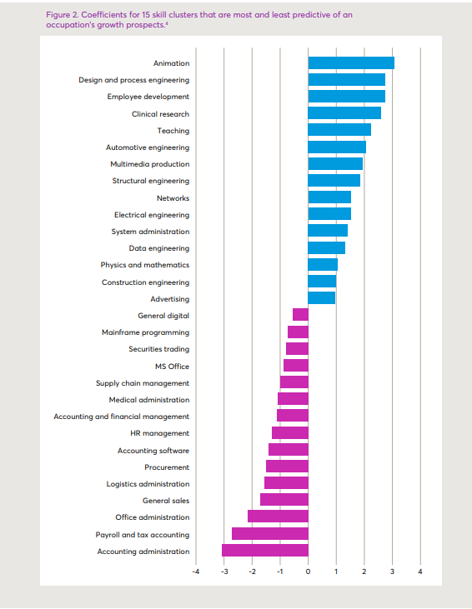
The graph shows skill clusters that are most and least predictive of occupations growth.
According to Djumalieva, J. and Sleeman, (2018, P. 5) These findings suggest that not all digital skills will be equally important in the future. The demand for those digital skills which involve non-routine tasks, problem-solving and creation of digital content (e.g., graphic and engineering designs, software products/services, analytical outputs, etc.) is positively correlated with occupations that have brighter outlooks

Slide 7
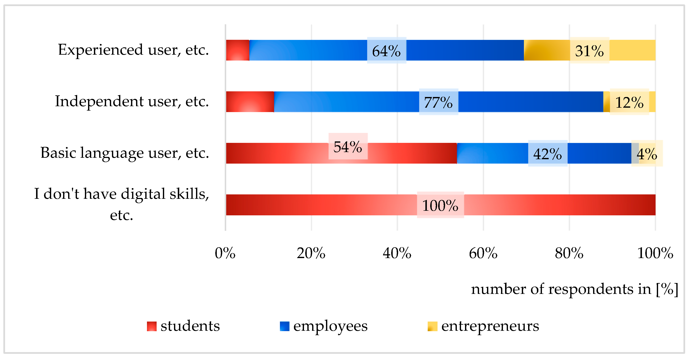
According jana stofkova and adela polokova (2022, linking section, para 4). to shows that the respondents are from a lower age category and they have basic digital skills. It shows the category's in which they fall under from in experienced to un experienced. The survey was done on students, employees and entrepreneurs.

Slide 8
An important research area on both the politic and scientific agenda is the division it has between people that have and do not have access to computers and the Internet (Van Dijk, 2005, Van Dijk, 2006).
Azuonwu (n.d.) 2022 states that Digital skill are defined as the ability to find, evaluate, use, share, and create content using digital devices, such as computers and smartphones.

Slide 9
Ethical considerations
Its quite evident that when it comes to digital skills the question remains are digital skills important for work and study as well as those here at UTWSD? And are UWTSD Students Confident In Using Their Digital Skills?
Yes, its important because without technology where would we be? The world we are living in is run by technology believe it or not, technology is at our fingertips i.e.) the lecturer who runs this course uses the computer in order to cast it upon a projector for us all to be able to be interactive and involved within what's happening in the class.
Us as students need to know how to collaborate digitally because without this, we wouldn’t be in sync with what's going on physically and mentally. The benefits of digital skills allow us to share content with others, communicate with others and collaborate information globally.

Slide 10
questions
1) what technology do you prefer to use ? And why
2)what are the key digital skills?
3)What are the benefits of digital skills?
4) do you think digital skills have affected us overall ?
5) on a scale of 1 – 5 how confident are you using technology digitally ?

Slide 11
SUMMARY
Digital skills are key in the world in which we live in today, its important that you're aware of all the digital skills that are available to use for work and personal reasons. When it comes to being digital in a workplace or study environment it allows us to have easier access to things such as virtual meetings because it removes the barrier of having to go to a direct location and using devices and internet connectivity. It enables us to have a better work/personal life balance while increasing productivity for us.
Digital skills have had a massive impact on the educational system as they have moved online, this was due to covid-19 and has affected nearly 80% of us and those worldwide.

Slide 12
references
FutureLearn (2020). The Complete Guide to Digital Skills. [online] FutureLearn. Available at: https://www.futurelearn.com/info/blog/the-complete-guide-to-digital-skills.
‌‌
Azuonwu, P. (n.d.). WHY DIGITAL SKILLS ARE IMPORTANT FOR UNIVERSITY STUDENTS. https://www.linkedin.com/pulse/why-digital-skills-important-university-students-precious-azuonwu?trk=pulse-article_more-articles_related-content-card
Ala-Mutka, K. (2011). Mapping Digital Competence: Towards a Conceptual Understanding (Technical Note No. JRC67075-2011). European Commission Joint Research Centre, Institute for Prospective Technological Studies.
Bawden, D. (2008). Origins and Concepts of Digital Literacy. In C. Lankshear (Ed.), Digital literacies: concepts, policies and practices (pp. 17-32). New York, NY: Lang
Djumalieva, J. and Sleeman, C., 2018. Which digital skills do you really need. London. Recuperado de https://www. nesta. org. uk/report/which-digital-skills-do-you-really-need.

Slide 13
references
Zhong, Z.J., 2011. From access to usage: The divide of self-reported digital skills among adolescents. Computers & Education, 56(3), pp.736-746.
Ronen Kasperski, Ina Blau, Gal Ben-Yehudah. (2022) Teaching digital literacy: are teachers’ perspectives consistent with actual pedagogy?. Technology, Pedagogy and Education 31:5, pages 615-635.
Tian-Chang Miao, Chuan-Hua Gu, Shengyingjie Liu, Z. K. Zhou. (2020) Internet literacy and academic achievement among Chinese adolescent: a moderated mediation model. Behaviour & Information Technology 0:0, pages 1-13.
Stofkova, J.; Poliakova, A.; Stofkova, K.R.; Malega, P.; Krejnus, M.; Binasova, V.; Daneshjo, N. Digital Skills as a Significant Factor of Human Resources Development. Sustainability 2022, 14, 13117. https://doi.org/10.3390/su142013117

Slide 14
THANK YOU
Morfide Notice - 2215703
Malieka Brown - 2219833

